Slide 1
BYOE AND THE CONSUMERIZATION OF TECHNOLOOGY AND THE BRING-YOUR-OWN-EVERYTHING (BYOE) ERA OF HIGHER EDUCATION, 2013
Eden Dahlstrom,
Senior Research Analyst, EDUCAUSE
Stephen diFilipo,
Vice President and CIO,
Cecil College

Slide 2
Slide Deck Overview
Introduction and Methodology
Findings
Planning and Governance
Security Practices
Fiscal Considerations
Technology Infrastructure
Support Strategies
Teaching and Learning
Recommendations

Slide 3
Introduction and Methodology

Slide 4
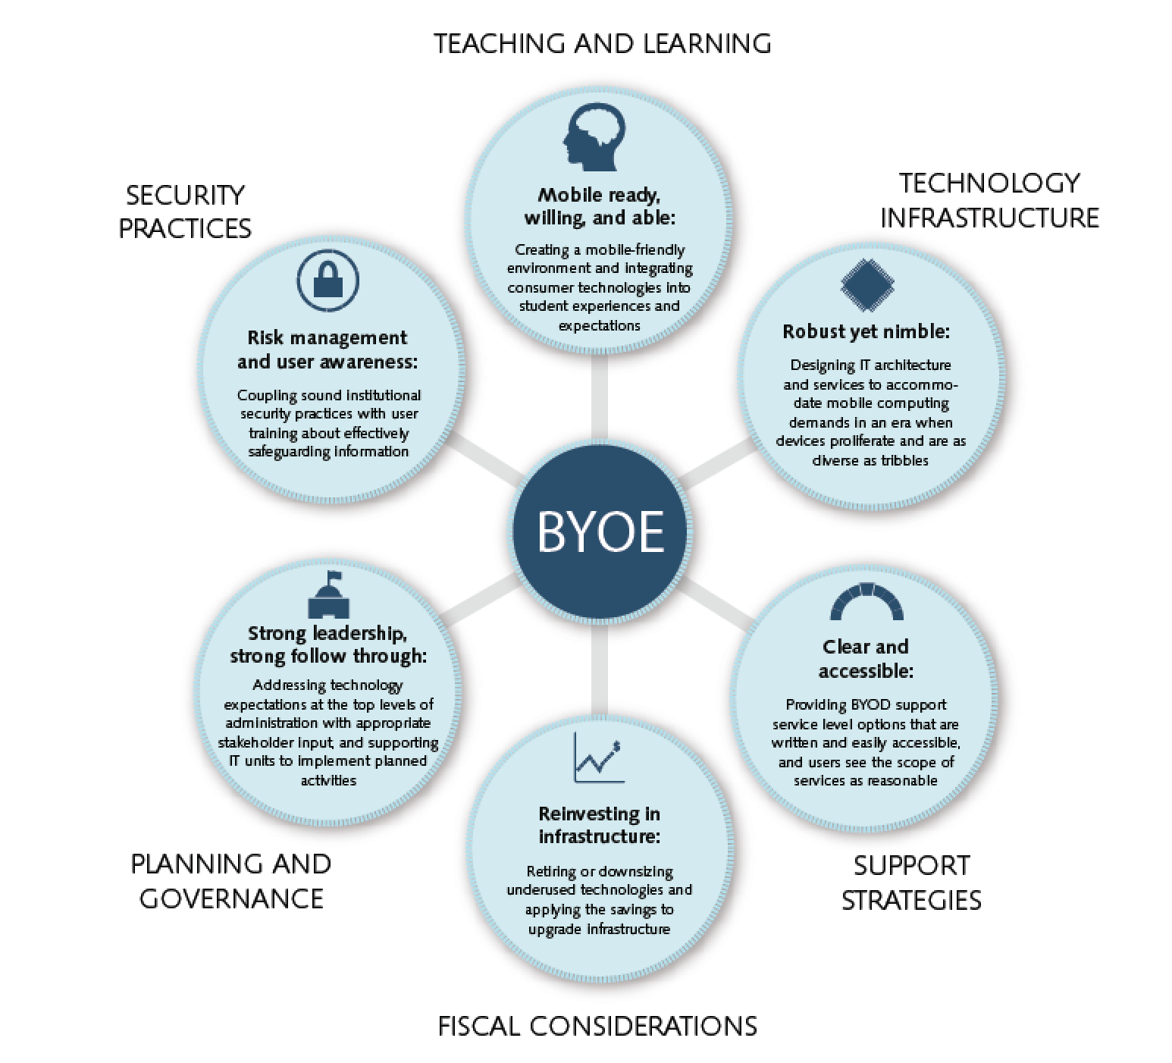
Introduction: A Framework for the Most Important BYOE IT Issues in HE

Slide 5
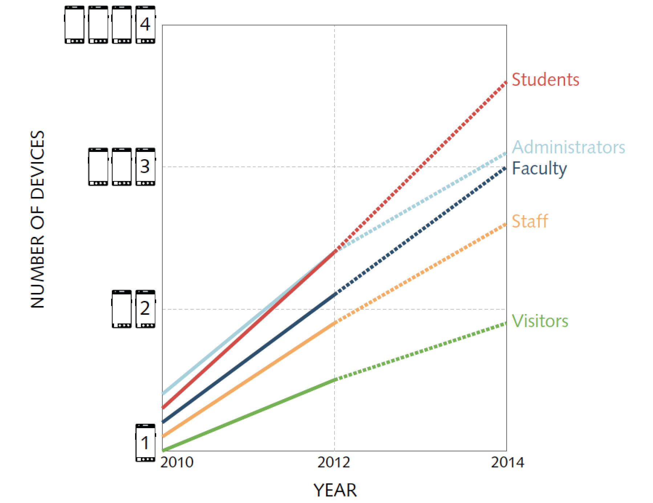
Introduction: Device Proliferation Is Manic
Device proliferation is manic, and unmanaged growth could result in a “tragedy of the commons” situation, where too many devices find their way to campus networks too fast and institutions find more opportunities lost
than taken.
Notes:
According to ECAR BYOE survey respondents, the average number of Internet-capable devices per person on college and university campuses has grown substantially over the past two years and is projected to continue growing over the next two years.
IT leaders predict a substantial increase in faculty, staff, and administrators using their own technology options.
Anticipating growth can inform the strategic decisions IT shops are making to best leverage opportunities and best accommodate challenges posed by this trend.
ECAR survey respondents estimated that about 20% of employees in 2010 and about 60% in 2014 will use their own devices for work-related purposes.

Slide 6
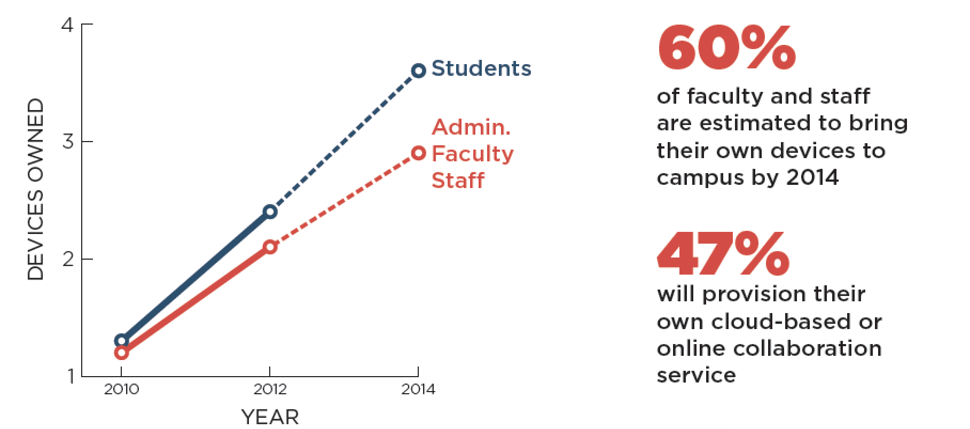
Introduction: IT Leaders Are Bracing for Personal Mobile Computing Environment Expansion
Notes:
Easy-to-use and readily accessible technologies facilitate a bring-your-own-everything (BYOE) standard.
Students, faculty, and staff bring their own devices, software, apps, and cloud-based technology to create a personal computing environment.
The furor over the consumerization of IT is part of the contemporary discourse of IT professionals in higher education and raises understandable concerns about IT infrastructure, planning and governance, security and compliance, support strategies, teaching and learning, and fiscal implications.

Slide 7
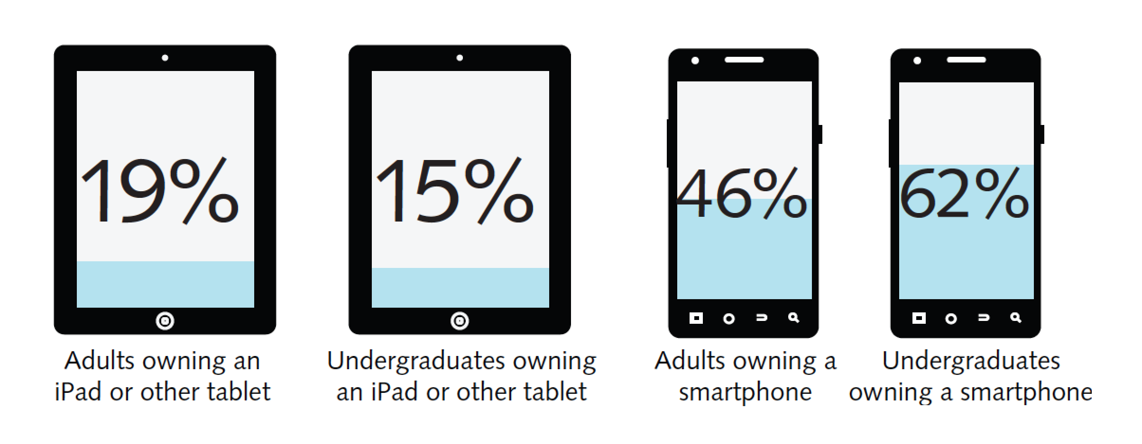
Introduction: Students Go Mobile
Smartphone ownership among undergraduate students increased from 55% in 2011 to 62% in 2012…
…and the trend for more, different, and better devices is predicted to continue to increase.
Notes:
By the end of 2012, there were 3.2 billion mobile plan subscribers, which is equivalent to about half of the world’s population.
Tracking device usage data and projecting future expansion of networkable device use can feed planning processes to prepare for increased IT resource allocation, or for implementing limitations on network access and usage.
Estimated growth in the number of Internet-capable devices is substantial.

Slide 8
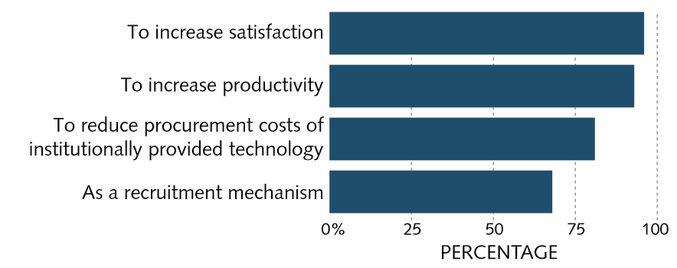
Introduction: Institutional Motivation for Permissive BYOE
IT leaders want happy and productive
faculty and staff.
Notes:
The vast majority of IT leaders agreed that their institutions have welcoming environments for students’ use of their own devices (82%), but one in five campuses didn’t agree.
Too many devices, too fast, has led many IT professionals to be simply accommodating to BYO technologies rather than being able to strategically plan ahead.
Extending enterprise systems for mobile access is a high or essential priority for just over half of institutions surveyed (52%). Most (55%) have also deployed enterprise systems for mobile access, and another one out of four (25%) are in the planning stages of deploying mobile access to enterprise systems.

Slide 9
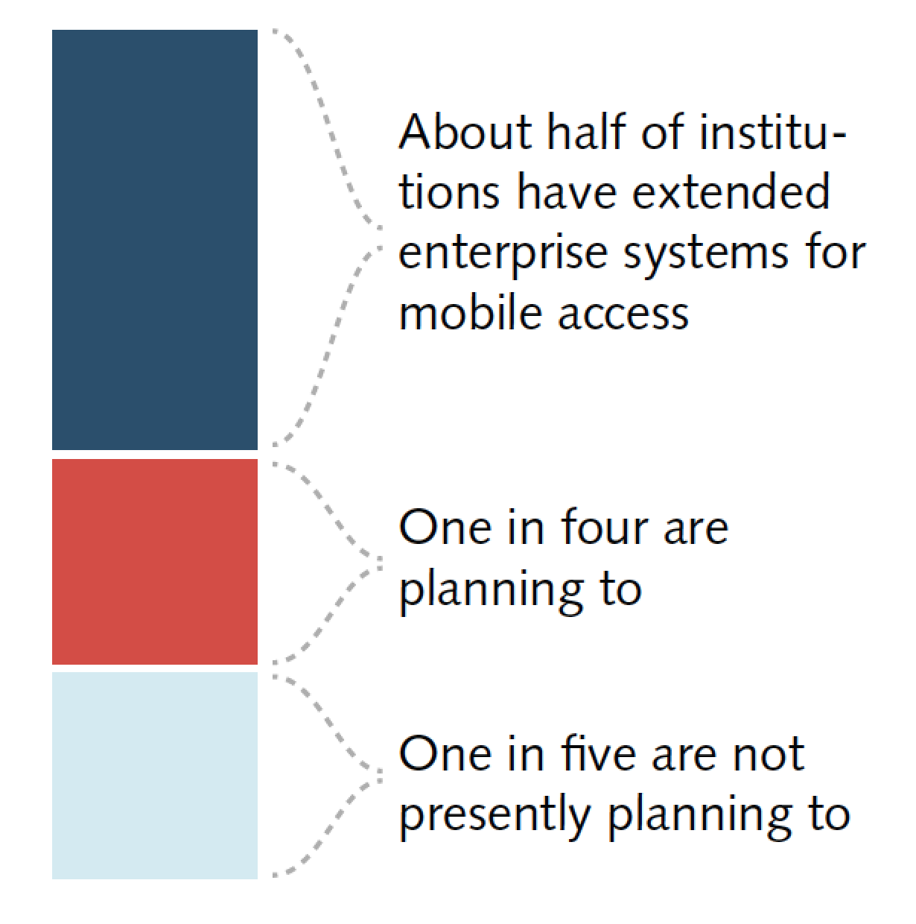
Introduction: Extending Enterprise Systems for Mobile Access
Most institutions have already–or are planning to–extend enterprise systems to be compatible and friendly with mobile devices.

Slide 10
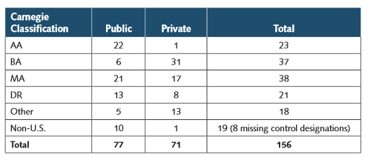
Methodology
IT Leader Interviews
Focus Groups
ECAR Survey

Slide 11
Findings

Slide 12
Findings: An Overview
Planning Doesn’t Necessarily Precede Action for BYOE
A Solid Security Presence and Plan Can Adjust to Most BYOE Security Challenges
Cost Savings from BYO Can Be Elusive
Think of IT Infrastructure as “Middleware”
Support Strategies Will Need to Adapt to BYOE Environments
Implications for Teaching and Learning Excite IT Professionals the Most about BYO

Slide 13
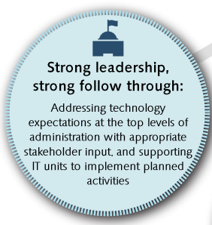
Planning and Governance

Slide 14
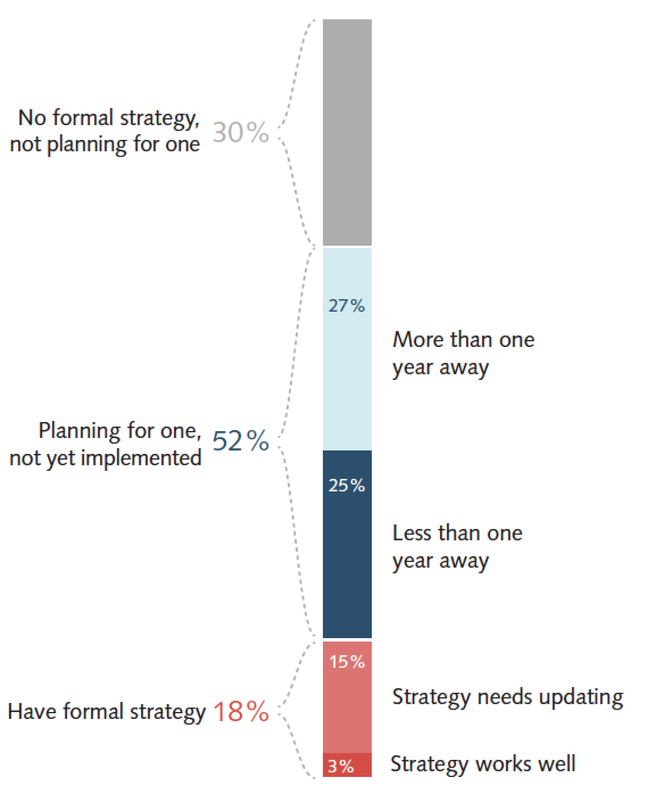
Planning and Governance: Formal Planning Strategies for BYOE
Planning doesn’t have to precede action when it comes to BYOE—doing before planning is actually the norm—yet policies are in place where they matter most, such as for security or end-user behaviors.
Notes:
Only 18% of respondents reported that their institution has a formal planning strategy for user-provisioned technologies, and just 3% of all respondents said both that they have a formal planning strategy and that it works well.
Just over half of all institutions (52%) are engaged in planning activities for an overall BYO strategy.
Forty-seven percent of institutions said that developing a comprehensive institutional mobile strategy is a high or essential priority.
About two in three survey respondents (68%) reported that their institution supports a culture of innovation (i.e., encourages new, pioneering technologies and activities), and innovation in IT is often coupled with a comfort level with ambiguity. True BYO leaders will combine available information with agile techniques in addressing BYO opportunities and challenges.
“Strong leadership, strong follow through: Addressing technology expectations at the top levels of administration with appropriate stakeholder input, and supporting IT units to implement planned activities. ”

Slide 15
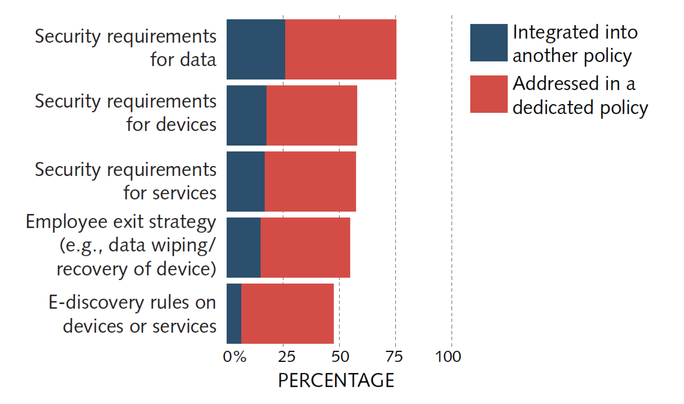
Planning and Governance: Policy Customs for Security Issues
Formal policies for BYOE are scarce, yet they are common where they matter most, like for security issues.

Slide 16
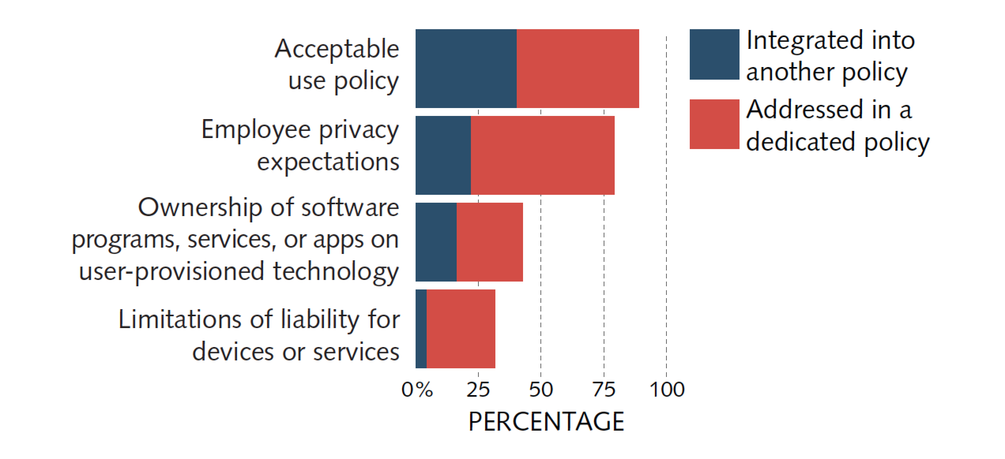
Planning and Governance: Policy Customs for Employee Behaviors
Acceptable use and employee privacy expectation
policies are the norm.

Slide 17
Security Practices

Slide 18
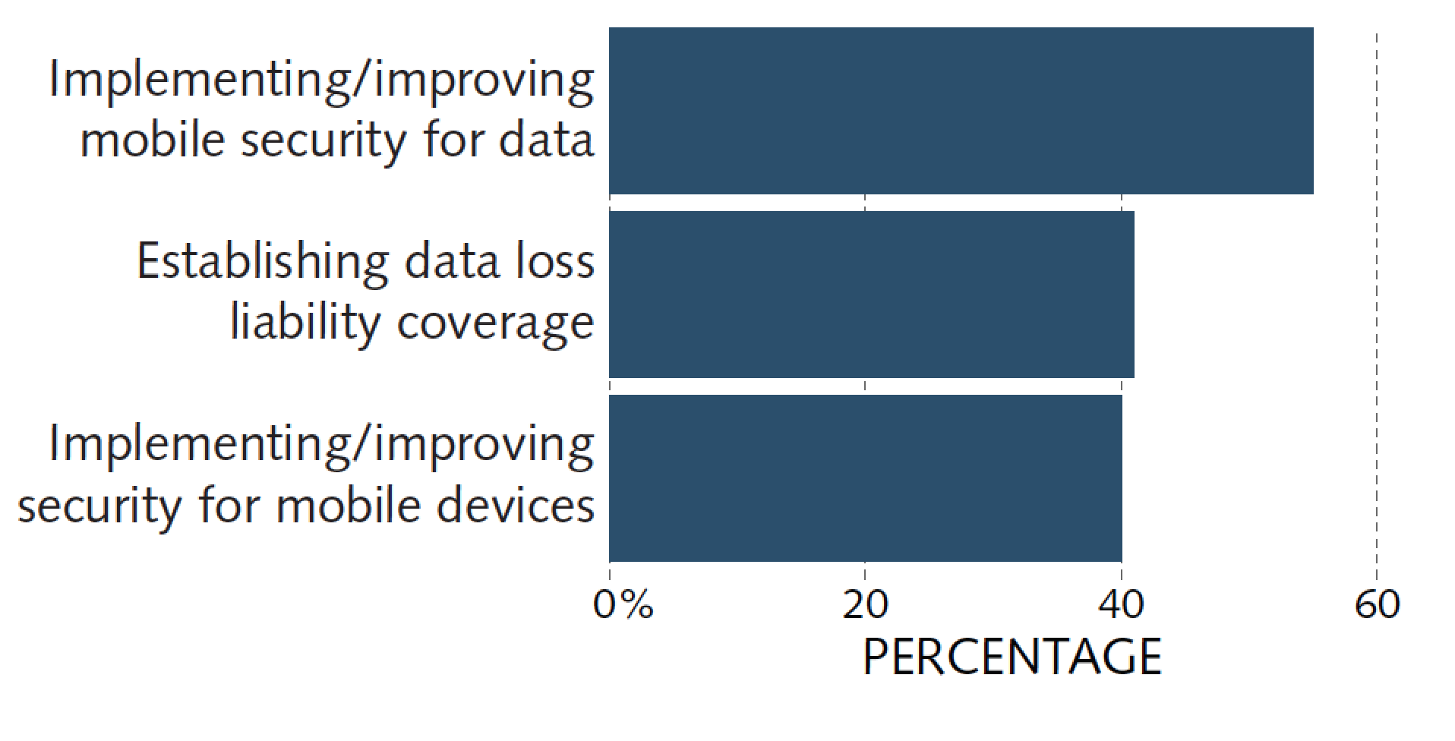
Security Practices: BYOE Security Issues Priorities
A solid security presence and plan can adjust to most BYOE security challenges.
Notes:
Implementing/improving mobile security for data was a high or essential priority for 55% of ECAR BYOE survey respondents.
“Data are the paramount institutional asset and are therefore the most important consideration when discussing BYOE security issues”

Slide 19
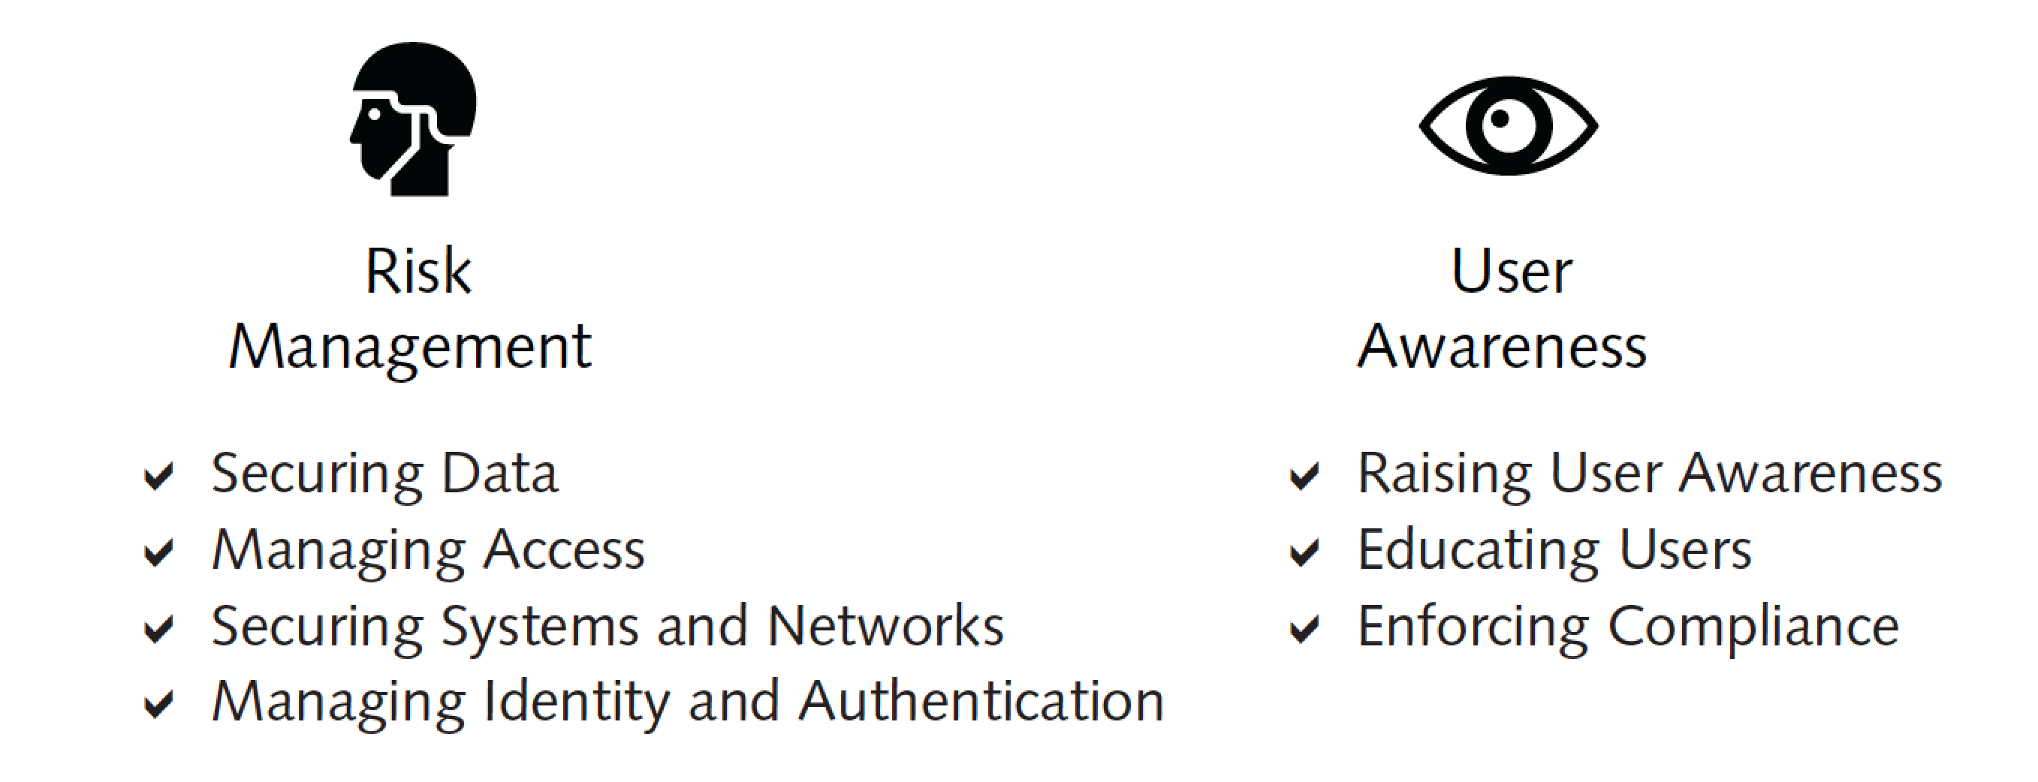
Security Practices: BYOE Security Issues Priorities
Managing risk and raising user awareness are two areas in which security practices are a wise investment.
Notes:
For risk management, plan to focus on securing data rather than devices.
Educating users about sound security practices will raise their awareness of security risks.
More than one in three IT leaders (39%) did not know whether security awareness training was mandatory at their institution.

Slide 20
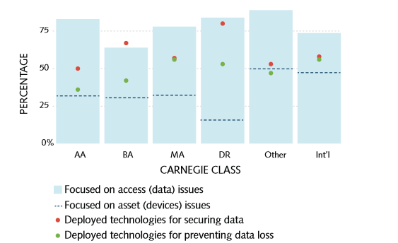
Security Practices: Focus on Securing Data Rather than Devices
Data are the paramount institutional asset and are therefore the most important consideration when discussing BYOE security issues.

Slide 21
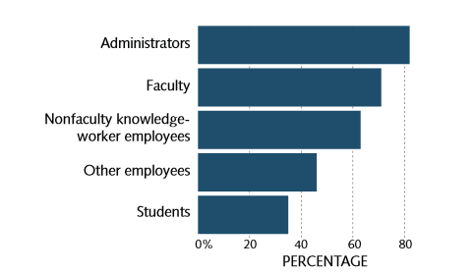
Security Practices: Mandated BYO Security Training Is Common for Knowledge Workers
Educating users about sound security practices will raise awareness of security risks.

Slide 22
Fiscal Considerations

Slide 23
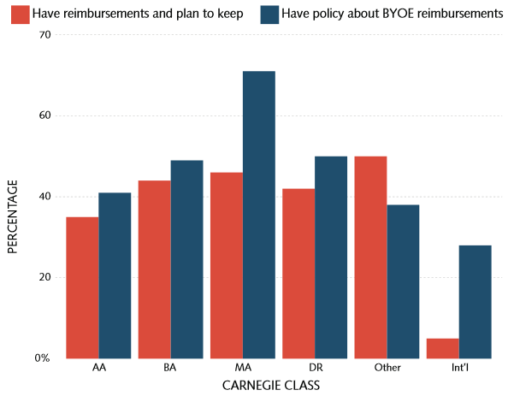
Fiscal Considerations: Reimbursement Practices
BYO reimbursements are
NOT the norm in higher education.

Slide 24
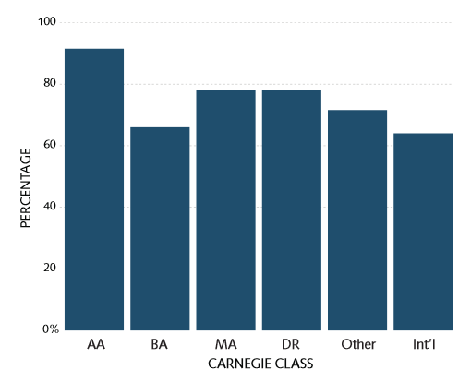
Fiscal Considerations: No Plans to Reduce Provisioned Devices for Students
Some institutions are converting former computer labs into general collaboration spaces with power, Wi-Fi, printing stations, and free-moving future for ad hoc get-togethers.

Slide 25
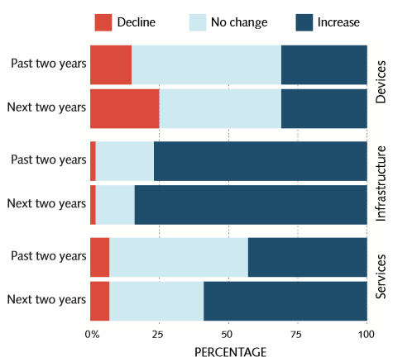
Fiscal Considerations: Financial Impact on IT Budgets
BYOE can cost more than it saves.
Notes:
Cost savings from BYOE can be elusive, with the cost to update/upgrade IT infrastructure outweighing cost savings for providing fewer institutionally provisioned devices and other technologies.
Yet, 81% of institutions are at least somewhat motivated by BYOE as a cost-savings factor.

Slide 26
Fiscal Considerations: Reinvest in Infrastructure
The cost to update/upgrade IT infrastructure can outweigh the cost savings from providing fewer institutionally provisioned devices and other technologies.
Retiring or downsizing underused technologies and applying the savings to upgrade infrastructure is a wise investment.

Slide 27
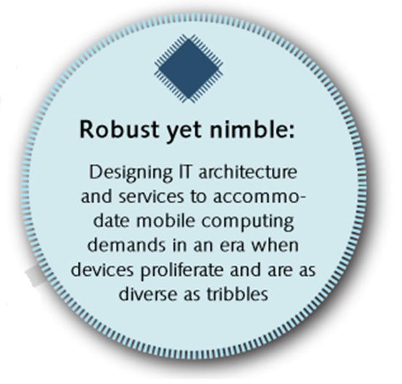
Technology Infrastructure

Slide 28
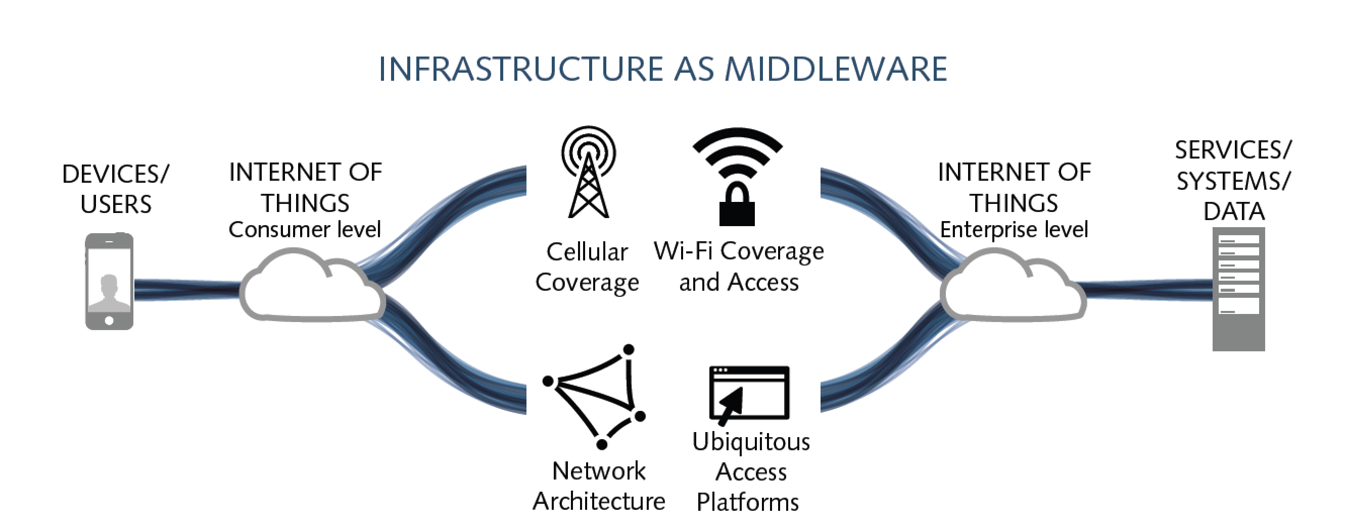
Technology Infrastructure: BYOE “Middleware”
Think of IT infrastructure as BYOE “middleware”—the commodities that bridge users, their devices, and their consumer-level applications to the institution’s data, services, systems, and enterprise-level applications. IT middleware should be robust yet nimble.
Notes:
Moving toward a robust yet nimble IT infrastructure means finding balance between a strategically planned IT infrastructure and one that is reactive/adaptable to new technologies.
IT infrastructure capable of supporting an emergent BYOE-heavy environment should provide frictionless access between any user device and any institutionally provided or managed services, systems, data, or apps that are accessed on these devices. If the important aspects of technology infrastructure for BYOE are in this “middleware,” then they are undeniably within the purview of IT professionals—and an increasingly significant part of their IT framework.

Slide 29
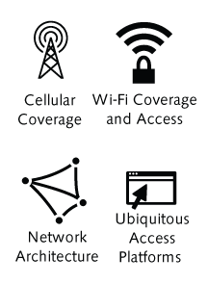
Technology Infrastructure: Ubiquitous and Frictionless Access
Including campus penetration of cellular coverage from main providers
Including network Wi-Fi capabilities and open public Wi-Fi versus restricted network access
Including bandwidth and Wi-Fi density ratios (i.e., number of devices per user)
Including access capabilities through device, applications, browsers, virtualized desktops, identify management tools,
and cloud services

Slide 30
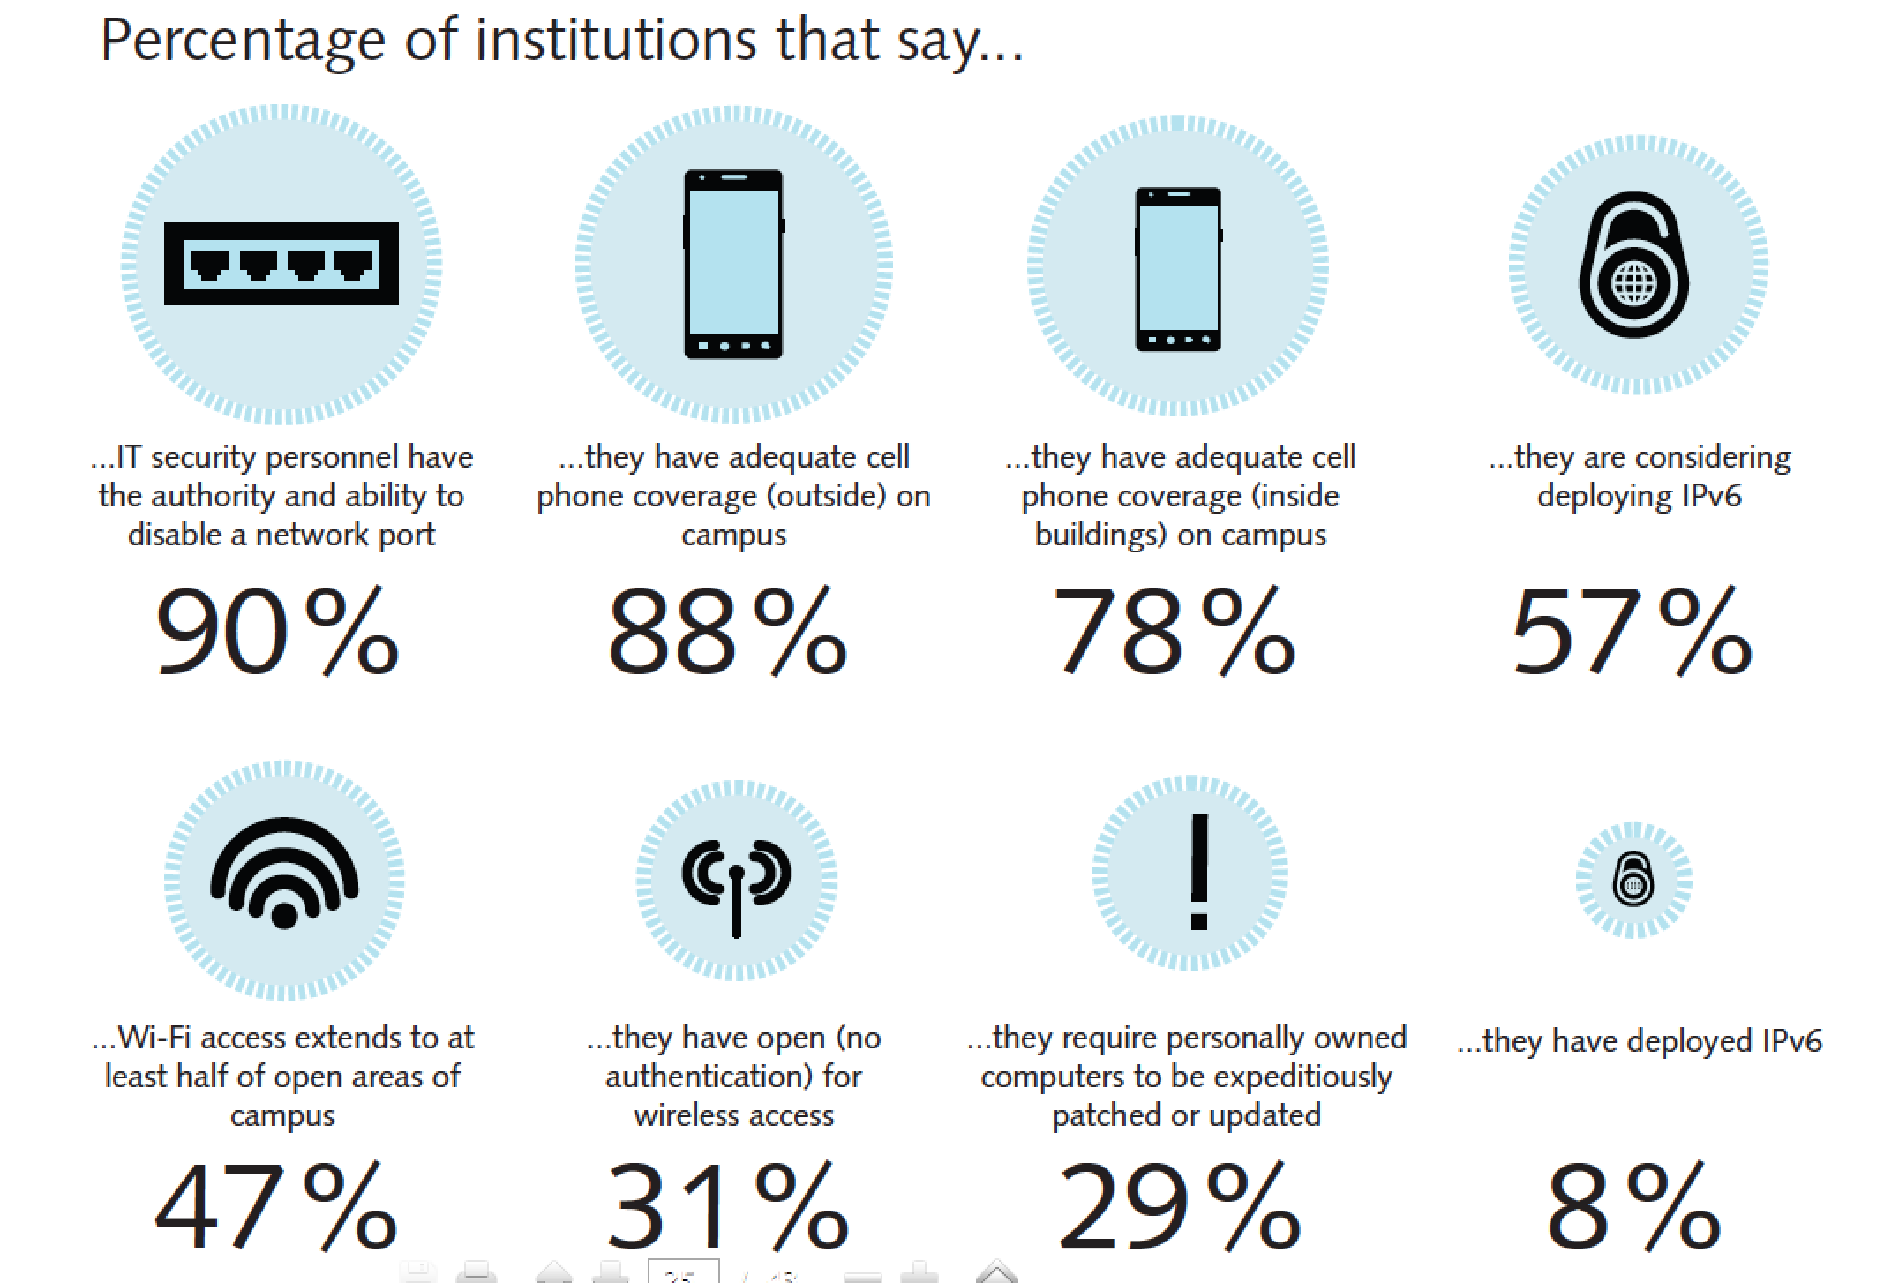
Technology Infrastructure: Current IT Practices that Relate to BYOE
Notes:
Current IT practice is captured in the EDUCAUSE Core Date Service. A sampling of these data are shown here, and the CDS Reporting Tool can be used to further explore practices at peer institutions.
An expansive overview of robust yet nimble exemplary practices and strategic innovation for each of the four IT middleware items was published in a special ECAR report on BYOE IT infrastructure.

Slide 31
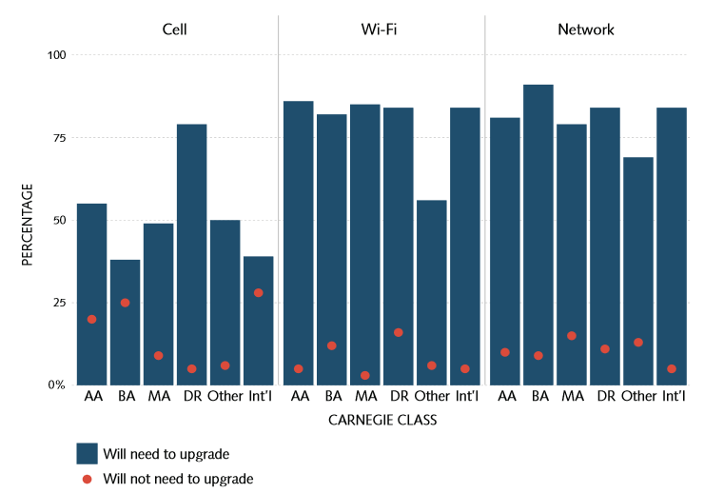
Technology Infrastructure: Upgrades Needed in Next Two Years
Though present accommodation of BYOE is adequate, most respondents expect infrastructure upgrades within two years for Wi-Fi and networks, in particular.
Notes:
Percentage who agree/strongly agree that infrastructure upgrades will be necessary w/in the next two years.

Slide 32
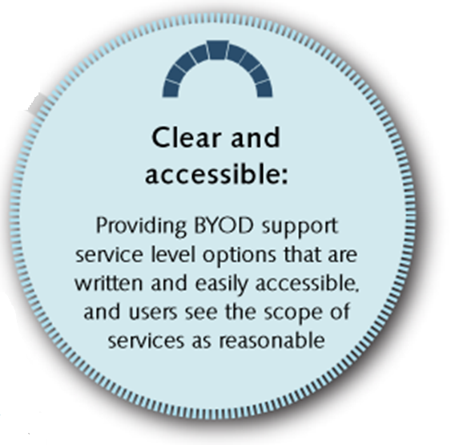
Support Strategies

Slide 33
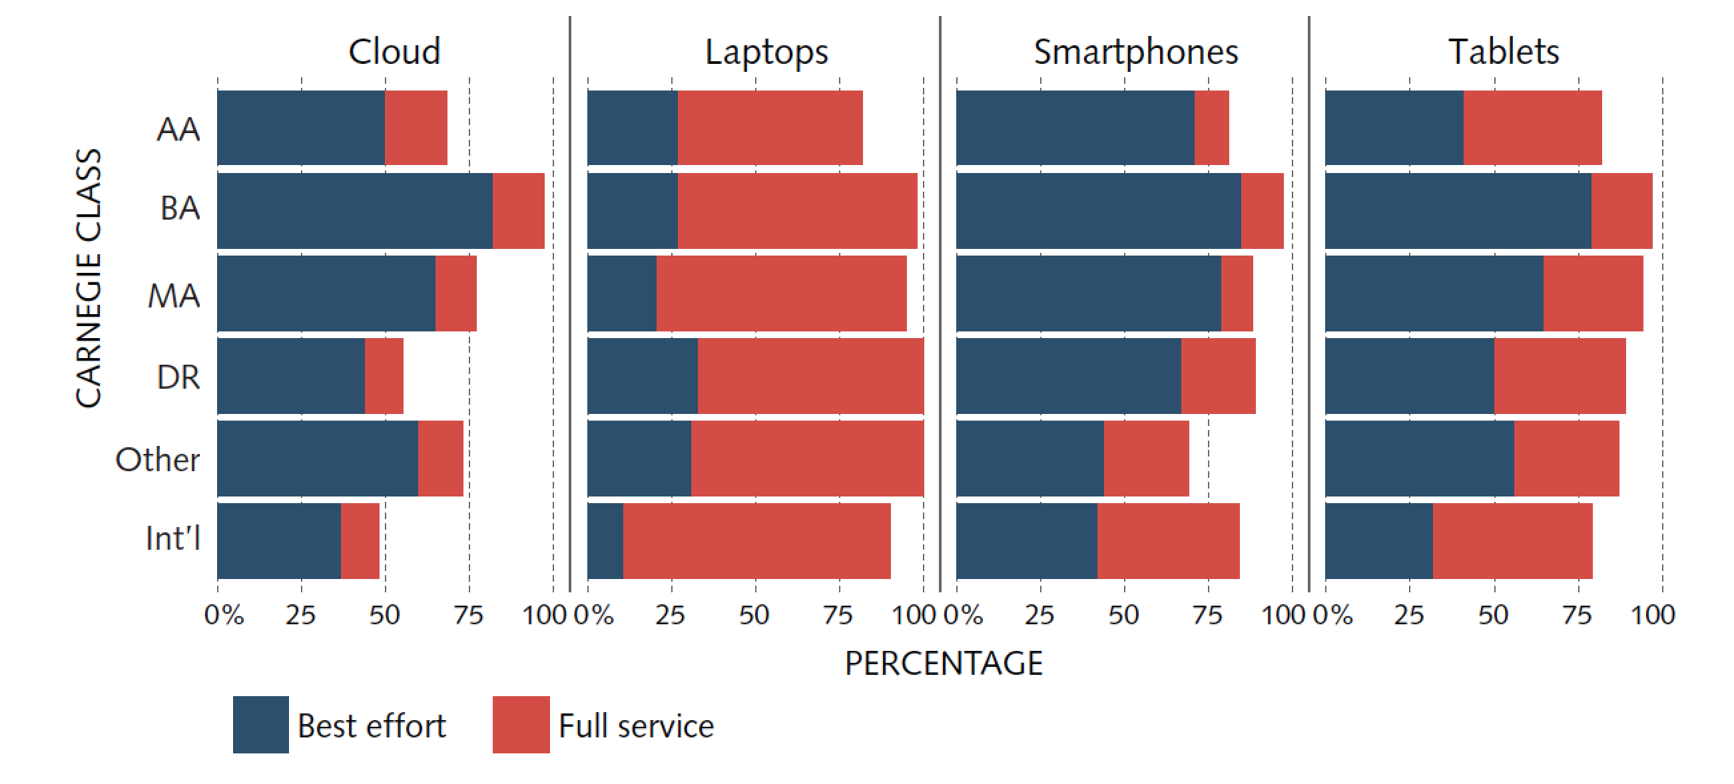
Support Strategies: Full and Best-Effort Support are Common for Employees
Current help desk support efforts for employees are extensive. Support strategies will need to adapt to BYOE environments.
Notes:
According to ECAR focus groups and interviews, the expectations for full and even best-effort support are changing as users look to their product and service vendors first for support. When focus group participants and interviewees were asked about the main challenges in providing support services to employees for user-provisioned devices, four themes surfaced:
• Diversity of devices, services, software, OS platforms, products, tools, and brands
• Insufficient staffing levels that can’t keep up with the volume of requests
• Customization, nonstandard configurations, and user proficiency/education
• Managing expectations of users
Providing configuration information and general device-specific (or device-agnostic) instructions for access to institutionally owned or managed systems, services, and data may be prudent. That, combined with instructions about how to contact service providers, is not an unlikely “new normal” for IT help desk staff. If the increase in user-provisioned technologies does not translate into DIY support, IT help desks will face serious workload challenges.

Slide 34
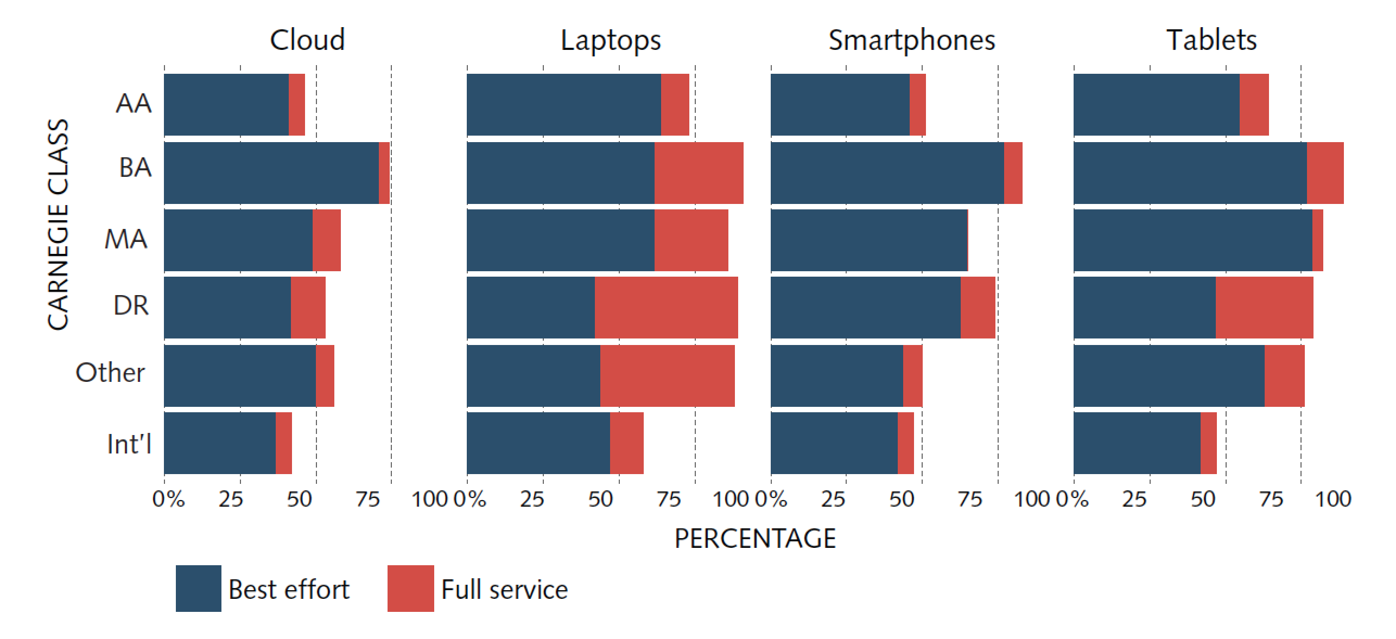
Support Strategies: Best Effort Support is Common For Students
“Having the manpower to provide the support [is a challenge]. We will work on their devices if we have time.” – ECAR BYOE Survey Respondent
Notes:
Unlike faculty and staff, who are experiencing a cultural transition from “my institution should help me with this ...” to “my mobile device vendor/service provider should help me with this ...,” students have long been redirected to vendors/service providers for certain support issues. Assisting students with finding services, reminding them of user names, and troubleshooting with network connectivity are among the most common support efforts.

Slide 35
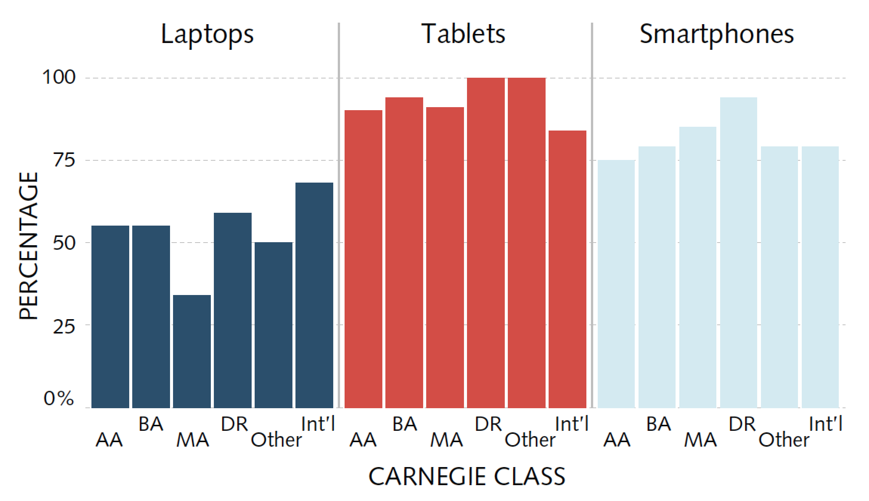
Support Strategies: Increased Support Demand Estimates in Two Years
74% of institutions predict costs to increase for providing IT services to support user-provisioned technology.
Notes:
Support strategies will need to adapt to BYOE environments, as there is an apparent lag between BYOE ubiquity and DIY support.
Clear and accessible: Providing BYOD support service level options that are written and easily accessible, and users see the scope of services as reasonable.
Support demands for user-provisioned technology are expected to increase over the next two years. These data represent the percentage of institutions that expect to see an increase of 50% or more in support requests (e.g., help desk calls, support request tickets, etc.) between now and 2014. This means that an institution that currently addresses 1,000 support requests monthly is estimated to have 1,500 monthly support requests in two years.

Slide 36
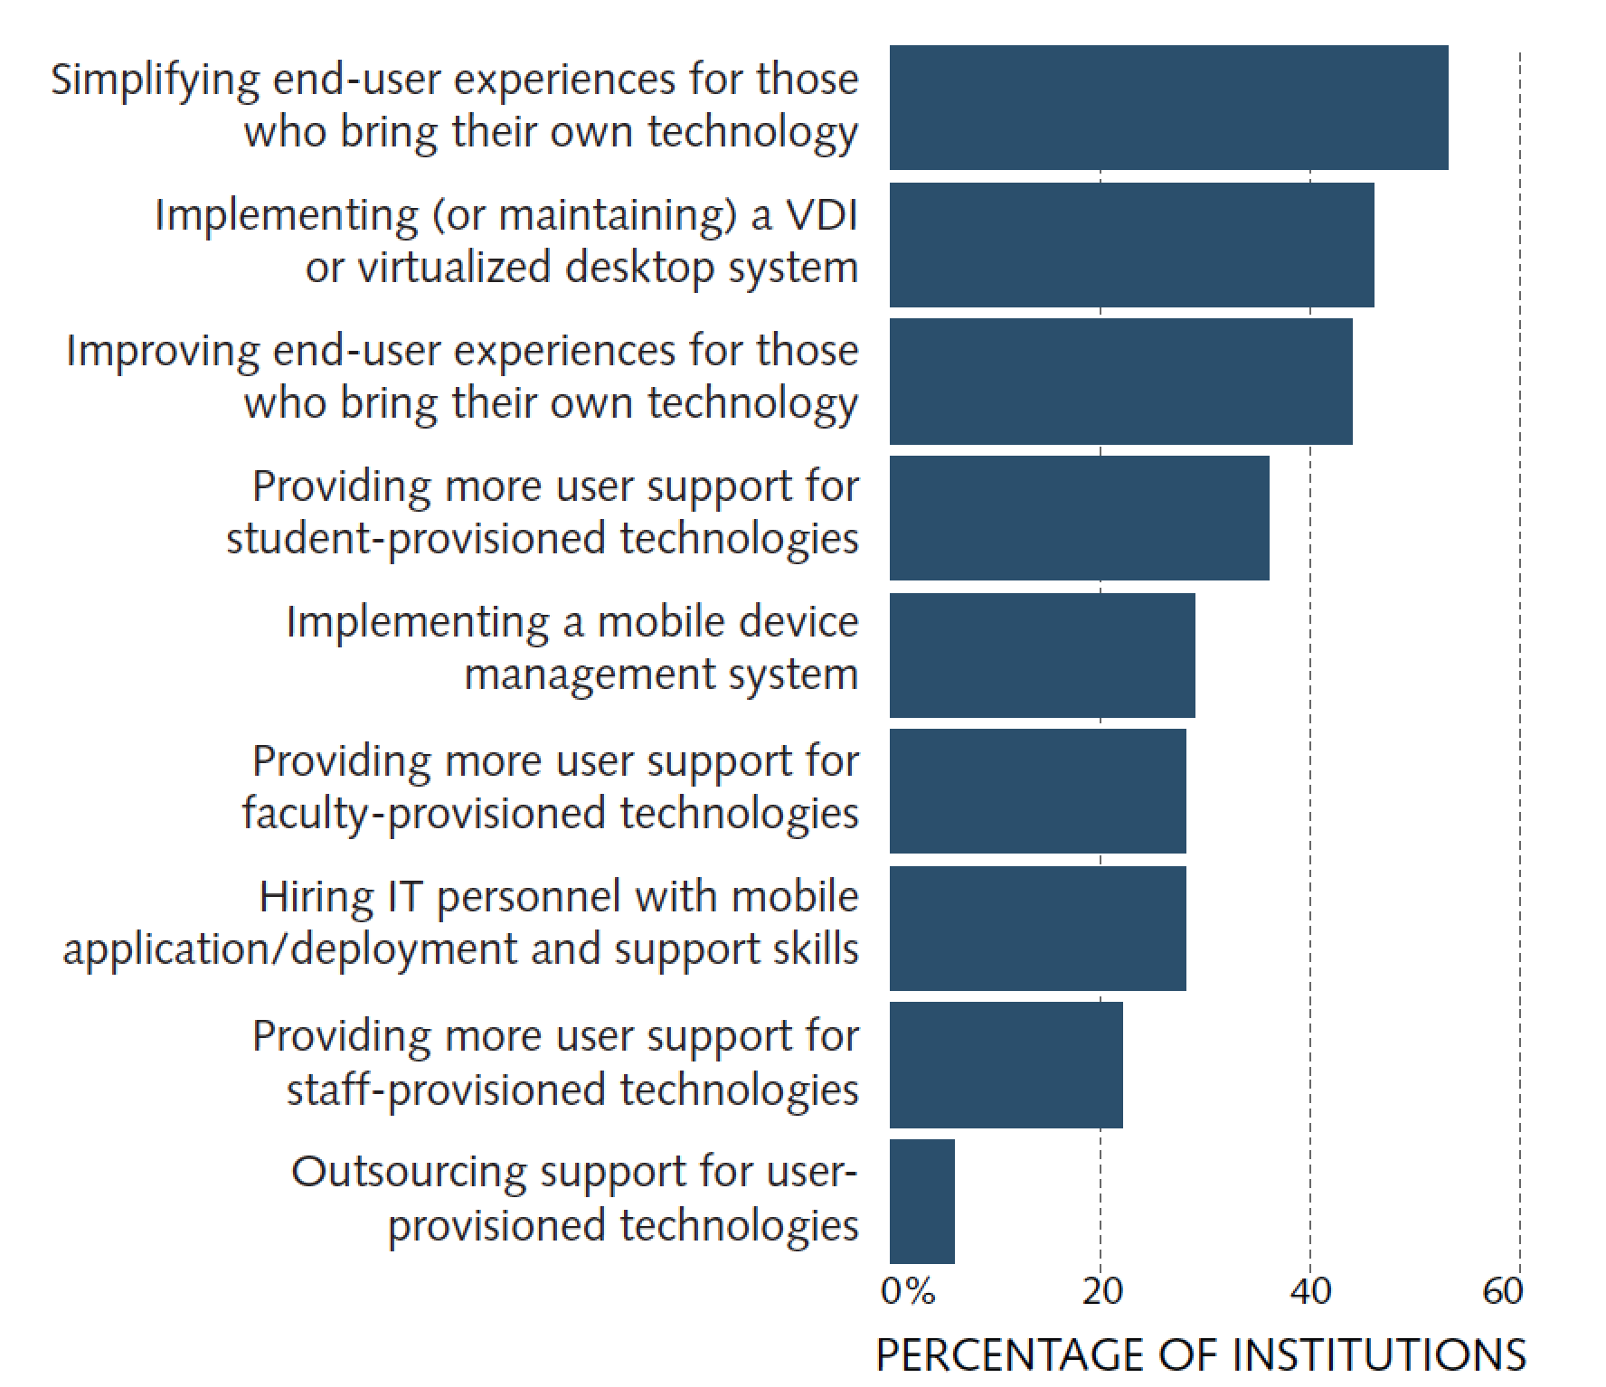
Support Strategies: Rating of BYOE Support Priorities as High or Essential
Improving end-user experiences and providing more support are among the top priorities of IT leaders.
Notes:
These items were two of the top-three priorities when identifying high and essential institutional priorities.
About one in three institutions (36%) consider providing more user support for student-provisioned technologies—and more than one in four (28%) consider providing more user support for faculty-provisioned technologies—to be a high or essential priority.
74% of institutions predict costs to increase for providing IT services to support user-provisioned technology

Slide 37
Support Strategies: The New Support Paradigm as “Technology Consultant”
Routing help seekers to self-service portals and tutorials
Providing links to vendor resources or direct customer support
Crowdsourcing solutions through blogs, wikis, and Google searches
Using what Jarod Green from Gartner calls “Hey, Joe!” support–asking about until you find something that works rather than opening a support ticket

Slide 38
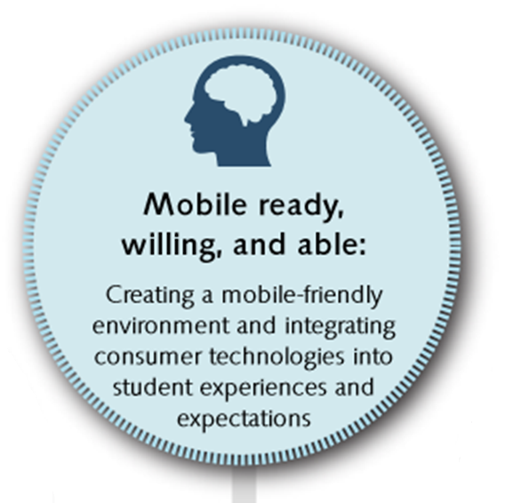
Teaching and Learning

Slide 39
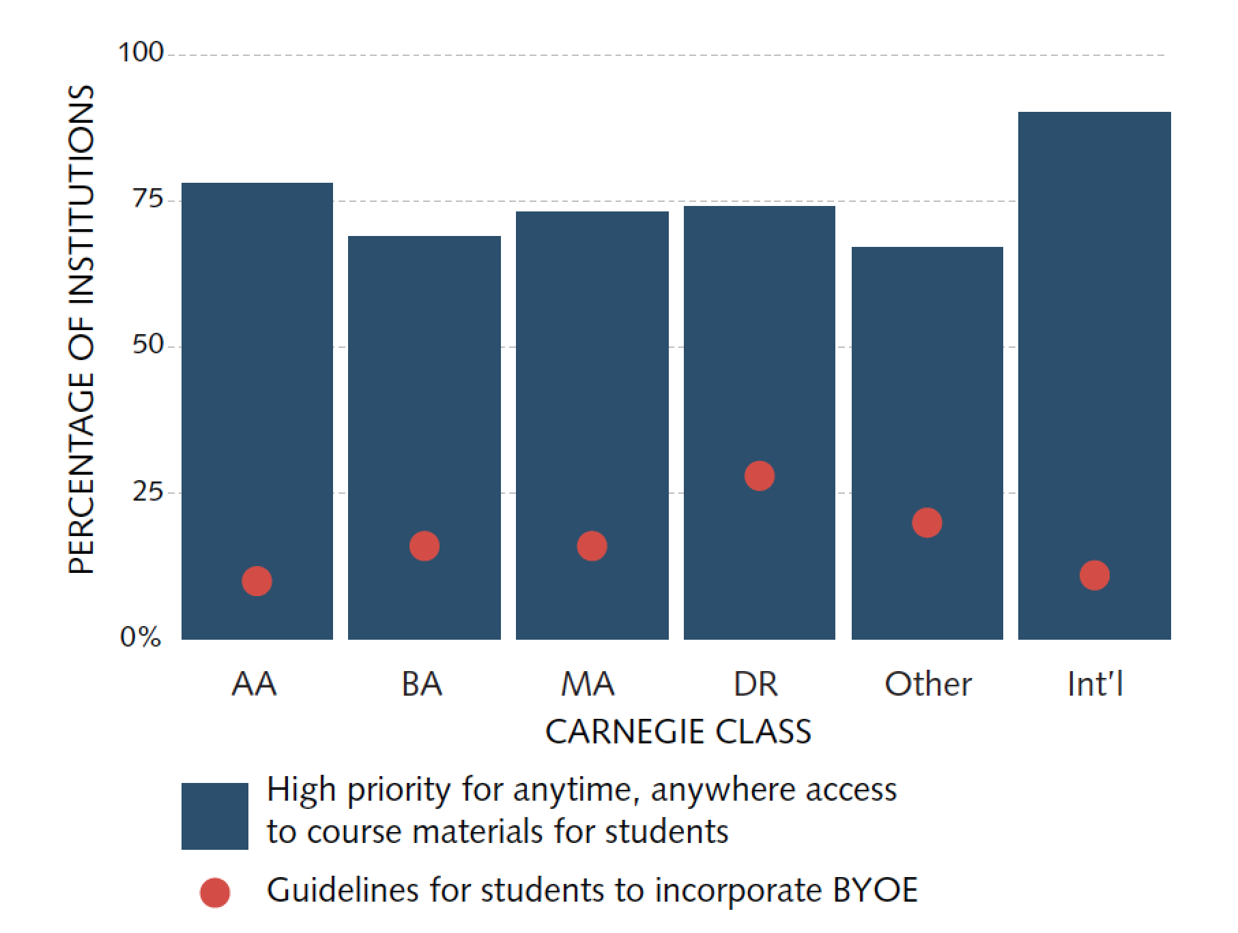
Teaching and Learning: Priority for Facilitating Anytime, Anywhere Access + Student Guidelines
Utilizing mobile technologies for T&L is a priority, but providing students guidance for how to do so is still rare.
Notes:
Utilizing mobile technologies for teaching and learning is a priority, but providing guidance or institutional support to students and faculty for how best to do so remains uncommon.
Mobile ready, willing, and able: Creating a mobile-friendly environment and integrating consumer technologies into student experiences and expectations.

Slide 40
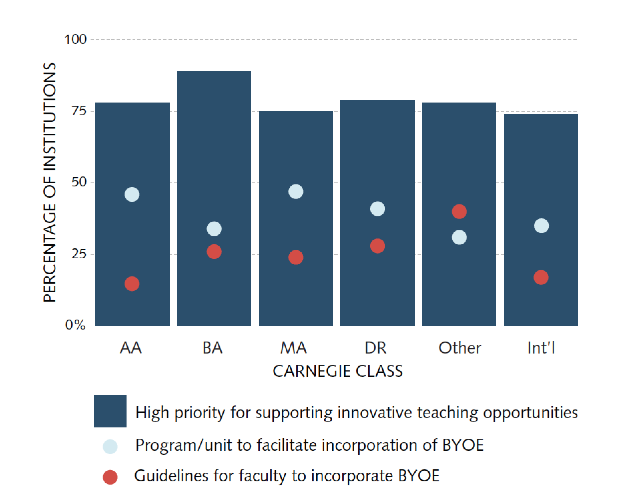
Teaching and Learning: Priority for Supporting Innovative Teaching Opportunities + Faculty Guidelines
Balancing academic freedom, professional development, and expectations for end-user experiences is important.

Slide 41
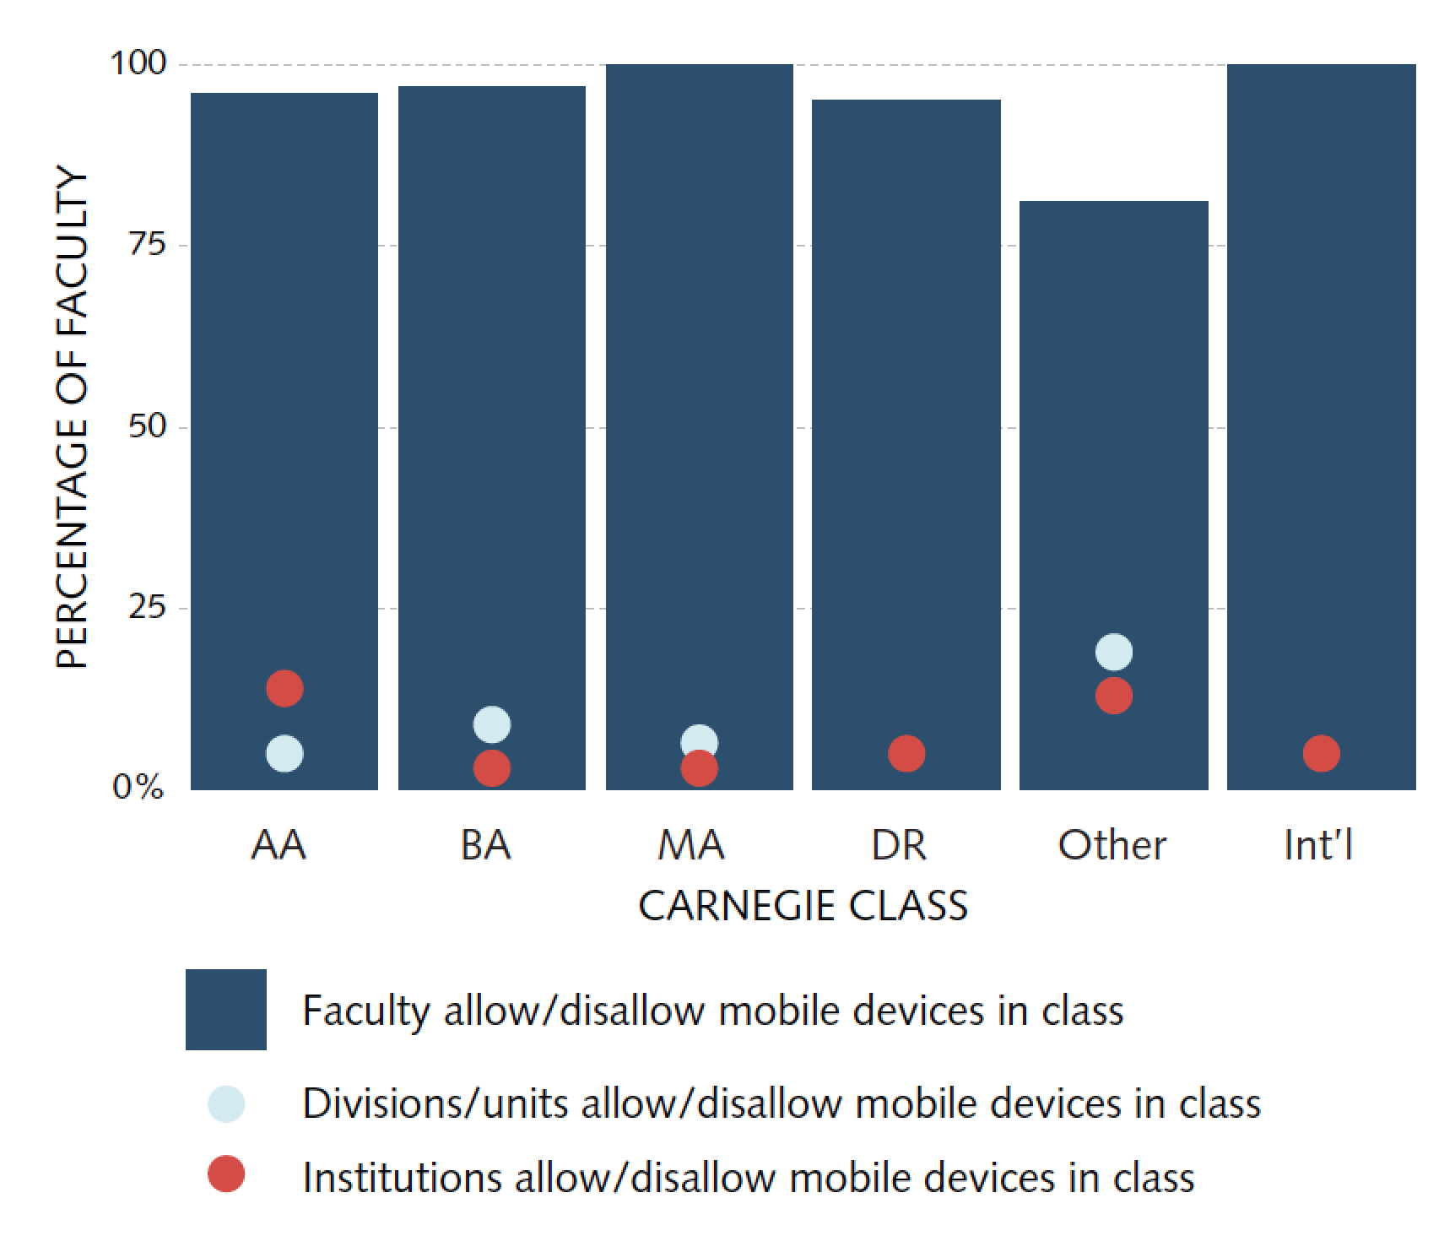
Teaching and Learning: Authority for Allowing/Disallowing Mobile Devices in F2F Courses
There is a general sense that institutions are accommodating BYOE practices to the best of their abilities

Slide 42
Recommendations

Slide 43
Recommendations: Planning, Governance, and Leadership
Have strong leadership and strong follow-through that address technology expectations at the top levels and are supported throughout the institution.
Establish a mobile vision that considers human behavioral traits as a significant variable.
Focus on having policies for issues that are within the purview of IT, such as securing data, and only have policies that can and will be enforced.

Slide 44
Recommendations: Security Practices
Balance rigorous security standards (managed risks) with user (in)conveniences.
Accept that the proliferation of user-provisioned technologies does little to change the basic best practices around security—a solid security presence and plan on campus can adjust to most BYOE challenges.

Slide 45
Recommendations: Security Practices
Manage risk through securing data (access) rather than devices (assets).
Collaborate with other units, such as human resources, to establish user-awareness training and education programs that focus on the understanding of risks of data exposure, how users can avoid security breaches, and how users can separate work and personal usage.

Slide 46
Recommendations: Fiscal Considerations
Don’t count on cost savings, but when they arise, invest in infrastructure.
Reconsider reimbursement plans for BYO and retain these services only if there is the right combination of political and financial investment for your institution.

Slide 47
Recommendations: Support Strategies
Have clear and accessible support service-level options.
Champion the paradigm shift so that BYOE means more DIY support.
Strive to improve end-user experiences through empowering solutions such as “Hey, Joe” support crowdsourcing.

Slide 48
Recommendations: Teaching and Learning
Be mobile ready, willing, and able with a mobile-friendly environment that meets student, faculty, and staff expectations.
Collaborate with other units to formalize systems for guiding students and faculty in incorporating mobile, networkable devices into the curriculum and pedagogy.

Slide 49
If an IT organization currently provides effective and innovative services for university-owned
technologies, it is likely well positioned to adapt to a bring-your-own culture.

Slide 50
Contact the 2013 BYOE Research Team: ecarstudy@educause.edu
Eden Dahlstrom
Stephen diFilipo

