Slide 1
Report from the NIST 800-53 Trenches
Dan Peterson
ESnet Security Officer
drpeterson@es.net

Slide 2
Report from the NIST 800-53 Trenches
Agenda
  ESnet overview
    ESnet Mission
    ESnet the network
    ESnet infrastructure
    ESnet, an Enclave of LBNL
  FISMA
  Assessing ESnets Risk
  Documenting Risk and Controls
  Demo
    FIPS 199
    Controls
    Procedures
    LBNL Policies
    Artifacts
  Discussion Topics

Slide 3
ESnet’s Mission
Primary mission is to enable the large-scale science that is the mission of the Department of Energy’s Office of Science by:
  Facilitating the sharing of massive amounts of data
  Networking thousands of collaborators world-wide
  Enabling distributed data processing / management, simulation, visualization, and computational steering
To accomplish this mission, ESnet provides reliable, high-bandwidth, networking and collaborative services to thousands of researchers across the country, whose work supports the Department of Energy’s goal of scientific innovation
  ~45 end user sites (16+ are NNSA or joint sponsored)
  Between 75,000 – 100,000 users

Slide 4
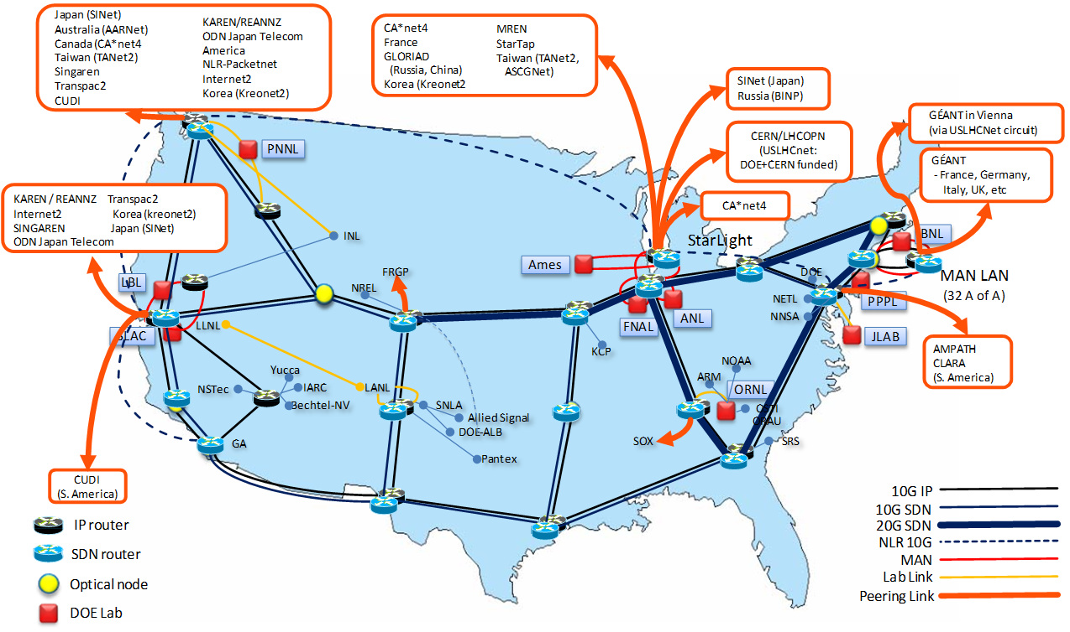
ESnet4 – May 2009

Slide 5
ESnet Infrastructure
ESnet infrastructure is comprised of:
  30+ Full time Staff (we are currently staffing up)
    Three engineers are located in remote facilities
  400+ hosts (UNIX, Windows, Apple and more)
  100+ routers and switches
Services provided by ESnet:
  Networking, DNS, NTP, etc…
  Authentication and Trust Federation (DOE grids CA)
  Video/Audio Conferencing (ECS)

Slide 6
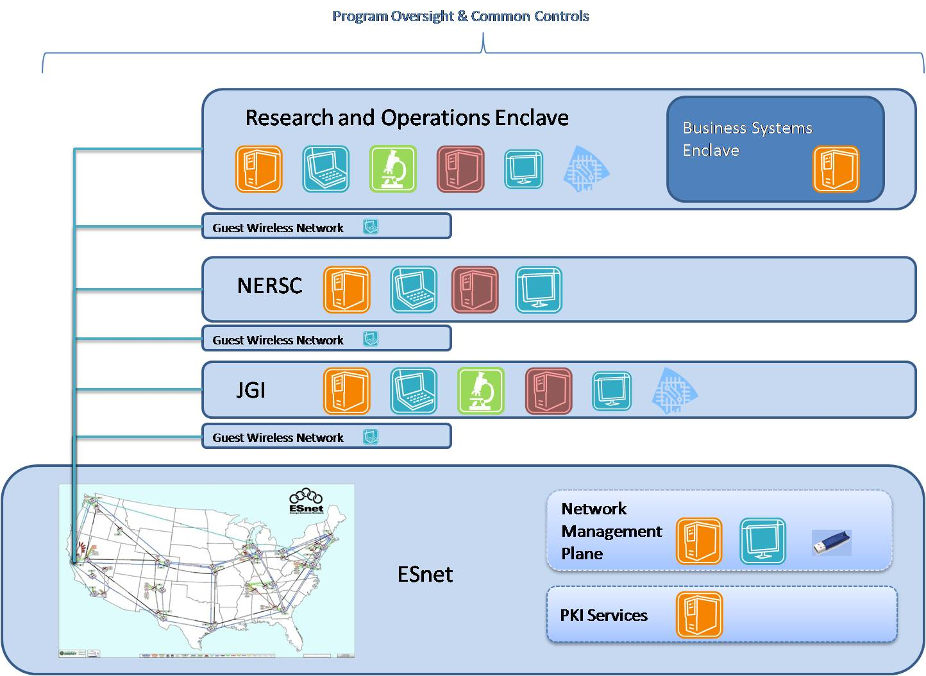
ESnet as an Enclave of LBNL

Slide 7
FISMA
Not sure about FISMA compliance?
  Adam Stone (LBNL) did a good talk about FISMA requirements and risk assessment at SEC 2009
    Play NISTY for me (see references for link)
The take away:
  Avoid check box security
  Take a holistic approach
    Risk Assessment
    Policies
    Dynamic Procedures
    Artifacts

Slide 8
Assessing ESnet Risk Level
Define level of system risk
  NIST 800-37 procedure
  Computer Security Protection Plan (CSPP)
  FIPS 199
FIPS 199
  A FIPS 199 security categorization serves as the starting point for the selection of security controls for an agency’s information system—controls that are commensurate with the importance of the information and information system to the agency.
  Three security objectives in the FIPS 199:
    Confidentiality; Low, Moderate, High
    Integrity; Low, Moderate, High
    Availability; Low, Moderate, High
ESnet is defined as, low, low, low
  Defined by Office of Science (SC) Project Manager

Slide 9
Documenting Risk and Controls
Set up two TWIKI webs
  Controls web
    Documented ESnet risk level (FIPS 199)
    Converted the NIST 800-53 document to TWIKI format
    Documented ESnet policies
      Including ATF controls specific to PKI
    Linked to Procedures
  Procedures web
    Document procedures and artifacts
    Cross referenced procedures with the 800-53 control ID

Slide 10
DEMO
FIPS 199
Controls
Procedures
LBNL Policies
Artifacts

Slide 11
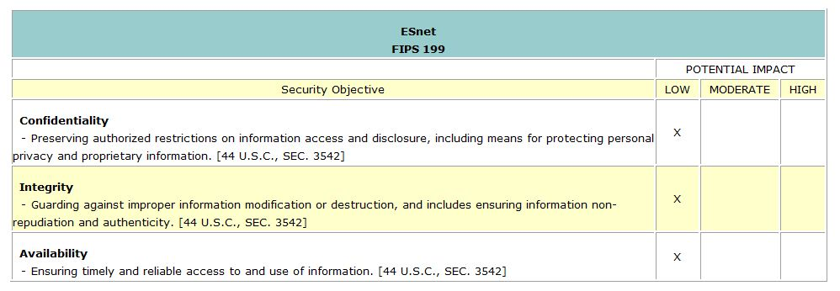
FIPS 199

Slide 12
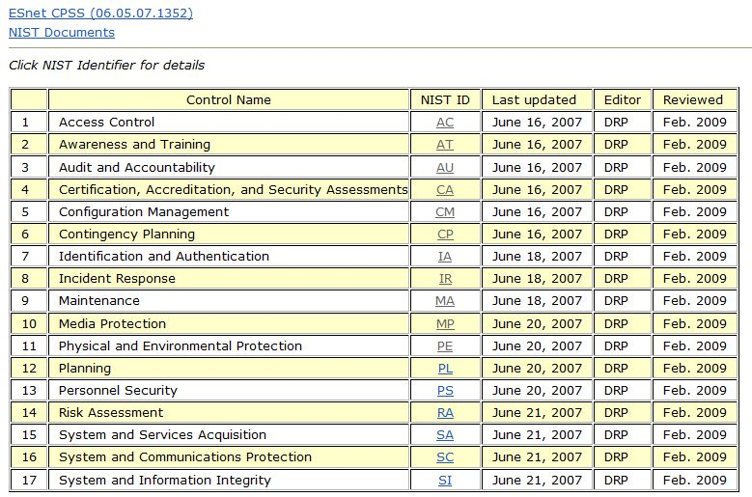
Catalog of Controls

Slide 13
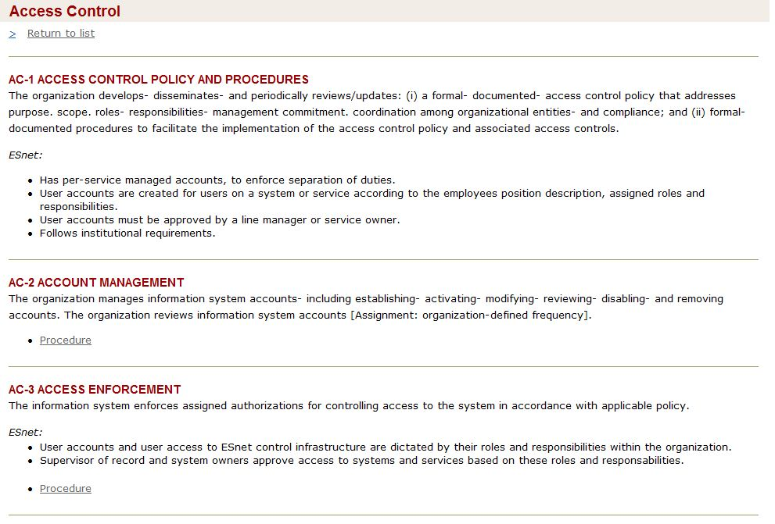
Controls

Slide 14
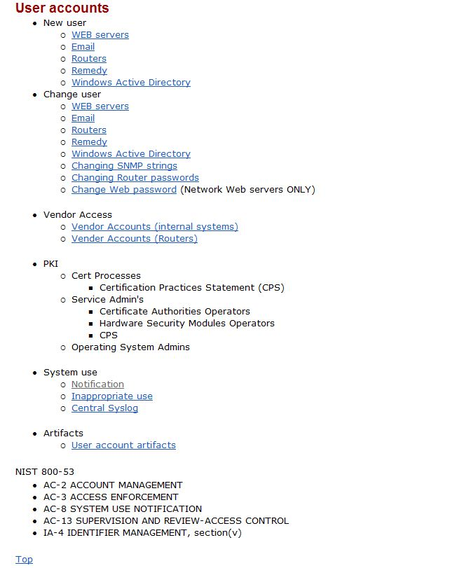
Procedures

Slide 15
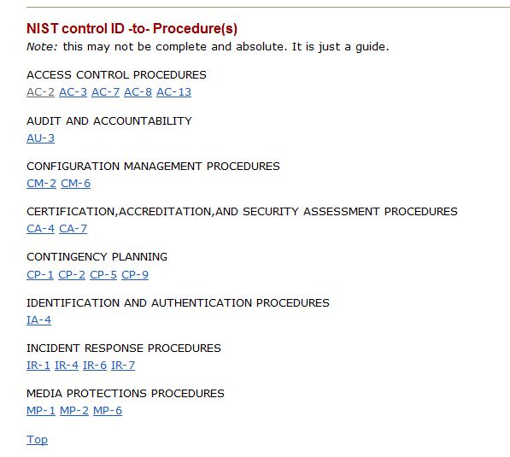
Control ID to Procedure

Slide 16
Procedures

Slide 17
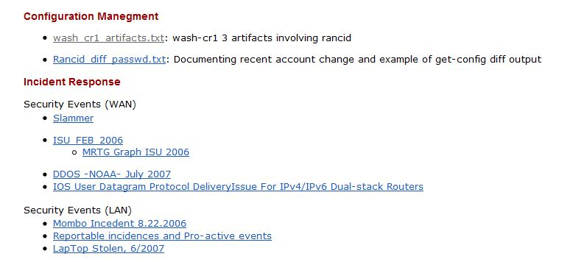
Artifacts

Slide 18
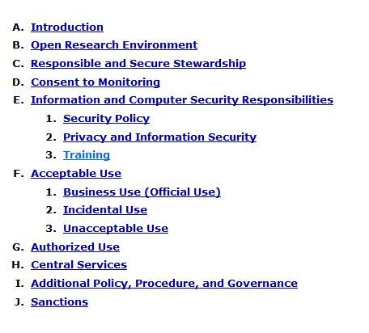
LBNL Regulations and Procedures Manual
Computing and Communications 9.01

Slide 19
Conclusion
Realistically define the risk level for the system
Use the 800-53 as a place to document what policies are in place for your organization
  Capture how security is done in both the policy and procedures
  Address the NIST 800-53 control enhancements when writing the policy
Policies and procedures that address a high level of control
  Put them in the 800-53 ; its okay to answer higher controls if there is a policy or procedure already in place
  Don’t answer controls outside your assessed risk level just because they are there
Allow the procedures to be dynamic
  Give sys-admin ownership of the procedure (as long as it meets the policy goals)
  System administrators or service owners need to write the procedures and collect the artifacts
  The sys-admins need to understand and follow the procedures to make them truly effective

Slide 20
References
  Adam Stone, Play NISTY for me http://net.educause.edu/SEC09/Program/1020687?PRODUCT_CODE=SEC09/SESS15
NIST 800-37
  http://csrc.nist.gov/publications/drafts/800-37-Rev1/SP800-37-rev1-IPD.pdf
FIPS 199
  http://csrc.nist.gov/publications/fips/fips199/FIPS-PUB-199-final.pdf
NIST 800-53 rev3
  http://csrc.nist.gov/publications/nistpubs/800-53-Rev3/sp800-53-rev3-final-errata.pdf
Special thanks to:
  The NERSC security team
    security@nersc.gov
  Adam Stone
    adstone@lbl.gov

