Slide 1
HIGHLIGHTS AND INSIGHTS FROM THE EDUCAUSE 2011 CORE DATA SURVEY
Susan Grajek | October 19, 2011

Slide 2
WElCOME, PHILADELPHIA AND ONLINE ATTENDEES!
Who are you?
  Fill out CDS this year?
  Type of institution: Associates, BA, MA, DR, public, private, system
  From Canada? Other international?
  Role: CIO, support, infosec, infrastructure, enterprise, research, teaching and learning, faculty, vendor?
  CDS role: Primary representative, author, review, manager?
What color is your institution?

Slide 3
TOPICS COVERED TODAY
The IT organization
  Leadership
  Governance and service level agreements
  Outsourcing
  Staffing and
  Managing the workforce
IT budgets and funding
Support for faculty use of IT in teaching and learning
Support for students
    Support of research
    IT in the institution
    IT support
    Student e-mail
    Enterprise systems
    Information security
    Data centers
    Sustainability
    There’s so much more in the Core Data Survey...

Slide 4
The IT ORGANIZATION

Slide 5
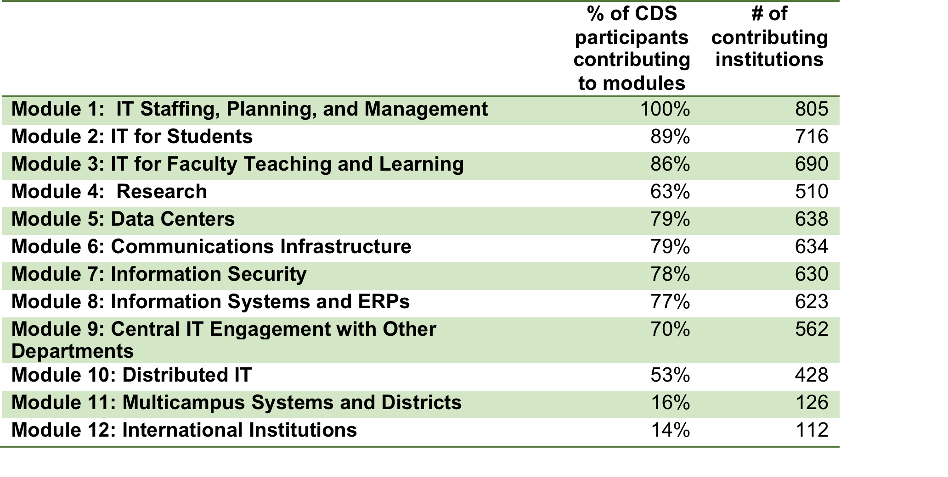
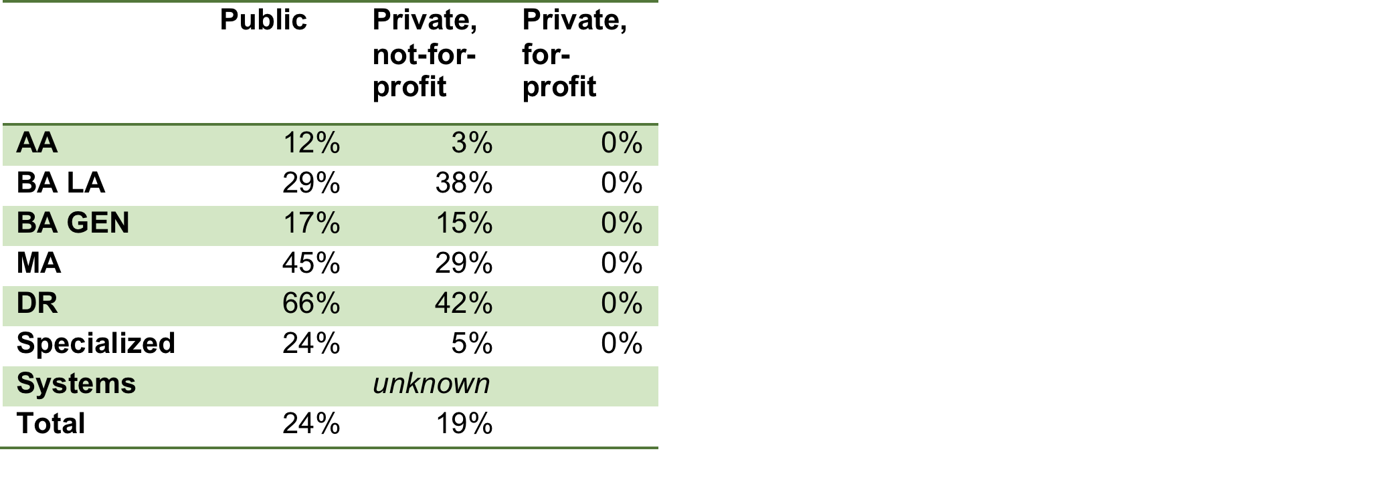
TODAY’s RESULTS ARE BASED ON
Response Rates of US Institutions
Initial analyses!
Participation in CDS Modules

Slide 6
Contributing non-us institutions

Slide 7
THE IT ORGANIZATION
  Which CIOs are most likely to have strategic impact as measured by:
    Membership on the President’s or Chancellor’s cabinet
    Having an institutional strategic plan that incorporates IT
  Here are your options. Pick the two you think are correct:
    Recently appointed
    Long-serving
    At private institutions
    At public institutions
    Report directly to the President or Chancellor
    Has an academic title such as Dean
    Reports to the Provost
    Has been a CIO elsewhere
    At community colleges
    At Bachelors-level institutions
    At doctoral universities
    At Masters-level institutions
    At international institutions

Slide 8
THE IT ORGANIZATION
  Which CIOs are most likely to have strategic impact?
    Members of the President’s or Chancellor’s cabinet
    An institutional strategic plan that incorporates IT
  Here are your options. Pick the two you think are correct:
    Recently appointed
    Long-serving
    At private institutions
    At public institutions
    Report directly to the President or Chancellor
    Has an academic title such as Dean
    Reports to the Provost
    Has been a CIO elsewhere
    At community colleges
    At Bachelors-level institutions
    At doctoral universities
    At Masters-level institutions
    At international institutions

Slide 9
ACADEMIC INVOLVEMENT IN IT GOVERNANCE
It is most common in doctoral and BA liberal arts institutions:
  Doctoral: 79% with a faculty and 57% with a student advisory committee
  BA liberal arts: 70% with faculty, 48% with students
Notes:
Module 1, Question 15:
Does central IT receive advice from any of the following committees or constituencies? (check all that apply)
Trustee/Regents IT committee
President’s cabinet/senior executive oversight
Separate committee for administrative info systems/ERP
Separate committee for educational technology
Separate committee for research computing
Separate committee for IT operations and communications infrastructure
A general IT services/support committee
Faculty advisory committee
Student advisory committee
System office (for campus in multi-campus system or district)
Component campuses (for campus in multi-campus system or district)
State agency
Other
Not applicable

Slide 10
PERCENT OF INSTITUTIONS USING SLAs
Notes:
Module 1, Question 50.
Which of the following central IT services, if applicable, are covered by written service-level agreements (SLAs) between central IT and other offices or departments. (Check all that apply.)
Percent of institutions NOT selecting option “Not applicable – there are no SLAs”

Slide 11
IT Functions Covered by SLAs in institutions that use slas
Percent of Institutions | IT Function
52% | Help desk
50% | Desktop computing, user support, training, computer store
41% | Network infrastructure & services
33% | IT security
33% | Telephony
32% | Student technology (labs, training, support, etc.)
32% | Data center, operations
29% | IT policy
29% | Admin info systems/ERP, Student
29% | Admin info systems/ERP, Finance
27% | Classroom and learning space support
25% | Web support services
24% | Admin info systems/ERP, HR
21% | Faculty instructional technology/CMS/LMS support
20% | Enterprise infrastructure and services; identity management
19% | Distance education
19% | Admin info systems/ERP, Alumni/Advancement/Fundraising
18% | Admin info systems/ERP, Other (facilities, grants management, etc.)
18% | Multimedia services
13% | Project management/Business process/Systems analysis
11% | Print/Copier services
10% | Business intelligence/Data administration/Data warehouse
7% | Library
6% | Research technology services
2% | Institutional research
1% | IT in an affiliated hospital
0% | Mailroom
Notes:
Module 1, Question 50. Which of the following central IT services, if applicable, are covered by written service-level agreements (SLAs) between central IT and other offices or departments. (Check all that apply.)

Slide 12
WHO DELIVERS IT SERVICES TO THE INSTITUTION?
But 11 services are commonly shared between IT and other units in the institution (50-25%)
Central IT dominates (>75% of institutions)
9 services
Other units in the institution dominate (>50%) 3 services
Administration of central IT organization | 96%
Data center operations | 96%
Research technology services | 95%
IT Security | 91%
Help Desk | 90%
Desktop Computing, user support, training, computer store | 87%
Enterprise infrastructure and services; identity management | 84%
IT Policy | 83%
Student Technology (labs, training, support, etc.) | 78%
Web Support Services | 46%
Classroom and learning space support | 33%
Network Infrastructure and Services | 32%
Telephony | 32%
Admin info systems-Other (facilities, grants mgt, etc.) | 31%
Project Management/Business Process/ Systems Analysis | 30%
Print/Copier Services | 30%
Admin info systems -Alumni/Advancement/Fundraising | 30%
Admin info systems - Student | 29%
Admin info systems - Finance | 28%
Admin info systems - HR | 27%
Mailroom | 79%
Institutional Research | 66%
Library | 63%
Notes:
Module 1, question 6
Which organizational units are responsible for the following functions in your institution?
Functions are listed in the slide as they appear in the question. Response options for organizational units are:
Primarily central IT
Shared between central IT and other admin or academic unit(s)
Primarily other admin or academic unit(s)
Primarily outsourced
Not applicable – no organizational unit responsible

Slide 13

OUTSOURCING: MORE TALK THAN ACTION
Only 2.5% of institutions’ IT staff are “all or nearly all” provided through an outsourcing arrangement
Only 4% of institutions have outsourced “all or nearly all” central IT services
Notes:
Module 1, question 8
Is all or nearly all of your IT staff provided through an outsourcing arrangement with an external supplier (other than your system or district office if your campus is part of a multicampus system or district)?
Module 1, question 51
Which, if any, of the following are run either partially or entirely by an external supplier (i.e, a nonaffiliated entity such as a vendor or other organization) through a contracted outsource or application service provider (ASP) arrangement. (NOTE: if your institution is a component campus of a multicampus system or district, the system or district office should not be considered an external supplier.) (Check all that apply.)
All who selected response option. “All or nearly all centralized IT services,” one of 32 options.

Slide 14
outsourcing ALL OR NEARLY ALL
IT STAFF by institutional type
Average percent of institutions outsourcing IT functions
Notes:
Module 1, question 8
Is all or nearly all of your IT staff provided through an outsourcing arrangement with an external supplier (other than your system or district office if your campus is part of a multicampus system or district)?

Slide 15
IT OUTSOURCING FOR ENTIRE FUNCTIONS
Notes:
Module 1, question 6
Which organizational units are responsible for the following functions in your institution?
Functions are listed in the slide as they appear in the question. Response options for organizational units are:
Primarily central IT
Shared between central IT and other admin or academic unit(s)
Primarily other admin or academic unit(s)
Primarily outsourced
Not applicable – no organizational unit responsible

Slide 16
IT OUTSOURCING/ASPs FOR SERVICES
“Run partially or entirely by an external Supplier”
Notes:
Module 1, question 51
Which, if any, of the following are run either partially or entirely by an external supplier (i.e, a nonaffiliated entity such as a vendor or other organization) through a contracted outsource or application service provider (ASP) arrangement. (NOTE: if your institution is a component campus of a multicampus system or district, the system or district office should not be considered an external supplier.) (Check all that apply.)

Slide 17
MANAGING THE IT WORKFORCE
32% of institutions have a salary scale for IT professionals that is different from that of other institutional staff
  97% of those have either a separate set of IT job titles or a broadband IT classification and compensations system, compared to…
  53% of the institutions without a separate salary scale for IT
Notes:
Module 1, Question 11
Does your institution have a separate salary scale for IT professionals? (yes/no)
Module 1, Question 12
Does your institution use *either* a separate set of IT job titles or a broadband IT classification and compensation system? (yes/no)

Slide 18
MANAGING THE IT WORKFORCE:
STAFF DEVELOPMENT
Travel budgets decrease for all,
training dollars decline for most, but not all
Average travel dollars per IT FTE declined from $744 to $477
Training per IT FTE decreased from $610 to $422
Notes:
Module 1, question 38.
Please enter central IT expenses other than compensation in USD for the following categories. Even if you do not use this taxonomy in your institution, please redistribute your non-compensation expenses according to these definitions to ensure comparable data across all CDS participants. If you had no expense in a category, enter 0.
Calculations were based on comparing “last FY actual expense” with “current FY budgeted expense” for the following categories:
Travel
Training, seminars, conferences
Remaining categories were:
Office supplies
Data, voice, video communications
Equipment – capitalized
Equipment – expensed
Equipment maintenance
Software – capitalized
Software – expensed
Software maintenance
Rent
Utilities
Institutional administrative costs
Other
Total

Slide 19
IT BUDGETS AND FUNDING

Slide 20
CENTRAL IT FUNDING SOURCES
An operating appropriation funds more than 80% of the central IT budget in all institutional types except public doctorals:
  27% of their IT funds are from chargeback or sales of services to institutional departments, schools, and individuals
Notes:
Module 1, question 28
Central IT funding
Amounts, in US dollars (USD), that central IT (a) received in the last FY, and (b) has budgeted for the current FY, from each funding category. (If no funding in a category, enter 0.)
NOTES:
If your institution permits carryover from one fiscal year to the next, funds received may be different from total expenditures for the fiscal year. Expenditure data are requested in other questions.
Unlike past years, campuses in multicampus system or districts are not requested to provide a best estimate of dollar equivalent for systems or services provided at no charge by the system or district office.
In line 8, enter any funding for salaries and/or benefits for central IT staff paid from a different institutional budget.
Data were based on Current FY budget for the following categories:
Operating appropriation
Capital appropriation (other than those amortized through rates)
Appropriation from revenue generated from student IT fees (if not included in line 1)
Revenue from sale (chargeback) of services (e.g., network services, computer repairs) to institutional colleges, schools, departments, students, staff, and others
Revenue from sale of centralized services to entities external to the institution
Net revenue from resale of products (e.g., computer store sales) to institutional colleges, schools, departments, students, staff, and others
Net revenue from resale of products (e.g., computer store sales) to entities external to the institution
If compensation or fringe benefits for central IT staff were paid from another institutional budget (i.e., not included in the central IT funding or budget), enter the amount here (if not already accounted for in line 1)
If your campus is part of a multicampus system or district, enter a best estimate of dollar equivalent for systems or services provided at no charge by the system or district office
Other (enter amount here; describe other funding source below)

Slide 21
MEDIAN IT SPEND/FTE: HIGHLY VARIABLE!
Associates,
Private Masters, Public Masters
Canadian and other International Institutions
BA LA and
BA General & Other Colleges
Private and Public Doctorals
Notes:
Central IT spend was based on:
Module 1, questions 35 and 38: Total central IT expenses for compensation (question 35) and expenses other than compensation (question 38).
IPEDS FTE data from 2009, the most recent verified IPED data available
WARNING:
Institutional IT spend was based on central IT spend PLUS module 1, questions 39 (IT compensation for all IT personnel employed *outside central IT*) and 40 (total non-compensation IT spend *outside central IT* including hardware, software, licenses, etc.)
These data are highly suspect due to the following factors:
Many institutions were unable to do more than estimate spending and report their estimates are guesses based on little or very poor institutional data.
During the initial weeks of data collection, all questions were required. Respondents were unable to skip this question, and many entered ‘0’. Therefore we cannot reliably distinguish between actual zero spending and these placeholder zeros.

Slide 22
SUPPORT FOR FACULTY USE OF IT IN TEACHING AND LEARNING

Slide 23
SUPPORT FOR FACULTY USE OF IT
Teaching and Learning Services
Percent of institutions offering service
Notes:
The break in the bars is the median for higher education institutions in the US. The brown bars are distance education services. The green bars are services that are more commonly provided by departments other than central IT.
Module 3, question 1
Which of the following support services for faculty use of IT in teaching and learning are available at your institution, and which organizations provide the services? (Check all that apply.)
Response options for each service were:
Provided by central IT
Provided by other administrative office(s)
Provided by school, college, or academic department(s)
Provided by multicampus system or district office
Not applicable – service not provided
Graph is based on % of institutions that answered the question and did NOT select “not applicable”

Slide 24
Connecting the dots
Deployment maturity for teaching and learning technologies
MAINSTREAM
Document management tools
Hybrid courses
E-learning (wholly online courses)
Distance learning with local instructor and remote students
Mainstream
In transition
Interactive learning
Collaboration tools (e.g., Google Apps, Sharepoint)
Blogs
Transitioning to Mainstream
TRANSITIONING TO MAINSTREAM
Facebook
Distance learning with local students and remote instructor
E-portfolios
Learning objects
Lecture capture
Wikis
E-books
Simulation
Experimental
Content management
EXPERIMENTAL
Instruction
Mobile applications
E-textbooks
Twitter
Open content
Gaming
Social media
Content
Innovative learning
Notes:
“Connecting the Dots” is an effort by ECAR staff to interpret and organize the data to suggest trends for higher education. Staff evaluated the average deployment stage as provided by institutions and organized technologies into three broad groupings (mainstream, transitioning to mainstream, and experimental, with three technologies falling neither fully in the mainstream nor the transitioning to mainstream group). The bars at the bottom of the deployment maturity graphics (innovative learning, content, social media, etc.) are the result of grouping the technologies by affinity and assessing the deployment status of those groupings. See the full report for more information.
Data based on Module 3, Question 4
Please indicate the status of the following learning technologies or practices, whether at the institutional or subunit level. In the cases of general-purpose services, such as Facebook or Twitter, consider on their use by faculty and/or students in the context of course work.
For the purposes of this question, “deployed broadly” refers to services that are supported across most or all of the institution, “deployed sparsely” refers to services that are supported in one or a few units, and “experimenting/considering” refers to pilot tests and other small-scale explorations.
Response options for each service in this slide were:
Deployed broadly
Deployed sparsely
In planning
Experimenting/considering
Considered, not pursued
No discussion to date

Slide 25
LEARNING MANAGEMENT SYSTEMS
Use of commercial LMSs is more common in all types of institutions except BA Liberal Arts colleges
But faculty and students are most satisfied in institutions using a single open-source LMS

Slide 26
Use of Commercial vs. OPEN-Source Learning Management Systems

Slide 27
Student and Faculty Satisfaction with Learning Management Systems
Notes:
Module 3, question 2
Which is your institution’s practice regarding course/learning management systems (CMS/LMS)? Consider offerings of central IT as well as other administrative or academic units. (Check all that apply.)
-
Module 3, question 3
If your institution supports one or more course/learning management systems (CMS/LMS), how would you characterize use of and satisfaction with the system(s)? (Check all that apply.)
Response options were
All courses are preloaded into the CMS/LMS with basic content
Nearly all courses use the CMS/LMS
Some faculty use the CMS/LMS; some do not
Most use of the CMS/LMS is rather basic (e.g., posting the syllabus and reading list)
Many faculty members use the more advanced features of the CMS/LMS
Faculty are generally satisfied with the functions and features of the CMS/LMS
Students are generally satisfied with the functions and features of the CMS/LMS
We measure usage of the CMS/LMS
We measure satisfaction with the CMS/LMS
Other (please specify)
Not applicable – no CMS/LMS in use
Data are based on institutions that both measure satisfaction and indicated general student or faculty satisfaction.

Slide 28
IT SUPPORT FOR STUDENTS

Slide 29
IT SUPPORT FOR STUDENTS
Question: Match the service with the percent of institutions that provide it in some or all student housing rooms:
Cable TV
Wireless access
Landline telephones
64%
72%
78%

Slide 30
IT SUPPORT FOR STUDENTS
Answer: Match the service with the percent of institutions that provide it in some or all student housing rooms:
Landline telephones
Cable TV
Wireless access
64%
72%
78%
Notes:
Module 2, question 9
What IT services are provided for students in residence halls or other student housing, regardless of whether the services are provided by central IT?
Ethernet connectivity
Wireless access
Cellular phone connectivity
Landline phone
Cable television
Computer lab in building
Other (select distribution here; describe other service below) Other service

Slide 31
INSTITUTIONS THAT REGISTER STUDENT CELL PHONES MAKE USE OF THEM
47% of institutions require students to register their cell phone numbers
94% of those institutions offer students the option of receiving emergency communications (vs. 51%)
15% of those institutions offer students the option to access institutional information systems via text message (vs. 5%)
Notes:
Module 2, question 16
16. What is the status of cell phone services for students at your institution? (Check all that apply.)
We have negotiated special pricing for handsets or service fees with at least one cell provider
We have provided for ubiquitous, or nearly ubiquitous, cell coverage on campus (e.g., via a distributed antenna system or a contract with a cell provider)
We encourage students to register cell phone numbers
We offer students the option of receiving emergency communications via cell text message
We offer students the option of accessing institutional information services via cell text message
We offer one or more location-based information services that can be accessed by those with GPS-enabled phones or other devices
Other (please specify)
Not applicable – no cell phone services are supported

Slide 32
POLICIES FOR STUDENT COMPUTERS
Notes:
Module 2, question 7
Select the statement below that best describes the student computer policy in your institution.
All students are provided with a desktop or laptop computer;
Students in general are required to purchase/lease a personal computer
Students in some departments or majors are required to purchase/lease a personal computer
Personal computer purchase/lease is recommended but not required for all students
Personal computer purchase/lease is recommended but not required for students in some departments or majors
There are no requirements or recommendations regarding personal computer purchase or lease
Other (please specify)

Slide 33
Institutions Charging a Student Technology Fee
Fee averages $200/year
Only 4% charge a fee that is a % of tuition, except Associates (69% of them do)
Notes:
Module 1, Questions 41 and 42
41. If your institution charges a general student technology fee (that is, a fee designated wholly for IT that is levied on all students--as opposed to specific IT fees based on academic major or other criteria) on what basis is the fee charged? Please note: In previous surveys, versions of this question requested data from the prior fiscal year. This question asks instead about the *current* fiscal year (FY 2010-2011).
Flat fee per year
Flat fee per semester
Flat fee per quarter
Flat fee per credit hours
Percentage of tuition
Other
42. How much is the fee (or percentage of tuition) in the current FY (FY 2010-2011)? (Enter fee amount in USD; NOTE that decimals *are* permitted here.) Please note: In previous surveys, versions of this question requested data from the prior fiscal year. This question asks instead about the *current* fiscal year (FY 2010-2011).

Slide 34
SUPPORT FOR RESEARCH

Slide 35
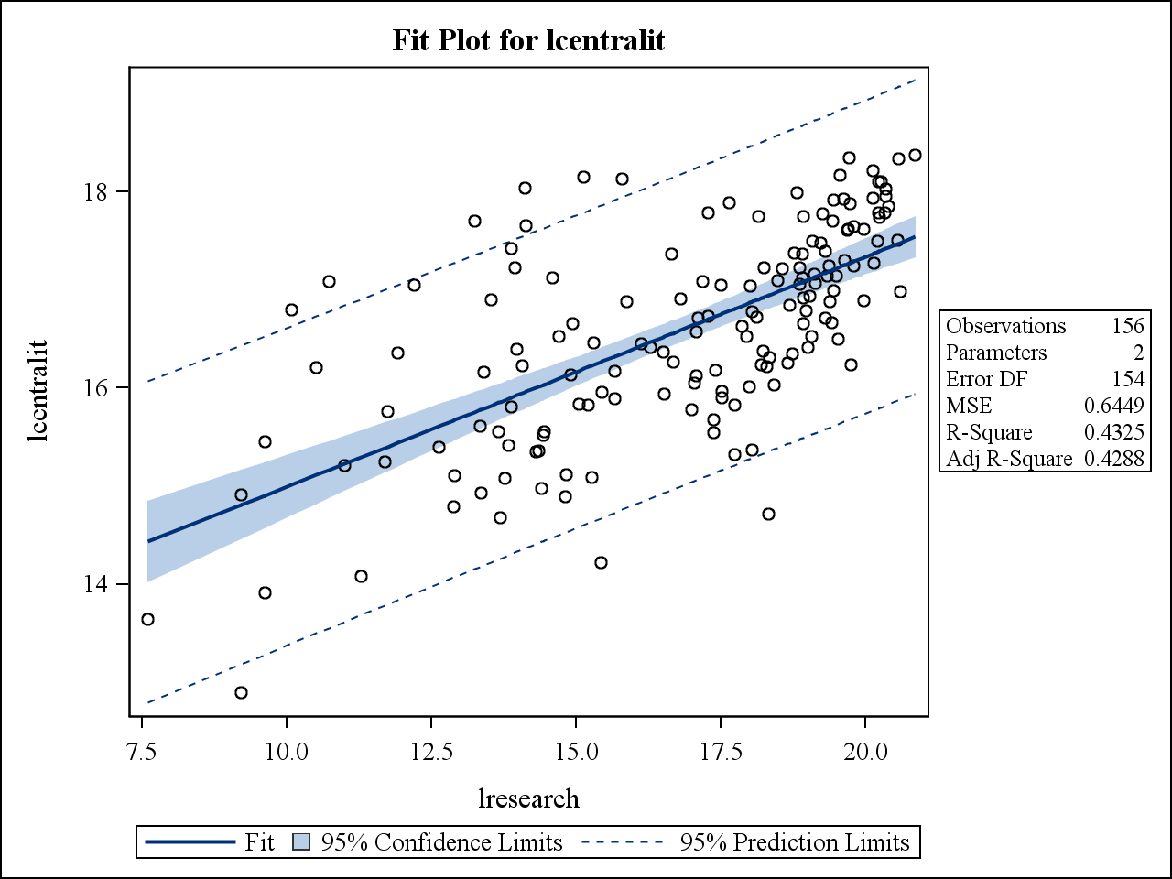
IT IN SUPPORT OF RESEARCH
WHAT DOES IT COST IT TO SUPPORT RESEARCH?
For every 10% increase in the institution’s research expenditures, IT spending increases by:
  2.0% in central IT
  0.5% in distributed IT
Notes:
Module 1
Question 27
What were the actual research expenditures (in USD) for the last FY (FY 2009-2010)?
Question 35 and 38: Total Central IT spending
Please provide a breakdown of actual central IT compensation expense for the last FY (FY 2009-2010) and the expense budgeted for the current FY (FY 2010-2011) according to the following categories. Include salaries, wages, and fringe benefits, even if benefits were paid elsewhere in the institution and not charged to central IT.
38. Please enter central IT expenses other than compensation in USD for the following categories. Even if you do not use this taxonomy in your institution, please redistribute your non-compensation expenses according to these definitions to ensure comparable data across all CDS participants. If you had no expense in a category, enter 0.
Questions 39 and 40: Total Distributed IT Spending
39. Please enter your best estimate of the total actually spent last FY (FY 2009-2010) and budgeted for the current FY (FY 2010-2011) for compensation (salaries, wages, plus benefits) for all IT personnel employed *outside central IT* (for example, administrative offices or academic departments), including part-time and limited-term employees.
40. Please enter your best estimate of the total actually spent in the last FY (FY 2009-2010) and budgeted for the current FY (FY 2010-2011) on IT (other than compensation reported in question 35 above) *outside central IT* in your institution. These expenditures would include hardware, software, licenses, and so forth.

Slide 36
RESEARCH SERVICES PROVIDED BY CENTRAL IT
Notes:
Module 4, questions 1, 2, 3, 5 and 7
Relevant items were grouped across questions into the categories shown on the slide.
How is your institution organized to support research that is dependent on information technology? (Check all that apply.)
Our institution is planning an integrated set of IT services, also known as cyberinfrastructure
Our institution provides an integrated set of IT services, also known as cyberinfrastructure
One or more departments, centers, or programs are engaged in application of IT in research, but their activities are largely independent of one another
Our institution devotes minimal resources to support research-related IT
Other (please specify)
2. What IT-related *consulting and support* services are offered to researchers at your institution, and which organizational unit(s) provide the services? Note that *operational* IT services are addressed in the next question. (Check all that apply.)
Assistance in preparing research grant applications
Participation on the Institutional Review Board (IRB)
Review and approval of data control plans for research
Review and approval of other technical aspects of research projects, such as hardware and software acquisition, systems management, and networking
Statistical consulting
Consulting/support for software development and software porting
Consulting/support for visualization
Consulting/support for high-performance computing configuration and operation
Consulting/support for storage solutions and data access, including those mandated by federal grants
Consulting/support for storage solutions and data access, including those mandated by federal grants
Consulting/support for access to remote research resources
Consulting/support for access to commercial cloud computing resources
Hosting or facilitating events to introduce new technologies to and share experiences among researchers
Other
3. What *operational* IT services are available to researchers in your institution, and which organizational unit(s) provide the services? Note that *consulting and support* services are addressed in the previous question. (Check all that apply.)
Management of research servers owned by academic units
Provision of data center facilities for academic units to operate their servers
High-performance computing services
High-throughput computing services
Institutional grid computing services
Data management, storage and curation services
Videoconferencing services
High-performance network provisioning within the institution
High-performance external network provisioning
An integrated system of research-related services, sometimes known as cyberinfrastructure or support for e-science
Other
5. Which, if any, of the following services does your institution make available to researchers at other institutions? (Check all that apply.)
High-performance computing
Server hosting
Server management
Access to specialized scientific apparatus (e.g., telescope, sensor network, etc.)
Storage resources
Visualization resources
Other (please specify)
Not applicable - no services are made available
7. What high-performance or research and education (R&E) networking services are available in your institution? (Check all that apply.)
Campus backbone
Metropolitan-area network
Statewide or regional network
Access to U.S. Internet2
Access to U.S. National LambdaRail
Access to U.S. Esnet
Access to U.S.
Access to other National Research and Education Network (NREN)

Slide 37
Institutional differences in Central IT Services for Research
The break in the bar represents the overall average for higher education
Notes:
White bar indicates median for US higher education institutions. The bar extends from the lowest institutional type (e.g., Associates) median to the highest.
See notes to previous slide (36) for more information about items within each category.

Slide 38
Institutional differences in Central IT Services for Research
Institutional type averages
DR
MA
BA LA
BA other
AA
The break in the bar represents the overall average for higher education
Notes:
Dots represent institutional type medians.
See notes to slide 36 for more information about items within each category.

Slide 39
Connecting the dots
Maturity of IT Support for Research in Research-Intensive Institutions
Based on
Doctoral universities
Institutions specializing in medicine or engineering
PERVASIVE
High Performance networking
Videoconferencing
Pervasive
FREQUENT
Storage and hosting
Data management
Community-building
Research and Education Network access and services
High performance computing and related
Frequent
Moderately Common
MODERATELY COMMON
Content-related support
Support for grants
Cyberinfrastructure services to other institutions
Notes:
“Connecting the Dots” is an effort by ECAR staff to interpret and organize the data to suggest trends for higher education. Staff evaluated the maturity of IT support for research based on the percent of research-intensive institutions (doctoral universities and institutions specializing in medicine or engineering) providing each group of services and categorized them into one of three groups: pervasive, frequent, and moderately common. Groupings are shown in the previous slide.
See notes to slide 36 for more information about items within each category.

Slide 40
IT IN THE INSTITUTION

Slide 41
IT IN THE INSTITUTION:
BEYOND CENTRAL IT
Reporting Lines for Information and Technology Functions
Percent of Institutions
Notes:
Module 9, question 1
What is the relationship of the following departments, programs, or units to central IT? For the purposes of this question, "administrative information systems/ERP" refers to the unit that focuses on the functionality of the applications software (design, development, testing, maintenance, etc.). These functions are conceptually distinct from systems operation and from the various functional responsibilities that are typically vested in offices of student affairs, financial affairs, and so forth.
Administrative information systems/ERP
Center for technology-enhanced learning (or equivalent)
Distance learning
Faculty teaching excellence center (or equivalent)
High-performance computing/Supercomputing
Institutional research
IT security
Libraries Telephone services
Institutional web design

Slide 42
IT Functions Provided Outside Central IT
Notes:
Module 10, question 1 and 3
See Slide 44 for administrative offices and academic units provided as response option
Which, if any, IT functions are provided by the following administrative offices delivered either to their own personnel and programs or to others units in the institution, or beyond? (Check all that apply.)
Which, if any, IT functions are provided by the following academic units? (Check all that apply.)
Enterprise application development
Enterprise application support
Classroom support
Data center
Desktop support
Support for faculty use of educational technology
E-mail, calendaring, web support
Help desk
In-building data networking (wired)
Support for faculty use of IT in research
IT security
In-building data networking (wireless)

Slide 43
ACADEMIC DEPARTMENTS ARE MORE LIKELY THAN ADMINISTRATIVE TO DELIVER IT SERVICES

Slide 44
Percent of Non-IT Departments Providing IT Functions
(Doctoral and Canadian Institutions only)
Administrative departments
Academic departments
Notes:
See notes to slide 42

Slide 45
IT SUPPORT

Slide 46
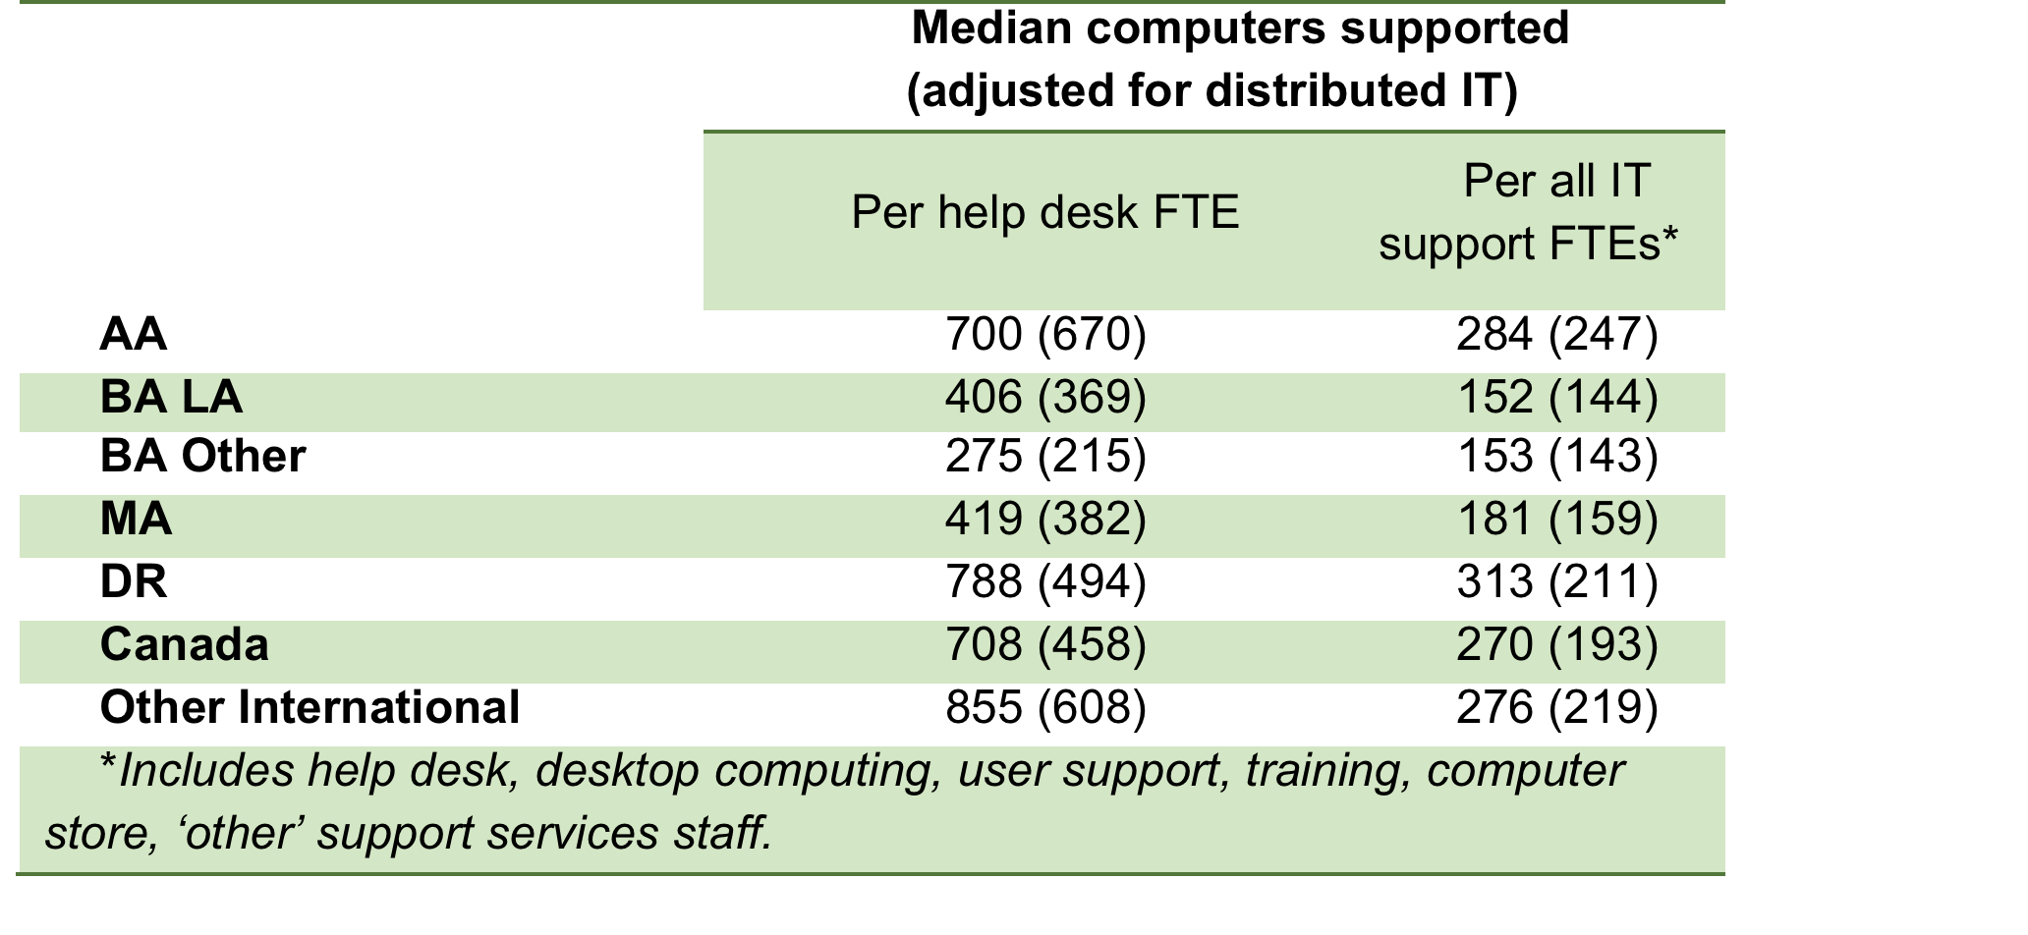
IT SUPPORT: COMPUTERS SUPPORTED PER IT SUPPORT FTE
Notes:
The numbers in parentheses divide all institutional computers by both central and distributed help desk/all IT support FTEs. The numbers not in parentheses reflect central IT only. The former (in parentheses) are a better measure for institutions where IT is highly distributed; the latter for those where IT is highly centralized.
Module 1, questions 7, 10, and 47
7. How many full-time equivalent (FTE) staff--including clerical, support, and management staff--and students are employed in central IT in each of the functional areas below for the current fiscal year (FY 2010-2011)? Please include part-time, temporary, and limited-term employees, as well as any employees of external suppliers of outsourced IT services.
1. Office of the CIO subtotal - Staff FTE
1. Office of the CIO subtotal - Student FTE
1a. Administration of IT organization, IT planning & budgeting, technology R&D - Staff FTE
1a. Administration of IT organization, IT planning & budgeting, technology R&D - Student FTE
1b. IT policy - Staff FTE
1b. IT policy - Student FTE
1c. IT security - Staff FTE
1c. IT security - Student FTE
1d. Project management, business process analysis, systems analysis - Staff FTE
1d. Project management, business process analysis, systems analysis - Student FTE
1e. Other - Staff FTE
1e. Other - Student FTE
2. Information Systems / ERP subtotal - Staff FTE
2. Information Systems / ERP subtotal - Student FTE
2a. Info systems/ERP, Finance - Staff FTE
2a. Info systems/ERP, Finance - Student FTE
2b. Info systems/ERP, HR - Staff FTE
2b. Info systems/ERP, HR - Student FTE
2c. Info systems/ERP, Student - Staff FTE
2c. Info systems/ERP, Student - Student FTE
2d. Info systems/ERP, Alumni/Advancement/Fundraising - Staff FTE
2d. Info systems/ERP, Alumni/Advancement/Fundraising - Student FTE
2e. Info systems/ERP, Other (facilities, grants management, etc.) - Staff FTE
2e. Info systems/ERP, Other (facilities, grants management, etc.) - Student FTE
2f. Business intelligence/Data administration/Data warehouse - Staff FTE
2f. Business intelligence/Data administration/Data warehouse - Student FTE
2g. Other - Staff FTE
2g. Other - Student FTE
3. Support Services subtotal - Staff FTE
3. Support Services subtotal - Student FTE
3a. Help desk - Staff FTE
3a. Help desk - Student FTE
3b. Desktop computing, user support, training, computer store - Staff FTE
3b. Desktop computing, user support, training, computer store - Student FTE
3c. Other - Staff FTE
3c. Other - Student FTE
4. Educational Technology Services subtotal - Staff FTE
4. Educational Technology Services subtotal - Student FTE
4a. Student technology (labs, training, support, etc.) - Staff FTE
4a. Student technology (labs, training, support, etc.) - Student FTE
4b. Faculty instructional technology/CMS/LMS support - Staff FTE
4b. Faculty instructional technology/CMS/LMS support - Student FTE
4c. Classroom and learning space support - Staff FTE
4c. Classroom and learning space support - Student FTE
4d. Multimedia services - Staff FTE
4d. Multimedia services - Student FTE
4e. Distance education - Staff FTE
4e. Distance education - Student FTE
4f. Other - Staff FTE
4f. Other - Student FTE
5. Communications Infrastructure Services subtotal - Staff FTE
5. Communications Infrastructure Services subtotal - Student FTE
5a. Network infrastructure and services - Staff FTE
5a. Network infrastructure and services - Student FTE
5b. Telephony - Staff FTE
5b. Telephony - Student FTE
6. Data center, operations - Staff FTE
6. Data center, operations - Student FTE
7. Enterprise infrastructure and services; identity management - Staff FTE
7. Enterprise infrastructure and services; identity management - Student FTE
8. Research technology services - Staff FTE
8. Research technology services - Student FTE
9. Web support services - Staff FTE
9. Web support services - Student FTE
10. Other (enter amounts here; describe other functional areas below) - Staff FTE
10. Other (enter amounts here; describe other functional areas below) - Student FTE
5c. Other - Staff FTE
5c. Other - Student FTE
11. Total - Staff FTE
11. Total - Student FTE
Other functional areas
10. Please estimate the number of FTE IT personnel *currently* employed by departments or offices outside the centralized IT organization of your campus (for example, employed by administrative offices or academic departments), including part-time, temporary, and limited-term employees. Your institutional HR office may be able to provide this number. If no IT personnel are employed outside the centralized IT organization, enter 0. Please note: In previous surveys, versions of this question requested data from the prior fiscal year. This question asks instead about the *current* fiscal year (FY 2010-2011).
47. Estimate how many computers your institution owns or leases. (NOTE: Do not include smart phones and e-book readers)

Slide 47
Modalities of Help Desk Support
The break in the bar represents the overall median for higher education
Notes:
White bar indicates median for US higher education institutions. The bar extends from the lowest institutional type (e.g., Associates) median to the highest.
Module 2, question 2
2. How does your help desk provide services? (Check all that apply.)
E-mail
Instant message
Phone
Text message
Walk-in
Web form
Other (please specify)
Not applicable - no help desk

Slide 48
Modalities of Help Desk Support
Institutional type averages
DR
MA
BA LA
BA other
AA
The break in the bar represents the overall median for higher education
Notes:
Dots represent institutional type medians.
Module 2, question 2
2. How does your help desk provide services? (Check all that apply.)
E-mail
Instant message
Phone
Text message
Walk-in
Web form
Other (please specify)
Not applicable - no help desk

Slide 49
Number of different services and APPLICATIONS supported by Help Desks
Median number supported
Notes:
Module 2, questions 4 and 5
Graph shows sum of all selected responses to questions 4 and 5 at any level of support
4. Which types of systems are supported by your help desk, what is the level of support offered, and are fees charged?
Windows-based systems
Macs
Linux- or UNIX-based systems
iPad
Tablet devices other than iPad
iPhone
Android-based smartphones
BlackBerry
Other smartphone(s)
E-book reader(s)
Other (select support level here; describe other system below)
Other system
5. Which types of services are offered by your help desk, what is the level of support offered, and are fees charged?
System authentication and passwords
Access to/use of a university portal
Access to/use of administrative information systems/ERP
Access to/use of institution's library system
Access to/use of a course/learning management system (CMS/LMS)
Access to/use of Internet resources
Office suite (word processing, spreadsheet, etc.)
End-user system performance, configuration
End-user operating system installation, reinstallation
Laptop checkout/loan
Tablet checkout/loan
Hardware repair
Telephony issues (moves, adds, changes; voicemail)
Other (select support level here; describe other service below)
Other service

Slide 50
HELP DESKS PROVIDE THE BESt SUPPORt FOR THE BASICS, BUT MOBILE DEVICES ARE NOT IGNORED
Notes:
Module 2, questions 4 and 5
Support level options were:
Full service, no charge
Best effort, no charge
Full service, fee charged
Best effort, fee charged
Not applicable, no support provided
4. Which types of systems are supported by your help desk, what is the level of support offered, and are fees charged?
Windows-based systems
Macs
Linux- or UNIX-based systems
iPad
Tablet devices other than iPad
iPhone
Android-based smartphones
BlackBerry
Other smartphone(s)
E-book reader(s)
Other (select support level here; describe other system below)
Other system
5. Which types of services are offered by your help desk, what is the level of support offered, and are fees charged?
System authentication and passwords
Access to/use of a university portal
Access to/use of administrative information systems/ERP
Access to/use of institution's library system
Access to/use of a course/learning management system (CMS/LMS)
Access to/use of Internet resources
Office suite (word processing, spreadsheet, etc.)
End-user system performance, configuration
End-user operating system installation, reinstallation
Laptop checkout/loan
Tablet checkout/loan
Hardware repair
Telephony issues (moves, adds, changes; voicemail)
Other (select support level here; describe other service below)
Other service

Slide 51
STUDENT E-MAIL

Slide 52
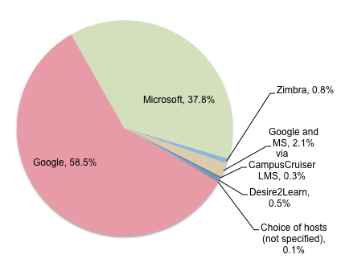
Student E-Mail OUTSOURCING
62% of institutions have outsourced student e-mail.
Another 12%-46% are planning to.
Notes:
Module 2, questions 11, 12, and 14
11. How is central IT providing student e-mail today?
Internally
Externally/outsourced
Not applicable, student e-mail not provided by central IT
12. Are there plans to change e-mail provisioning?
Planning to provide internally
Planning to provide externally/outsourced
Planning to stop providing student e-mail
No plans to change
14. If you outsource your student e-mail service, which company provides the service?
Google
Microsoft
Zimbra
Other
Not applicable

Slide 53
REASONS FOR OUTSOURCING STUDENT
E-MAIL: COSTS AND FEATURES
Notes:
Module 2, question 15
15. If you outsource your student e-mail service, what factors contributed to this decision? (Check all that apply.)
Access to additional applications (document sharing, etc.)
Integrated calendaring
Reduced institutional costs
Enhanced messaging services
Increased storage
Other (please specify)
Not applicable - student e-mail is not outsourced

Slide 54
ENTERPRISE SYSteMS

Slide 55
ENTERPRISE SYSTEMS TODAY:
VENDOR APPLICATIONS MANAGED IN-HOUSE
Application management
  79% of enterprise applications are managed in-house
  8% by a system office (30% for community colleges)
  11% are outsourced (6% for doctorals, 5% for international institutions)
Application origin
  Vendors (85% of applications)
  Home-grown = 9%, open-source = 6%
  Grants management has most homegrown (31%)
  Content (21%) and learning (24%) management most open source
Notes:
Module 8, question 1
Please complete the following grid regarding key information systems in your institution regardless of whether these systems are operated or supported by central IT.
Systems listed:
Student
Financial
HR/Payroll
Alumni/Advancement/Development
Library
Learning management
Grants management (pre-award)
Grants management (post-award)
Facilities management
Portal
Administrative data warehouse/Business intelligence
Web content management
Staff/Faculty e-mail
Student e-mail
IT service/Help desk trouble ticket
Customer relationship management (CRM)
Other
Provider options:
Institution
System office
Outsourced
Not applicable, not provided
Origin options:
Vendor product
Open source
Homegrown

Slide 56
ENTERPRISE SYSTEMS TOMORROW: OUTSOURCED, OPEN-SOURCE, MINIMAL CUSTOMIZATION
The most common current strategy, purchasing a commercial product with minimal customization, will be surpassed or equaled by two less common current strategies: outsourcing and using an open-source product with minimal customization
Notes:
Module 8, question 2
Please indicate the strategies your institution has employed to date for implementing or converting the above information systems and your preferred strategies for future (next 3 years) implementations or conversions (check all that apply).
For each response option, respondents were asked to select from the following choices:
Current strategy
Future strategy
Not applicable – strategy not employed
Response options:
Develop systems in house (homegrown)
Develop systems in partnership with a vendor
Purchase a commercial product with minimal customization
Purchase a commercial product with substantial customization
Use an open source product with minimal customization
Use an open source product with substantial customization
Select best-of-breed applications
Select a package of integrated systems
Enhance legacy systems and provide web interfaces
Outsource systems
Other (select options here; describe other strategy below)

Slide 57
WHERE MIGHT WE SEE THESE TRENDS FIRST?
Average Age of Enterprise Systems and Plans to Replace or Implement Within Three Years
Notes:
Module 8, question 1
Please complete the following grid regarding key information systems in your institution regardless of whether these systems are operated or supported by central IT.
Systems listed:
Student
Financial
HR/Payroll
Alumni/Advancement/Development
Library
Learning management
Grants management (pre-award)
Grants management (post-award)
Facilities management
Portal
Administrative data warehouse/Business intelligence
Web content management
Staff/Faculty e-mail
Student e-mail
IT service/Help desk trouble ticket
Customer relationship management (CRM)
Other
For each system, respondents were asked to indicate:
Year implemented
Will implement or replace in next 3 years

Slide 58
USER SATISFACTION WITH ENTERPRISE SYSTEMS: IT DEPENDS
Estimated user satisfaction with enterprise systems overall (no data on particular applications)
High general satisfaction:
72% satisfied vs. 11% dissatisfied
Mixed user assessments of ease-of-use (39% vs. 29%)
Low satisfaction with data access and reporting capabilities (only 38% satisfied vs. 41% dissatisfied)
Institutions gave themselves high marks for systems implementations and upgrades: 68% satisfaction and only 10% dissatisfaction
Notes:
Module 8, question 3
3. What is the overall status of the deployment and use of your institution's information systems?
We have deployed all the systems we need, and they are generally up to date
We have deployed all the systems we need, but some are due, or overdue, for upgrades
We have deployed all the systems we need, but some need to be replaced due to inadequate functionality, outdated technology, expiration of vendor support, etc.
We need a more integrated suite of systems
We need one or more replacement systems that are substantially less costly than our current systems
Users are generally satisfied with the transaction processing capabilities of our systems
Users are generally satisfied with the data access and reporting capabilities of our systems
Users are generally satisfied with the ease-of-use of our systems
Users are generally satisfied with our track record for systems implementations and upgrades

Slide 59
INFORMATION SECURITY

Slide 60
INFORMATION SECURITY
The lead role varies greatly
35% have executive/
officer titles
20% are directors
8% are managers
8% are line staff
29% of CIOs
occupy the role
Notes:
Module 7, questions 1 and 3
What is the title of the highest-ranking person with primary responsibility for the *operational* aspects of IT security across your institution? Note that this person may not report within the central IT organization.
Chief Information Security Officer
Chief, IT Security Officer
Information Security Officer
IT Security Officer
Executive Director, Information Security
Executive Director, IT Security
Director, Information Security
Director, IT Security
Manager, Information Security
Manager, IT Security
CIO or equivalent also serves in this role
Other (please specify) [NOTE: The text responses to this option were reviewed and coded to develop the percentages on the slide
3. To whom does this person report? (Check all that apply.)
Board of Trustees/Regents
Chief Administrative Officer
Chief Financial Officer
Highest-ranking IT administrator/officer (e.g., CIO) in central IT
Director of Internal Audit
First-line director in central IT
President/Chancellor
Provost/Chief Academic Officer
Second-line manager in central IT
Other (please specify)

Slide 61
INFORMATION Security Responsibilities
The break in the bar represents the overall average
Notes:
White bar indicates median for US higher education institutions. The bar extends from the lowest institutional type (e.g., Associates) median to the highest.
Module 7, question 5
5. Which of the following are responsibilities of IT security in your institution?
Answering/processing your abuse e-mail address
Acceptable use violation processing
Security awareness, education and training
Regulatory compliance for central IT in general
DMCA (U.S. Digital Millennium Copyright Act) notices
Disaster recovery/business continuity
Firewall operation and management
Forensic analysis
Incident response, management and communication
Intrusion detection system operation
Liaison with law enforcement
Malware identification and cleanup
Netflow data collection and analysis
PCI (payment card industry) compliance
Penetration testing
Review/signoff on IT procurements
Review/signoff on security protocols in research projects
Scanning the network for vulnerabilities
Selection of security software (AntiVirus, etc.)
Other (please specify)
Not applicable - none are the responsibility of IT security

Slide 62
INFORMATION Security Responsibilities
Institutional type averages
DR
MA
BA LA
BA other
AA
Private institutions
Public institutions
The break in the bar represents the overall average
Notes:
Dots represent institutional type medians.
Module 7, question 5
5. Which of the following are responsibilities of IT security in your institution?
Answering/processing your abuse e-mail address
Acceptable use violation processing
Security awareness, education and training
Regulatory compliance for central IT in general
DMCA (U.S. Digital Millennium Copyright Act) notices
Disaster recovery/business continuity
Firewall operation and management
Forensic analysis
Incident response, management and communication
Intrusion detection system operation
Liaison with law enforcement
Malware identification and cleanup
Netflow data collection and analysis
PCI (payment card industry) compliance
Penetration testing
Review/signoff on IT procurements
Review/signoff on security protocols in research projects
Scanning the network for vulnerabilities
Selection of security software (AntiVirus, etc.)
Other (please specify)
Not applicable - none are the responsibility of IT security

Slide 63
INFORMATION SECURITY ACTIVITIES
Most common (>75% of institutions):
Firewall at external Internet connection(s)
Require all critical systems to be expeditiously patched or updated
IT security personnel have authority and ability to disable a network port in the event that a device has been detected to be violating institutional policy or disrupting network services
Require institutionally owned or leased computers to be expeditiously patched or updated
Enterprise directory
Notes:
Module 7, questions 6-10 and 12
6. Please indicate the status in your institution of the following identity management technologies.
Status options were:
Deployed broadly
Deployed sparsely
In planning
Considering
Considered, not pursued
No discussion to date
Technologies were:
Biometrics
Electronic signatures
Enterprise directory
PKI
Smart cards
Tokens
Two-factor authentication
Other
7. What is the status of end-user authentication for data network access in your institution? (Check all that apply.)
We are considering an end-user authentication requirement for network access
We currently require end-user authentication for all institutionally-provided wireless access
We are a member of a federation such as InCommon and support inter-domain authentication
We have a separate authentication process for guest access to wireless
We require end-user authentication only for access to institutional services
We have no plans for requiring end-user authentication for network access
We provide open access to the public Internet
We are planning to require end-user authentication for all wired access
We are planning to require end-user authentication for all wireless access
We currently require end-user authentication for wired access from all workstations
We currently require end-user authentication for all wired access from public workstations
Other (please specify)
Not applicable - no authentication exists
8. Which of the following apply at your institution regarding firewalls? (Check all that apply.)
Firewalls deployed by or on behalf of individual departments
Firewall at external Internet connection(s)
Requirement that personal firewall product be turned on when connected to the institutional network
Personal firewall product deployed on workstations
A plan in place to implement one or more firewalls
Firewall between campus network and residence hall network(s)
Firewalls around certain high-security servers or networks
Other (please specify)
Not applicable - no firewalls exist
Decline to answer - we are not comfortable revealing information about our firewall strategy
9. Which of the following IT security policies and practices apply at your institution? (Check all that apply.)
Security assessments are required prior to contracting for hosted services
Security assessments are required prior to licensing commercial software
Our IT security personnel have the authority and ability to disable a network port in the event that a device has been detected to be violating institutional policy or disrupting network services
We have deployed DNSSEC (domain name system security extensions)
We require all institutionally owned portable devices to be encrypted
We require all institutionally owned portable devices containing sensitive information to be encrypted
Our security system includes an intrusion detection system.
We require all of our critical systems to be expeditiously patched or updated
We require institutionally owned or leased computers to be expeditiously patched or updated
We require all personally owned computers to be expeditiously patched or updated
We conduct proactive scans to detect known security exposures in our critical systems
We conduct proactive scans to detect known security exposures in all institutionally owned or leased computers connected to our network
We conduct proactive scans to detect known security exposures in all personally owned computers connected to our network.
Other (please specify)
Decline to answer - we are not comfortable revealing information about these security policies and practices
Not applicable - no security-related practices exist
10. In which of these areas has your institution undertaken an IT security risk assessment within the past two years? (Check all that apply.)
Central administrative systems and data
Central IT systems and infrastructure
Instructional systems and data
Medical center systems and data
Research systems and data
Other (please specify)
Not applicable - no risk assessments have been undertaken
12. Federal cybersecurity professionals in the U.S. will soon be required to be professionally certified. Does your institution require certification for IT security personnel?
Currently require certification
Plan to require certification
Not applicable, don't require certification and no plans to do so

Slide 64
LEAST COMMON ACTIVITIES
(<25% oF INSTITUTIONS)
Security assessments are required prior to contracting for hosted services
PKI implemented (broadly or sparsely)
Electronic signatures implemented (broadly or sparsely)
Risk assessments on Instructional systems and data
Firewalls deployed by or on behalf of individual departments
Security assessments are required prior to licensing commercial software
Two-factor authentication implemented (broadly or sparsely)
Requirement that personal firewall product be turned on when connected to the institutional network
Conduct proactive scans to detect known security exposures in all personally owned computers connected to our network.
Smart Cards implemented (broadly or sparsely)
Require all institutionally owned portable devices to be encrypted
Biometrics implemented (broadly or sparsely
Member of a federation such as InCommon and support inter-domain authentication
Tokens implemented (broadly or sparsely)
Require IT Security Professional certification
Risk assessments on Medical center systems and data
Have deployed DNSSEC (domain name system security extensions)
Risk assessments on research systems and data
Notes:
Module 7, questions 6-10 and 12
6. Please indicate the status in your institution of the following identity management technologies.
Status options were:
Deployed broadly
Deployed sparsely
In planning
Considering
Considered, not pursued
No discussion to date
Technologies were:
Biometrics
Electronic signatures
Enterprise directory
PKI
Smart cards
Tokens
Two-factor authentication
Other
7. What is the status of end-user authentication for data network access in your institution? (Check all that apply.)
We are considering an end-user authentication requirement for network access
We currently require end-user authentication for all institutionally-provided wireless access
We are a member of a federation such as InCommon and support inter-domain authentication
We have a separate authentication process for guest access to wireless
We require end-user authentication only for access to institutional services
We have no plans for requiring end-user authentication for network access
We provide open access to the public Internet
We are planning to require end-user authentication for all wired access
We are planning to require end-user authentication for all wireless access
We currently require end-user authentication for wired access from all workstations
We currently require end-user authentication for all wired access from public workstations
Other (please specify)
Not applicable - no authentication exists
8. Which of the following apply at your institution regarding firewalls? (Check all that apply.)
Firewalls deployed by or on behalf of individual departments
Firewall at external Internet connection(s)
Requirement that personal firewall product be turned on when connected to the institutional network
Personal firewall product deployed on workstations
A plan in place to implement one or more firewalls
Firewall between campus network and residence hall network(s)
Firewalls around certain high-security servers or networks
Other (please specify)
Not applicable - no firewalls exist
Decline to answer - we are not comfortable revealing information about our firewall strategy
9. Which of the following IT security policies and practices apply at your institution? (Check all that apply.)
Security assessments are required prior to contracting for hosted services
Security assessments are required prior to licensing commercial software
Our IT security personnel have the authority and ability to disable a network port in the event that a device has been detected to be violating institutional policy or disrupting network services
We have deployed DNSSEC (domain name system security extensions)
We require all institutionally owned portable devices to be encrypted
We require all institutionally owned portable devices containing sensitive information to be encrypted
Our security system includes an intrusion detection system.
We require all of our critical systems to be expeditiously patched or updated
We require institutionally owned or leased computers to be expeditiously patched or updated
We require all personally owned computers to be expeditiously patched or updated
We conduct proactive scans to detect known security exposures in our critical systems
We conduct proactive scans to detect known security exposures in all institutionally owned or leased computers connected to our network
We conduct proactive scans to detect known security exposures in all personally owned computers connected to our network.
Other (please specify)
Decline to answer - we are not comfortable revealing information about these security policies and practices
Not applicable - no security-related practices exist
10. In which of these areas has your institution undertaken an IT security risk assessment within the past two years? (Check all that apply.)
Central administrative systems and data
Central IT systems and infrastructure
Instructional systems and data
Medical center systems and data
Research systems and data
Other (please specify)
Not applicable - no risk assessments have been undertaken
12. Federal cybersecurity professionals in the U.S. will soon be required to be professionally certified. Does your institution require certification for IT security personnel?
Currently require certification
Plan to require certification
Not applicable, don't require certification and no plans to do so

Slide 65
INDICATORS OF INFORMATION SECURITY MATURITY: WHO HAS DONE THE MOST?
Doctoral and public institutions are engaged in more activities
Information security departments with more responsibilities
Information security leads with full-time allocations to the role
Information security leads who report to the CIO
Notes:
Sum of relevant responses to Module 7, questions 6-10 and 12 (see previous slide for details). Correlated with the following:
Carnegie classification
Control (private vs. public)
Sum of responses to Module 7, question 5
5. Which of the following are responsibilities of IT security in your institution?
Answering/processing your abuse e-mail address
Acceptable use violation processing
Security awareness, education and training
Regulatory compliance for central IT in general
DMCA (U.S. Digital Millennium Copyright Act) notices
Disaster recovery/business continuity
Firewall operation and management
Forensic analysis
Incident response, management and communication
Intrusion detection system operation
Liaison with law enforcement
Malware identification and cleanup
Netflow data collection and analysis
PCI (payment card industry) compliance
Penetration testing
Review/signoff on IT procurements
Review/signoff on security protocols in research projects
Scanning the network for vulnerabilities
Selection of security software (AntiVirus, etc.)
Other (please specify)
Not applicable - none are the responsibility of IT security
Module 7, question 2:
2. What percentage of full-time does this person devote to IT security?
100%
80-99%
60-79%
40-59%
20-39%
less than 10%
Module 7, question 3:
3. To whom does this person report? (Check all that apply.)
Board of Trustees/Regents
Chief Administrative Officer
Chief Financial Officer
Highest-ranking IT administrator/officer (e.g., CIO) in central IT
Director of Internal Audit
First-line director in central IT
President/Chancellor
Provost/Chief Academic Officer
Second-line manager in central IT
Other (please specify)

Slide 66
DATA CENTERS

Slide 67
Data centers: WHO MANAGES THEM?
Central IT manages more than 9 of 10 data centers in associates and BA colleges, but fewer than two-thirds of data centers at doctoral and Canadian institutions
Notes:
Module 5, questions 1 and 2
Which statements apply to the management of data centers at your institution? (Check all that apply.)
Some data center hosting is located on our campus
Our institution provides data center services for other institutions
Our institution provides data center services or manages data centers on behalf of a shared service or consortium
We make use of hosting services within our multicampus system or district
We make use of commercial data center services
We make use of hosting services at a shared or state/consortia facility (not within a multicampus system or district)
Other (please specify)
2. How many data centers are managed by your institution?
Number managed by central IT
Number managed by other administrative units
Number managed by academic units
Other

Slide 68
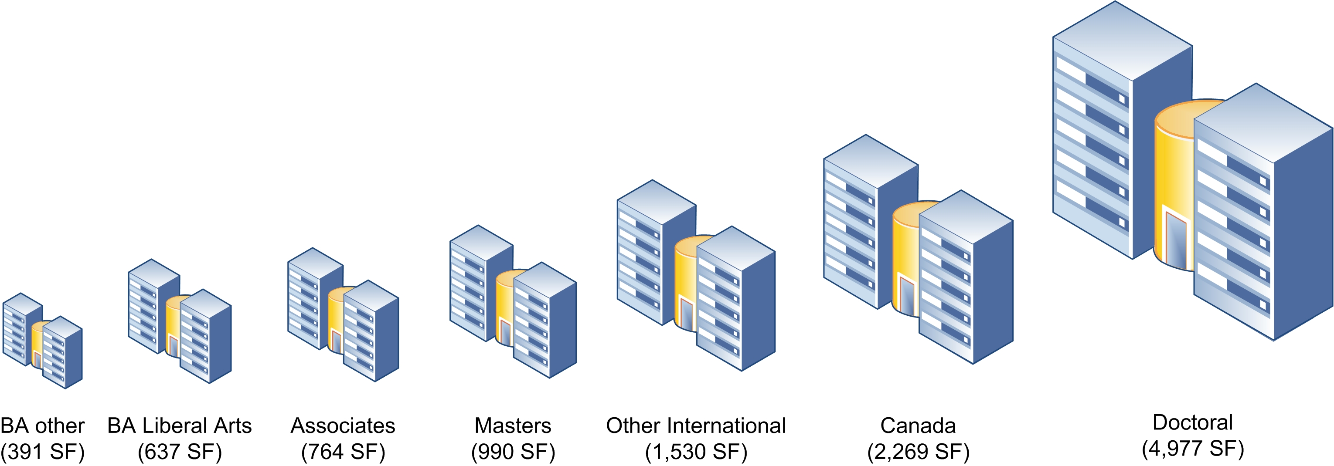
DATA CENTERS COME IN ALL SIZES
Average size of central IT data centers varies more than tenfold
Notes:
Module 5, question 3
3. What are the technical characteristics of up to four of the largest data center(s) operated by central IT? If a data center has not undergone an expansion or an upgrade, enter the year of installation in that field.
Data center 1 - Percent occupied
Data center 1 - Percent of servers virtualized
Data center 1 - Approximate square footage of raised floor
Data center 1 - Year data center installed
Data center 1 - Year of most recent expansion or major upgrade
Data center 2 - Percent occupied
Data center 2 - Percent of servers virtualized
Data center 2 - Approximate square footage of raised floor
Data center 2 - Year data center installed
Data center 2 - Year of most recent expansion or major upgrade
Data center 3 - Percent occupied
Data center 3 - Percent of servers virtualized
Data center 3 - Approximate square footage of raised floor
Data center 3 - Year data center installed
Data center 3 - Year of most recent expansion or major upgrade
Data center 4 - Percent occupied
Data center 4 - Percent of servers virtualized
Data center 4 - Approximate square footage of raised floor
Data center 4 - Year data center installed
Data center 4 - Year of most recent expansion or major upgrade

Slide 69
DATA CENTER UTILIZAtiON:
UnDER CONTROL
Data centers have capacity:
Is it due to virtualization?
Half the servers in US higher education data centers are virtualized, ranging from 37% of doctoral to 57% for BA liberal arts and 53% of other BA colleges. (34% of Canadian.)
Notes:
Module 5, question 3
3. What are the technical characteristics of up to four of the largest data center(s) operated by central IT? If a data center has not undergone an expansion or an upgrade, enter the year of installation in that field.
Data center 1 - Percent occupied
Data center 1 - Percent of servers virtualized
Data center 1 - Approximate square footage of raised floor
Data center 1 - Year data center installed
Data center 1 - Year of most recent expansion or major upgrade
Data center 2 - Percent occupied
Data center 2 - Percent of servers virtualized
Data center 2 - Approximate square footage of raised floor
Data center 2 - Year data center installed
Data center 2 - Year of most recent expansion or major upgrade
Data center 3 - Percent occupied
Data center 3 - Percent of servers virtualized
Data center 3 - Approximate square footage of raised floor
Data center 3 - Year data center installed
Data center 3 - Year of most recent expansion or major upgrade
Data center 4 - Percent occupied
Data center 4 - Percent of servers virtualized
Data center 4 - Approximate square footage of raised floor
Data center 4 - Year data center installed
Data center 4 - Year of most recent expansion or major upgrade

Slide 70
When disAster strikes
24% of data centers managed by central IT do not have a secondary power source
77% lack a tertiary power source
23% of institutions have no disaster recovery provisions in place for their data centers
81% with a disaster recovery site have not tested it in the past year
Notes:
Module 5, questions 5 and 7
5. What are the primary, secondary, and tertiary power sources for each data center operated by central IT?
Data Center response options:
Data center 1 - primary
Data center 1 - secondary
Data center 1 - tertiary
Data center 2 - primary
Data center 2 - secondary
Data center 2 - tertiary
Data center 3 - primary
Data center 3 - secondary
Data center 3 - tertiary
Data center 4 - primary
Data center 4 - secondary
Data center 4 – tertiary
Power source response options:
Public grid
Alternate public grid
Campus generation
Dedicated on-site generator
Other (please describe below)
Not applicable
7. What provisions are in place for data center disaster recovery? (Check all that apply.)
Contract with commercial provider
Contract or reciprocal arrangement with government agency
Multiple data centers on campus provide redundancy
Contract or reciprocal arrangement with another educational institution
Facility at central office of our multicampus system or district
Testing of disaster recovery site has been performed within the past year
Other (please specify)
Not applicable - no provisions are in place

Slide 71
Data Center Disaster Recovery Provisions
(of those with provisions)
Most disaster recovery sites are on campus
Notes:
Module 5, question 7
7. What provisions are in place for data center disaster recovery? (Check all that apply.)
Contract with commercial provider
Contract or reciprocal arrangement with government agency
Multiple data centers on campus provide redundancy
Contract or reciprocal arrangement with another educational institution
Facility at central office of our multicampus system or district
Testing of disaster recovery site has been performed within the past year
Other (please specify)
Not applicable - no provisions are in place

Slide 72
IT’S CONTRIBUTIONS TO SUSTAINABILITY

Slide 73
IT-Related Sustainability Initiatives
The break in the bar represents the US higher education median
Notes:
White bar indicates median for US higher education institutions. The bar extends from the lowest institutional type (e.g., Associates) median to the highest.
Module 1, question 17
17. This question asks about IT-related environmental or green IT initiatives at your institution.
Initiative status options:
Deployed
In planning
Considering
Considered, not pursued
No discussion to date
Initiative options:
Institutional policy or plan for sustainability
Institutional policy on carbon neutrality
Institution is a signatory to the ACUPCC (American College and University Presidents’ Climate Commitment)
Campus-wide program to minimize energy consumption of desktop technology
Central IT program to minimize its energy consumption
Submetering of power for data centers operated by central IT
Submetering of power in data centers operated by other units
GHG (greenhouse gas) baseline survey
Contribution of central IT to GHG separately reported
Central IT facilities or equipment located or relocated to reduce energy costs
Central IT facilities or equipment located or relocated to reduce institution's carbon footprint
Other (select status here, and describe other initiative below)

Slide 74
IT-Related Sustainability Initiatives
Institutional type averages
DR
MA
BA LA
BA other
AA
The break in the bar represents the US higher education median
Notes:
Dots represent institutional type medians.
Module 1, question 17
17. This question asks about IT-related environmental or green IT initiatives at your institution.
Initiative status options:
Deployed
In planning
Considering
Considered, not pursued
No discussion to date
Initiative options:
Institutional policy or plan for sustainability
Institutional policy on carbon neutrality
Institution is a signatory to the ACUPCC (American College and University Presidents’ Climate Commitment)
Campus-wide program to minimize energy consumption of desktop technology
Central IT program to minimize its energy consumption
Submetering of power for data centers operated by central IT
Submetering of power in data centers operated by other units
GHG (greenhouse gas) baseline survey
Contribution of central IT to GHG separately reported
Central IT facilities or equipment located or relocated to reduce energy costs
Central IT facilities or equipment located or relocated to reduce institution's carbon footprint
Other (select status here, and describe other initiative below)

Slide 75
Connecting the dots
DEPLOYMENT MATURITY FOR
IT-RELATED SUSTAINABILITY INITIATIVES
FREQUENT
Central IT program to minimize its energy consumption
Campus-wide program to minimize energy consumption of desktop technology
Institutional policy or plan for sustainability
Frequent
MODERATELY COMMON
Institution is a signatory to the ACUPCC (American College and University Presidents’ Climate Commitment
Central IT facilities or equipment located or relocated to reduce energy costs
Institutional policy on carbon neutrality
Moderately Common
Deployed by Some
Rarely Considered
DEPLOYED BY SOME
Central IT facilities or equipment located or relocated to reduce institution's carbon footprint
GHG (greenhouse gas) baseline survey
Submetering of power for data centers operated by central IT
RARELY CONSIDERED
Submetering of power in data centers operated by other units
Contribution of central IT to GHG separately reported
Notes:
“Connecting the Dots” is an effort by ECAR staff to interpret and organize the data to suggest trends for higher education. Staff evaluated the average deployment stage as provided by institutions and organized technologies into four broad groupings: frequent, moderately common, deployed by some, and rarely considered.
Module 1, question 17
17. This question asks about IT-related environmental or green IT initiatives at your institution.
Initiative status options:
Deployed
In planning
Considering
Considered, not pursued
No discussion to date
Initiative options:
Institutional policy or plan for sustainability
Institutional policy on carbon neutrality
Institution is a signatory to the ACUPCC (American College and University Presidents’ Climate Commitment)
Campus-wide program to minimize energy consumption of desktop technology
Central IT program to minimize its energy consumption
Submetering of power for data centers operated by central IT
Submetering of power in data centers operated by other units
GHG (greenhouse gas) baseline survey
Contribution of central IT to GHG separately reported
Central IT facilities or equipment located or relocated to reduce energy costs
Central IT facilities or equipment located or relocated to reduce institution's carbon footprint
Other (select status here, and describe other initiative below)

Slide 76
A WORD ABOUT THE CORE DATA SERVICE
Big redesign this year
Some hits, some misses
We’re reviewing your evaluations to adapt the service for this year
We have plans to do more: Come learn more about our plans for data, benchmarking, and analytics tomorrow at 12:30 in room 201A

Slide 77
THANK YOU
sgrajek@educause.edu

