Slide 1




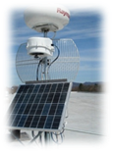
GENI
Exploring Networks of the Future
EDUCAUSE
GENI Layer 2 / Software-Defined Networking
Campus Deployment Workshop
Chip Elliott
GENI Project Director
July 7, 2011
www.geni.net

Slide 2
Outline
GENI – Exploring future internets at scale
Introducing GENI: an example
GENI’s growing suite of infrastructure
Experiments going live across the US!
Taking the next steps
Notes:
2

Slide 3
What is GENI?
GENI is a virtual laboratory for exploring future internets at scale, now rapidly taking shape in prototype form across the United States
GENI opens up huge new opportunities
  Leading-edge research in next-generation internets
  Rapid innovation in novel, large-scale applications
Key GENI concept: slices & deep programmability
  Internet: open innovation in application programs
  GENI: open innovation deep into the network

Slide 4
Revolutionary GENI Idea
Slices and Deep Programmability
Install the software I want throughout my network slice
(into firewalls, routers, clouds, …)
And keep my slice isolated from your slice,
so we don’t interfere with each other
We can run many different “future internets” in parallel

Slide 5
Outline
GENI – Exploring future internets at scale
Introducing GENI: an example
GENI’s growing suite of infrastructure
Experiments going live across the US!
Taking the next steps
Notes:
5

Slide 6
A bright idea
I have a great idea! The original Internet architecture was designed to connect one computer to another – but a better architecture would be fundamentally based on PEOPLE and CONTENT!
That will never work! It won’t scale! What about security? It’s impossible to implement or operate! Show me!
Notes:
6

Slide 7
Trying it out
My new architecture worked great in the lab, so now I’m going to try a larger experiment for a few months.
And so he poured his experimental software into clouds, distributed clusters, bulk data transfer devices (‘routers’), and wireless access devices throughout the GENI suite, and started taking measurements...
He uses a modest slice of GENI, sharing its infrastructure with many other concurrent experiments.
Notes:
7

Slide 8
It turns into a really good idea
Boy did I learn a lot! I’ve published papers, the architecture has evolved in major ways, and I’m even attracting real users!
Location-based social networks are really cool!
His experiment grew larger and continued to evolve as more and more real users opted in...
His slice of GENI keeps growing, but GENI is still running many other concurrent experiments.
Notes:
8

Slide 9


The (opt-in) user’s view
Interesting new services –
I just use them through an app!
Good old Internet
Slice 0
Slice 1
Slice 1
Slice 2
Slice 3
Slice 4

Slide 10
Outline
GENI – Exploring future internets at scale
Introducing GENI: an example
GENI’s growing suite of infrastructure
Experiments going live across the US!
Taking the next steps
Notes:
10

Slide 11
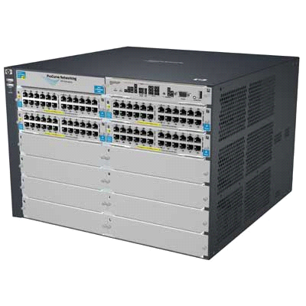
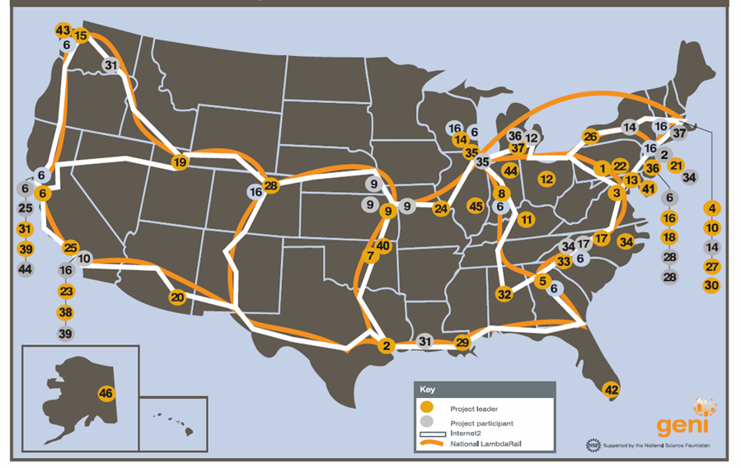
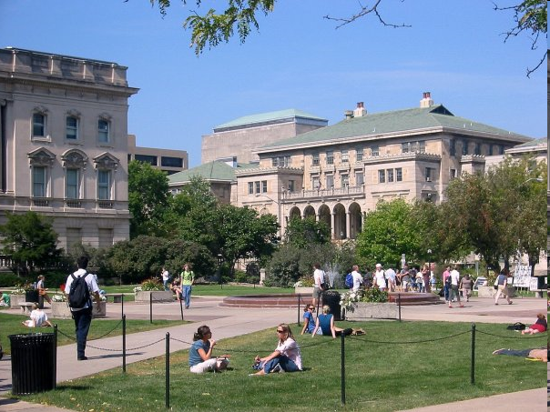
Enabling “at scale” experiments
How can we afford / build GENI at sufficient scale?
  Clearly infeasible to build research testbed “as big as the Internet”
  Therefore we are “GENI-enabling” testbeds, commercial equipment, campuses, regional and backbone networks
  Students are early adopters / participants in at-scale experiments
  Key strategy for building an at-scale suite of infrastructure
HP ProCurve 5400 Switch
NEC WiMAX Base Station
GENI-enabled
equipment
GENI-enabled campuses,
students as early adopters
“At scale” GENI prototype
Campus photo by Vonbloompasha

Slide 12
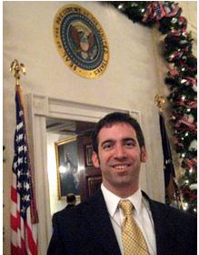
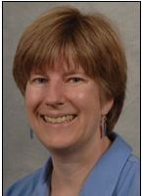
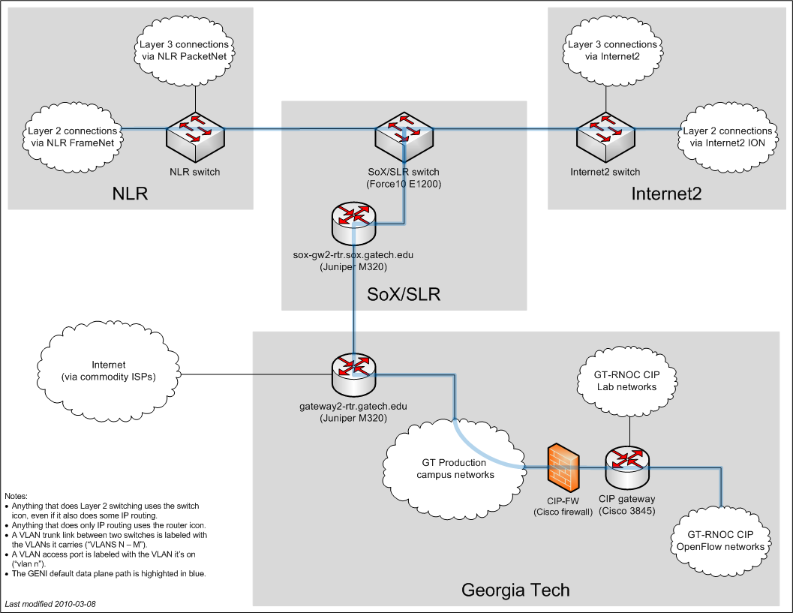
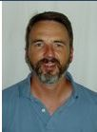

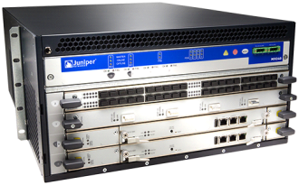

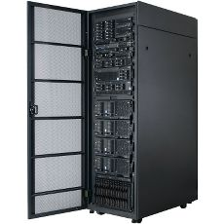


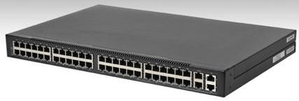

Georgia Tech: a great example
One of the first 14 GENI-enabled campuses
OpenFlow in 2 GT-RNOC lab bldgs now
OpenFlow/BGPMux coursework now
Dormitory trial
Students will “live in the future” – Internet in one slice, multiple future internets in additional slices
Nick Feamster
PI
Ellen Zegura
Russ Clark, GT-RNOC
Ron Hutchins, OIT
Trials of “GENI-enabled” commercial equipment
Toroki LightSwitch 4810
HP ProCurve 5400 Switch
Juniper MX240 Ethernet
Services Router
NEC WiMAX Base Station
HTC Android smart phone
NEC IP8800 Ethernet Switch
Arista 7124S Switch
GENI racks

Slide 13
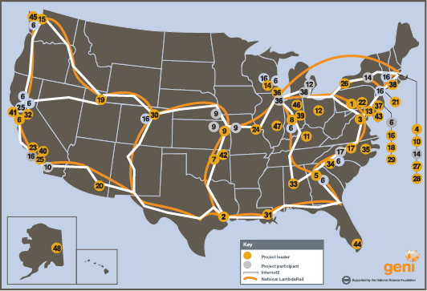
Spiral 2 infrastructure examples
Building the GENI Meso-scale Prototype
OpenFlow
WiMAX
Stanford
U Washington
Wisconsin
Indiana
Rutgers
Princeton
Clemson
Georgia Tech
Stanford
UCLA
UC Boulder
Wisconsin
Rutgers
Polytech
UMass
Columbia
OpenFlow
Backbones
ShadowNet
Seattle
Salt Lake City
Sunnyvale
Denver
Kansas City
Houston
Chicago
DC
Atlanta
Salt Lake City
Kansas City
DC
Atlanta
Toroki LightSwitch 4810
HP ProCurve 5400 Switch
Juniper MX240 Ethernet
Services Router
NEC WiMAX Base Station
HTC Android smart phone
NEC IP8800 Ethernet Switch
Arista 7124S Switch
GENI racks
Notes:
13
13

Slide 14
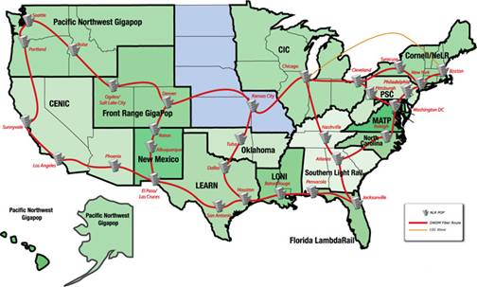
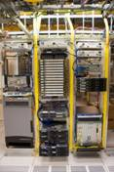
GENI equipment installed and operating
National LambdaRail and Internet2
Internet2
National LambdaRail
Up to 30 Gbps bandwidth
GENI has installed OpenFlow & PC racks within two national footprints
that support end-to-end GENI slices (IP or non-IP)
Photo by Chris Tracy
Notes:
14

Slide 15
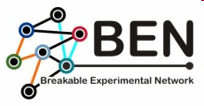

































































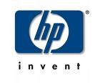








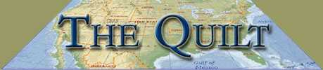
Many, many groups are already engaged in building GENI

Slide 16
Outline
GENI – Exploring future internets at scale
Introducing GENI: an example
GENI’s growing suite of infrastructure
Experiments going live across the US!
Taking the next steps
Notes:
16

Slide 17
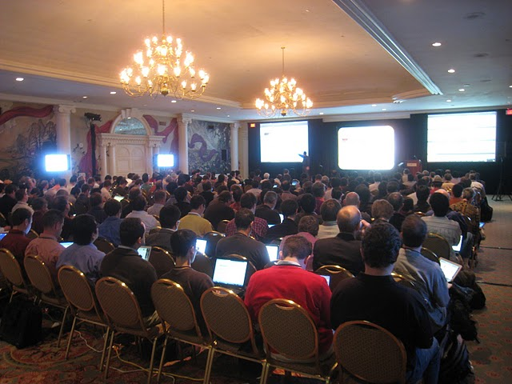
Recent GENI news
Major research demos, Nov 2010
GENI supported 9 different future internet experiments,
simultaneously, each in its own slice

Slide 18
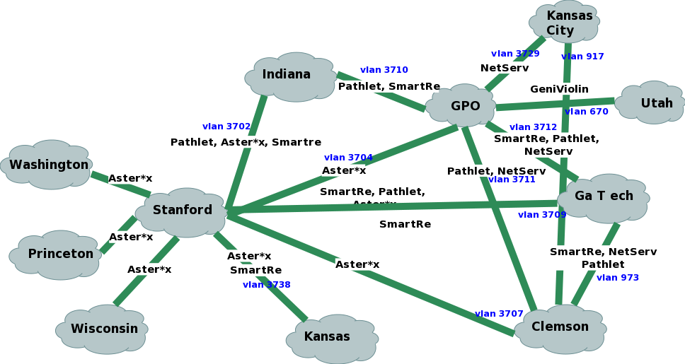
GENI meso-scale infrastructure for GEC 9 demos
Nationwide GENI slices, a different experiment in each slice
Spanning 15 campuses, 2 national backbones, 11 regional networks
All using “GENI-enabled” commercial equipment

Slide 19



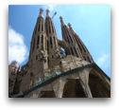
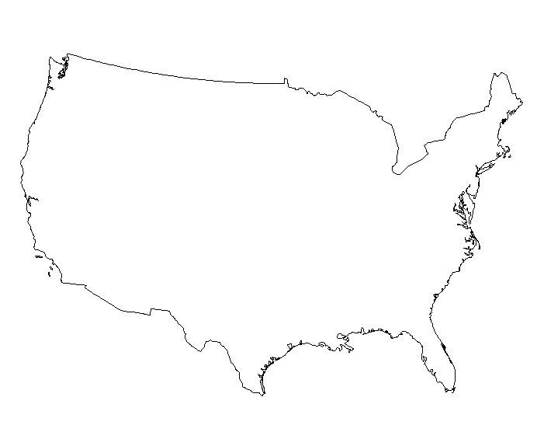



Pathlet Architecture
GEC 9 experiment demonstration
Resilient Routing in the
Pathlet Architecture
Ashish Vulimiri and Brighten Godfrey
University of Illinois at Urbana-Champaign
Deploy innovative routing architecture deep into network switches across the US
path 1
failed link
Lets users monitor and select their own network paths to optimize their services
Protects critical traffic even without waiting for adaptation time
19
path 2
Sponsored by the National Science Foundation
November 3, 2010

Slide 20
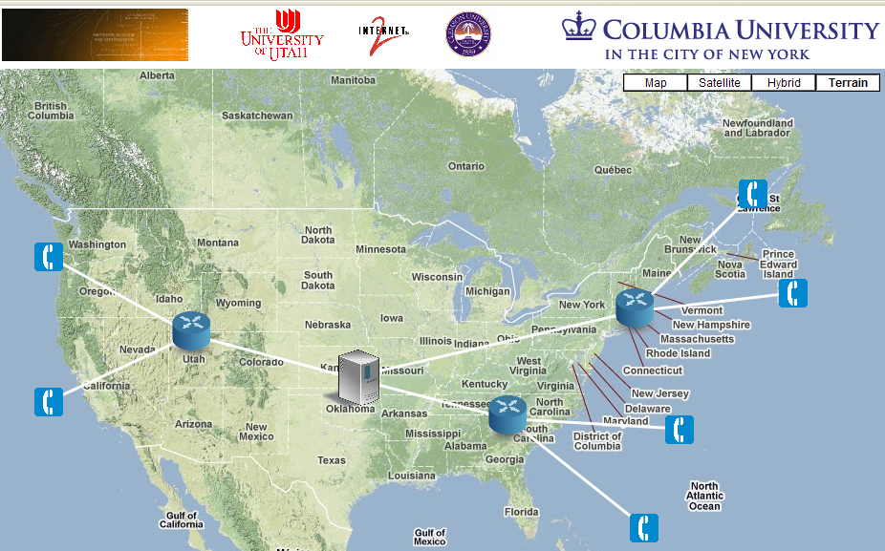






ActiveCDN
GEC 9 experiment demonstration
Program content distribution services deep into the network, adapt distribution in real time as demand shifts
ActiveCDN
ActiveCDN
GPO
Utah
Kansas
Clemson
Benefits of ActiveCDN:
Dynamic deployment based on load
Localized services such as weather, ads and news
Jae Woo Lee, Jan Janak, Roberto Francescangeli, SumanSrinivasan, Eric Liu, Michael Kester, SalmanBaset, Wonsang Song, and Henning Schulzrinne
Internet Real-Time Lab, Columbia University

Slide 21


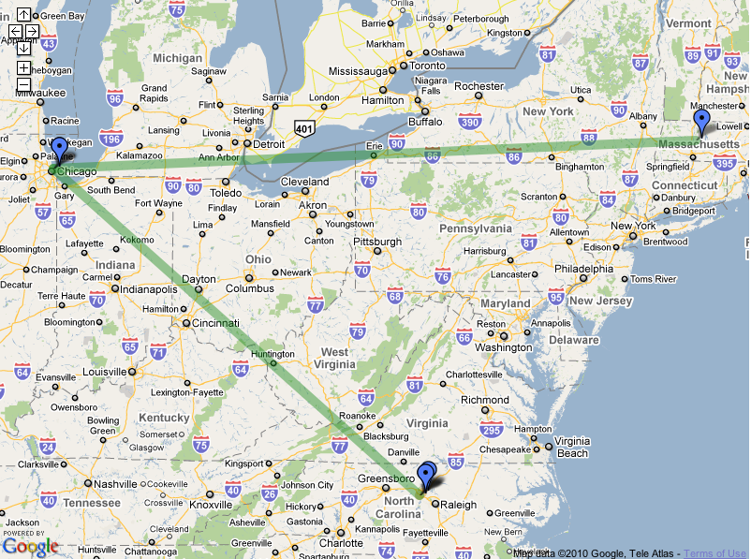

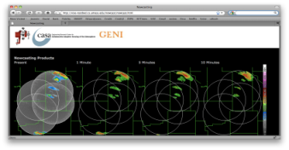
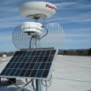

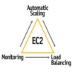


Weather NowCasting
GEC 9 experiment demonstration
ViSE views steerable radars as shared, virtualized resources
http://geni.cs.umass.edu/vise
David Irwin et al
Generate “raw” live data
ViSE/CASA radar nodes
http://stb.ece.uprm.edu/current.jsp
Create and run realtime
“weather service on demand”
as storms turn life-threatening
“raw” live data
Nowcast images
for display
Spin up system in Amazon commercial EC2 and S3 services on demand
Multi-radar NetCDF Data
Nowcast Processing

Slide 22
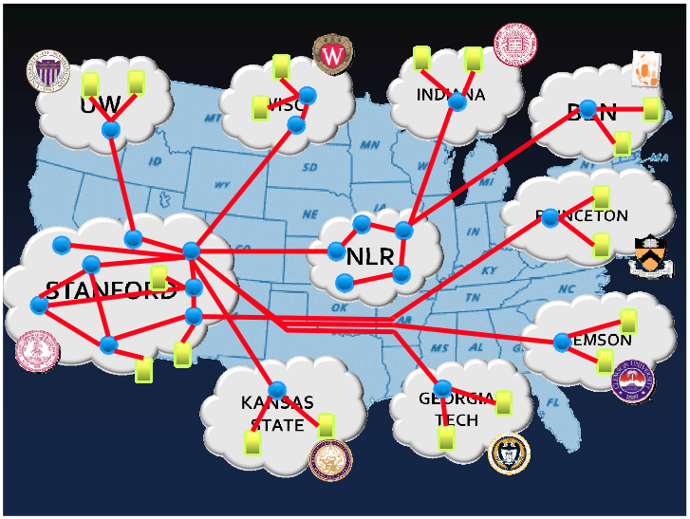
GEC 9 experiment demonstration
Aster*x Load Balancing (via OpenFlow)
Nikhil Handigol et al, Stanford Univ.
Program realtime load-balancing functionality deep into the network itself

Slide 23
Outline
GENI – Exploring future internets at scale
Introducing GENI: an example
GENI’s growing suite of infrastructure
Experiments going live across the US!
Taking the next steps
Notes:
23
23

Slide 24
An overview of the campus plan
Growing to “at scale” GENI
GENI Solicitation 3
  More WiMAX base stations
  with Android handsets
  GENI-enable 5-6 regional networks
  Inject more OpenFlow switches
  into Internet2 and NLR
  Add GENI Racks to 50-80 locations
  within campuses, regionals, and
  backbone networks
Grow to 50, then 100-200 campuses
  2nd CIO workshop, July 2011
  “Buddy system” for each meso-scale campus to guide 2-3 new campuses
  Increase GENI-enabled campuses from 14 to 40-50 in a staged manner, over several years
  Repeat once, to grow to 100-200 campuses
Transition to community governance
GENI Racks serve as programmable routers, distributed clouds, content distribution nodes, caching or transcoding nodes, etc

Slide 25
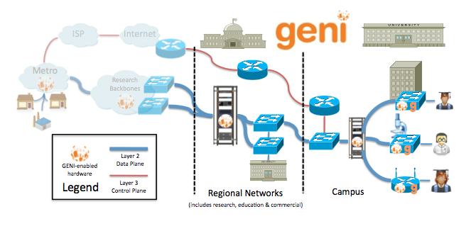
Envisioned architecture
Flexible network / cloud research infrastructure
Also suitable for physics, genomics, other domain science
Support “hybrid circuit” model plus much more (OpenFlow)
Distributed cloud (racks) for content caching, acceleration, etc.

Slide 26
Growing GENI: near-term plans
Solicitation 3 expands “meso-scale” build
  Inject more OpenFlow into backbones
  Field OpenFlow in 5-6 regionals
  Field 50-80 GENI racks in campuses, regionals
  Boost WiMAX deployments
U.S. Ignite adds 6 cities initially
  GENI rack / OpenFlow in cities
  Layer 2 transport enables both IP and non-IP

Slide 27
GENI-enabled cities
First concrete step in U.S. Ignite activity
Very strong interest from 6 US cities to date
  Chattanooga, Cleveland, Lafayette LA, Philadelphia,
  Salt Lake City region, Washington DC
  Their citizens will be able to “live in the future”
Cities can be GENI-enabled very rapidly
  We have visited all 6 cities for surveys, discussions
  GENI rack, OpenFlow, and Layer 2 connectivity appear quite feasible
  Can be federated into GENI very quickly
Can support experimental, gigabit applications in GENI slices through cities
  Creates tremendous new research opportunities

Slide 28
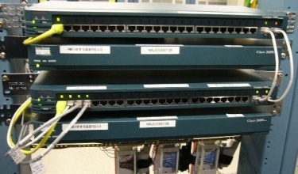
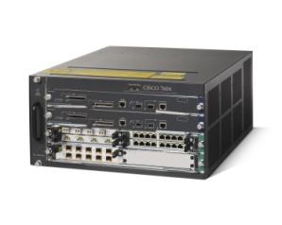

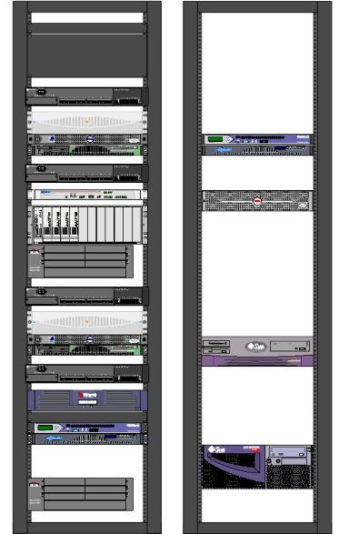
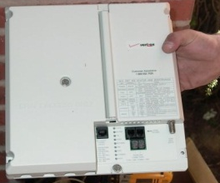

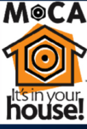
Draft of U.S. Ignite City Technical Architecture
Existing head-end
Early DRAFT CONCEPT –
for discussion only!
Existing ISP connects
Most equipment not shown
Layer 3 GENI control plane
Layer 2 connect to subscribers
OpenFlow switch(es)
Flowvisor
Remote management
Instrumentation
Aggregate manager
Measurement
Programmable PCs
Storage
Video switch (opt)
Home
Layer 2 Ignite Connect
(1 GE or 10GE)
New GENI / Ignite rack pair

Slide 29
The Next Step
Growing GENI to 30-50 campuses
“Buddy system” for high-performing meso-scale campuses to guide 3-5 new campuses each
  Increase number of GENI-enabled campuses in a staged manner, over several years
  Technologies: OpenFlow, GENI Racks, and some WiMAX
This is an enormous national opportunity
Campus IT organizations will provide key leadership
The time is right to take the next step

