Slide 1
eTexts: A Perishable Opportunity for Higher Education?
Brad Wheeler
Vice President for IT & Professor
Indiana University

Slide 2
Term: eTexts
Shorthand for
Digital versions of textbooks
Simulations, labs, multi-media
Online Tutors and exercises
…any digital learning experience
Focus today is on for-fee eTexts

Slide 3
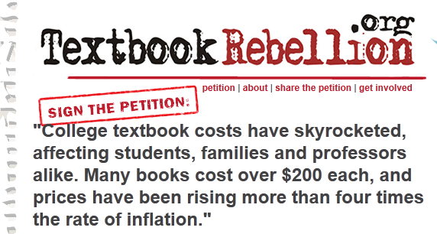
Textbook Challenges
Students: $900 - $1,200 a year on textbooks
August 2011 Chronicle and Inside Higher Ed
New Site Brazenly Trades Pirated E-Textbooks
7 in 10 Students Have Skipped Buying a Textbook Because of Its Cost
The Secondary Cost of Digital
The Model
is Broken
“Currently, renting books or buying them used is almost always cheaper than buying access to an e-textbook, according to CampusBooks.com… found that 91.6 percent of the time, renting a book or buying a used copy was less expensive. The remaining 8.4 percent of the time, the e-textbook was less expensive.”

Slide 4
eTexts…why so much?
Rental $85.35
Used (if avail) $136.80
New $171.00
Etextbook $119.10
Amazon
75% of List
70% of List
Rental $101.10
Used (if avail) $162.10
New $202.65
Etextbook $154.85
77% of List
Common Restrictions
Limited access
Limited devices
Limited printing
Rental $96.10
Used (if avail) $154.05
New $192.55
Etextbook $134.10
70% of List

Slide 5
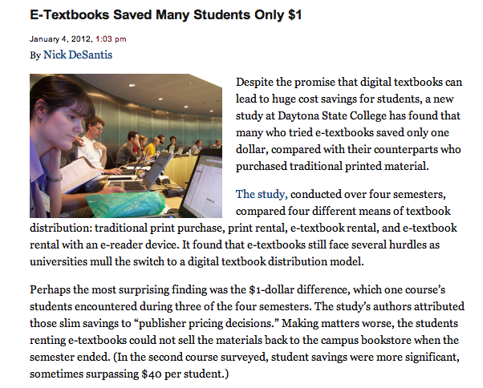
Only $1 Saving?...Really?...No.

Slide 6
Paper Textbook Dysfunction
Root Causes
High Price
Students Choose Substitutes
Authors/Publishers Sell Less
Raise Prices
“New Editions”
Author and publisher only paid for NEW
Used
Old Editions
No Book
Piracy

Slide 7
eTexts?
High Price
Students Choose Substitutes
Authors/Publishers Sell Less
Price at Will
No Used
⬆Piracy?

Slide 8
IU eText Approach

Slide 9
IU eText Initiative (2009)
Drive down the cost of materials for students
Provide high quality materials of choice
Enable new tools for teaching and learning
Shape the terms of sustainable models that work for students, faculty, authors…etc.

Slide 10
A Model to Fix the ROOT Causes
Value creators (authors, publishers) get paid for each use of their work; thus, they
Dramatically drop the price for every user
Students pay less and incentivizes create work
Get ahead of the software platform wars
Institution is the key: “Move the Toll Booth”

Slide 11
IU Timeline
IU issues formal Request for Proposal to publishers and platform providers
IU Trustees endorse Empowering People, IU’s Strategic Plan for IT
Jan 2012
Go Live
iPad
Discussions
------------------------- Pilot Trials --------------------------
Dec 2008
Feb 2011
IU begins eTexts pilots
IU signs eTexts deals with 5 publishers and a platform provider
Aug 2009
Sep 2011

Slide 12
Institutional Actions
Contract for Purchasing Digital Content
Each student in section pays a reduced eText fee for required course materials
Faculty choice, Digital and Print, Remove unnecessary use restrictions
Contract for an eReader/Annotation Platform
Support browsers, tablets, mobile phones, etc.
Integrates with Learning Management Software

Slide 13
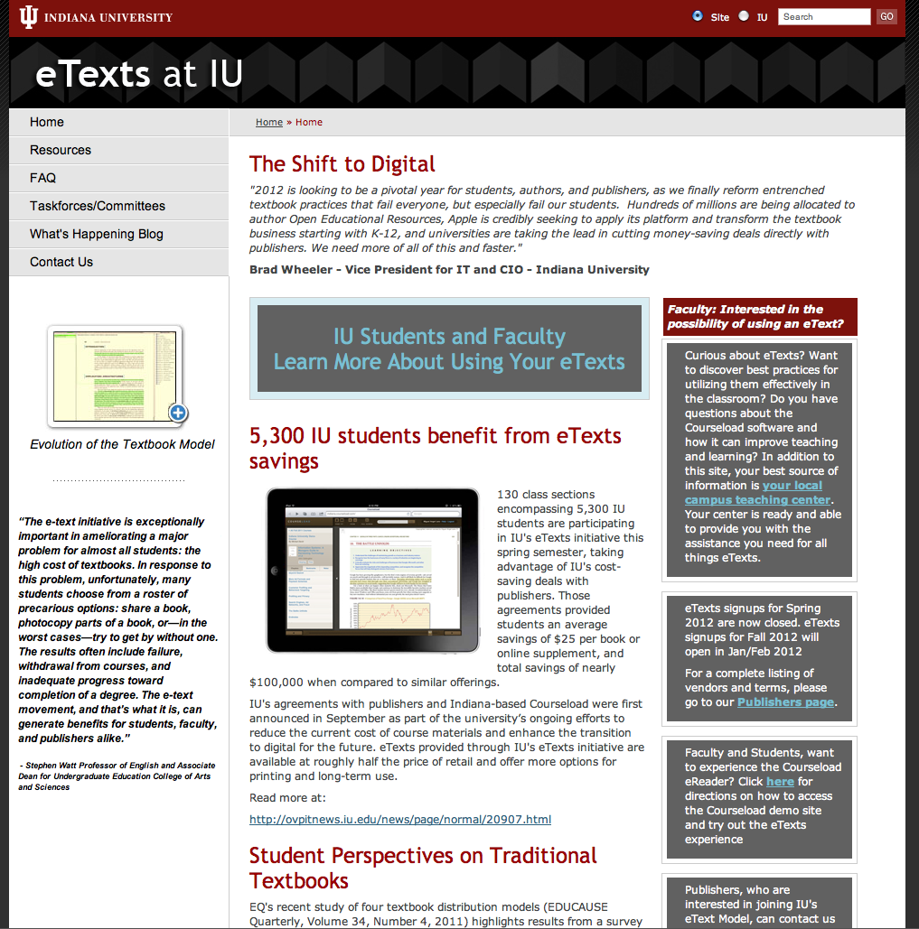
http://etexts.iu.edu

Slide 14
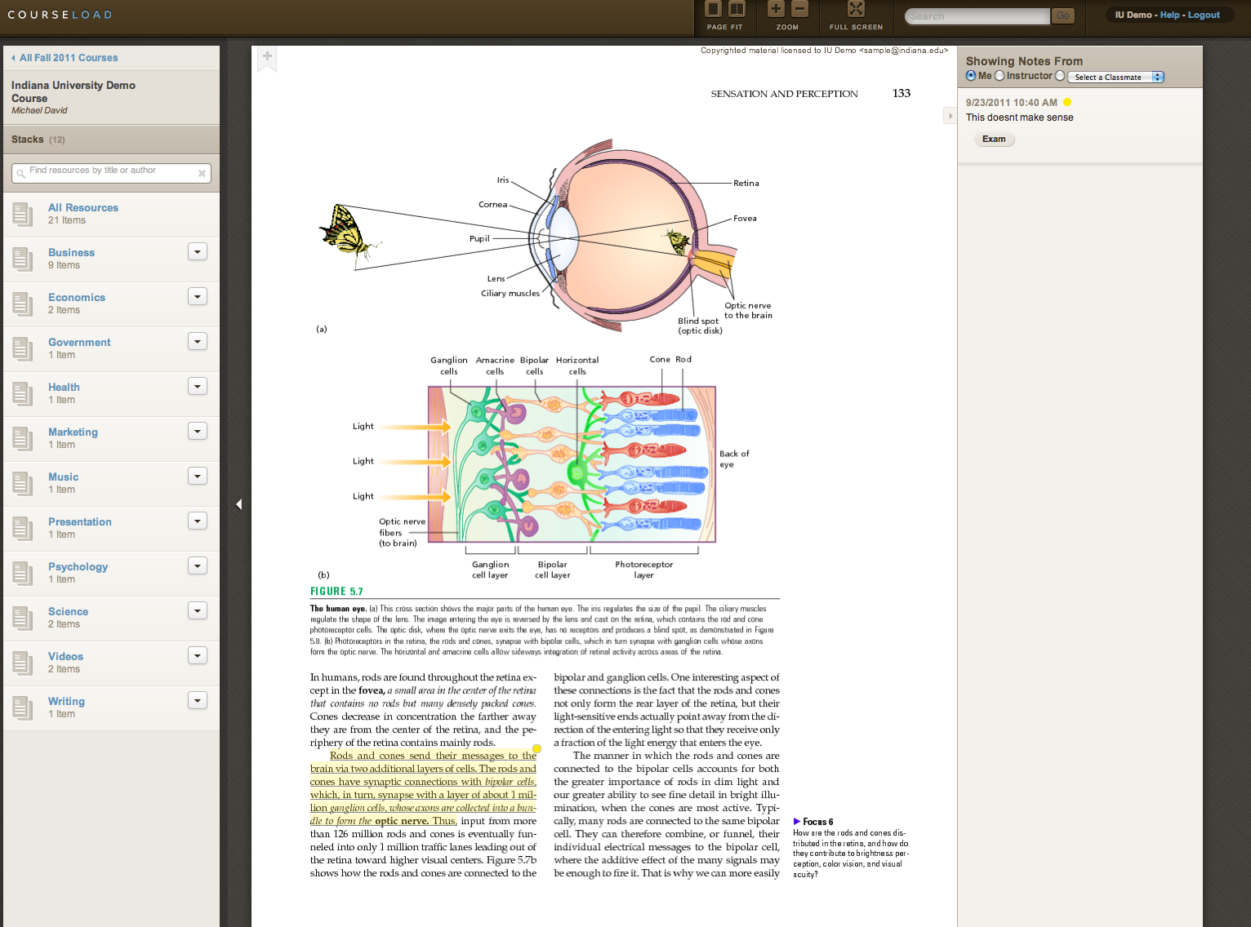
READING/ANNOTATION SOFTWARE
iPads, Browsers, Smartphones, etc.

Slide 15
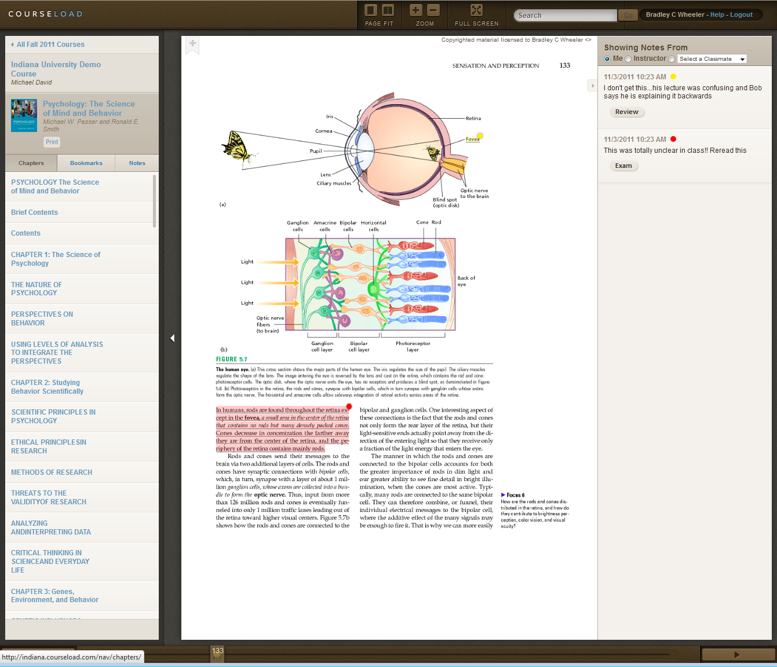
Navigation to Book Chapters
Full-text search
Textual notes or links from a student, study group, or professor
Popup thumbnail visual navigation through pages
Typical publisher textbook with 1:1 match to print
Highlighting

Slide 16
Spring 2012 Semester @ IU
Enabled a faculty option
130 course sections – 5,300 students
Sections spanned technology, math, the sciences, politics, media, psychology, etc.
IU deals beat best retail eText pricing 96%
Students saved on average $25 per book
Around $100,000 in collective savings

Slide 17
2012 and Beyond

Slide 18
3 Great Developments in 2012
Open
$1B+
New
Platforms
New Terms

Slide 19
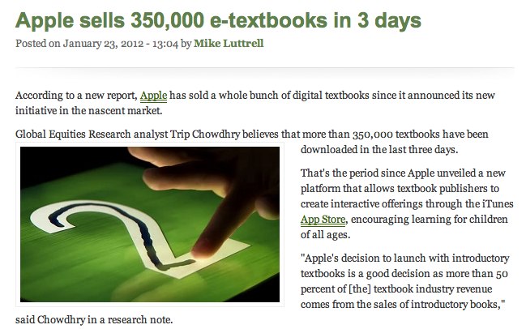

Slide 20
eText Trial Pack Timeline
Pilot Idea shared with institutions, I2, Publishers and Courseload
Agreements between I2, MH, and CL - signed
Institutional MOU’s finalized, eText sections determined
Go Live!
Public Announcement
Nov. 2 2011
Nov. 7-18
Dec. 20 2011
Jan. 4 2012
Jan. 18 2012
From Concept to Reality in ~60 days

Slide 21
Internet2 Net+ eText Pilot Pack
Provided institutions with a simple way to quickly pilot eTexts as part of an approach to understand and influence the eText transition.
McGraw-Hill & Coursload contracted via Internet2; Internet2 contracted with campuses.
Buy the future faster by enabling a small set of Internet2 institutions to engage in a collective, comprehensive pilot and learn from each other.

Slide 22
Keys to Rolling Out an eText Fee Model
Socialize, socialize, socialize ..students, faculty, administration, trustees
Make eTexts an option for faculty prerogative
Digital and Print
Prices must be generally equal/better than net cost of buying and selling a used textbook
Great software platform for reading/annotation, online/offline, LMS integration

Slide 23
Insights and Actions

Slide 24
What To Do Now
Refrain from signing “weak” pricing deals
Begin socializing eTexts with faculty & students
Join Educause eText constituent group listserv:
http://www.educause.edu/blog/aciavonne/JointheConversationontheFuture/245274
Pursue sound economic models that are sustainable for involved parties

Slide 25
Questions & Discussion
http://etexts.iu.edu
IU Lead Contact:
Nik Osborne – nosborne@iu.edu

Slide 26
eTexts: A Perishable Opportunity for Higher Education?
Brad Wheeler
Vice President for IT & Professor
Indiana University

Slide 27
eText Savings – 2011 MBA Core
Previous Semesters - $655 Total
$495 for articles and cases
$125 for one custom textbook
$35 for critical thinking packet
Under IU eText Fee Model - $295 Total ($360 savings)
Articles and Cases
Two custom textbooks
Critical thinking packet
Online Simulation
If students want POD of everything - $180 ($475 Total)

Slide 28
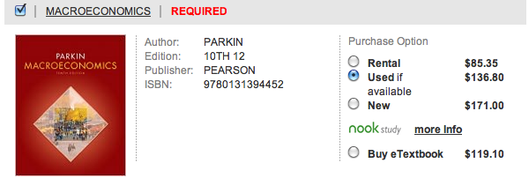
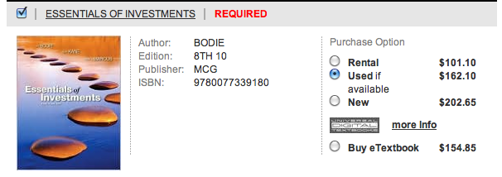
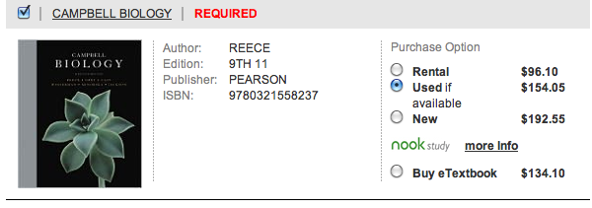
Under the eText Fee Model
Amazon
These Four Textbooks
If bought new – $737
After Sellback - $295
If bought used – $578
After Sellback - $231
If rented (3) – $282
If non IU eText (3) - $408
IU eText Model - $258

