Slide 1

Security Awareness and Communication in the C-Suite
EDUCAUSE Live! Broadcast
4 October 2012
Dave Cullinane
CEO
Security Starfish LLC

Slide 2
Agenda
Being a C-level Executive
Establishing Relationships
Communicating Risk

Slide 3
C-Level Execs
Execs read. They hear about APT’s, major company security breaches, friends/colleagues.
  How many meet with Execs on a Regular basis?
  Brief Execs regularly on what is going on…?
You are a C level employee. Learn to act like/be one.
  Strategic Focus
  In depth knowledge of business goals and objectives
  How does Security Strategy support the achievement of business goals?
  Getting stopped in the hallway…

Slide 4
Need for Intelligence-based Security
Execs (including CIOs) say they are tired of being told they have to do something “due to some regulation”…
Establishing relevance in a tight economy.
Identify the threats most likely to impact your company and spend your limited funds defending against those.
We are still novices at managing information risk.
How many of you have:
  Assessed the threat (actor & capability)?
  Determined how vulnerable you are to the threats?
  Determined how much of a target you are?
  Designed a security plan to implement mitigating controls?
  Measure the effectiveness of your plan/controls?

Slide 5
Information Risk Management
Risk measurement and management
  How much of a target are you?
    Credit Unions were not a target, until top 10 banks put controls in place
    Heartland is a card processor – but Hannaford is a supermarket. Zappos sells shoes.
  What is happening that is likely to impact you?
  What will be the business impact of an incident?
    Public expectations are much higher today
    Quantifying Reputational Risk
Caution – there is no “steady state”
Measurements & Metrics
  KRIs & KPIs
  Grids & Graphs
  Tools & Technologies

Slide 6
Questions?

Slide 7
Getting Started

Slide 8
Risk Grid Calculation
High
> $100M
Significant DR Event
Criminal Activity
Data Breach
Regulatory Action
Medium
$50-100M
Operations Security
SW / Site Security
Low
<$50M
Audit Failure
Low <33%
Medium 33-66%
High >66%
Probability
Notes:
MP Top 10 Risks
Malicious code on site (listings, ads, etc.) leading to fraud and BBE
Site loophole leading to customer data breach
Weak securtiy at Adjacency – leading to customer data breach
Targeted attacks on eBay Users (BayRob, etc.)
Data breach/fraud resulting from Insider collaboration (Call Centers and others)
Application layer denial of service attack – Extortion
Data breach/fraud resulting from intrusion at remote office
Using eBay site as mechanism to deliver malicious code (drive by browser/system contamination)
Site loophole used to perpetrate fraud (new issue bi-weekly)
Virus/worm attack on site/corp servers – causing availability issues/theft of data
MP 2009
4x100 = 400 1x100 = 100
1x75 = 75 3x75 = 225
2x50 = 100 3x50 = 150
Total = 575 Total = 475
$100M reduction in risk for $30M spend
PP
3x100 = 300
2x75 = 150
2x50 = 100
Total = 550

Slide 9
Information Security Risk
Risk
Security Risk Curve
Investment

Slide 10
Information Security Risk Tolerance
Risk
Security Risk Curve
Initial Risk Profile
$300M
$10M
25HC
Investment

Slide 11
Information Security Risk Tolerance
Risk
Security Risk Curve
initial Risk Profile
$300M
Adjusted Risk Profile with new funding levels
$140M
$10M
25HC
$20M
50HC
Investment

Slide 12
Information Security Risk Tolerance
Risk
Security Risk Curve
China
eCrime Threat Surface/Attacks
Russia (RBN)
Increasing
Risk
E. Europe
$300M
Brazil
$140M
$10M
25HC
$20M
50HC
Investment

Slide 13
Information Security Risk Tolerance
Risk
Security Risk Curve
China
eCrime Threat Surface/Attacks
Russia (RBN)
Increasing
Risk
E. Europe
$300M
Brazil
$140M
Added Savings from Process improvement
$10M
25HC
$20M
50HC
Investment

Slide 14
Information Security Risk Tolerance
Risk
Security Risk Curve
China
eCrime Threat Surface/Attacks
Russia (RBN)
Increasing
Risk
E. Europe
$300M
Brazil
$140M
$60M
Added Savings from Process improvement
2009 Target Risk Profile
$10M
25HC
$20M
50HC
Investment

Slide 15
Risk across multiple businesses
Financial Impact
Need to Focus Here
A
B
C
D
E
$100M
F
Legend:
Size – Importance to company
Color – Effectiveness of Security controls
Data at Risk
Notes:
4 square picture of where eBay Marketplaces; Corporate IT; and Adjacencies exist utilizing two biggest security & availability risk factors:
Financial Impact (associated with availability) and Data at Risk (associated with confidentiality and the potential to disclose or make whole to customers and/or employees)
The color represents control effectiveness as determined by: Assessments conducted by GIS; Internal Audit; PwC; external consultants related to security controls and our ability to mitigate against threat environment.

Slide 16
Questions?

Slide 17
Next Generation IRM

Slide 18
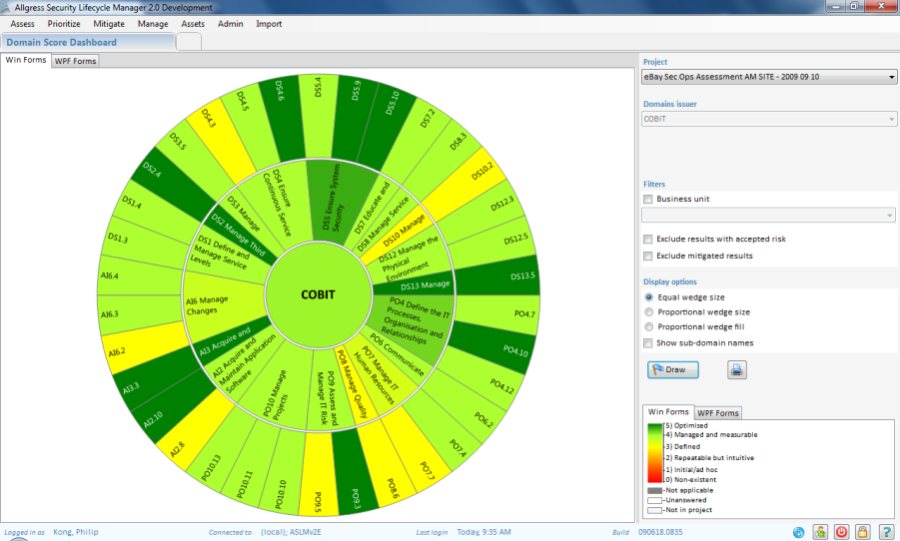
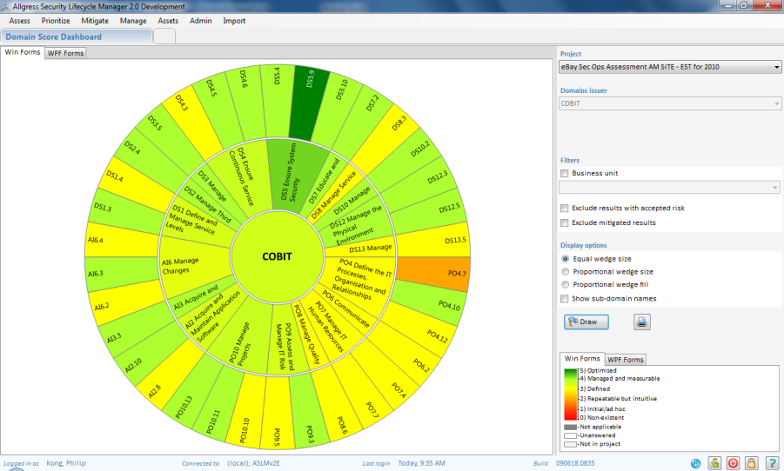

Left Top: Current Controls Environment as noted using Cobit Assessment criteria. Scores reflect support levels based on existing budgets.
Left Bottom: Controls Environment as noted using Cobit Assessment criteria after budget cuts. Scores reflect decreased support levels due to less resources.
Effective Controls
No Controls

Slide 19
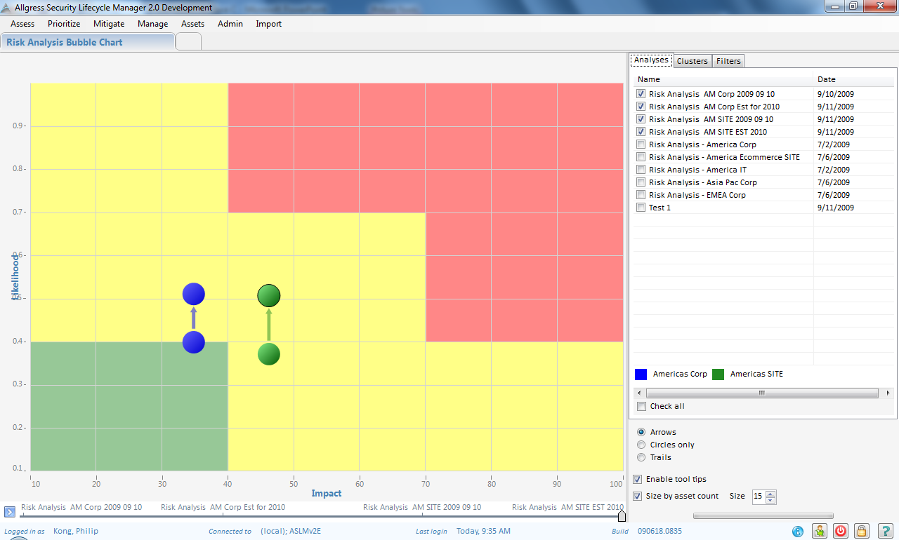
Circles sized according to importance to company
Ability to measure control effectiveness and see impact
Ability to determine best expenditure of limited funds to maximize ROSI
Risk:
High
Medium
Low

Slide 20
Summary
Threat and resultant risk increasing daily
Reactive practices will not work
  Einstein’s definition of insanity
Not all companies can afford same level of protection, but not all need the same level of protection
  What is your risk profile?
Must share information
  Doing it on small scale now – limited success
  Need to expand that capability
  Volunteers can’t do it.
Measuring and Managing Risk
  Must do ROSI

Slide 21
Questions?

