Slide 1
Information Technology Services in Community Colleges: Strengths, Opportunities, and Challenges
Eden Dahlstrom, Senior Research Analyst, EDUCAUSE
Pam Arroway, Senior Statistician, EDUCAUSE
Susan Grajek, Vice President for Data, Research & Analytics, EDUCAUSE
Joy Hatch, Vice Chancellor for Technology, Virginia Community College System

Slide 2
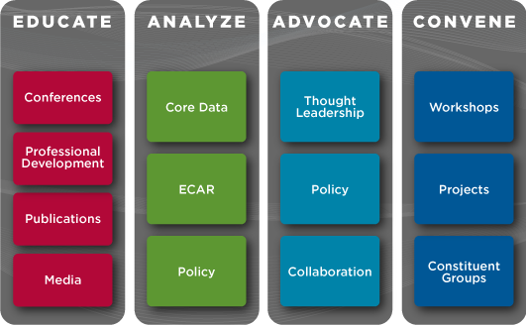
EDUCAUSE
Data from these sources were used to create the CC report card.

Slide 3
Secondary Data Analysis: Data Sources
Core Data Service (CDS) survey, 2011
133 community colleges responded to CDS
www.educause.edu/cds
ECAR National Study of Undergraduate Students and Information Technology, 2011
1,122 community college students from 398 different institutions
www.educause.edu/ecar

Slide 4
Questions to Ask
What do you know about the technologies your students own and how well IT services are meeting their needs?
What support do you currently provide to help faculty use technology in teaching?
How many students, faculty, and staff does each IT support FTE service? What is your IT cost per FTE?
Does your institution’s strategic plan include IT? Do faculty and students have a voice in IT planning?

Slide 5
Questions to Ask
Do you have a program to minimize IT energy consumption, and, if so, how comprehensive is this program?
How safe are your data centers?
Do you have a disaster recovery plan, and, if so, when was the last time it was rehearsed?
Do you participate in CDS and the student technology surveys to give your institution access to benchmarking data about IT?

Slide 6
IT Service Areas
Governance
Managing Risk
Sustainability
Resource Allocation
Teaching and Learning
Management

Slide 7
Governance
Governance
Managing Risk
Sustainability
Resource Allocation
Teaching and Learning
Management

Slide 8
Institutional Strategic Plan Includes IT
2011 CDS: M1Q13 (q112)
Notes:
CCs more often incorporate IT into institutional strategic plan.
2011 CDS: M1Q13 (q112)
Sig. diff: p=.0027; V=-.1128

Slide 9
More Likely to Involve Senior Executives in IT Governance
* significant at the .01 level
2011 CDS: M1Q15 (q114)
Notes:
Most community college IT departments receive advice from the president’s cabinet or above (a trustee or regents committee), a general IT services committee, and a separate committee for administrative information systems. This differs from other types of colleges and universities.
Execs p=.0044, V=-.1039; Faculty p<.0001, V=.1754; Student p<.0001, V=.1916
Most colleges and universities involve their students in IT governance, except for community colleges where nearly half do not. The most common type of student involvement is through IT-related advisory groups that exist outside of central IT. Where students are involved in a central IT advisory committee, they are much more likely to be included as voting members than non-voting members. Public institutions are more likely than private to include students on central IT advisory committees.

Slide 10
Governance: Community Colleges Have Their Acts Together
Governance
Managing Risk
Sustainability
Resource Allocation
Teaching and Learning
Management

Slide 11
Sustainability
Governance
Managing Risk
Sustainability
Resource Allocation
Teaching and Learning
Management

Slide 12
Progress by Community Colleges
FREQUENT
MODERATELY COMMON
Central IT program to minimize energy consumption
Campus-wide desktop consumption program to minimize energy consumption
Frequent
Moderately Common
DEPLOYED BY SOME
Institutional sustainability policy/plan
Signatory to the ACUPCC
Central IT facilities/equipment located to reduce energy costs
Institutional policy on carbon neutrality
Deployed by Some
Rarely Considered
RARELY CONSIDERED
Central IT facilities/equipment located to reduce carbon footprint
GHG (greenhouse gas) baseline survey
Submetering of power for data centers
Contribution of central IT to GHG separately reported

Slide 13
Leading Higher Education Efforts to Minimize Energy Consumption
*significant at the .05 level
Institutional Type Averages
DR
MA
BA LA
BA other
AA
2011 CDS – M1Q17 (q116)
The break in the bar represents the U.S. higher education median.
Notes:
With all the attention paid to the value of sustainability, IT is just beginning initiatives that will deliver environmental benefits. Of 11 potential initiatives, deployment ranges from 2% of colleges separately reporting the central IT contribution to greenhouse gasses to 45% with a campus-wide program to minimize energy consumption of desktop technology. Community colleges are among the leaders in campus-wide programs to minimize energy consumption of desktop technology and programs to minimize IT’s energy consumption (deployed in 42%) but are lagging in most other others.
Community colleges exceed the aggregated sum of all other institutions in the number of central IT programs to minimize energy consumption and in campus-wide programs to minimize energy consumption of desktop technology.

Slide 14
Sustainability: Making Progress
Governance
Managing Risk
Sustainability
Resource Allocation
Teaching and Learning
Management

Slide 15
Teaching and Learning
Governance
Managing Risk
Sustainability
Teaching and Learning
Resource Allocation
Management

Slide 16
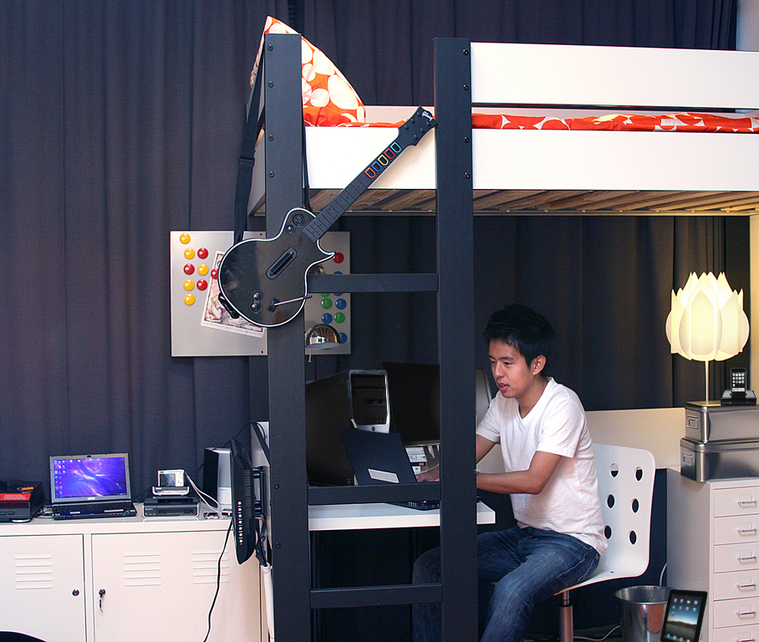
Device Ownership and Use
Technology Ownership
Technology | CC Students | Other Students
Wi-Fi** | 65% | 71%
Laptop/netbook** | 80% | 92%
Smartphone | 54% | 54%
USB Thbdrive** | 66% | 74%
Digital Camera | 57% | 55%
Printer | 81% | 82%
Desktop Comp.** | 64% | 46%
iPod** | 47% | 71%
iPad | 7% | 8%
Handheld Gaming Device | 39% | 38%
E-Reader | 11% | 12%
DVD Player** | 79% | 72%
1
2
3
…they prefer small, mobile ones.
4
5
Types of Computers
Differ
6
7
8
9
10
7
8
11
6
12
2
2
5
12
Students own an average of 11 devices asked about
10
6
4
11
3
* = significant diff. at .05 level
** = significant diff. at .01 level
1
Significant differences persist for all age categories and students from households earning less than $100,000 per year.
2011 SS – Q1 – device ownership
©2012 EDUCAUSE
9
16
Notes:
One of four respondents to the 2011 ECAR Student Study (23.8%) were community college students. Community college students bring with them an average of 11 “technology devices” to college, the same number as students from other types of institutions. The nature of technology each type of student brings to campus differs, however. Community college students are more likely to say they own stationary devices (e.g., desktop computers, stationary gaming devices, HDTV), while non-community college students bring more mobile devices (e.g., laptop computers, USB thumbdrives, iPods). Though there were statistically significant differences in the area of comparing devices student own, the effect sizes were small (rarely exceeding .20). Still, the data indicate a practical difference for things like small and mobile devices.
In looking at how family income impacts device ownership, most significant differences persist for students with a family income of less than $100,000, indicating that socioeconomic status levels the playing field for device ownership. Younger students (less than age 25) don’t fare as well as older students (age 25 and over) when it comes to device ownership equity—most significant differences persist for students less than 25 years of age. Effect sizes for both age and income analysis were small (rarely exceeding .20).

Slide 17
Nearly All Students Own a Computer, But Community College Students Aren’t as Mobile-Capable
Any Computer
Ownership
Mobile Computing Device* Ownership
* Includes laptops, netbooks, and tablets
2011 SS – Q1 – device ownership
Notes:
Community college students are particularly underrepresented when it comes to owning a mobile computing device—83% of community college students own one, as compared to 95% of non-community college students. This difference persists for all age categories and is true for students from households earning less than $100,000 per year. With the industry push to mainstream mobile technologies into the teaching and learning paradigm, as well as to utilize these devices for information and transactional purposes, community college students may find themselves disadvantaged in this arena. (Q1)
Ten percent of CCs have a student computer policy; 49% of other institutions have a student computer policy requiring students to own or lease a computer.

Slide 18
… and so, Community Colleges Meet Their Students’ Needs
2011 CDS – M2Q8 – q158
Notes:
Community college students are particularly underrepresented when it comes to owning a mobile computing device—83% of community college students own one, as compared to 95% of non-community college students. This difference persists for all age categories and is true for students from households earning less than $100,000 per year. With the industry push to mainstream mobile technologies into the teaching and learning paradigm, as well as to utilize these devices for information and transactional purposes, community college students may find themselves disadvantaged in this arena. (Q1)
Ten percent of CCs have a student computer policy; 49% of other institutions have a student computer policy requiring students to own or lease a computer.

Slide 19
Maslow's Law Applies to IT: Students Value the Basics for Academics
* significant at the .05 level
** significant at the .01 level
2011 SS – Q7 – activities valued
Notes:
In terms of the technical activities students value when it comes to their academic success, community college students rated more items lower than their non-community college counterparts. CC students find the most value in word processors, e-mail, college library website, presentation software, and spreadsheets (Q7). This top-five list looks basically the same for non-community colleges students, with CMS/LMS replacing spreadsheets as the fifth highest item.
Noteworthy areas are CC students interests in e-books or e-textbooks, text messaging, and online forums or bulletin boards—these are less traditional methods of T&L when compared to the basics.

Slide 20
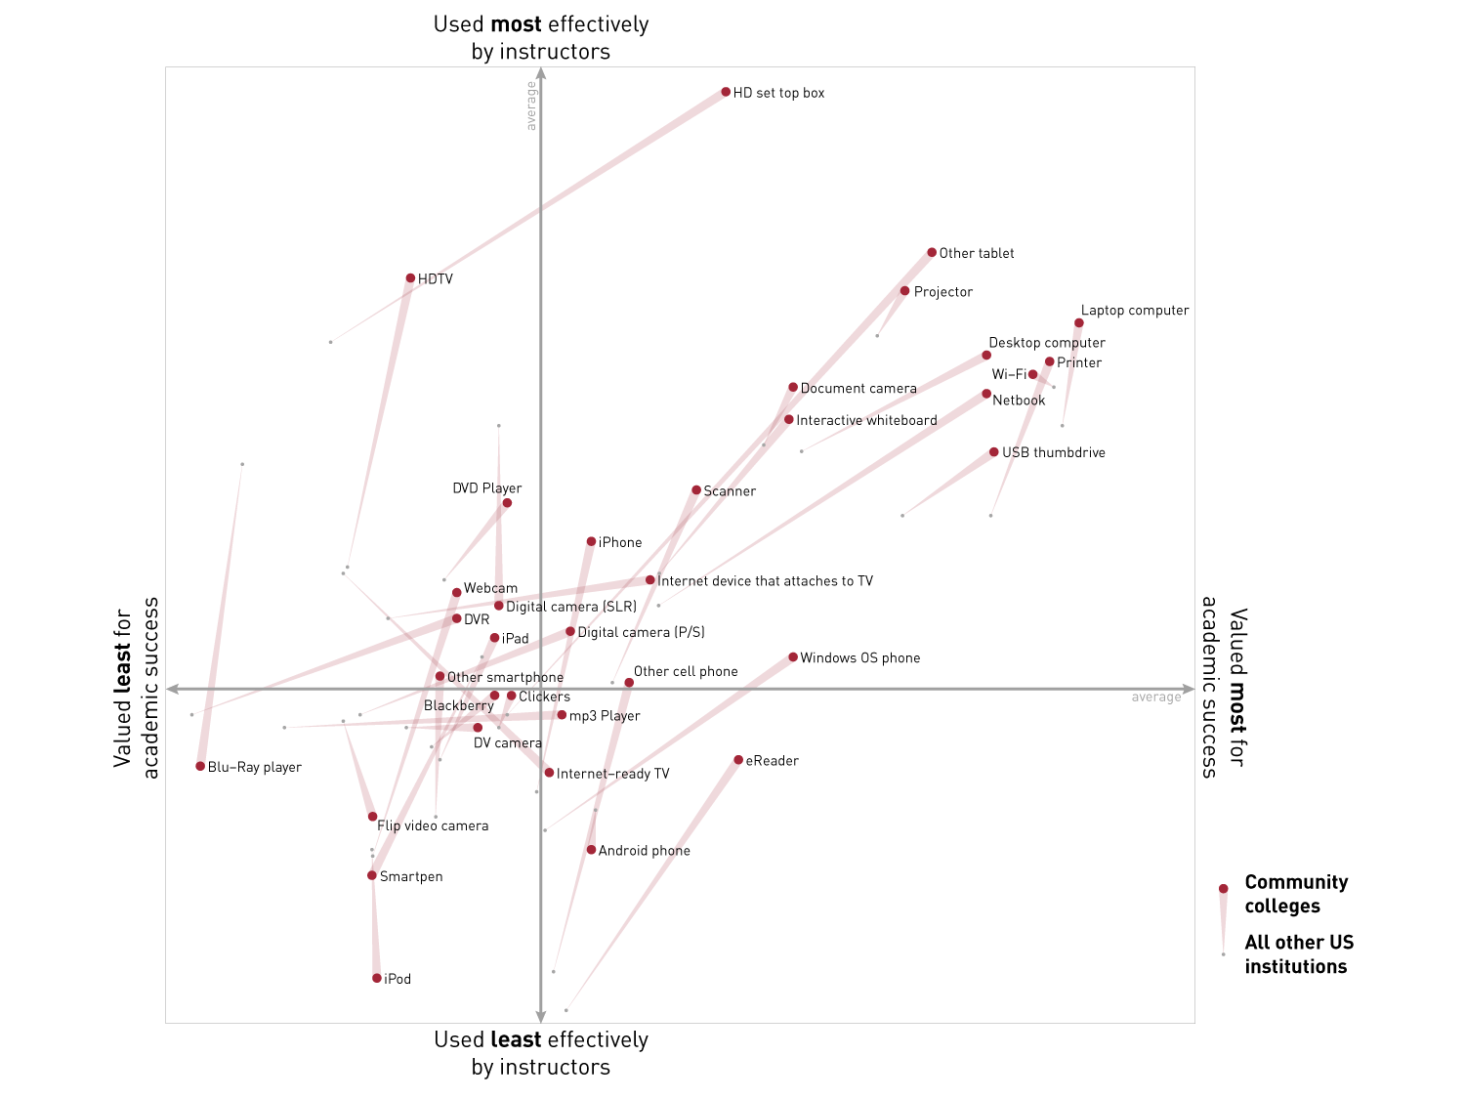
Community college instructors excel in using technology their students value…
Delivering higher value
20

Slide 21
… and IT services their students value
IT Services Students Wished Their Instructors Used More Often
* significant at the .05 level
** significant at the .01 level
2011 SS – Q8 – wish list
Notes:
When asked what technologies students wished instructors used more often, community college and non-community college students demonstrated areas of congruence and incongruence. For example, e-mail hit the top of the list for both types of student, yet significantly fewer community college students reported e-mail on their wish list than other students. Effect sizes were small (less than .10 in all cases of significance).
In looking at students’ “wish list” data as a proxy for measuring the extent to which student expectations are met, community college students technology use needs are met more so than non-community college students (i.e., fewer community college students want instructors to use more technology than non-community college students).

Slide 22
Community College Students Give Institutions Higher Marks for Some Technology
Percentage of Students Rating Service “Good” or “Excellent”
2011 SS – Q16 – online services
Notes:
Community colleges take the lead in delivering some basic online services to students. Nearly 9 out of 10 CC students rated this as good or excellent (Q16). Doctoral institutions outpace all others in offering library resources online, CCs outpace all others in offering textbooks online, doctoral institutions outpace CCs and MAs in making transcripts available, doctoral institutions outpace BAs for making grades available online, CCs and DRs outpace MAs in offering online course registration, and DRs outpace CCs and MAs in making financial aid info available online (all statements significant for at least .05 level).

Slide 23
Community Colleges Are More Likely to Provide Many Teaching and Learning Technology Services
Percentage of Institutions Providing Service
2011 CDS – M3Q1 – Q174
Notes:
CCs generally track with or offer more IT services to support teaching and learning when compared to other types of institutions. CCs outpace other institutions in the areas of distance education and online learning. CCs lag behind other institutions in providing student technology assistance in supporting faculty technology use.

Slide 24
Community Colleges Outpace Others in Deployment of Learning Technologies and Practices
Percentage of Institutions That Have Deployed This Broadly
2011 CDS – M3Q4 – Q177

Slide 25
Students Prefer Online Learning Options, and Community Colleges Deliver
Preferred Learning
Environment
No online components
Some online components
Completely online
Institution Offers
Entirely Online Courses
Students Have Taken
an Online Course
Yes
No
2011 SS – Q18, 18c, 18d – online learning
Notes:
Community college students are particularly underrepresented when it comes to owning a mobile computing device—83% of community college students own one, as compared to 95% of non-community college students. This difference persists for all age categories and is true for students from households earning less than $100,000 per year. With the industry push to mainstream mobile technologies into the teaching and learning paradigm, as well as to utilize these devices for information and transactional purposes, community college students may find themselves disadvantaged in this arena. (Q1)
Ten percent of CCs have a student computer policy; 49% of other institutions have a student computer policy requiring students to own or lease a computer.

Slide 26
Teaching and Learning: Go to the head of the class!
Governance
Managing Risk
Sustainability
Resource Allocation
Teaching and Learning
Management

Slide 27
Resource Allocation
Governance
Managing Risk
Sustainability
Resource Allocation
Teaching and Learning
Management

Slide 28
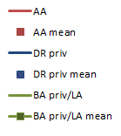
Most of the Variability in IT Expenditures “Explained” by Institutional Size
Starting at about 800 FTEs and $250K, expenditures increases by about $645/FTE.
This model explains 74% of the variability.
Notes:
The slope of the line shows expenditures per total FTE. The slope is essentially the same for AAs and everyone except BA LA and DR Private.
The fixed costs vary from year to year and by Carnegie class, but the expenditures per total FTE is about $645 for all schools EXCEPT DRs ($1168) and BA LAs ($1347). This estimate is stable from 2009, 2010 and 2011. (no signif interaction with year).
Remember also that this Resource Allocation does not take in to account distributed IT expenditures.
There are difference in fixed costs across the Carnegie classes, particularly by pub/private.

Slide 29
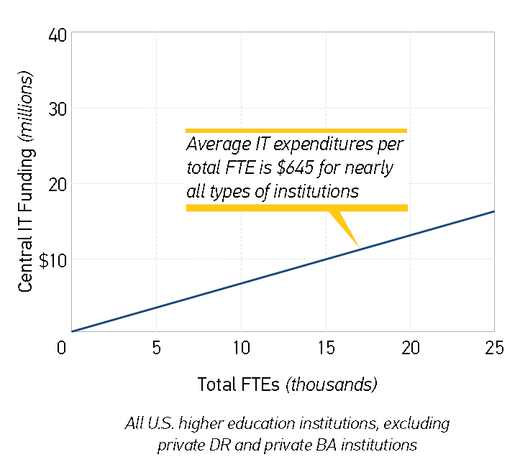
A Simplified Look at IT Resource Allocation Per FTE
Notes:
The slope of the line shows expenditures per total FTE. The slope is essentially the same for AAs and everyone except BA LA and DR Private.
The fixed costs vary from year to year and by Carnegie class, but the expenditures per total FTE is about $645 for all schools EXCEPT DRs ($1168) and BA LAs ($1347). This estimate is stable from 2009, 2010 and 2011. (no signif interaction with year).
Remember also that this Resource Allocation does not take in to account distributed IT expenditures.
There are difference in fixed costs across the Carnegie classes, particularly by pub/private.

Slide 30
Resource Allocation: Closest to the Mission
Governance
Managing Risk
Sustainability
Teaching and Learning
Resource Allocation
Management

Slide 31
Managing Risk
Governance
Managing Risk
Sustainability
Teaching and Learning
Resource Allocation
Management

Slide 32
Lagging in Many Security Areas
2011 CDS – M7Q7-9 (q233-236)
Notes:
Information Security Activities
To meet its responsibilities, information security engages in a number of activities. Of 40 information security activities listed in the survey, community colleges employ an average of 14. These practices vary based on institutional type. Community colleges are more likely (by 10 percentage points or more) to require encryption of all institutionally owned portable devices, require end-user authentication for wired access from all workstations, and conduct risk assessments in central IT systems and infrastructure. They are less likely (by 10 percentage points or more) to engage in 12 activities.

Slide 33
Restoring Power and Disaster Recovery Plans
Secondary
Power Source
Disaster Recovery
Plans
Disaster Recovery
Plans Was Recently Tested
2011 CDS – M5Q1, Q7 - (q200, q208)
Notes:
Community college students are particularly underrepresented when it comes to owning a mobile computing device – 83% of community college students own one as compared to 95% of non-community college students. This difference persists for all age categories, and is true for students from households earning less than $100,000 per year. With the industry push to mainstream mobile technologies into the teaching and learning paradigm, as well as to utilize these devices for information and transactional purposes, community college students may find themselves disadvantaged in this arena. (Q1)
10% of CCs have a student computer policy; 49% of other institutions have a student computer policy requiring students to own or lease a computer.

Slide 34
Managing Risk: Vulnerable
Governance
Managing Risk
Sustainability
Teaching and Learning
Resource Allocation
Management

Slide 35
Management
Governance
Managing Risk
Sustainability
Teaching and Learning
Resource Allocation
Management

Slide 36
Outsourcing Still Uncommon, But Community Colleges Lead in Most Areas
* significant at the .05 level
** significant at the .01 level
2011 CDS – M1Q51 (q146)
Notes:
In these difficult economic times, outsourcing is on the minds of many as a potential cost-reduction strategy. The Core Data survey asked both about outsourcing IT services and outsourcing IT functions. Outsourcing seems still to be more the topic of conversation than action.
Only 4.5% of community colleges are outsourcing three or more functions, and 5.3% reported that ”all or nearly all” of their IT staff were provided through an outsourcing arrangement with an external supplier. (The latter are not exactly the same institutions as the former.) But community colleges are, nonetheless, three times as likely as other institutions to have outsourced three or more functions and twice as likely to have outsourced all or nearly all IT staff.

Slide 37
Community Colleges Not Likely to Use Service Level Agreements

Slide 38
Majority of Community Colleges Charge a Student Technology Fee

Slide 39
Community Colleges Serve More Students per IT Support Staff Than Others
2011 CDS – M1Q28 (q124)
Includes help desk, desktop computing, user support, training, computer store, and “other” support services staff.

Slide 40
Management: A Positive Review
Governance
Managing Risk
Sustainability
Teaching and Learning
Resource Allocation
Management

Slide 41
ECAR Recommends
IT Governance
Include IT in institutional strategic plans, have representation on the president’s cabinet or higher, and include faculty and student representatives in the IT advisory process.
IT Sustainability
Continue to be leaders in sustainability practices that involve central IT programs to minimize energy consumption; work toward improving sustainability practices in other areas, such as establishment of policies on carbon neutrality and submetering of power for data centers.

Slide 42
ECAR Recommends
IT Teaching and Learning
Recognize that fewer community college students own mobile devices and assess your institution’s efforts to meet student needs for computer access.
Identify the technology that students value for their academic success, make that technology available, and support faculty use of that technology.
Assess the status and availability of student-facing services, applications, and websites and be prepared to meet students’ evolving expectations for access
Continue to be leaders in the domain of distance education; pinpoint areas in which there is room to improve through regular benchmarking.

Slide 43
ECAR Recommends
IT Resource Allocation
Consider how your institution measures up to the overall average of $645 in IT expenditures per total FTE, and consider whether your institution is under or over this mark by design or by chance.
IT Risk
Consider how well data are protected at your institution, whether there is a current and achievable disaster recovery plan in place, and the frequency of testing that plan.
Management
Consider opportunities to outsource IT functions and services with external suppliers.

Slide 44
Eden Dahlstrom
edahlstrom@educause.edu

