Slide 2
Prediction is hard, especially about the future.
Ethan Benatan, Marylhurst University
The University for the Connected Age
Services Demanded for the Connected Age
One Perspective
Design Principles
Design Choices and Baby Steps
A word of caution
Notes:
We’re deciding and building now for a future that is just emerging. We have to work with our best guesses.
I will ask you to participate, via short answer polls, during this session. I’m going to try to include responses into this discussion. which means I don’t know what’s about to happen.
Even without audience participation I’m not always completely sure what’s going to happen, so this is my predicted outline for this talk.

Slide 3
Notes:
My goal is to approach this question from a design perspective: start by imagining and exploring the use, the designing so we can build for it.
That means we need to start with some thought explorations.
background

Slide 5
One perspective….

Slide 6
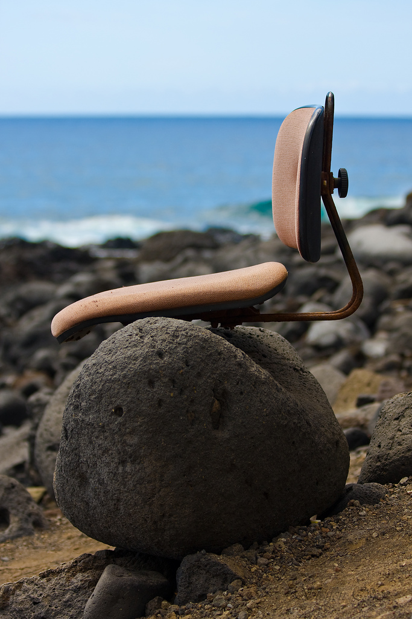
The view from here
Private, not-for-profit
Small, regional
Adult-focused, commuter
Half online, half grad
Mission: social justice
flickr: Steffen O.
Notes:
Where you stand depends upon where you sit…

Slide 7
Principles
Support the self-directed learner (heutagogy)
Make learning visible wherever it happens
Learn from consumerization (BYOx?)
Power connections
Deliver value

Slide 8
Choices, 1: What to own?
For scale, risk, and convenience: IAM, security
For efficiency & effectiveness: back office systems
Support for one simple, powerful, general toolset for communication & collaboration
Passion & expertise for teaching and learning
Notes:
The stuff that technology does really, really well for institutions….institutions need to own
Rabidly resist demands to support multiple overlapping toolsets because (in spit of the heat) the precise choice of toolset is rarely the defining factor in quality.

Slide 9
Choices, 2: What to help others own?
The learning environment…it’s a dance! (Designing, building, working for Post-LMS)
Student content and presentation (Student-owned prior and concurrent learning, reflection, meaning-making)
Notes:
The stuff that technology does really, really well for individuals and networks—individuals need to own.
“Management” is a pretty lousy framework for the messy, human activity of learning. Gardner Campbell: “Understanding Augmentation Networks”
The dance: cede control but relentlessly pursue ease of use by working to limit scope.
assessment tools: eports can be good examples on both sides—Browning and Cambridge are both eloquent speakers to this.
Challenge: pressure is to pave the cowpath

Slide 10
Choices, 2b: What to help others own?
Assessment practices (Authentic, direct, formative assessment; student-owned assessment. Beware of tools that impose practices!)
Information, inquiry
Notes:
The stuff that technology does really, really well for individuals and networks—individuals need to own.
“Management” is a pretty lousy framework for the messy, human activity of learning. Gardner Campbell: “Understanding Augmentation Networks”
The dance: cede control but relentlessly pursue ease of use by working to limit scope.
assessment tools: eports can be good examples on both sides—Browning and Cambridge are both eloquent speakers to this.
Challenge: pressure is to pave the cowpath

Slide 11
A cautionary tale
“The blob…turned into a surprisingly detailed map of the world”
http://www.facebook.com/notes/facebook-engineering/visualizing-friendships/469716398919
Notes:
In 2010 Paul Butler, an intern at Facebook, mapped connections around the world and displayed them beautifully

Slide 12
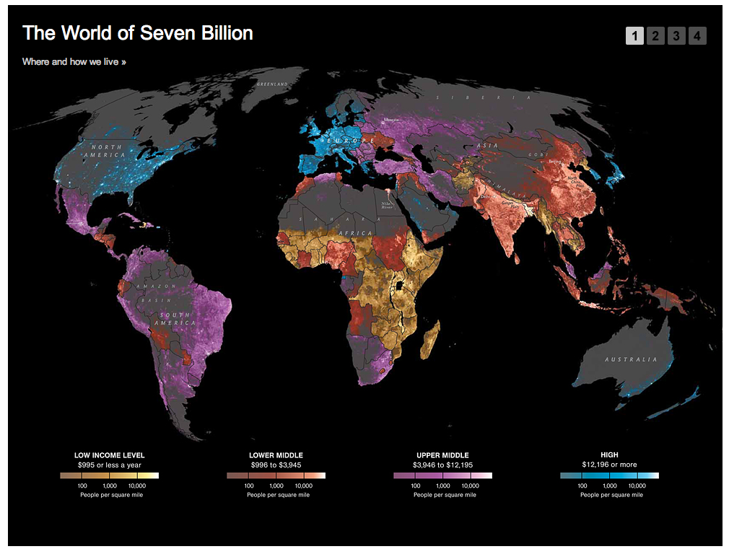
http://ngm.nationalgeographic.com/2011/03/age-of-man/map-interactive

Slide 13
land area
worldmapper.org
wealth
population
Notes:
As we build for the connected age, it is imperative to remember that the trends of globalization, demographic shifts, and technology will increasingly level the playing field as capital gets more mobile.
Remember this: http://www.era.lib.ed.ac.uk/bitstream/1842/6683/1/Edinburgh%20MOOCs%20Report%202013%20%231.pdf
It’s our job to build so that the tide can lift all boats. It won’t unless we set out to ensure that it happens.

