Slide 1

EDUCAUSE Technology Research in the Academic Community:
What Matters Most to Your Students and Faculty?
Wednesday, Oct. 1, 2014
2:40 PM – 3:30 PM
#EDU14
#ECAR
@datadeeva @dcbphd

Slide 2

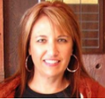
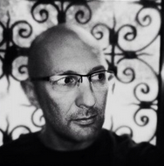

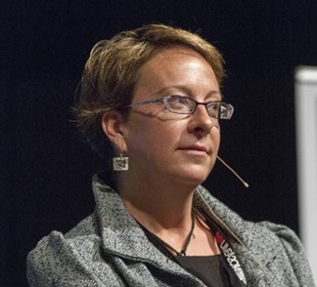
Eden’s section
Jacqueline Bichsel
Senior Researcher
D. Christopher Brooks
Senior Researcher
@dcbphd
Eden Dahlstrom
Director of Research
@datadeeva

Slide 3
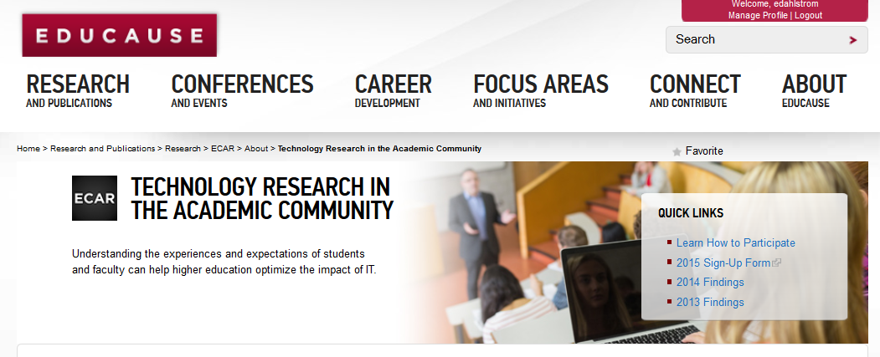
Research Hub:
http://www.educause.edu/ecar/about-ecar/technology-research-academic-community

Slide 4


Thanks to our sponsors for the 2014 ECAR Student Study:

Slide 5

Eden’s section
History, Background, and Context

Slide 6
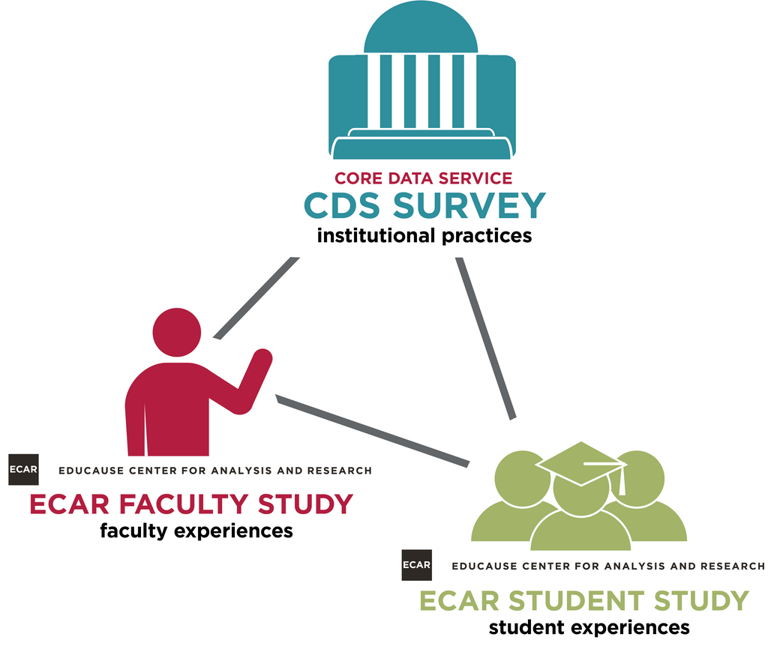
What is EDUCAUSE’s Technology Research Academic Community?
institutional perspectives

Slide 7


What is EDUCAUSE’s Technology Research Academic Community?
A series of ECAR studies that research technology experiences and expectations among students, faculty, and other populations of the academic community.
#partnership #collaboration #mutualbenefit #symbiotic

Slide 8




Research Process:
ECAR
  Conceptualizes
  Operationalizes
  Invites
  Facilitates
  Incentivizes
  Returns
  Analyzes
  Reports
Institutions
  Volunteer
  Implement
  Remind
  Utilize

Slide 9
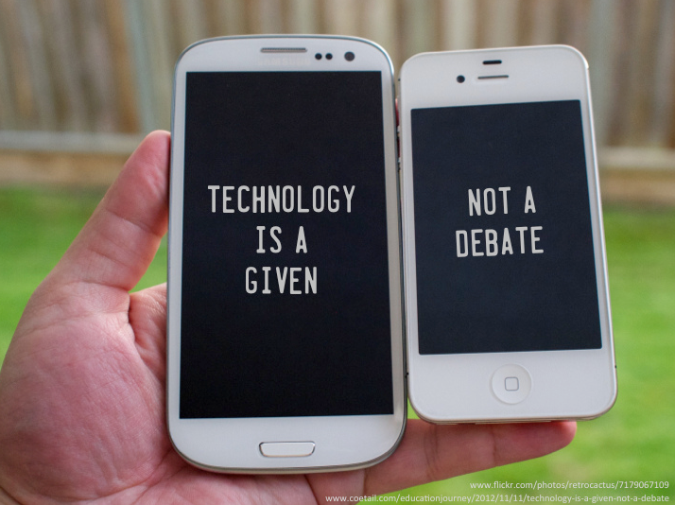

Why do *we* do this research?

Slide 10
Why do *we* do this research?
Provides data that can:
  Calibrate user experiences with institutional priorities
  Benchmark with others
  Benchmark with self-improvement goals
Institutions use these insights to:
  Improve IT services
  Increase technology-enabled productivity
  Prioritize strategic contributions of IT to higher education
  Plan for tech shifts among the various constituencies of the academic community
  Become more technologically competitive among peer institutions, and find out what it might take to compete at the next level
Srsly?!
…we do it for *you*!

Slide 11

Findings – What matters most…

Slide 12


Christopher’s section
Busting the faculty ed tech stereotypes
Graphics cred: Kyle Bowen aka, Class Hack
http://classhack.com/post/76426209140/fave-updated

Slide 13

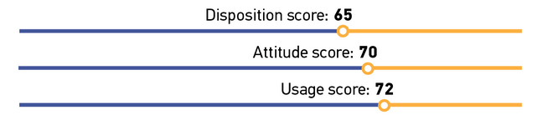

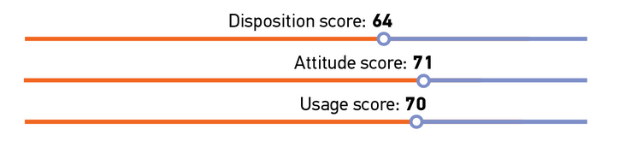

Faculty & students’ tech inclinations - results

Slide 14
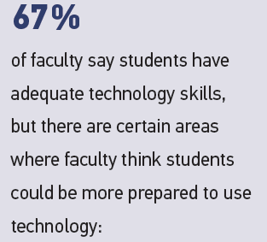
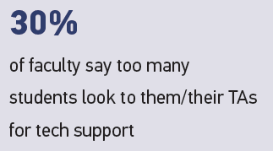
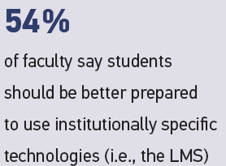
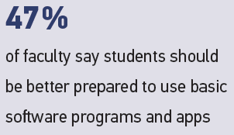
Faculty and students’ tech inclinations

Slide 15
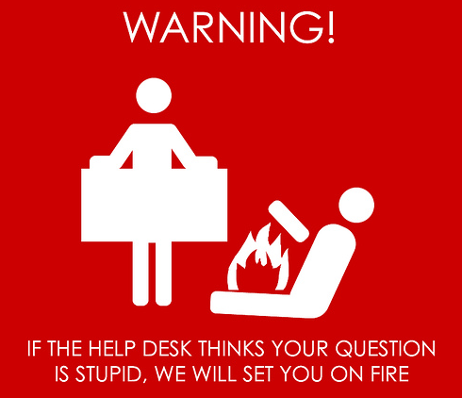

DCB’s section
Tech support and help desk experiences
sd
NOT TRUE!

Slide 16
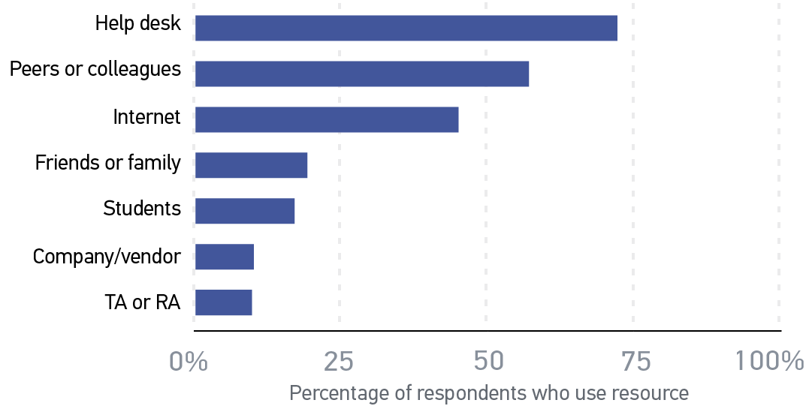
Faculty seek technology help from…

Slide 17
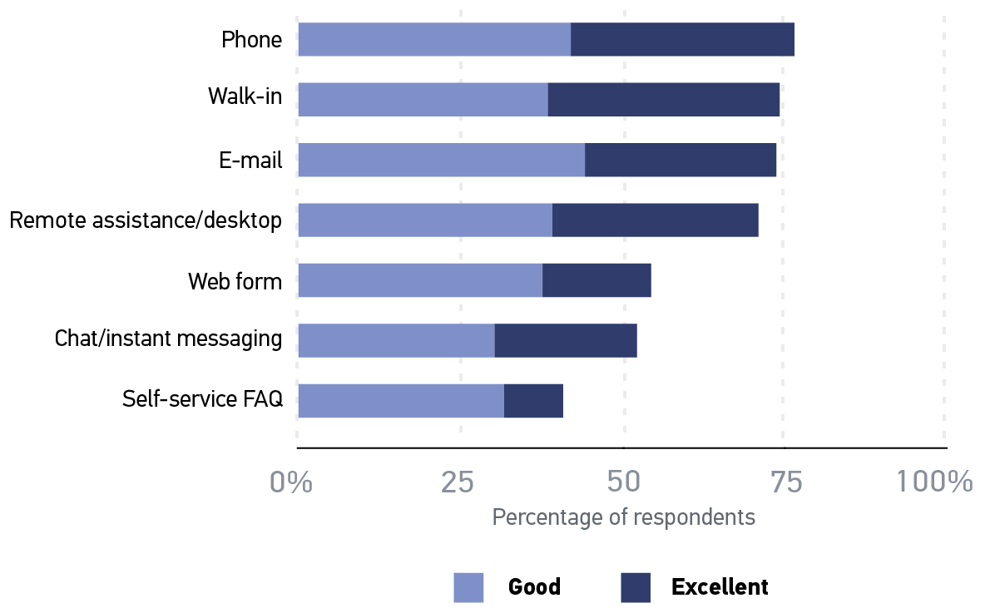
Faculty help desk ratings, by modality

Slide 18
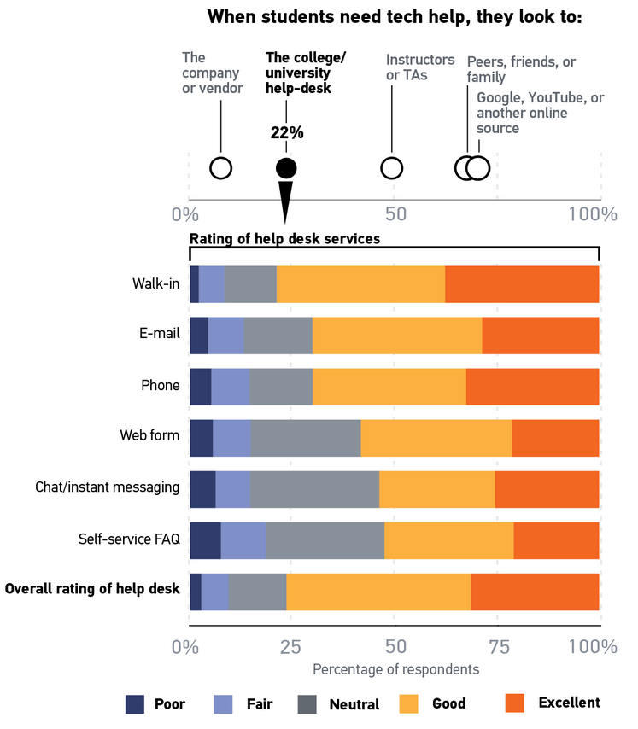
Student help desk use and ratings

Slide 19


Technology and the learning environment for the contemporary student

Slide 20
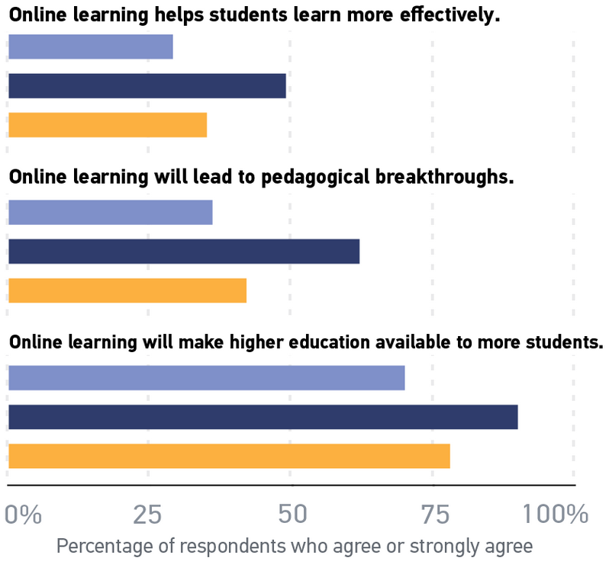
Faculty opinion about online learning, based on online teaching experience

Slide 21
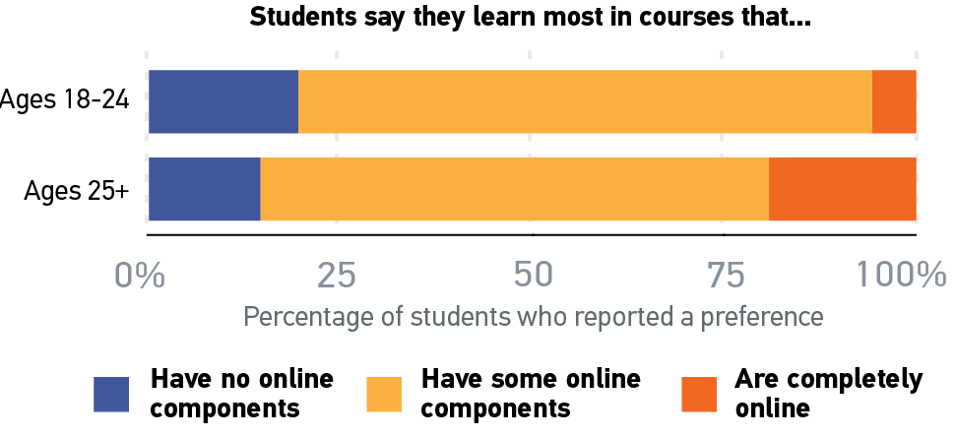
Learning environments in which students say they learn most

Slide 22
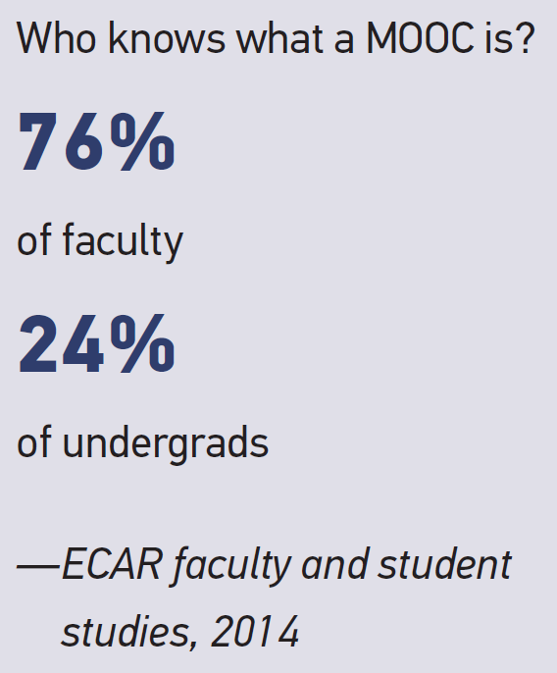
MOOC…what’s a MOOC?

Slide 23
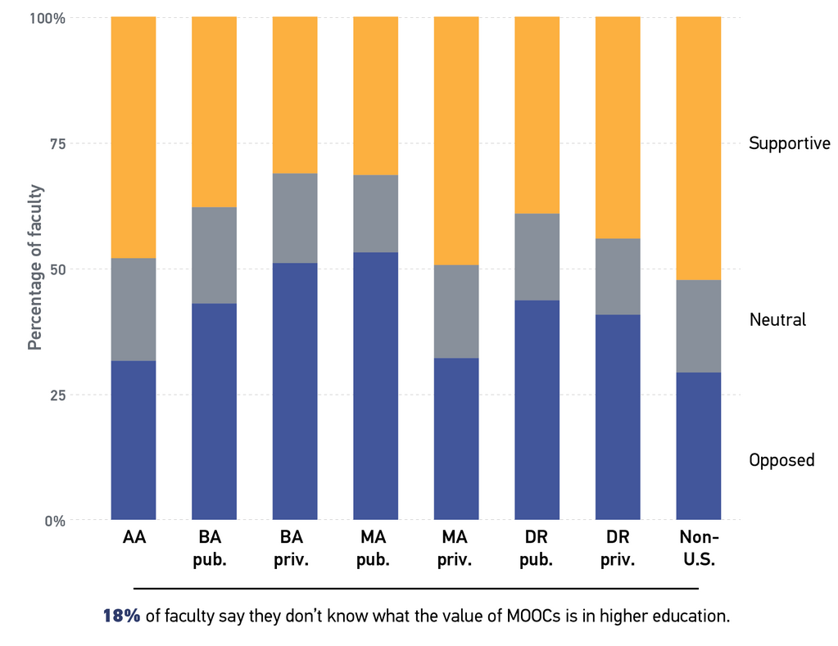
Faculty perception of MOOCs’ value to HE

Slide 24
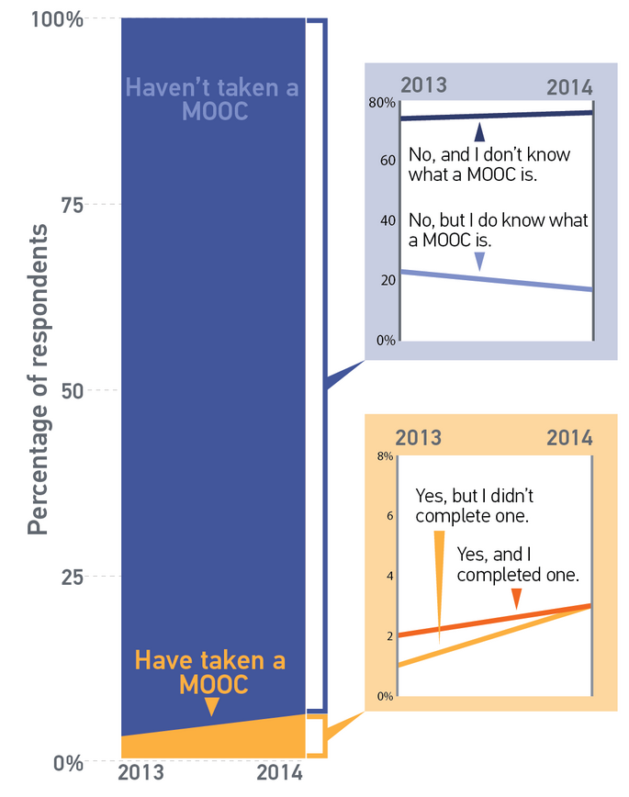
Students’ experience with MOOCs

Slide 25
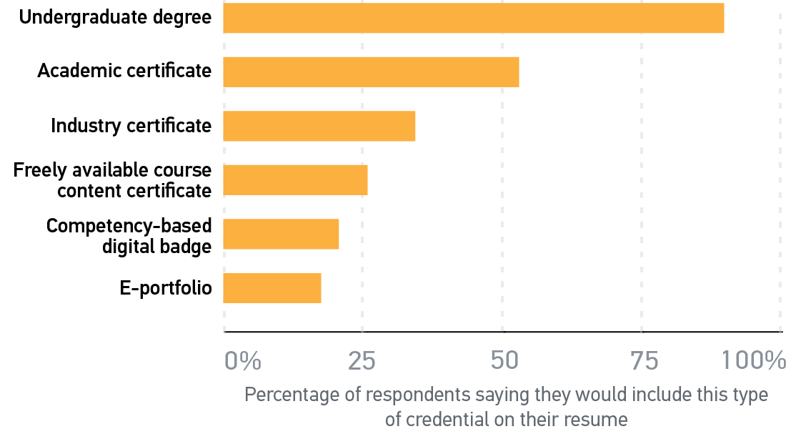
Students value the traditional undergraduate degree

Slide 26


Christopher’s section
Not another brick in the wall -- learning analytics, dashboards, and big data

Slide 27
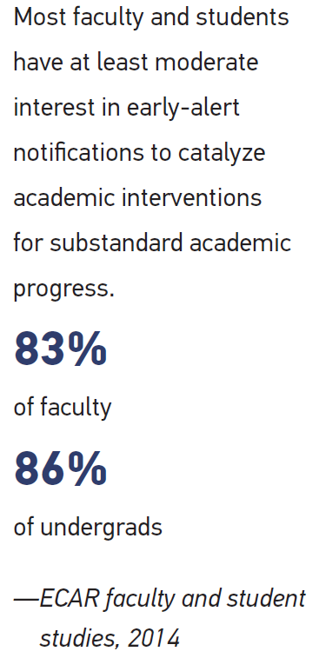
Interest level in early alert and intervention notifications to students:

Slide 28
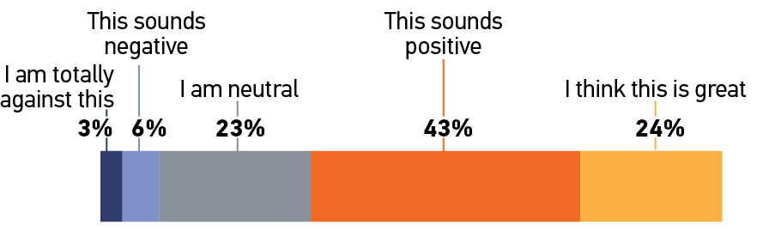
Student opinions about data collection for analytics

Slide 29
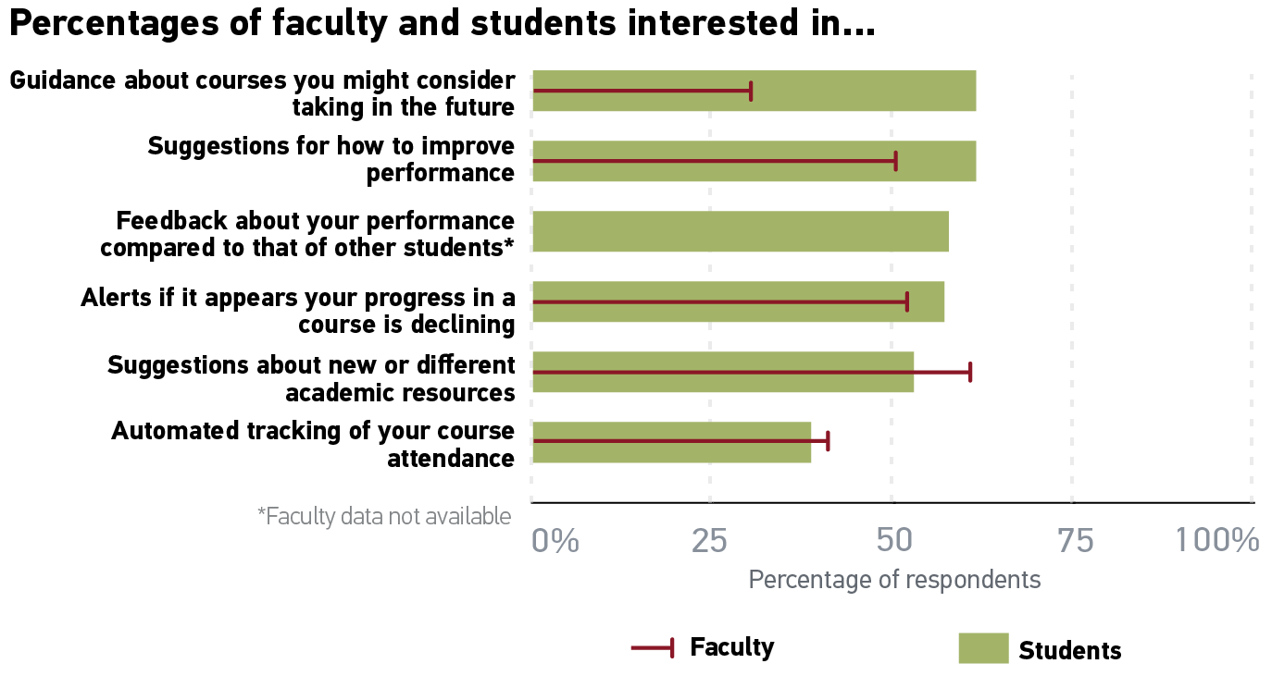
Interest level in early alert and intervention notifications to students:
Percentage very or extremely interested.
Almost all are at least moderately interested.

Slide 30


The potential of the LMS as the “next generation learning environment”

Slide 31
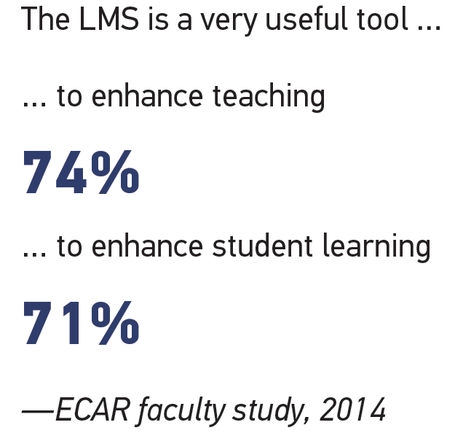
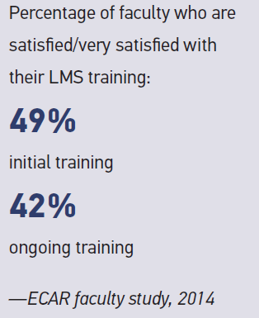
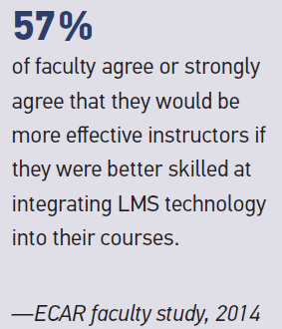
Faculty Perceptions of the LMS

Slide 32
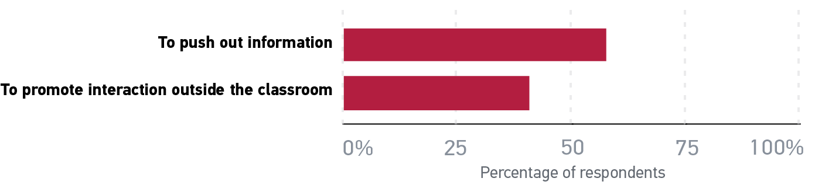
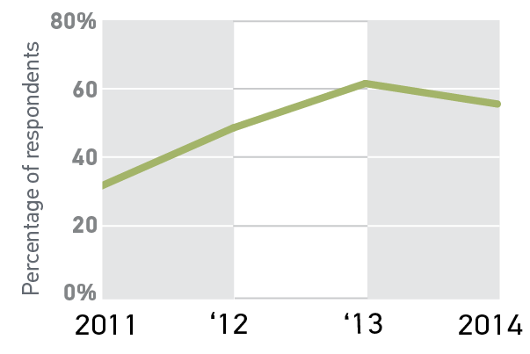
How faculty use the LMS…
…and extent that students want their instructors to use it more

Slide 33
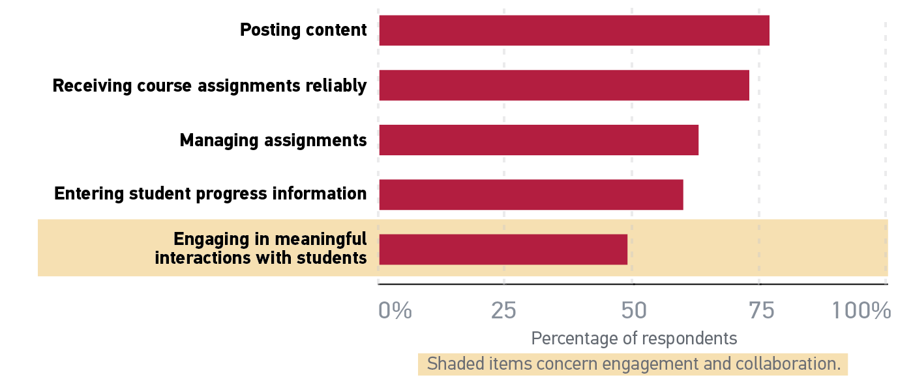
Faculty satisfaction with the LMS:

Slide 34
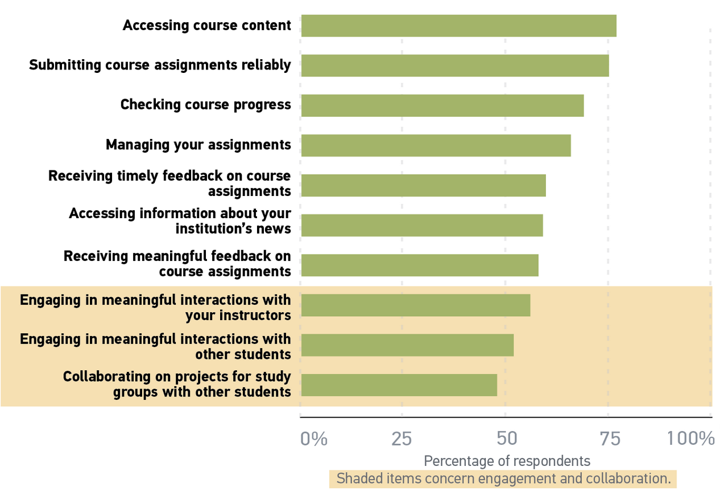
Student satisfaction with the LMS:
Percentage satisfied or very satisfied.

Slide 35
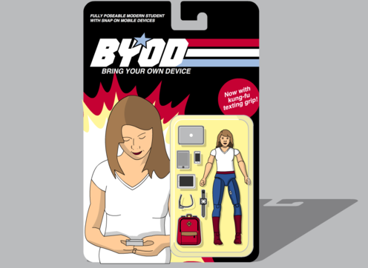
Eden’s section
Consumerization of technology
“…and knowing is half the battle!”
Graphics cred: Kyle Bowen aka, Class Hack
http://classhack.com/post/57024983820/byod

Slide 36
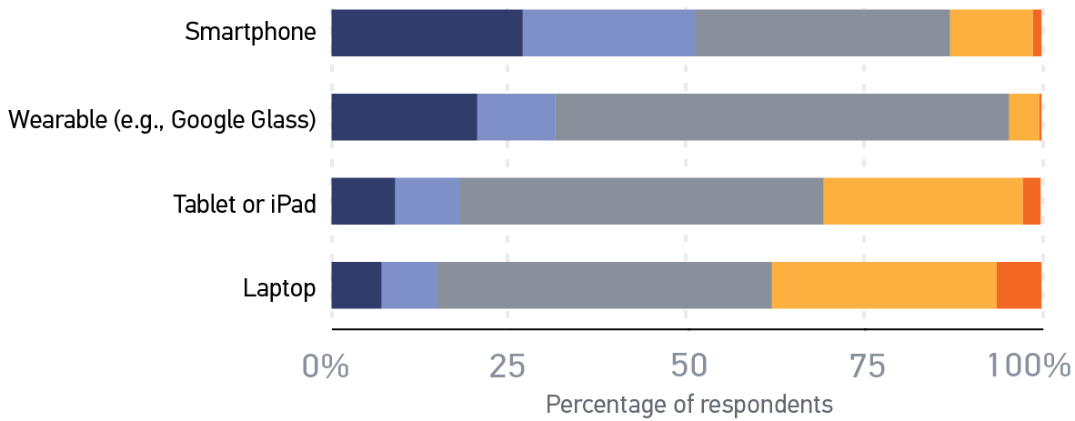

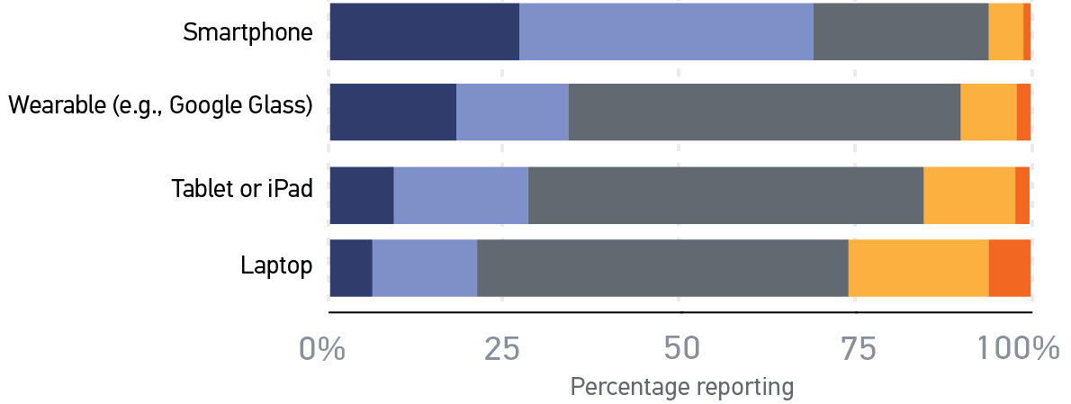
In-class BYOD experiences

Slide 37
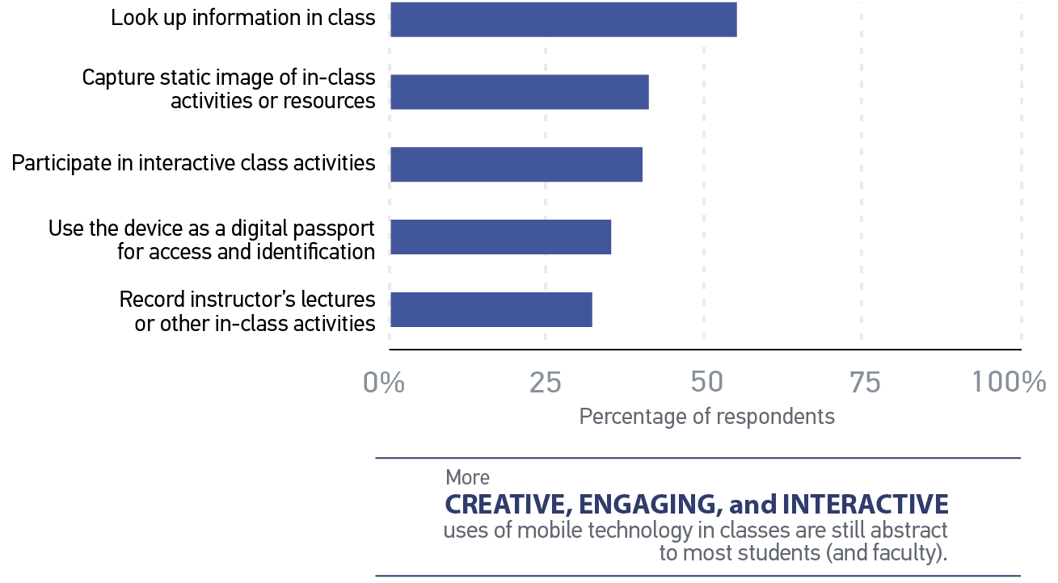
How students say they would use mobile devices in class

Slide 38
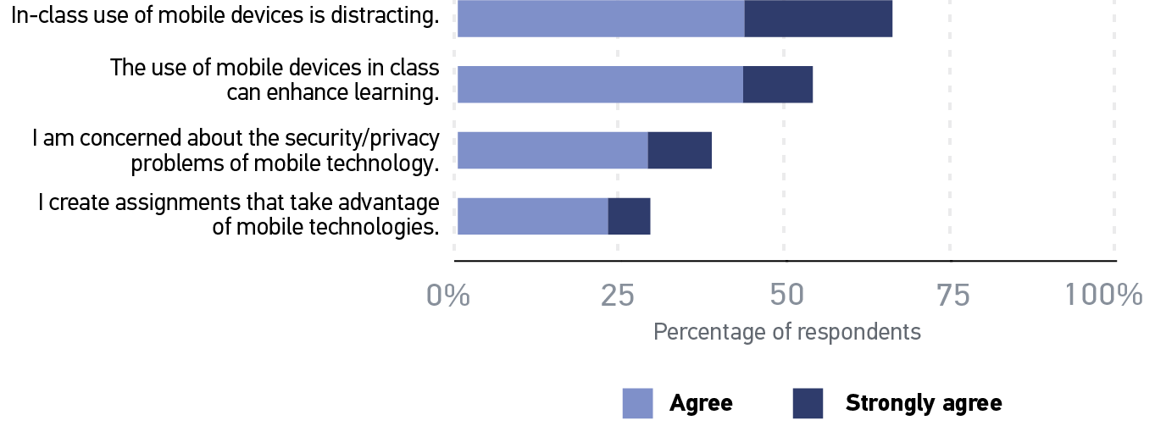
What do faculty say about in-class BYOD?

Slide 39
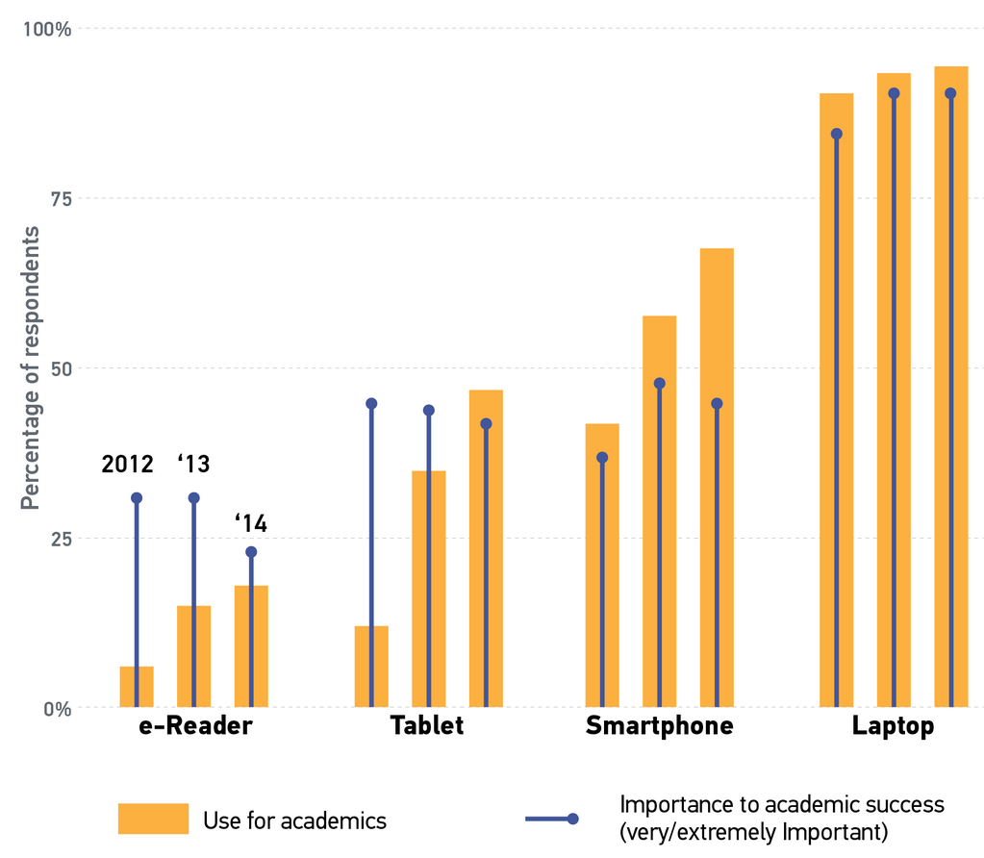
What do students say about the importance and use of devices for academics?

Slide 40
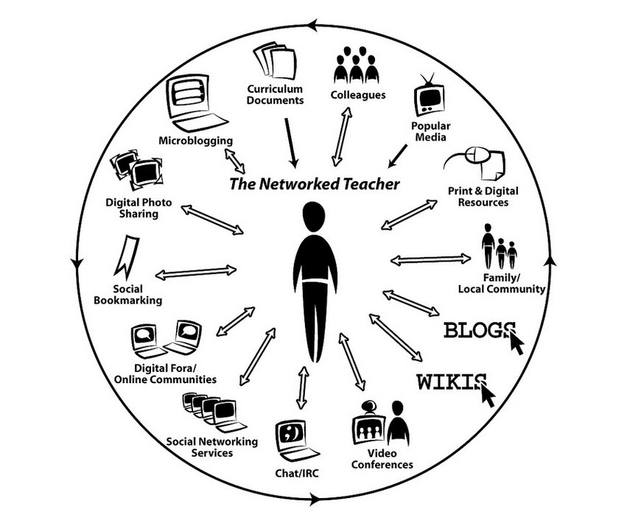

Reconciling student “wishes” for technology and faculty willingness to incorporate technology

Slide 41
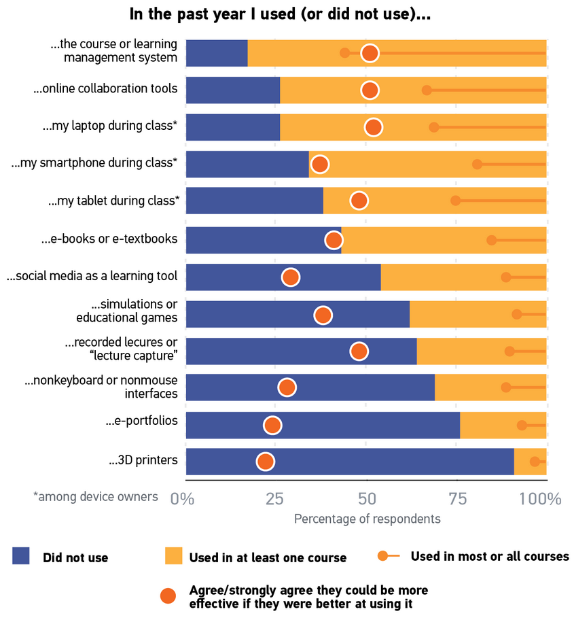
Extent of tech use and perceived needs for better skills

Slide 42
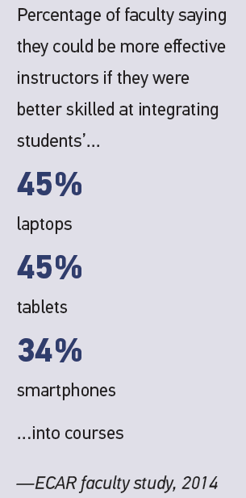
Motivating faculty to integrate tech more
Top 4 motivators in getting faculty to use more technology
Evidence that students would benefit
Release time to redesign courses
Confidence that technology would work as planned
A better understanding of T&L-relevant technologies

Slide 43
Get involved

Slide 44
Resources and opportunities
Eden’s section
http://www.educause.edu/ecar/about-ecar/technology-research-academic-community

Slide 45
Thanks (again) to our sponsors for the 2014 ECAR Student Study:
And thank you ECAR subscribers!

Slide 46






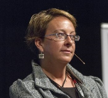
Learn more
Sign up for the 2015 student study or faculty study!
Participation is free and you’ll receive powerful institution-specific data and benchmarking data about your students’ and faculty’s tech experiences and expectations.
Participation Website:
http://www.educause.edu/ecar/about-ecar/technology-research-academic-community
E-Mail:
study@educause.edu
Twitter updates from Eden: @DataDeeva
Jackie Bichsel
jbichsel@educause.edu
Know who you are connecting with:
Jamie Reeves, Research Assistant
jreeves@educause.edu
D. Christopher Brooks
cbrooks@educause.edu
Eden Dahlstrom
edahlstrom@educause.edu

Slide 47
Q&A

Slide 48
Help Us Improve and Grow
Thank you for participating
in today’s session.
We’re very interested in your feedback. Please take
a minute to fill out the session evaluation found within
the conference mobile app, or the online agenda.

