Slide 1
Data to Drive Decisions:
The 2015 ECAR Faculty & Student Technology Surveys
D. Christopher Brooks, EDUCAUSE
Charles D. Dziuban, University of Central Florida
Tanya Joosten, University of Wisconsin-Milwaukee
Elizabeth Kuebler-Wolf, University of Saint Francis

Slide 2
October 2015
Coming Soon!

Slide 3
Thanks to Our Sponsor
EDUCAUSE thanks the 2015 student study sponsor
PLATINUM Partner

Slide 4
Faculty and student respondents

Slide 5
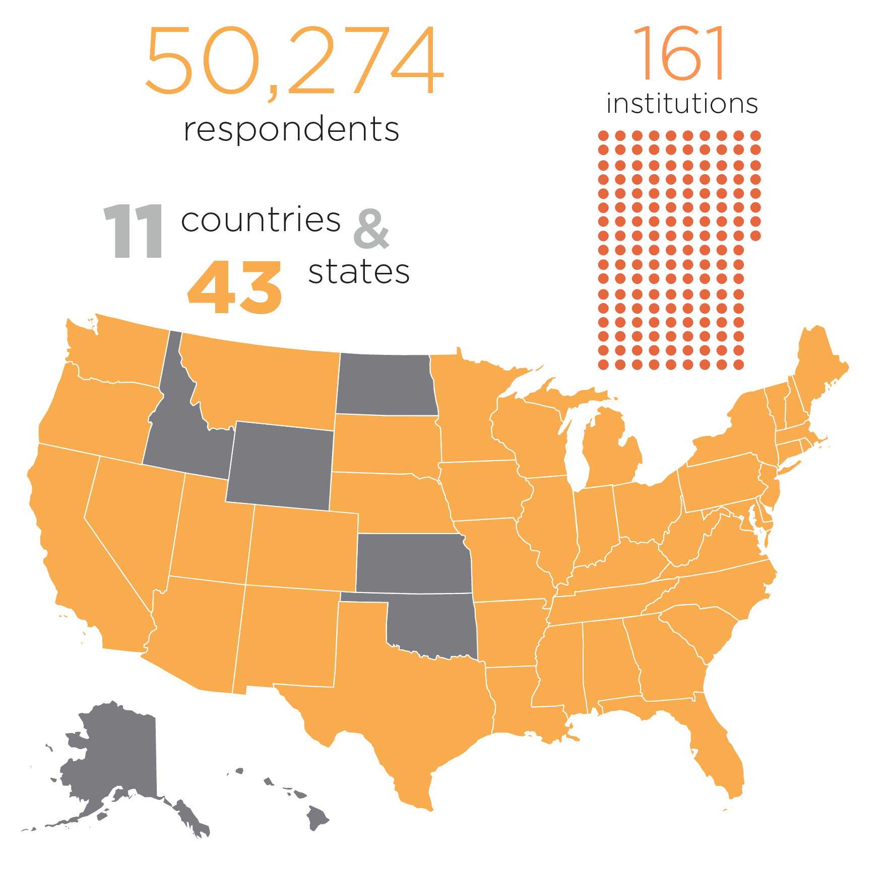
Student study participation overview

Slide 6
Faculty study participation overview

Slide 7
Student and faculty IT orientation

Slide 8
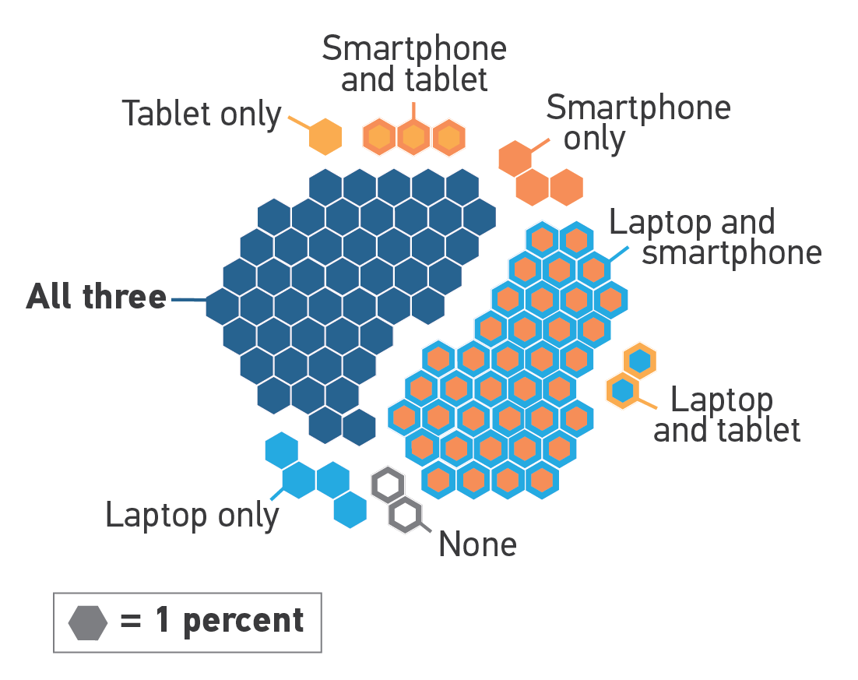
Student device ownership

Slide 9
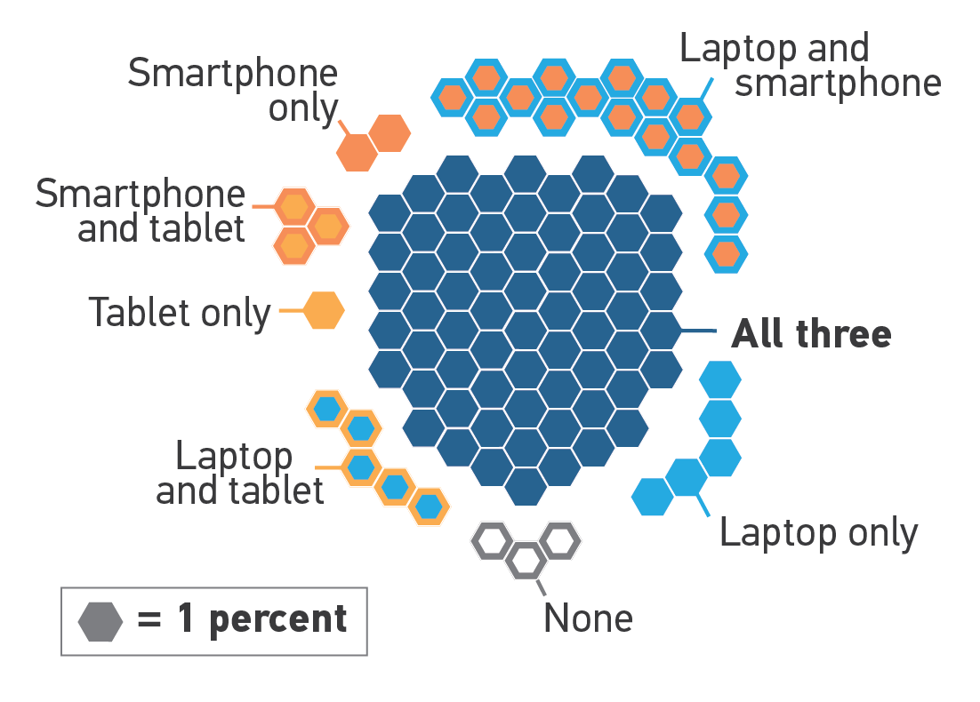
Faculty device ownership

Slide 10
Teaching and learning with technology

Slide 11
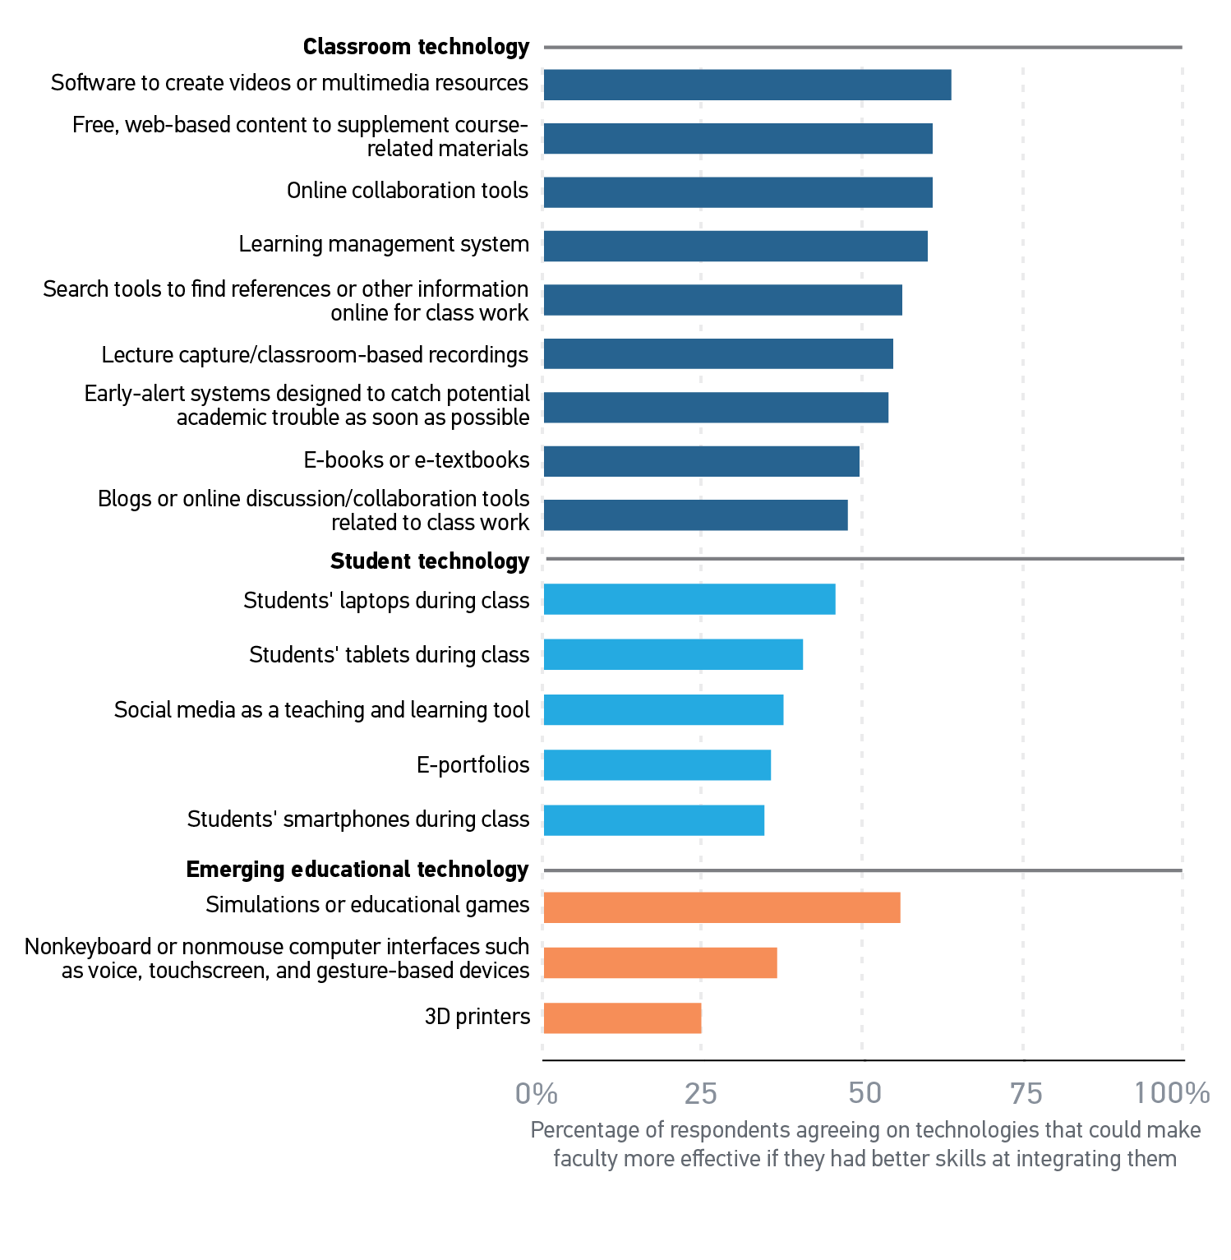
Faculty technology skill wish list

Slide 12
Typical faculty use of learning management systems

Slide 13
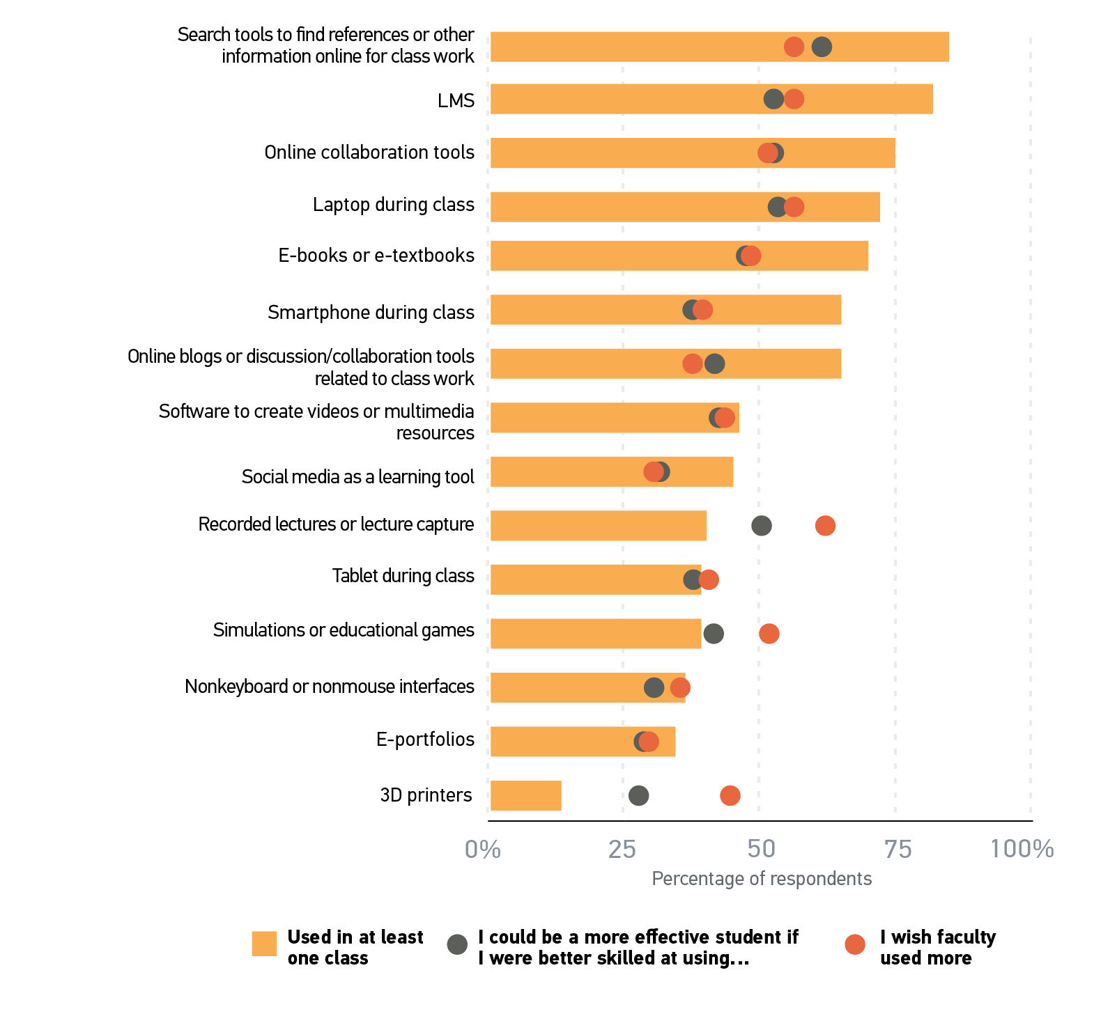
Student experiences with technology-based resources and tools

Slide 14
Mobile technology

Slide 15
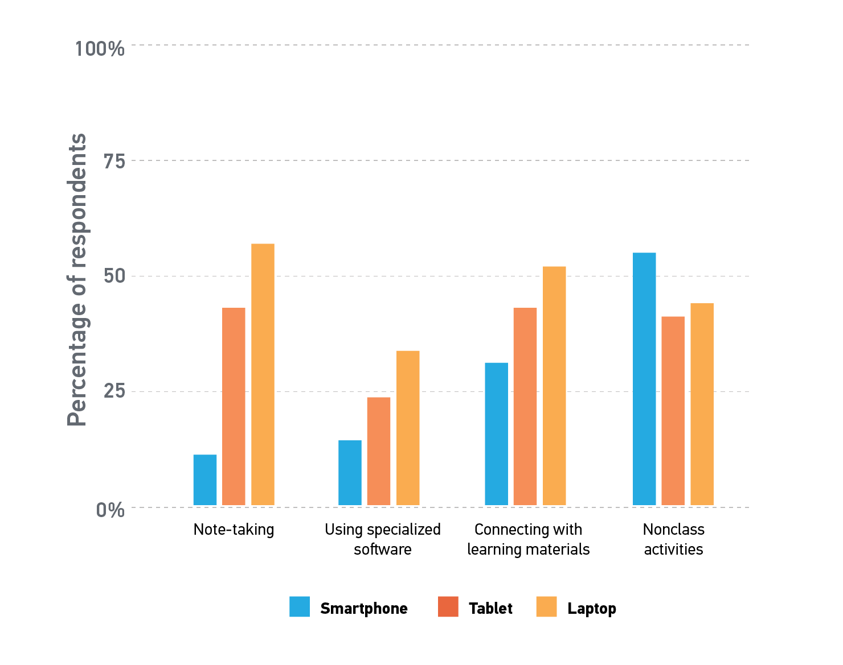
Faculty perception of how students use mobile technology in the classroom

Slide 16
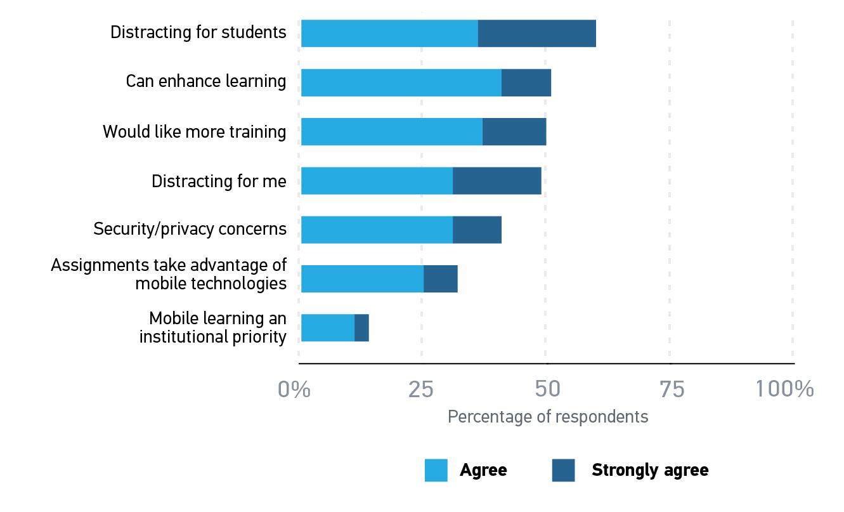
Faculty views on mobile technology in the classroom

Slide 17
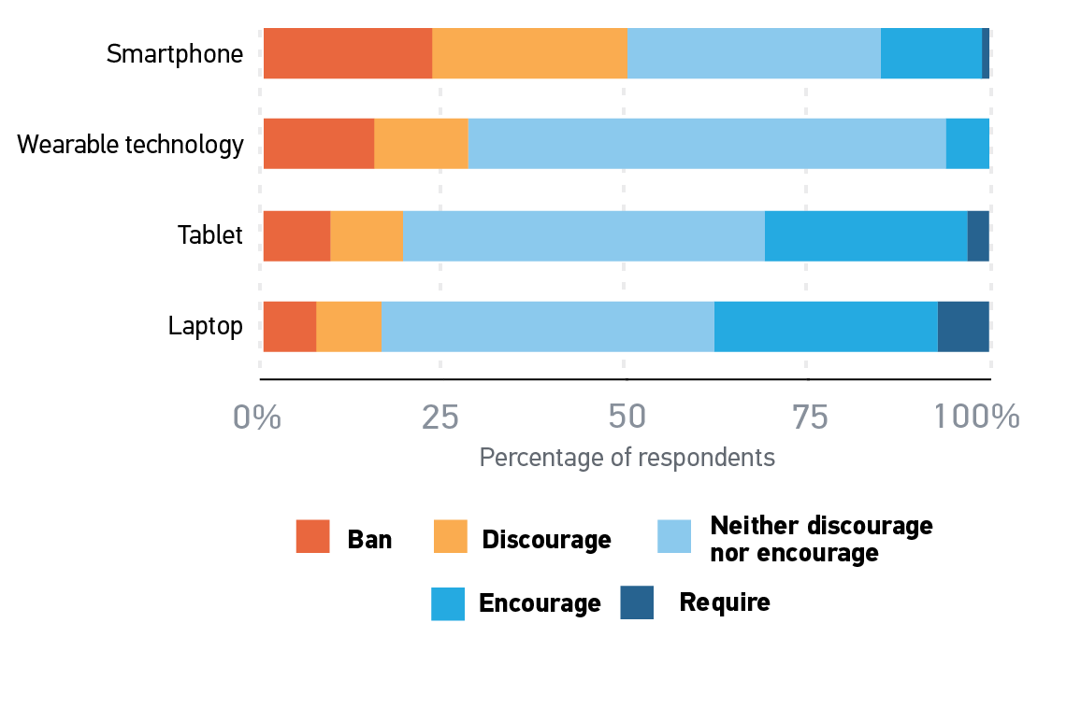
Faculty in-class BYOD policies and practices

Slide 18
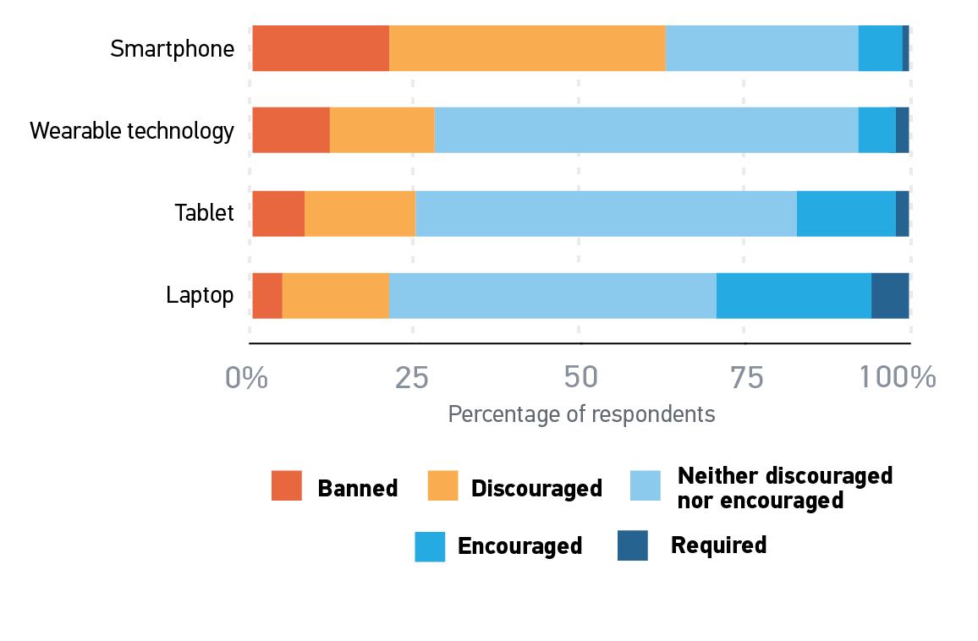
Student perceptions of in-class BYOD policies and practices

Slide 19
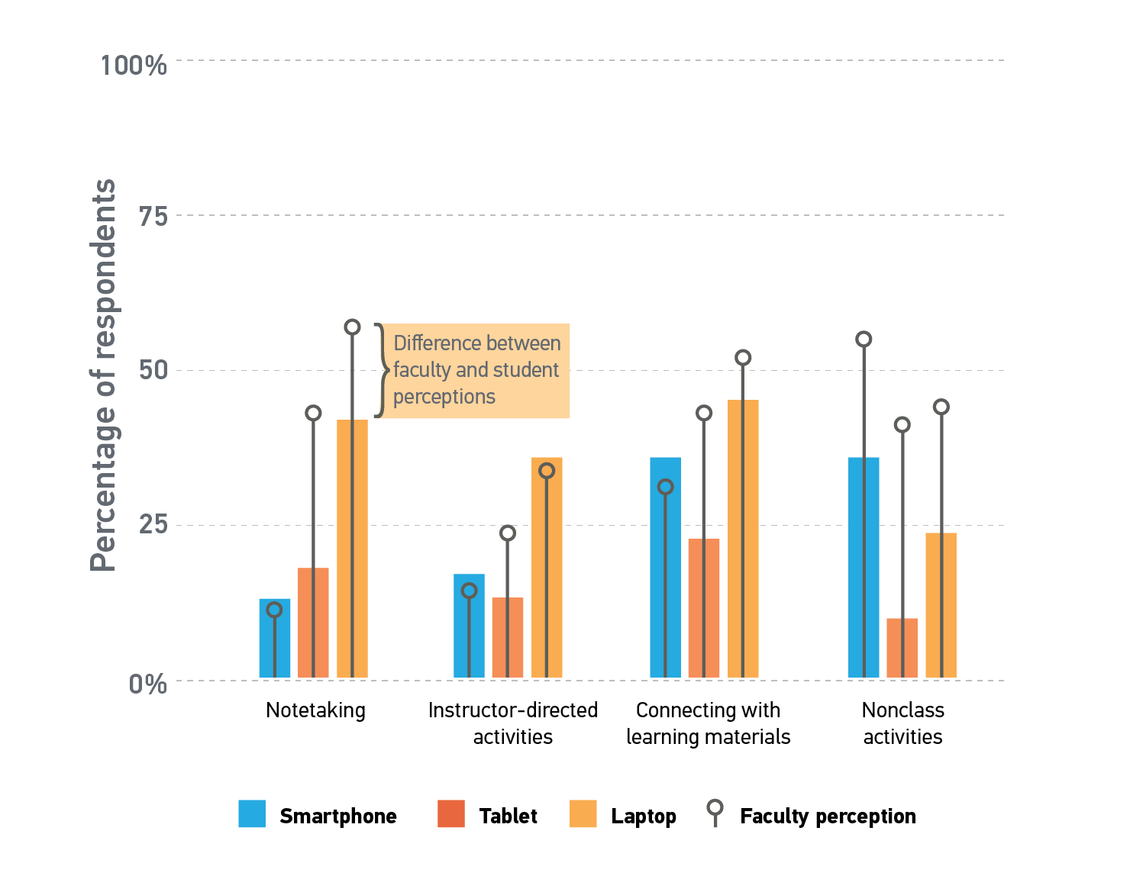
How students claim to use mobile technology in the classroom (versus faculty perceptions)

Slide 20
Analytics

Slide 21
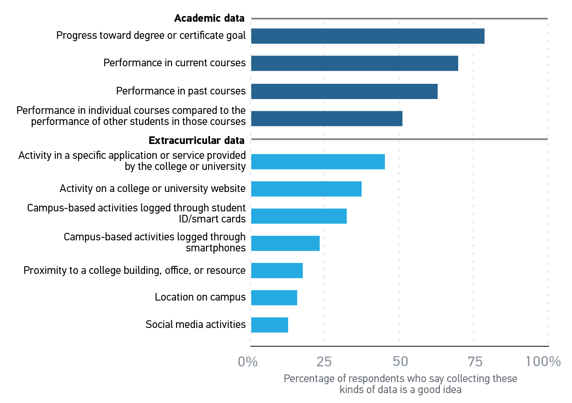
Faculty opinion about using specific types of student data

Slide 22
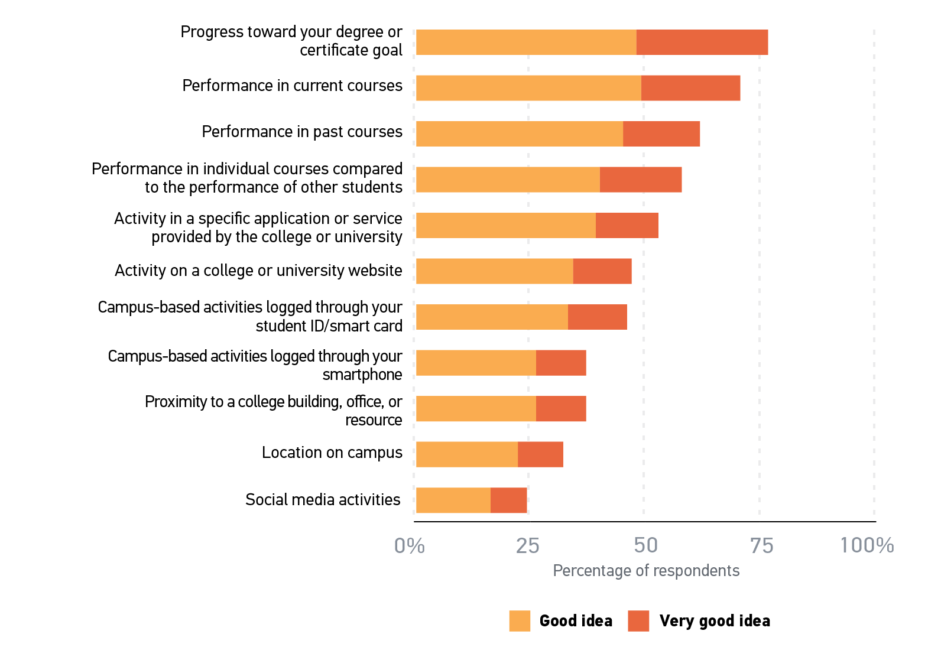
Student opinion about using specific types of student data

Slide 23
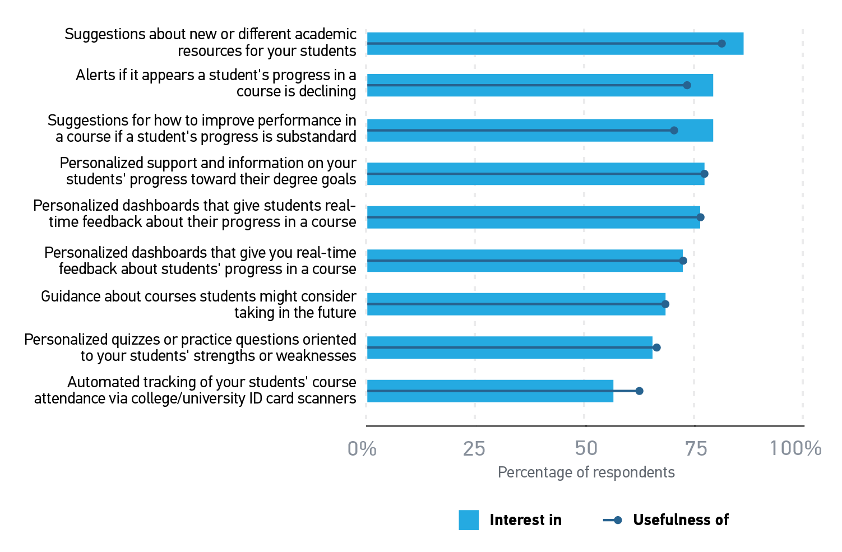
Faculty evaluation of the usefulness of interest in IPAS features

Slide 24
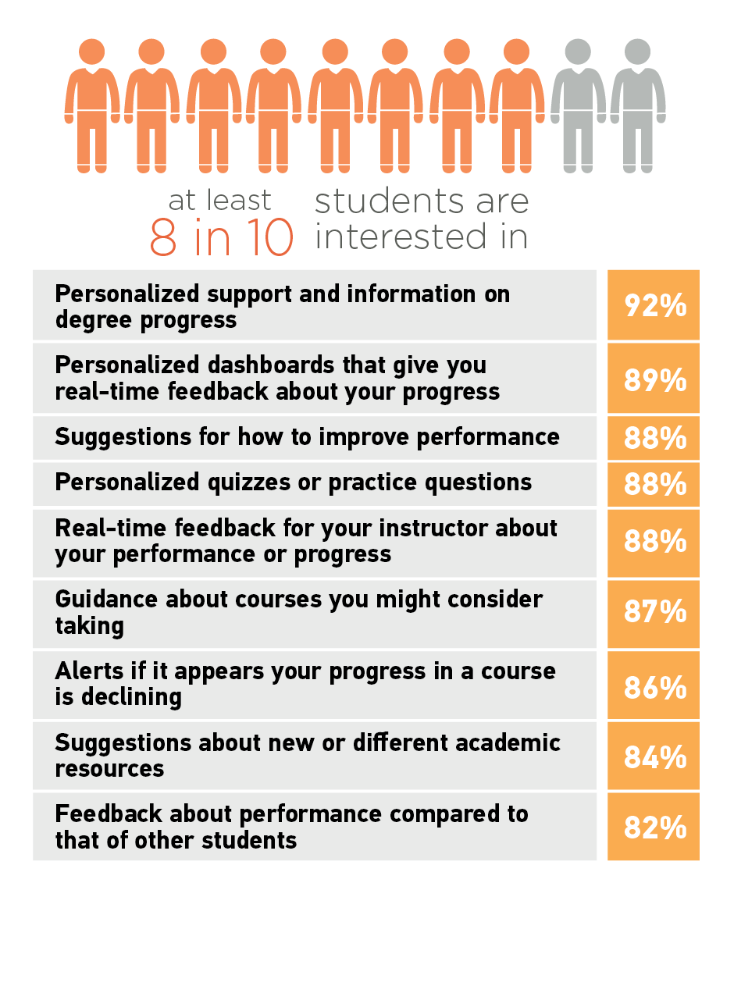
Student interest in IPAS features

Slide 25
Significance of ECAR studies

Slide 26
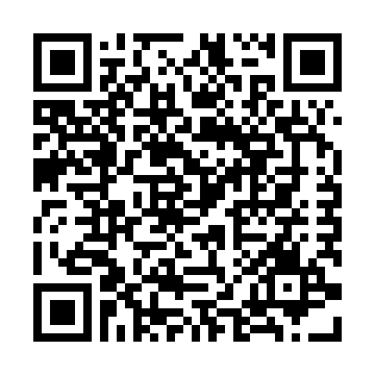
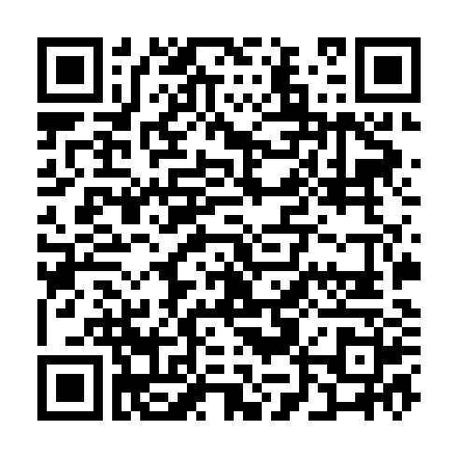
ECAR Research Hub
ECAR Participation Hub
http://bit.ly/1W6iRJ6
http://bit.ly/NzalBj

Slide 27
Thank you for participating
in today’s session.
We’re very interested in your feedback. Please take
a minute to fill out the session evaluation found within
the conference mobile app, or the online agenda.
Christopher: @dcbphd
Chuck: @Papuga
Tanya: @tjoosten
Beth: @kueblerwolf

