Slide 1
Student and Faculty Technology Experiences: Research and Benchmarking
D. Christopher Brooks
Senior Research Fellow
EDUCAUSE
Jeffrey Pomerantz
Senior Research Analyst
EDUCAUSE
#SS16

Slide 2
Thanks to Our Sponsor
#SS16

Slide 3
Overview
#SS16

Slide 4
Student study participation overview
#SS16

Slide 5
Guideposts
Benchmarking
Student attitudes about & use of technology
Students’ experience of campus technology
Students’ technology preferences
The effects of technology on students
Conclusions
#SS16

Slide 6
Benchmarking
#SS16

Slide 7
2017 ECAR Student and Faculty Survey Timeline
October 2016 – January 2017
January 30 – April 14, 2017
July 2017
Review your institution's primary rep and survey administrator status.
Finalize local survey implementation logistics
Choose dates
Draft invitations
Create a marketing plan
Data files will be accessible on the ETRAC portal
Raw data
Benchmarking data
Complete planning forms and upload any approval documentation needed on the ETRAC portal
Implement your survey
Send out links to students/faculty
Monitor response rates
#SS16

Slide 8
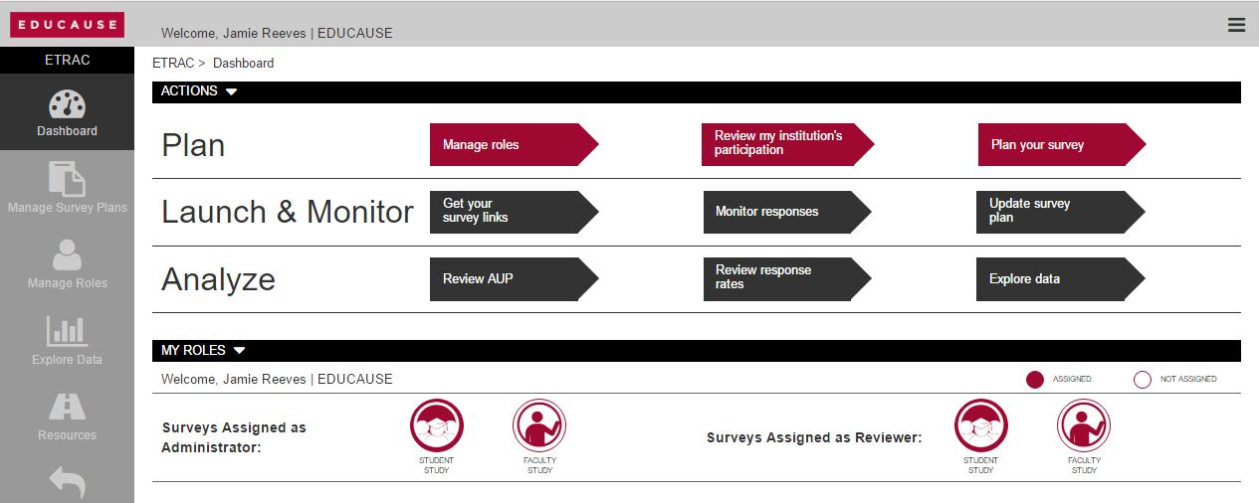
#SS16

Slide 9
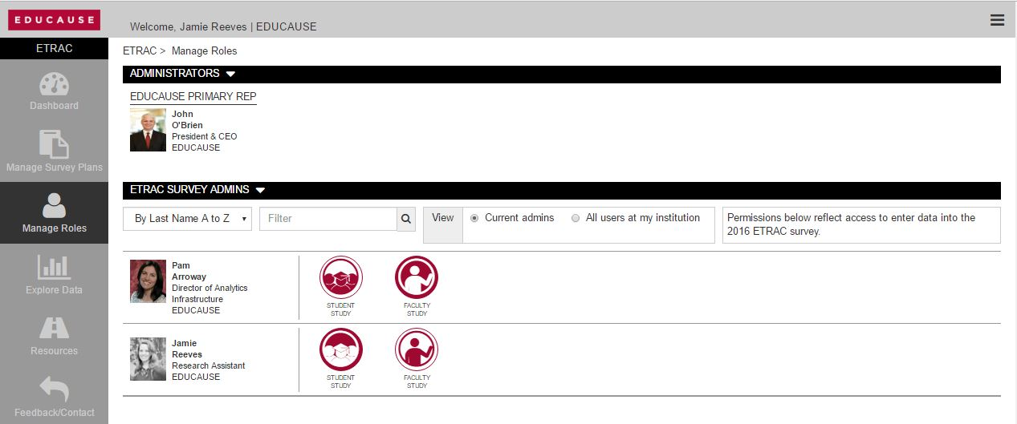
#SS16

Slide 10
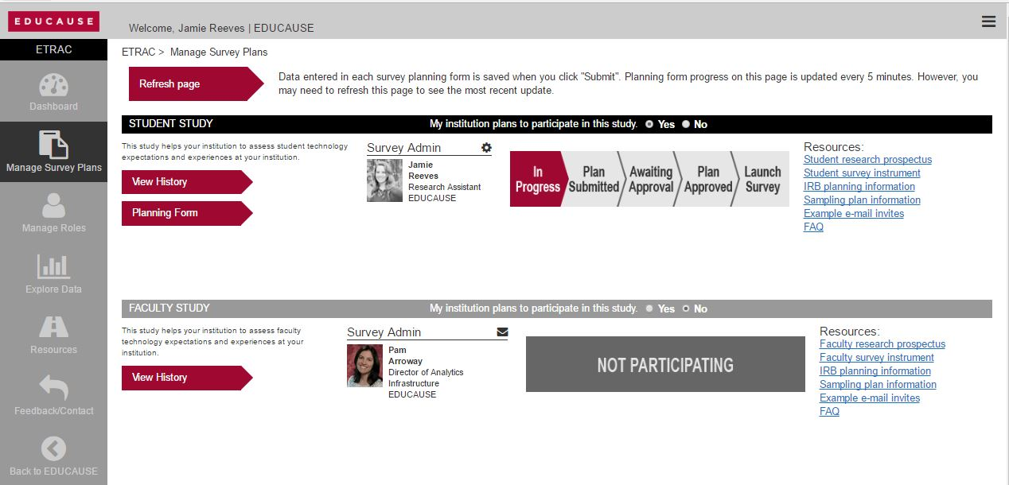
#SS16

Slide 11
Student attitudes about & use of technology
#SS16

Slide 12
Student laptop, tablet, and smartphone ownership
#SS16

Slide 13
Correlation of device used for coursework with importance to student success
#SS16

Slide 14
Mean scores of student techieness
#SS16

Slide 15
Mean scores of student techieness, by sex
#SS16

Slide 16
Mean scores of student techieness, by ethnicity
#SS16

Slide 17
Mean scores of student techieness, by enrollment status
#SS16

Slide 18
Students’ experience of campus technology
#SS16

Slide 19
Students’ overall technology experiences
#SS16

Slide 20
Student experiences with wireless networks
#SS16

Slide 21
Faculty use of technology as a means to engage students
#SS16

Slide 22
Determinants of technology experience
Technology Experience
Dormitory Wi-Fi
Library Wi-Fi
Ease of log in
Network performance
Skilled instructors
Technology attitude
Tech used in courses prepares for career
#SS16

Slide 23
Students’ technology preferences
#SS16

Slide 24
Students’ preferred learning environments

Slide 25
Determinants of learning environment preferences
Prefer completely or mostly online
Taken completely online courses
Taken mostly online courses
Active in courses that use technology
Instructors use technology to deepen learning
Women
Disposition
Attitude
#SS16

Slide 26
Determinants of learning environment preferences
Completely mostly face-to-face
Taken completely face-to-face courses
Taken mostly face-to-face courses
#SS16

Slide 27
The effects of technology on students
#SS16

Slide 28
Student-faculty
Technology engagement
Student-student
Student-content
#SS16
#EDU16

Slide 29
Determinants of technology engagement
Engagement
Women
First-generation
Attitude
Usage patterns
Disposition
#SS16

Slide 30
Student technology enrichment
#SS16

Slide 31
Determinants of technology enrichment
Enrichment
Women
First-generation
Attitude
Usage patterns
#SS16

Slide 32
Student technology efficacy
#SS16

Slide 33
Determinants of technology engagement
Efficacy
Women
Attitude
Non-White
Disposition
First-
generation
Usage patterns
#SS16

Slide 34
Conclusions
#SS16

Slide 35
Key findings
Students use their devices extensively and view them as important to their academic success.
Student campus technology experiences are a function of their encounters with campus infrastructure and their beliefs and attitudes about technology’s use.
A majority of students prefer learning environments that are blended; those preferences are shaped by the courses they have taken.
Students, especially women and first-generation students, think technology increases their learning engagement, enrichment, & efficacy.
#SS16

Slide 36
Available NOW!
www.educause.edu/etrac
#SS16

Slide 37
Help Us Improve and Grow
Thank you for participating
in today’s session.
We’re very interested in your feedback. Please take
a minute to fill out the session evaluation found within
the conference mobile app, or the online agenda.
#SS16

Slide 38
Thank you!
D. Christopher Brooks
Senior Research Fellow
EDUCAUSE
@dcbphd
Jeffrey Pomerantz
Senior Research Analyst
EDUCAUSE
@jpom
#SS16

