Slide 1
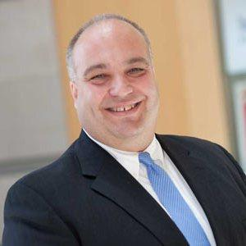
A Focus on Research Data
TODAY’S EVENT BEGINS AT 3 P.M. ET
An ECAR Working Groups Webinar • February 7, 2017
Kim Owen Program Manager for Research and Education Network Resources North Dakota State University
Ralph Zottola CTO, Research Computing University of Massachusetts Central Office
Notes:
Add save the date for e16

Slide 2
A Focus on Research Data
An ECAR Working Groups Webinar February 7, 2017 • 3-4 p.m. ET
Notes:
Add save the date for e16

Slide 3
When faculty evaluate their institution’s support for data-intensive research, they are generally satisfied with the provision of research computing technologies (42%), but many also claimed that they do not have the IT cyberinfrastructure resources and support needed to effectively pursue their research (44%).
ECAR Study of Faculty and Information Technology, 2015

Slide 4
Today’s Speakers
Ralph Zottola CTO, Research Computing University of Massachusetts Central Office
Kim Owen Program Manager for Research and Education Network Resources North Dakota State University

Slide 5
Considerations for Research Data Sharing
Setting the Stage for Greater Openness
Ralph Zottola, University of Massachusetts Central Office

Slide 6
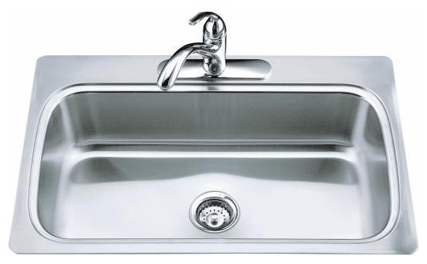
What Is Research Data?
Just about anything, including the...

Slide 7
Why Share Research Data?
Prospect of new discoveries
Improved research transparency
Greater interdisciplinary collaboration
Increases the value of public funding by allowing scientists to ask new questions of extant datasets
Enabling “big data” projects
Since most university research is publicly funded, should the public have access to the data?

Slide 8
Stakeholders
Researchers
Libraries and Repositories
Higher Education Institutions
Funding Agencies
Publishers
General Public

Slide 9
Barriers and Considerations
Social and Cultural Influences
Data Ownership
Legal Compliance
Funding
Data Governance
Information Technology Considerations
Data Management
Training and Education

Slide 10
ADNI - A Model Use Case?
Alzheimer’s Disease Neuroimaging Initiative
Public-private partnership with focus on collaboration and rapid data sharing.
Multiple repositories store the data redundantly at institutions worldwide.
Uniquely, no single researcher or institution owns the data. Both data and ideas are shared.
The approach allowed the study to be conducted at a scale not possible by individual researchers and research organizations.
The study has been used in over 1,200 research papers.
To date, more than 8,500 researchers have sought access.
Notes:
The Alzheimer’s Disease Neuroimaging Initiative, or ADNI is a unique public-private partnership and collaborative research effort to find the biological markers that show the progression of Alzheimer’s.
Key feature of ADNI is its focus on collaboration and rapid data sharing.
Multiple repositories store the data redundantly at institutions worldwide.
Uniquely, no single researcher or institution owns the data. Both data and ideas are shared.
The approach allowed the study to be conducted at a scale not possible by individual researchers and research organizations.
The NIH recently awarded a third round of funding ($40 million).
ADNI investigators make their collected data widely available.
The study has been used in over 1,200 research papers. MRI- and PET-scanned brain images, as well as clinical, genetic, and fluid biomarker data, are available to qualified researchers worldwide through a web-based interface.
To date, more than 8,500 researchers have sought access.

Slide 11
It Will Take a County, err, Country!
Any path forward needs to involve all stakeholders
Recent requests for comments from the NIH, NLM, and others
New policies (national and local) needed?
Different approaches?
Blockchain
Github
Are we ready to disrupt the status quo? Or put another way, can we really stop progress? Is this a conversation at your institution yet? If no, why not?

Slide 12
You can have data without information, but you cannot have information without data.
Daniel Keys Moran, Programmer and
Science Fiction Writer

Slide 13
Developing an Institutional Research Data Management Plan Service and Research Data Storage
Kim Owen
Program Manager, Research and Education Network Resources
North Dakota State University
kim.owen@ndsu.edu
February 7, 2017

Slide 14
Why Data Management?
1999 Public access to data from federally funded research
2013 Increasing access to the results of federally funded scientific research
Objective of this paper
Provide insights on developing data management planning services at research higher education institutions.

Slide 15
What the Guide Is and Isn’t
What this guide IS…
Provides overview of common DMP service elements
Time-sensitive – a moving target
A broad synopsis of current practices and models
Only one component of a larger, formalized process addressing research data management infrastructure
What this guide IS NOT…
A comprehensive check-list intended to cover all things for all research grant proposals
Not a guarantee for successful grant awards

Slide 16
The Purpose of Data Management Plans
Communicate (findings, hypotheses, insights, replicability)
Organize (nomenclature, terminology, disciplines)
Build communities toward collaboration
Document, manage, resolve controversies
Establish precedence
Be trustworthy
Be reproducible
Perturb assumptions and methods

Slide 17
The Benefits of Data Management Plans
Save time
Increase research impact
Ensure long-term ability to preserve fragile data sets
Organize and categorize data for efficient access, analysis, queries, etc.
Support sharing and open-access
Focus on data sharing as an objective of investigation
Support data-intensive discovery across disciplines
Promote verification and replication of research analysis and findings

Slide 18
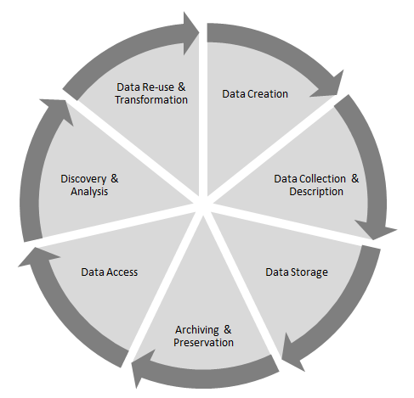
The Big Picture: Common Data Lifecycle Stages

Slide 19
Developing a DMP Service
Organizing
Institutional culture / Organizational makeup / Geographic dispersion
Funding
Staff, resources, core service of the institution
Service Delivery / Instructions / Guidance
Central IT, Faculty/Deans, Legal Counsel, Library, Research Computing, Office of Sponsored Programs, Others
Critical skill sets: disciplines / data

Slide 20
Quality of the Plan
Institutional Vetting of the DMP improves quality:
Clarifies roles, responsibilities and risks
Storage requirements
Curation needs
Commitment of technology resources
Viability of network capabilities
Minimizes risk to the researcher and institution

Slide 21
Researcher Resources
Storage options
DMP products vs. in-house templates
Research administration management software
Institutional / discipline-specific repositories
Consulting

Slide 22
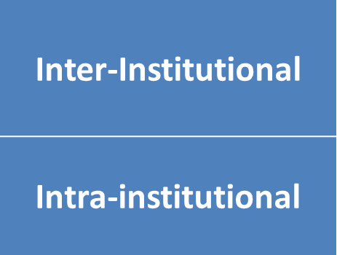
Storage Environments Throughout the Data Lifecycle
Central IT storage
Research storage
Divisional/departmental
Cloud

Slide 23
In Summary
Identify a model for local administration of research data management services
Provide resources for convenient access to researchers during the research data lifecycle
Designate one or more dedicated staff to serve a range of consulting needs

Slide 24
Research Data Storage
A Framework for Success
ECAR Working Group
July 2014

Slide 25
Objective
Create a framework that helps higher education institutions establish and evaluate research and data storage efforts on their campus.

Slide 26
Framework
Governance, Policy and Oversight
Data Life Cycle
Us of Third-Party (Cloud) Providers of Storage
Communication and Collaboration
Infrastructure
Operation and Management
Leading Edge
Industry Standard
Lagging

Slide 27
All founded on communication ...
Conversations about research data storage planning and management are critical across departments.
Multiple perspectives
A comprehensive storage-management structure

Slide 28
Anticipated outcomes
Starting the conversation at your institution
Come to a common understanding of what research data storage maturity means across your institution.
Address accountability issues with stakeholders.
Strategizing
Use or modify matrix components to identify your institution in the continuum of higher ed institutions.
Identify specific areas that, when addressed, will help your institution move up to the next level.
Use as leverage when justifying needs in planning and budgeting.

Slide 29
Understanding the Maturity Classifications
Leading Edge
Ongoing communication, collaborative planning and development across the institution: review and piloting of new tools and resources is a joint venture, especially among those in academics, research, the libraries and information technology.
Industry Standard
A general awareness exists across the institution but developing critical practices may be viewed as unnecessary to address randomly recurring issues; minimal or sporadic communication occurs when needed. ‘Hot spots’ exist across campus where leading edge activities are more frequent.
Lagging
Issues are addressed in isolation and with little consideration to the bigger picture of the institution’s goals; communication is minimal.

Slide 30
Example: Compliance with Research Grant Data Storage Requirements
Leading Edge | Industry Standard | Lagging
A formal process exists to understand and comply with storage requirements based on pending grant proposals and awards, as does a formal mechanism for the institution to respond to those requirements effectively and efficiently. | Compliance for research grant data storage is considered and addressed when new grants are awarded or new agency requirements are announced. | Compliance is addressed independently by grant PIs, often with little communication or engagement with centralized IT and other departments charged with maintaining the institution’s practices and policies.

Slide 31
In Summary
Research data growth and needs continue to expand at a rapid pace
Use framework to initiate and expand discussion surrounding this topic at your institution
Categories and maturity classifications invite engagement from diverse disciplines and support entities

Slide 32
Questions?

Slide 33
Resources
ECAR Research Data Sharing Working Group - Project Description
Research Data Storage: A Framework For Success
Developing An Institutional Research Data Management Plan Service
ECAR Study of Faculty and Information Technology, 2015
EDUCAUSE Data Governance and Chief Data Officers Constituent Group
EDUCAUSE Research Computing Constituent Group
ECAR Working Groups Home

Slide 34
Give Us Your Feedback!
Please take the time to fill out this brief evaluation
Save the Date!
Tuesday, March 7 • 3-4 p.m. ET Focus on Administrative Data
Tuesday, April 4 • 3-4 p.m. ET Focus on Academic Data
Find out more at: www.educause.edu/ecar/ecar-working-groups

