Slide 1
2018 Community Groups Peer Mentoring Pilot
Overview, Experience Sharing, and Look at 2019
November 2018
Notes:
Karen intro slide

Slide 2
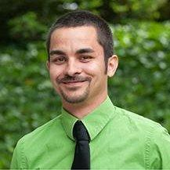
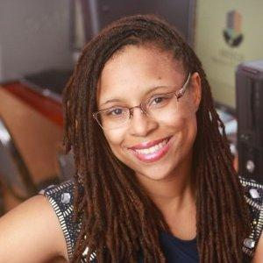
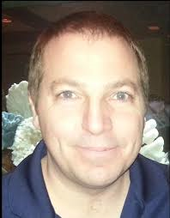
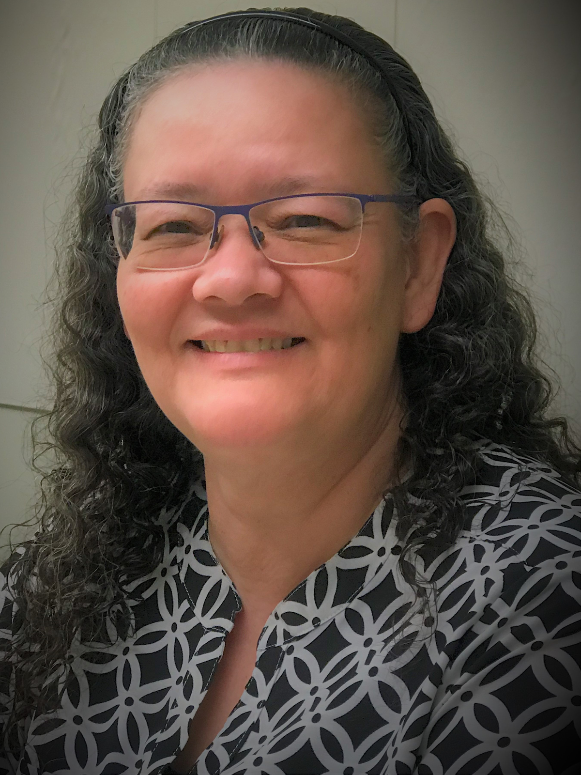
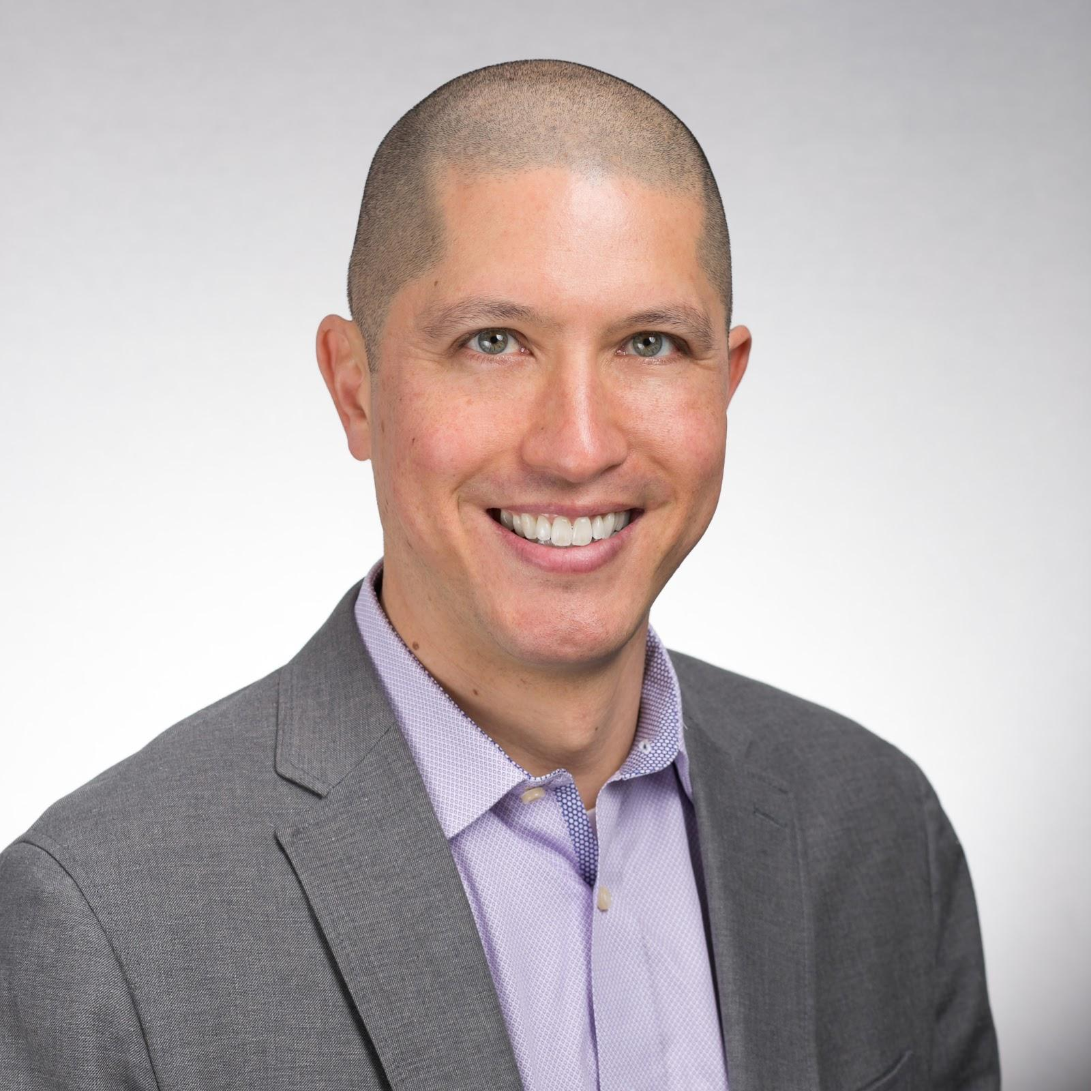
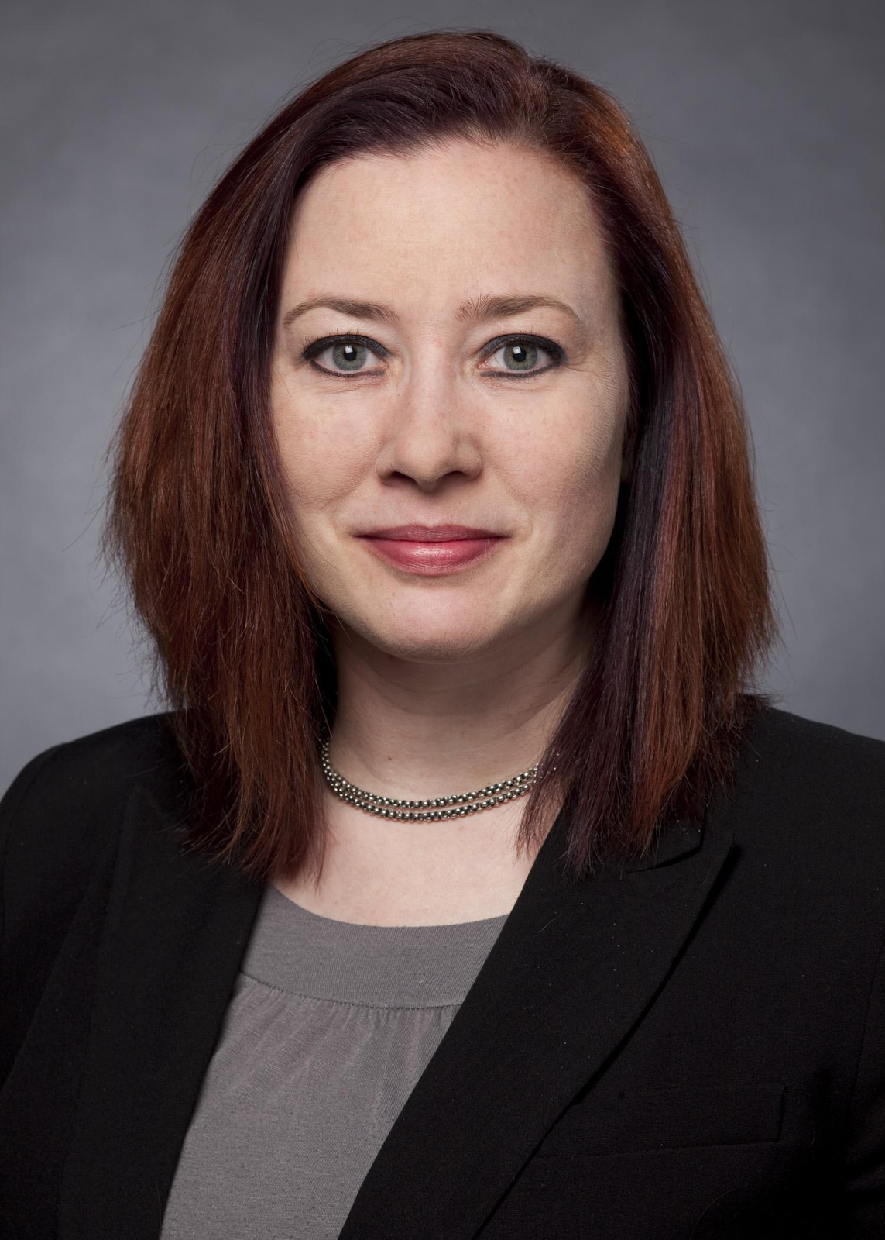
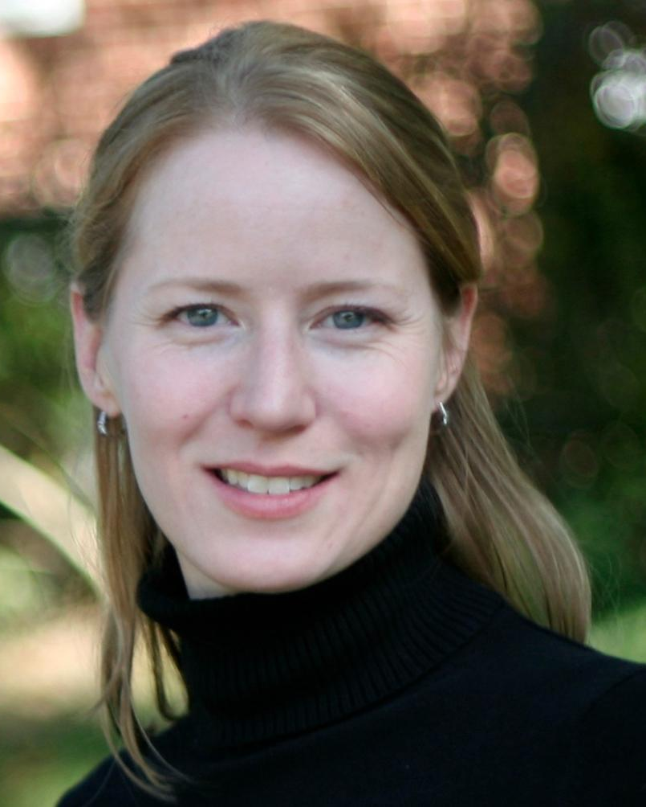
Today’s Speakers
Jonathan Hardy, University of Georgia (Young Professionals CG Leader)
Precious McKoy, Guilford College (SharePoint CG Leader)
Mitchell Pautz, University of Southern California (ITSM CG Leader)
Aixa Pomales, Swarthmore College
Joel Price, Swarthmore College
Beth Schaefer, University of Wisconsin-Milwaukee (Itana CG Leader)
Karen Wetzel, EDUCAUSE

Slide 3
Notes:
Karen intro slide

Slide 4
2018 CG Peer Mentoring Pilot
5 Community Groups • 18 Participants
January 19: Pilot Approved
March 7: Subgroup Kick-off Call
May 25: Finalize CG Leader Commitment
June 11: First Announcement
June 25: Open Application
July 6: Application Deadline
July 9: Select and Announce Participants
July 25: Confirm Initial Interaction
August 7: Initial Participant Webinar
August 31: Participant Check-in
September 14: Virtual Social
September 28: Midway Checkpoint
November 1: Mentoring Breakfast
November 9: Pilot Evaluation, Badges
November 29: Closing Webinar
December 7: Final Subgroup Call
Notes:
Karen intro slide

Slide 5
Participating Community Groups
Communications Infrastructure and Architecture
Itana (Enterprise Architects)
IT Service Management
Sharepoint/Office 365
Young Professionals
Notes:
Karen intro slide

Slide 6
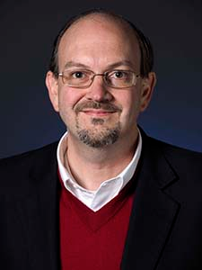
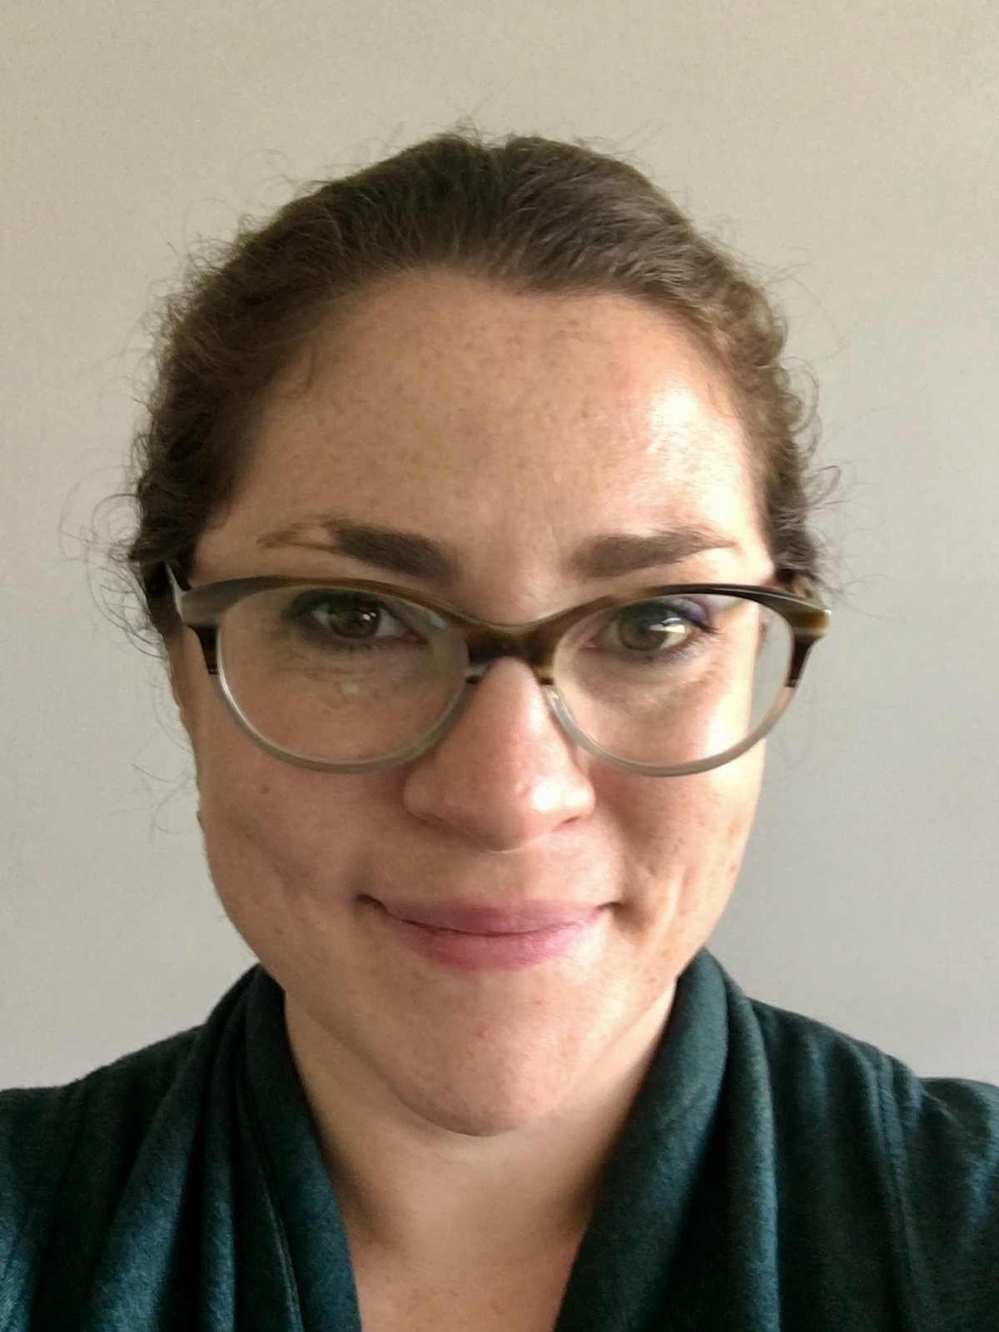
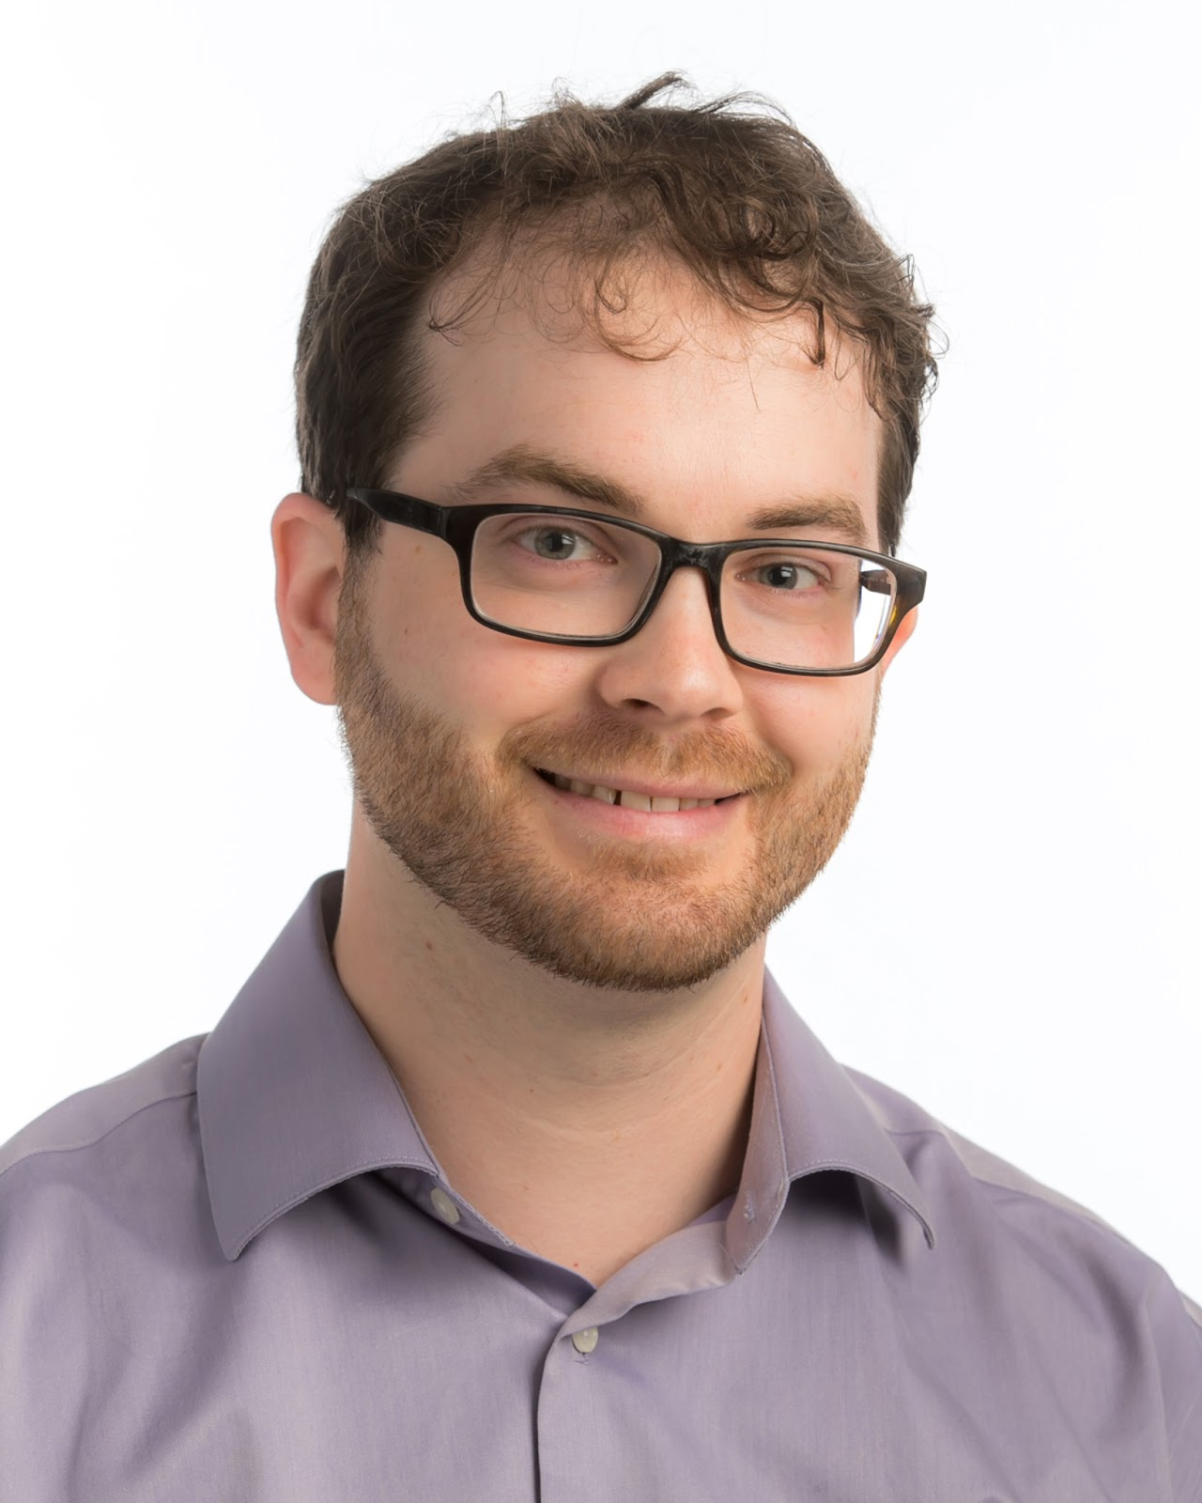
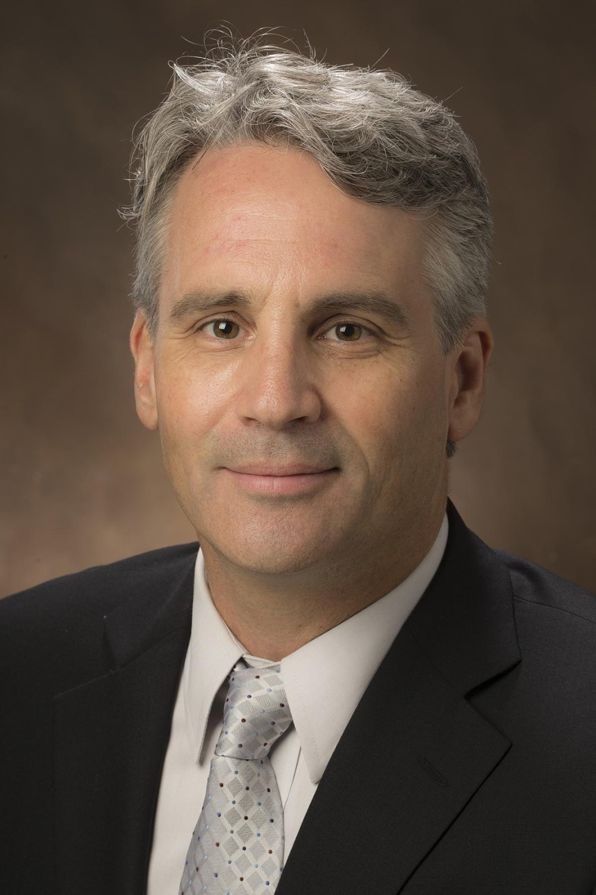
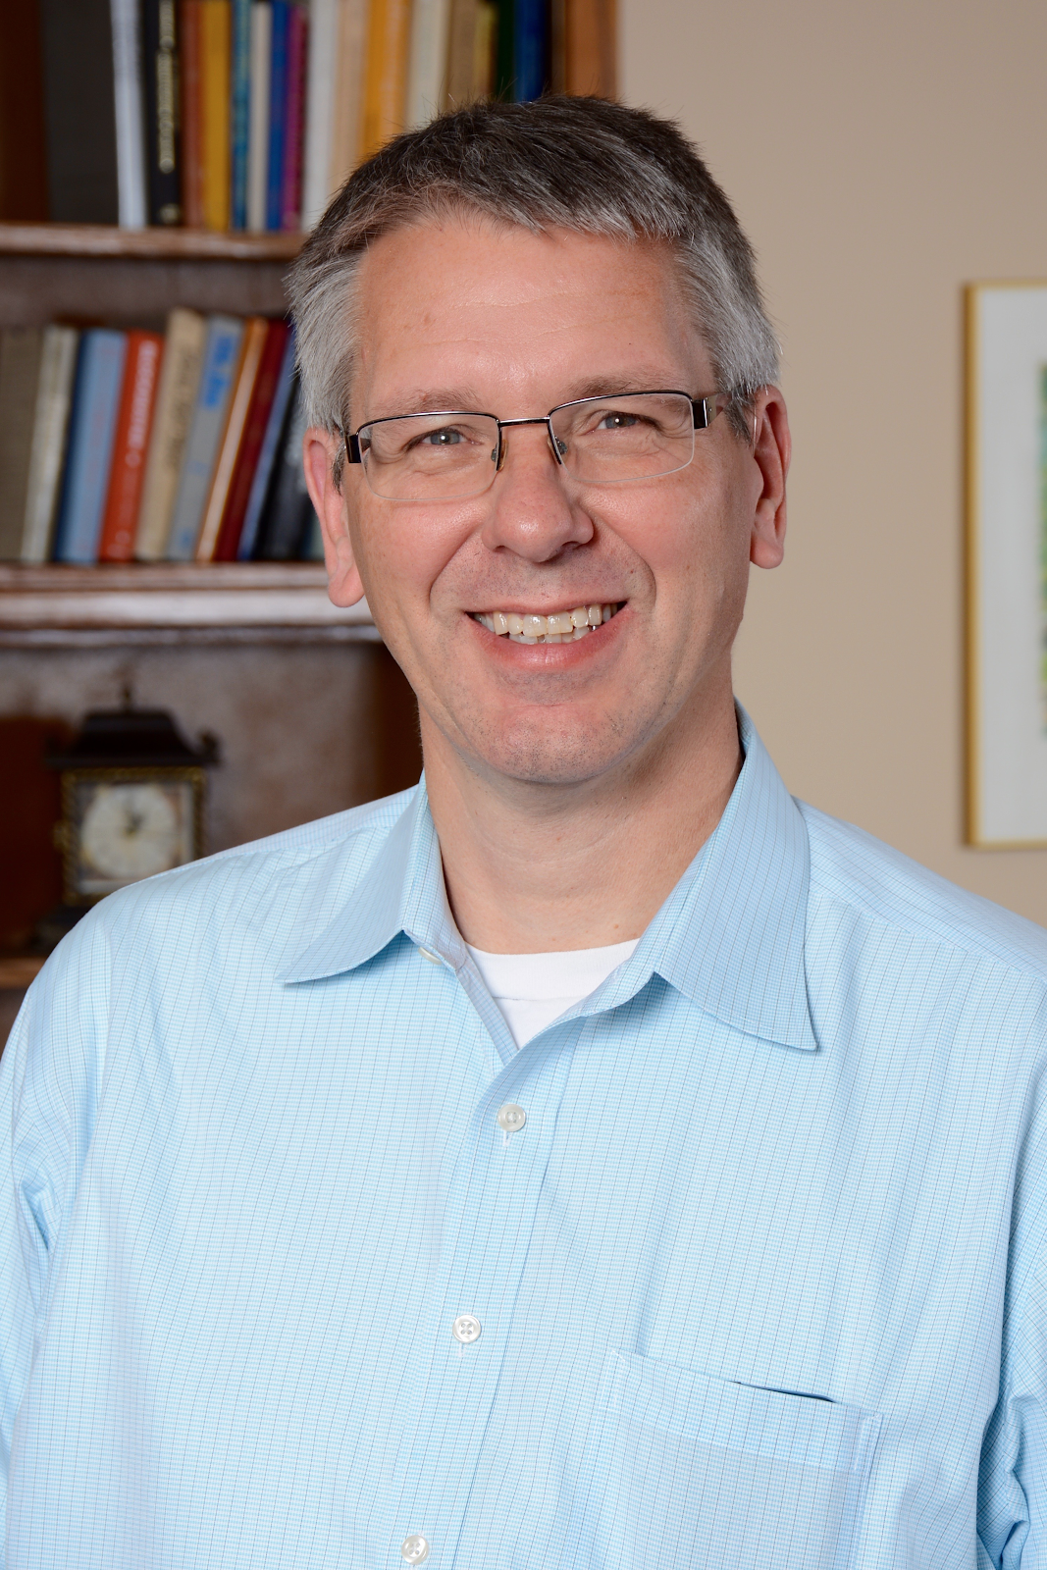
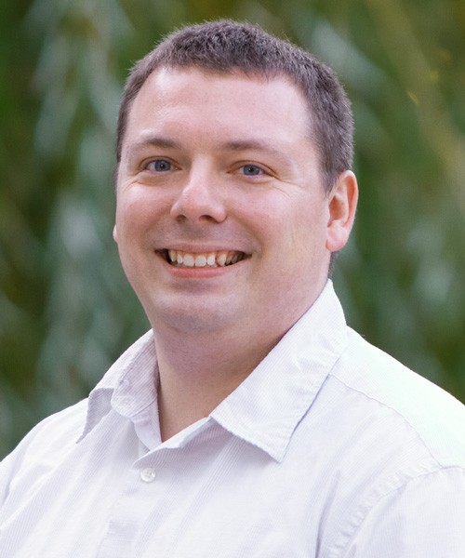
Participants
Communications Infrastructure and Applications CG
Chuck Aikman, Manager, Knowledge Management, Indiana University
Arthur Brant, Director, Enterprise Infrastructure, Abilene Christian University
Rachel Weaver, Client Services Manager, Macalester College
Itana (Enterprise Architects) CG
Dan Brubaker Horst, CTS Architect, University of Notre Dame
Dana Miller, Business Analyst, Miami University
Chris Eagle, Acting Director, Strategy & Planning Office of CIO and ITS, University of Michigan, Ann Arbor
Matthew House, Enterprise IT Architect, Washington University in St. Louis
Notes:
Karen intro slide

Slide 7
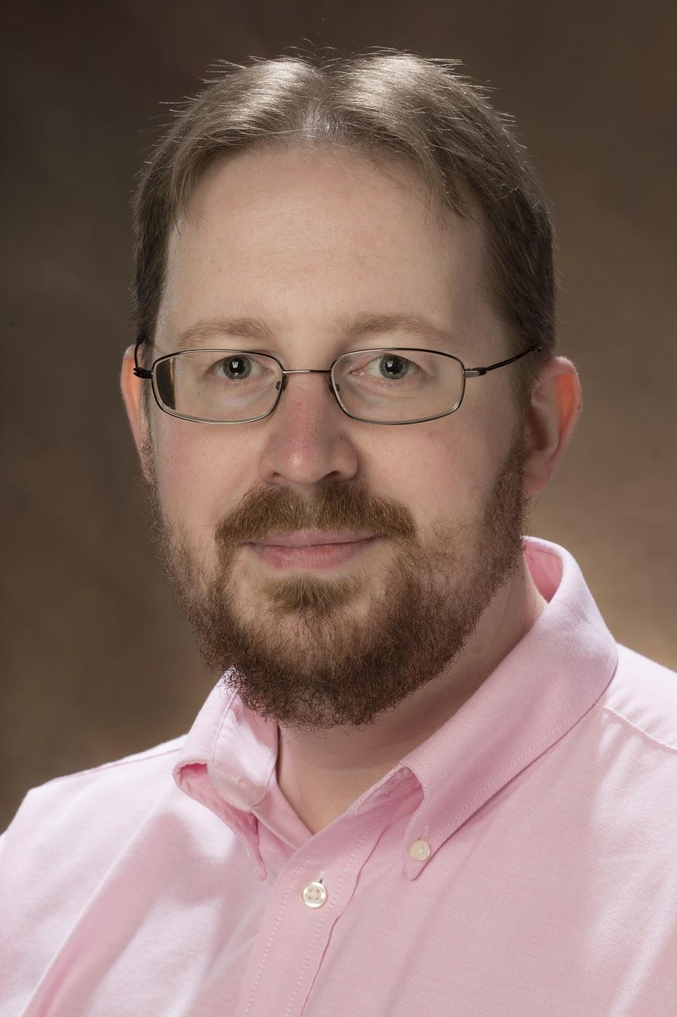
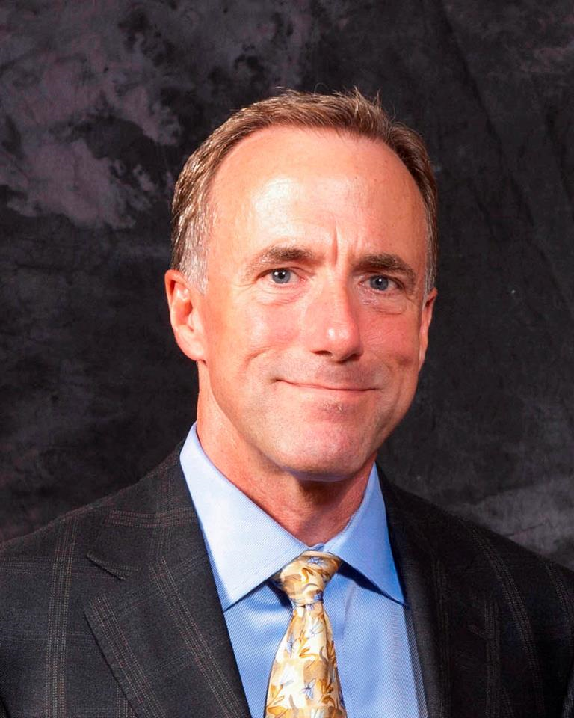
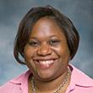
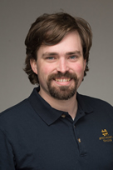
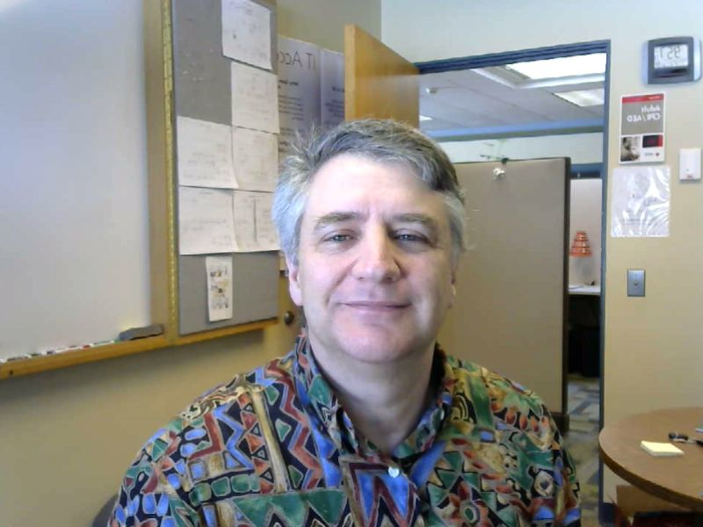
Participants
ITSM Community Group
Pete Ferris, Service Management Analyst II, Miami University
John Lowe, CMT Team Lead, Northern Arizona University
Veronica Rosel, Assistant Manager Technical Support Operations, Rutgers University
Joseph Caudle, Manager, Auxiliary Operations IT Solutions, University of Notre Dame
Michael Cyr, Director, Architecture & Service Management, University of Maine System
Notes:
Karen intro slide

Slide 8
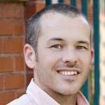
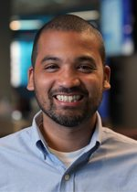
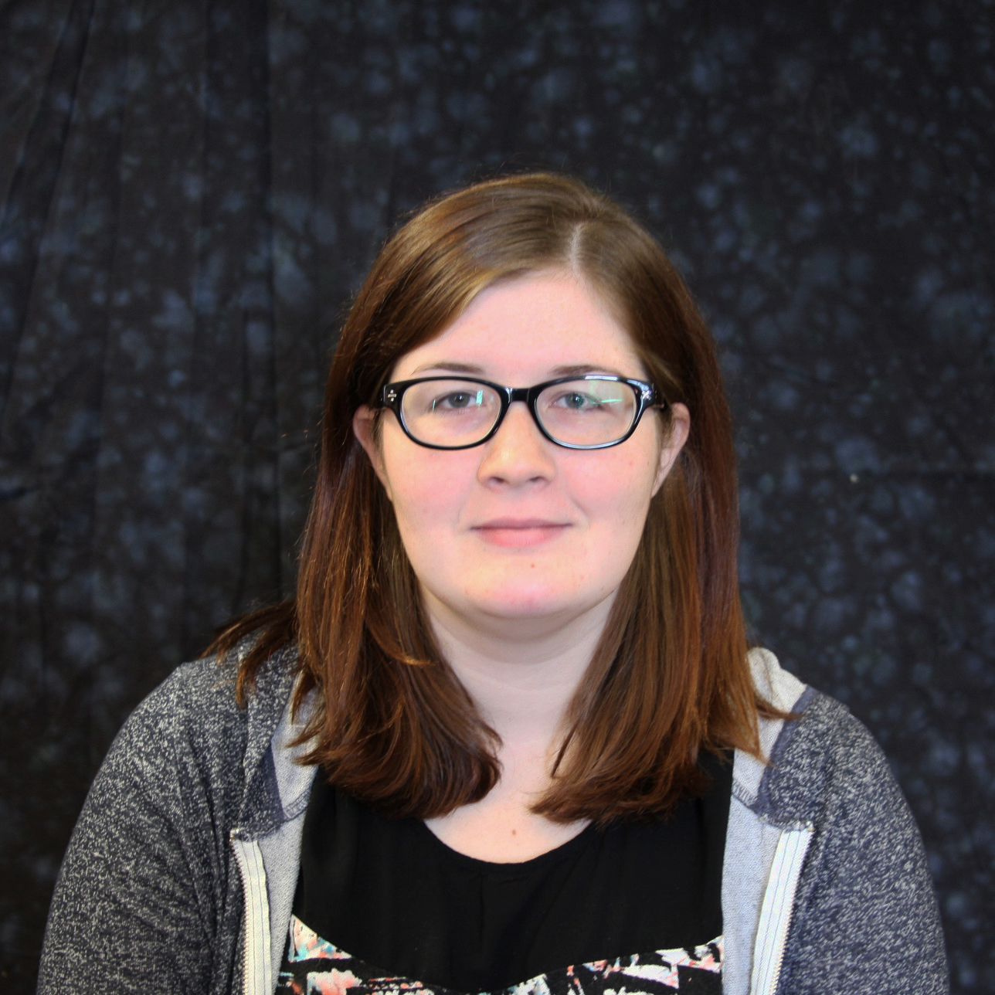
Participants
Sharepoint/Office 365 Community Group
Josh Henderson, Senior SharePoint Administrator, Auburn University
Rajaa Shindi, Systems Developer, New Mexico State University
Young Professionals Community Group
Chad Marchong, Manager, Learning Analytics, Georgia State University
Joel F. W. Price, Technology Outreach Team Lead, Swarthmore College
Aixa Pomales, Director of Support Services, Swarthmore College
Patricia Carpenter, User Support Services Manager, Harvey Mudd College
Notes:
Karen intro slide

Slide 9
CG Leaders Discussion
Jonathan B. Hardy, University of Georgia (Young Professionals CG Leader)
Mitchell Pautz, University of Southern California (ITSM CG Leader)
Notes:
Discuss from CG leaders - Mitch, Jonathan
- Brief origin story
- Our experience as organizers
- Where we want to take it next year

Slide 10
CG Leaders Subgroup
Jonathan B. Hardy, IT Director, University of Georgia (Young Professionals)
Mark Katsouros, Director, Service Design & Development, The Pennsylvania State University (Communications)
Precious McKoy, Web Developer, Guilford College (Sharepoint)
Mitchell Pautz, IT Service Management Analyst, University of Southern California (ITSM)
Beth Schaefer, Chief Operating Officer, University of Wisconsin-Milwaukee (Itana)
Notes:
Chatter/feedback about mentoring from list
late 2017 reached out to EDUCAUSE/Karen
Researched existing program - Beth Rugg (SIGUCCS)
Expressed an interest in topic specific mentoring program vs professional growth or career advancing
Reached out to most of the CG leaders
Several CG expressed interest
in the end 5 participated
Top 3 delights - appreciating the value of mentoring from experienced organizers, hearing about positive and enriching experiences from the participants, collaborative nature of the subgroup
Top 3 surprises/challenges - struggle of process in pairing peers, unclear expectations of the participating members, and for some the feedback that selecting a topic of focus was tough/needed more guidance

Slide 11
Peer Mentoring: Tentative Planning for 2019
Expand CG Participation
Slightly Lengthen Duration
More Support Materials
Two Instances
Annual Conference “Reunion”
Notes:
Commitment in the future: be more engaged with the participating members, provide some prescriptive guidance ahead of time
Two instances: start early spring - end conference | start after conference - end before next instance

Slide 12
Participants Discussion
Aixa Pomales, Swarthmore College
Joel F. W. Price, Swarthmore College
Notes:
B. Participants discussion - Joel, Chris, and Aixa
- Share experience being in the pilot
- What they learned about themselves and each other
- What topics are they discussing
- What did peer mentoring mean to you?

Slide 13
Open Table and Q&A
Precious McKoy, Guilford College (SharePoint CG Leader)
Beth Schaefer, University of Wisconsin-Milwaukee (Itana CG Leader)
Notes:
C. Open table – allow audience to join one of these conversations - Precious and Beth to facilitate
- Topics
- What is mentoring/peer mentoring
- Pilot organizers QA

Slide 14
For More Information...
Are you a community member who would like to participate in the 2019 CG Peer Mentoring program?
Are you a CG leader interested in offering mentoring to your community?
Do you have more questions about the pilot or just want to chat? ;)
Karen Wetzel Director, Community and Working Groups kwetzel@educause.edu

