Slide 1

“Small Change is Big Change”
Hosted jointly by:
EDUCAUSE Women in IT and ITSM Community Groups
September 18th, 2018
Notes:
Introductions - Todd - Start :03
Event Facilitation
Housekeeping
Welcome everyone
We will be recording this session
Dial in if you encounter computer audio issues
Trying something new to provide more interactivity and engagement
Begin recording
On behalf of the Educause ITSM and Women in IT Community Groups
Thank you for attending
Next
Slide deck

Slide 2
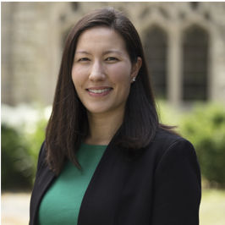
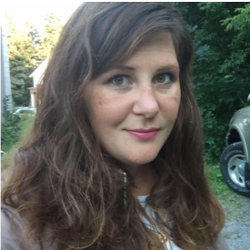
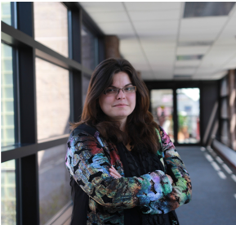
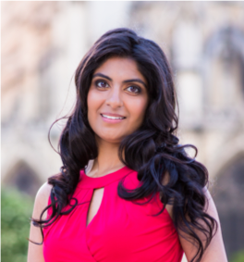
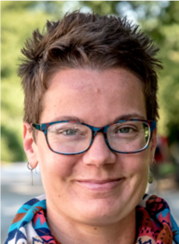
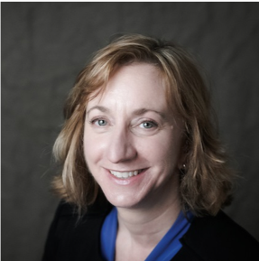
Welcome
Jackie Milhans
Northwestern University
Becky Nelson
University of Minnesota Duluth
Claire Krendl Gilbert
Virginia Tech
Tina Pappas
Rutgers University
Marcia L. Dority Baker
University of Nebraska
Sandra Silk
Harvard University
#EDUchangemaker
Notes:
Todd - :03
Quick overview of topics
Distinguished panel guests
Next

Slide 3

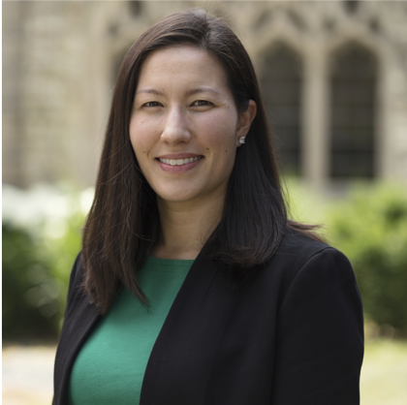
Jackie Milhans
Recruiting, Hiring, and Communication
In Northwestern IT Research Computing Services, we’ve made changes in how we write job descriptions, how we interview, and how we build communication skills on our team. These small changes have led to a wider candidate pool, faster hiring, and open communication on our team.
Manager, Computing and Data Support Services
Northwestern University
milhans@northwestern.edu
https://members.educause.edu/jackie-milhans
@jmilhans
#EDUchangemaker
Notes:
Jackie - :time

Slide 4
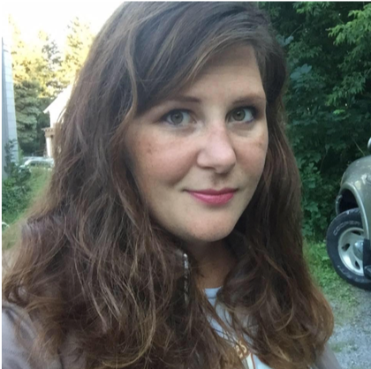
Becky Nelson, Identifying Allies, Bystander Intervention,
Changing Interpersonal Behavior
Staff and management have worked together in Information Technology Systems & Services at UMD on identifying allies, implementing bystander intervention training, limiting interruptions, and conducting listening sessions with employee groups. These small changes impact our day to day work in big ways.
Student Support for
Online & Hybrid Courses
University of Minnesota Duluth
rmnelson@d.umn.edu
https://itss.d.umn.edu/faculty-staff/becky-nelson
#EDUchangemaker
Notes:
Jackie - :time

Slide 5
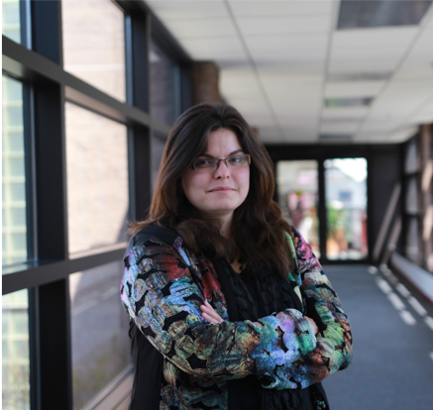
Claire Krendl Gilbert
Diverse Workforce, Building Communities, Inclusive Culture
Some of the small changes we’ve pursued at Virginia Tech as part of our broader diversity and inclusion strategy include updating our recruiting venues and practices, creating new structures that add capacity and help sustain transformation goals, implementing an IT-specific climate survey, and running a range of campus and K-12 outreach and engagement events around diversity and inclusion in IT and STEM.
Executive Director,
IT Experience & Engagement
Virginia Tech
gilbertc@vt.edu
https://members.educause.edu/claire-krendl-gilbert
@ckrendlgilbert
#EDUchangemaker
Notes:
Jackie - :time

Slide 6
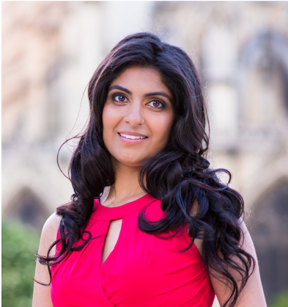
Tina Pappas
Building Community
With over 1,000 IT employees working throughout the state of New Jersey for a decentralized institution, it’s difficult for technology staff in distributed and central units to even be aware of one another let alone connect and develop relationships. Tools like Slack and good ol’ mailing lists coupled with the determination of some inspired changemakers has helped build bridges in dynamic ways. Rutgers IT continues to evolve from a workforce of professionals to a community of partners.
Assistant Director, IT
Rutgers University
t.p@rutgers.edu
https://members.educause.edu/tina-pappas
#EDUchangemaker
Notes:
Jackie - :time

Slide 7
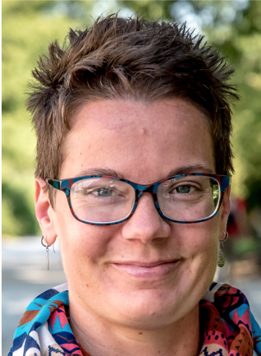
Marcia L. Dority Baker
Peer Groups, Building Community, Inclusive Culture
The BTAA Women in IT Peer Group was officially approved by the BTAA CIOs this Summer 2018. The purpose of the group To proactively support and foster collaboration on best practices for the effective recruitment, retention and advancement of women in IT at Big Ten Academic Alliance member institutions. To improve the climate and productivity of our IT enterprises, and better align with our institutional goals.
Assistant Director,
Academic Technologies
Office of Information Technology Services
University of Nebraska
MDorityBaker@nebraska.edu
https://members.educause.edu/marcia-dority-baker
@MarciaLDB
#EDUchangemaker
Notes:
Jackie - :time

Slide 8
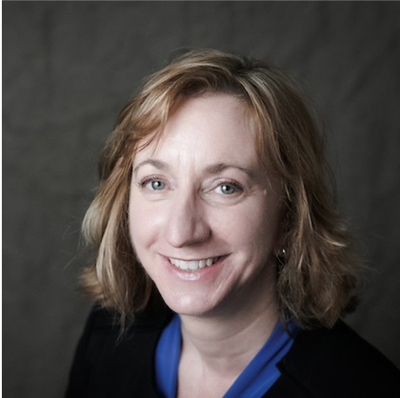
Sandy Silk
Women in IT Mentoring Program
The HarvardWIT group recently was awarded grant money from the President’s Administrative Innovation Fund to start up a grass roots WIT Mentoring program. Today I’m sharing with you detail about a drop-in coaching session we coordinated at the annual internal IT Summit at Harvard in June, in preparation for the more formal mentoring program we’re preparing to launch later this month. The coaching session was a simple and free event others could replicate easily.
Director, Information Security
Education & Consulting
Harvard University
sandra_silk@harvard.edu
https://members.educause.edu/sandra-silk
#EDUchangemaker
Notes:
Jackie - :time

Slide 9
Poll Question
Does your institution offer a Women in IT mentoring program?
Yes, we already have one in place
We are actively planning one to launch soon
We are interested, but not yet planning one
No, it’s not on our radar

Slide 10
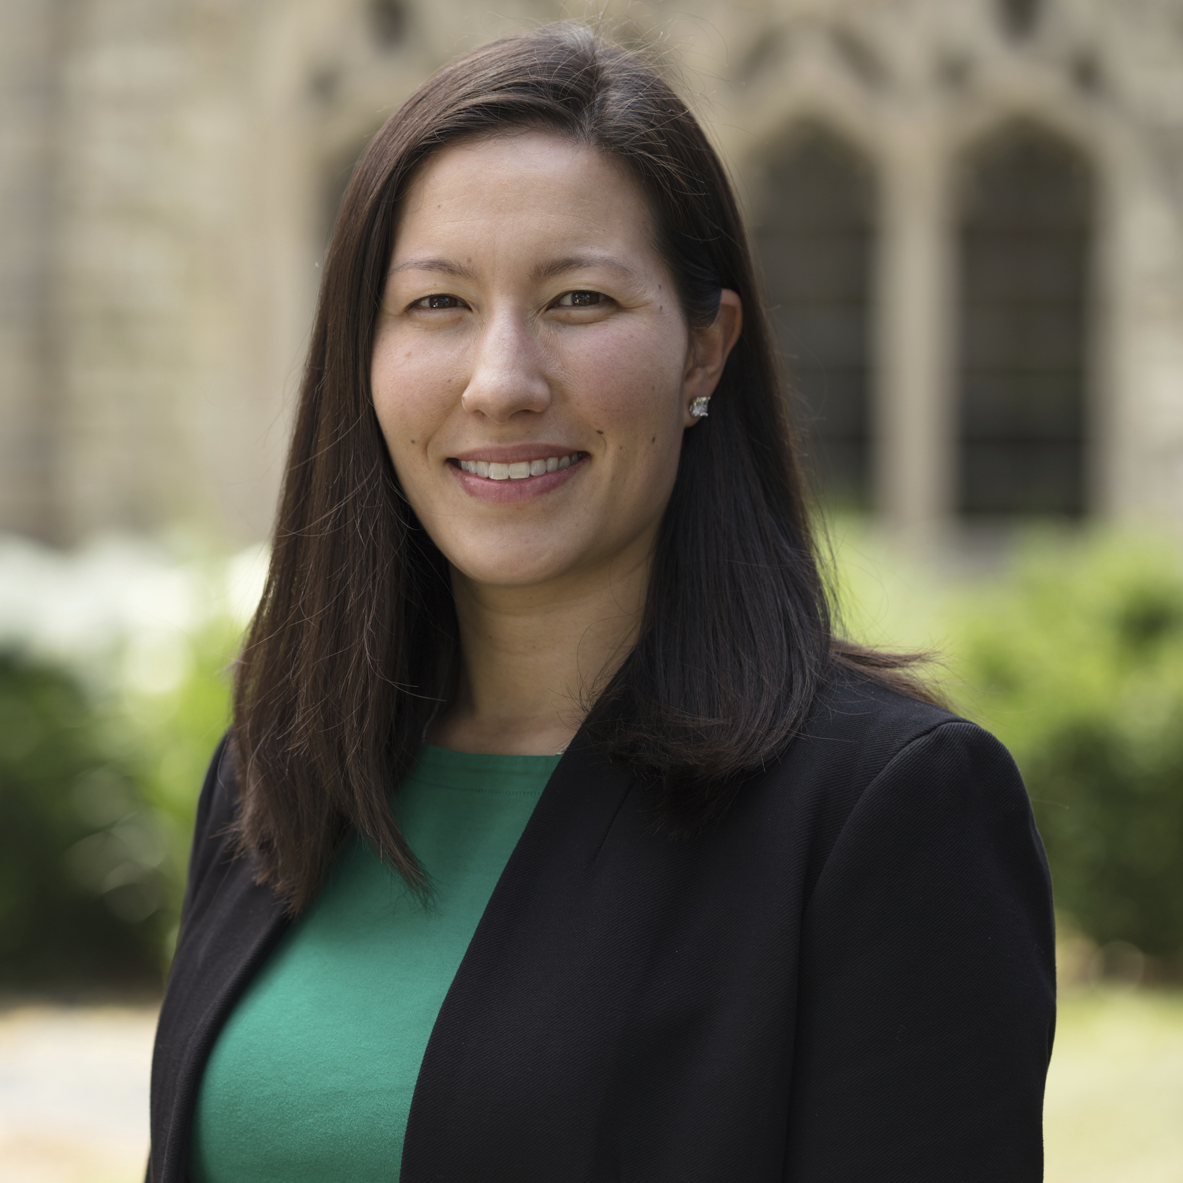
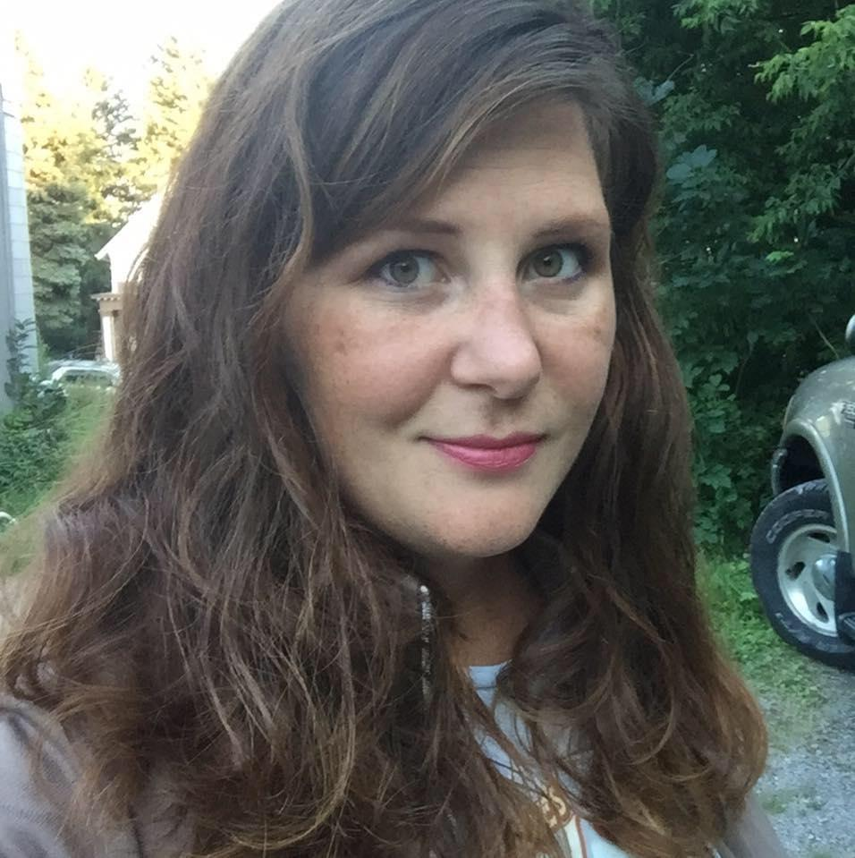
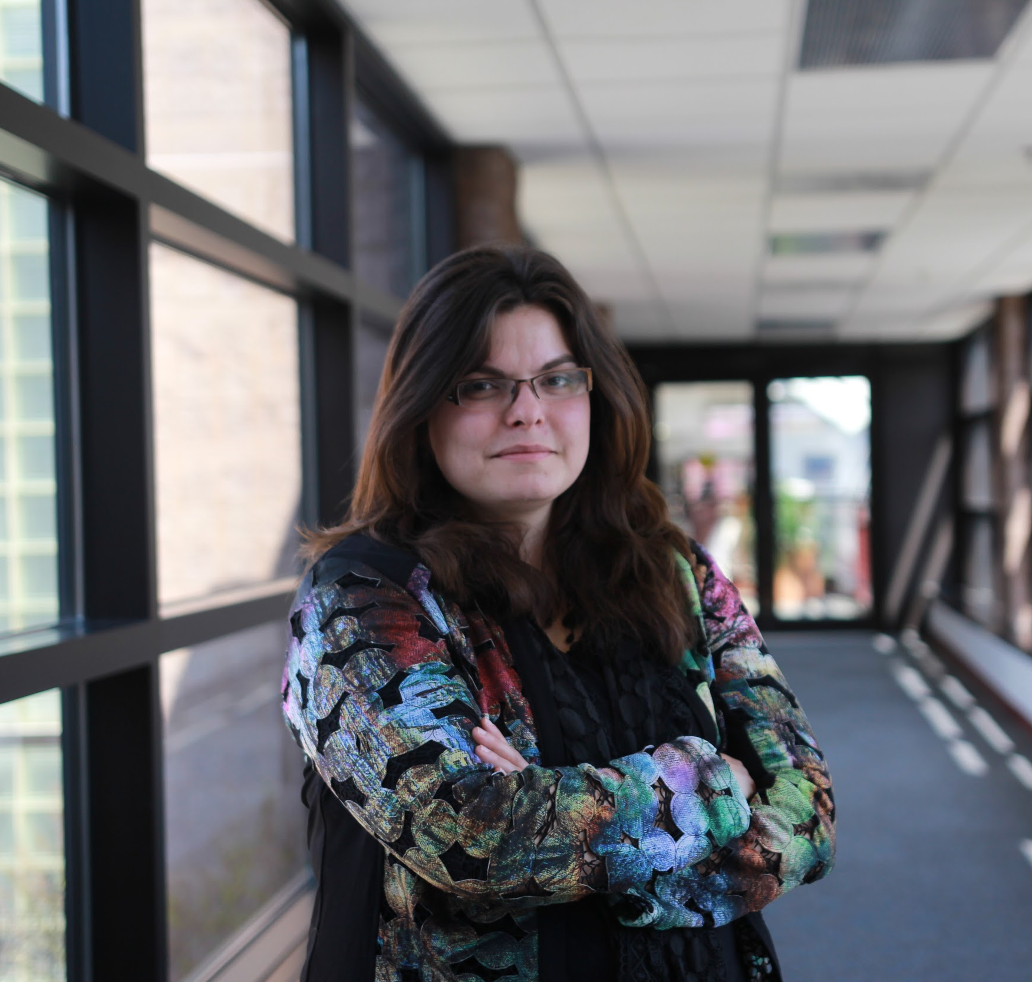
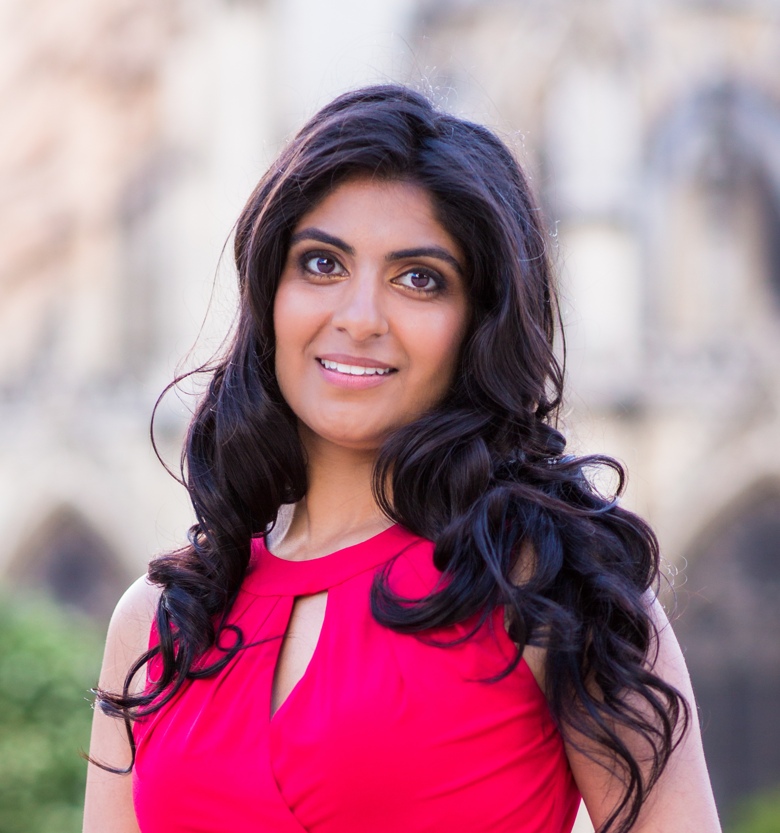
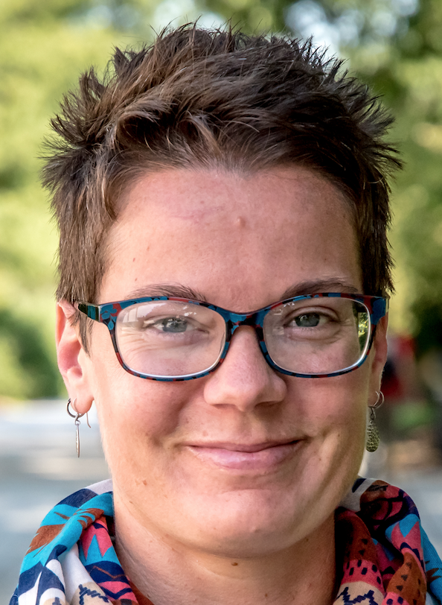
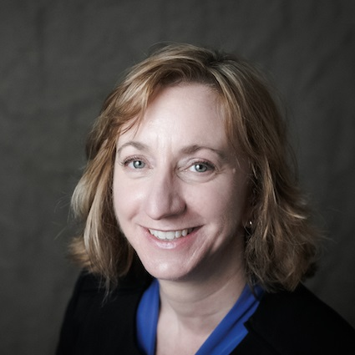
Q&A
Jackie Milhans
Northwestern University
Becky Nelson
University of Minnesota Duluth
Claire Krendl Gilbert
Virginia Tech
Tina Pappas
Rutgers University
Marcia L. Dority Baker
University of Nebraska
Sandra Silk
Harvard University
Notes:
12. Audience :57

Slide 11
Thank you for attending!
Learn more about and join
EDUCAUSE Community Groups at: https://www.educause.edu/community/
Notes:
Todd - 58
http://bit.ly/itsm-cg-feedback

