Slide 1
Robot Writers
And the future of OER
Kyle Bowen
Director, Education Technology
kbowen@psu.edu
@kyledbowen
Bart Pursel
Affiliate Faculty,
College of Information Sciences and Technology
Manager, Faculty Programs
bkp10@psu.edu

Slide 3
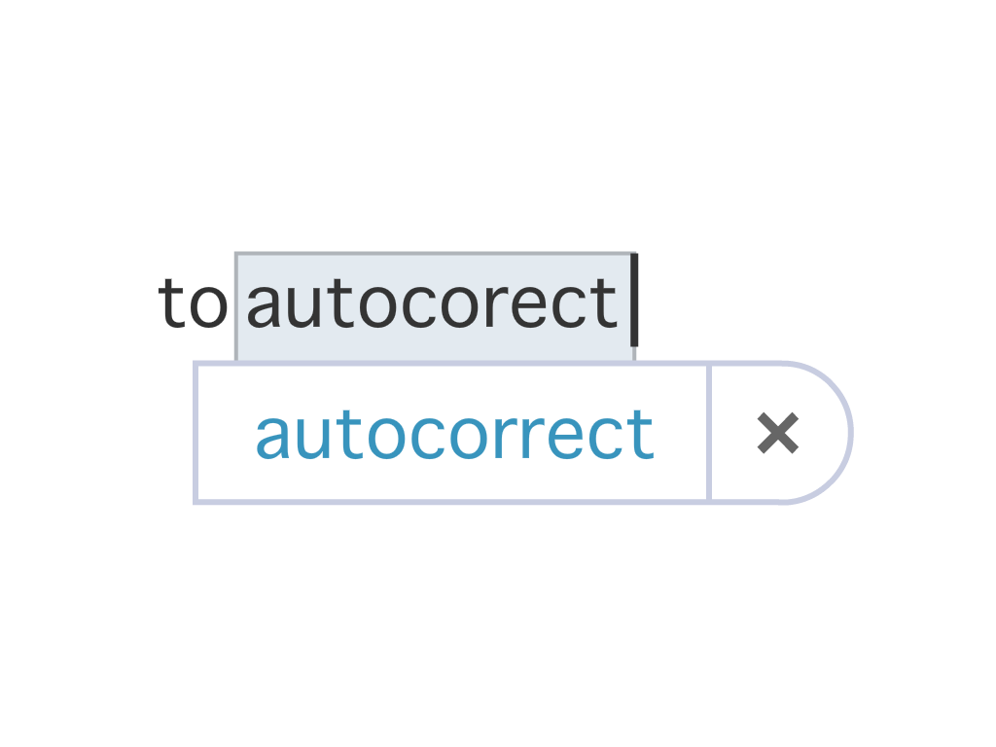

Slide 4
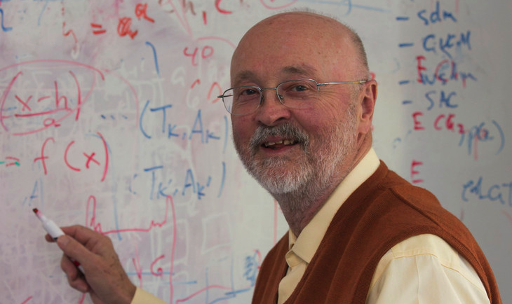
TLT Fellows – C. Lee Giles

Slide 6
For good and not evil?

Slide 7
AP, NCAA to grow college sports coverage with automated game stories
March 4, 2015
The Associated Press, working with data from the NCAA, plans to use automation technology to provide thousands of stories about college sports previously not covered by the news organization.

Slide 8
What does this mean for
Teaching?

Slide 10
Adapted from CIRTL MOOC, stemteachingcourse.org

Slide 11
HUMAN-ASSISTED
COMPUTING

Slide 12
A textbook generated by a computer algorithm, then reviewed by an expert is: Very Credible Credible Somewhat Credible Not Credible

Slide 14
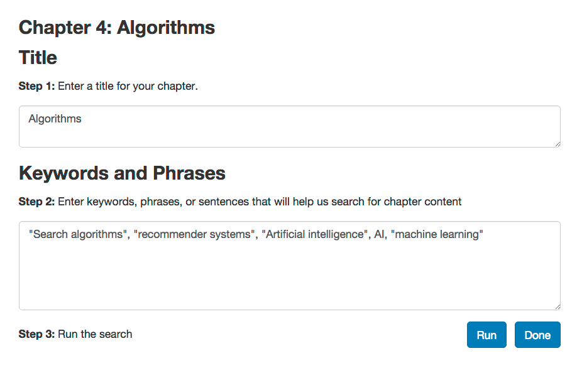

Slide 15
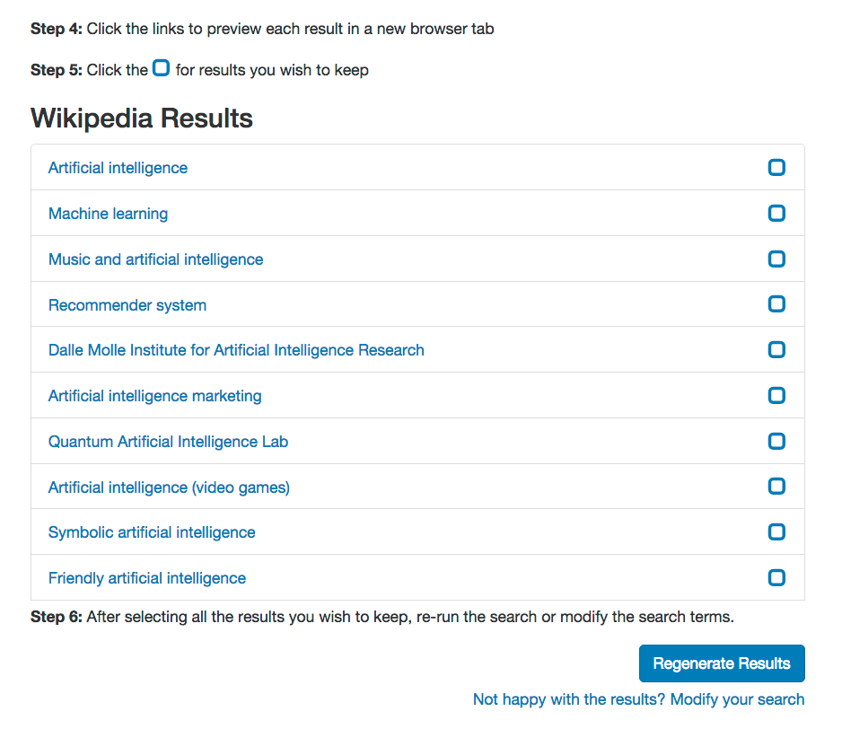

Slide 16
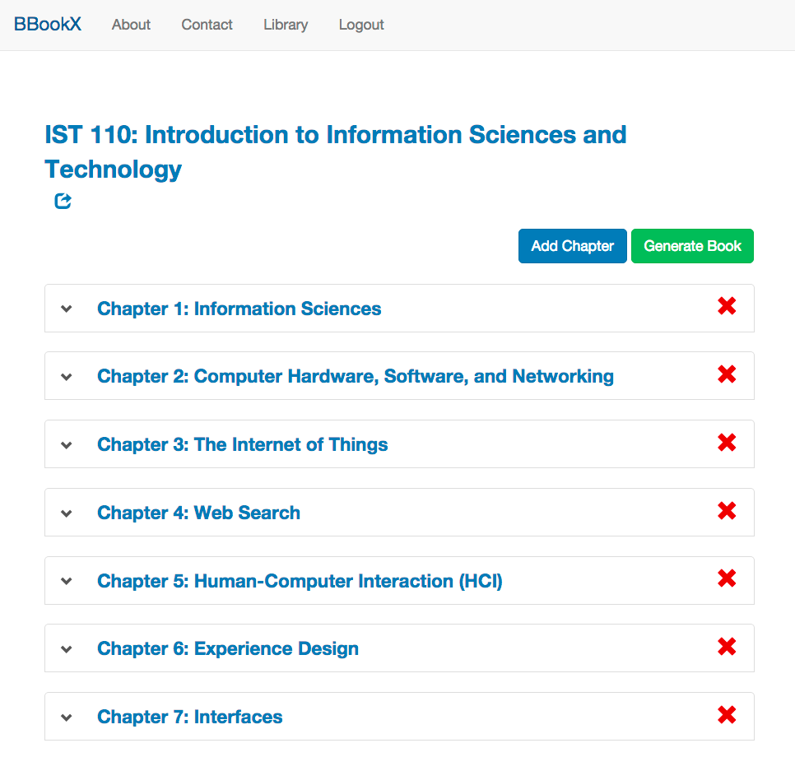

Slide 17
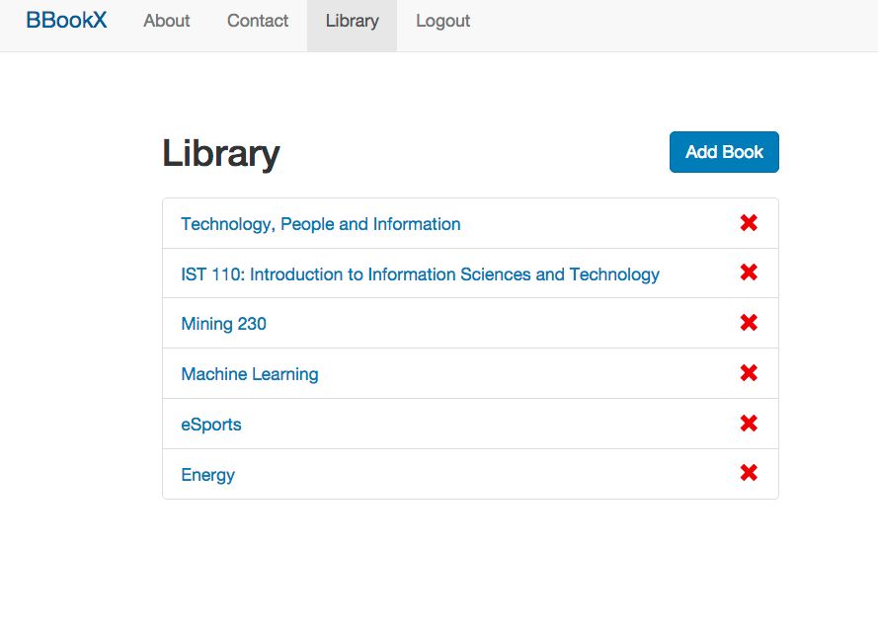

Slide 18
Case Study
IST 110

Slide 19
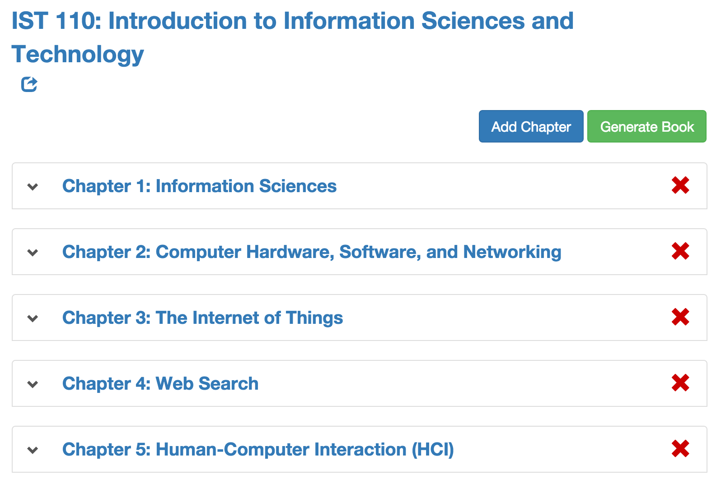
The “Book”

Slide 20
85%
Prefer this type of textbook over purchasing a traditional textbook
Notes:
Always available online
Available on multiple devices

Slide 21
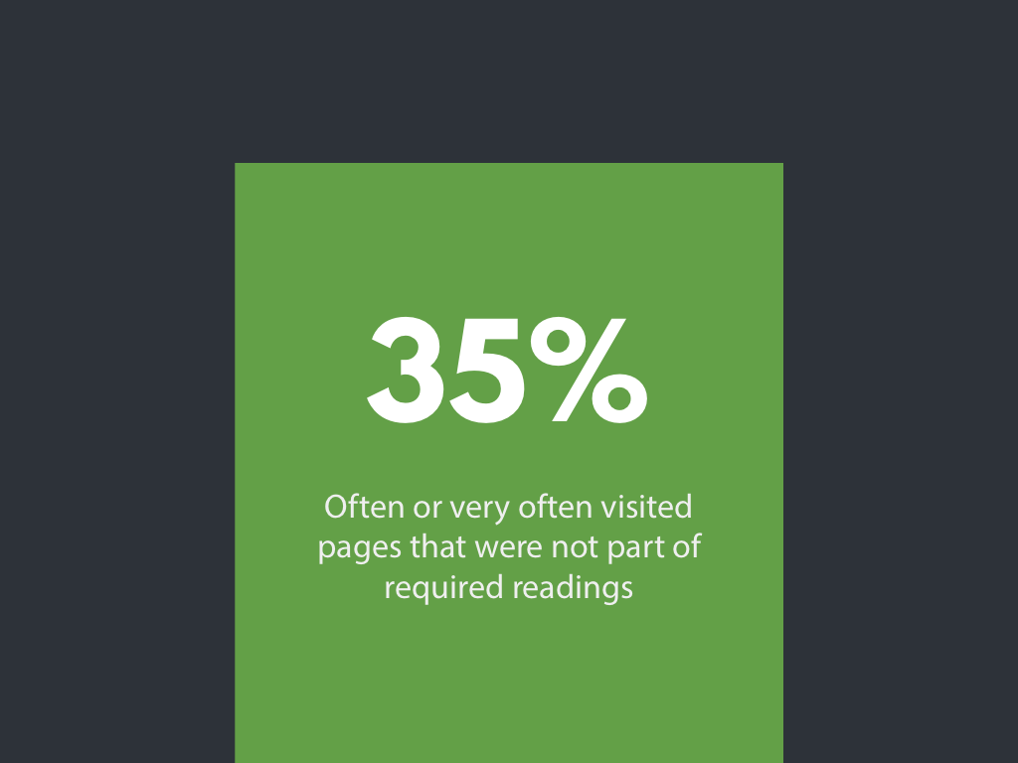
35%
Often or very often visited pages that were not part of required readings

Slide 22
$15k
Notes:
Total cost of textbooks for my class, if students purchased textbooks for IST 110.

Slide 23
When students make their own book
73%
BBooKX surfaced content they never encountered before in their major.
Notes:
Students build a book, intersection of IST and their major
73% indicated BBooKX surfaced content they never encountered before in their major.

Slide 24
Design-based
research

Slide 25
Student
GENERATED CONTENT
Notes:
Students creating content that can then be used as part of a course. Students can use BBookX to create study guides, then the best study guides can be integrated into the course the next semester.

Slide 26
Learning
GUIDANCE SYSTEM
Notes:
Students can use BBookX to help them hone in on topics they want learn more about. The algorithms act as something akin to a personal learning tutor or guide.

Slide 27
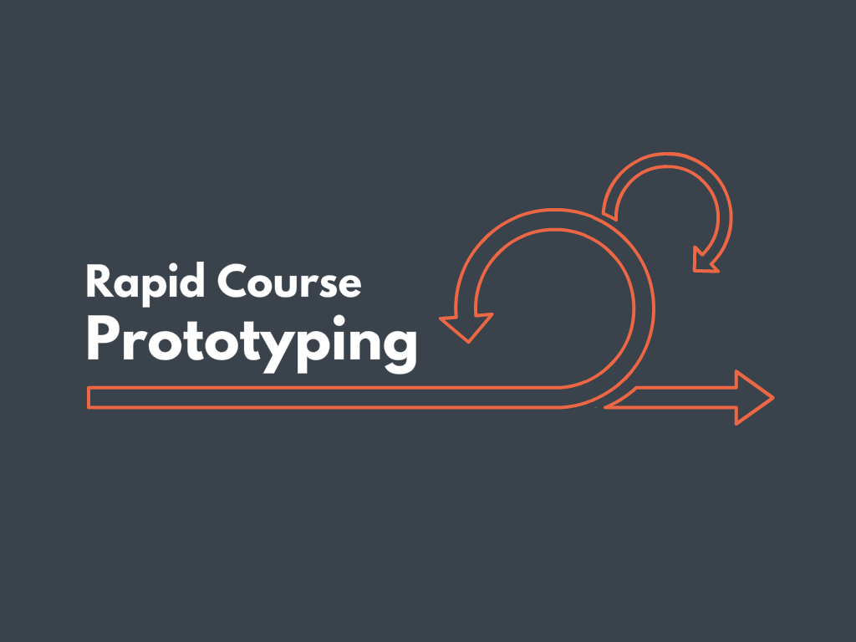
Notes:
Similar to Paul Otlet example. If you are putting together a course, BBooKX can act as a tool that can help you find new content, examples, cases, etc.

Slide 28
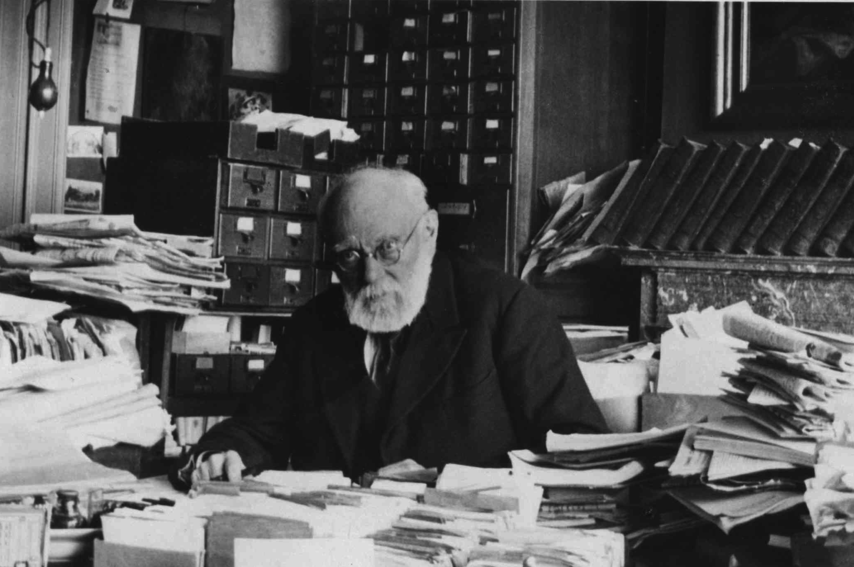
Notes:
Paul Otlet

Slide 29
What’s next?
Notes:
Can we take a similar approach to creating courses, assessments, other things? The same approach as we use with BBookX.

Slide 30
What will be bionic?
Notes:
Can we take a similar approach to creating courses, assessments, other things? The same approach as we use with BBookX.

Slide 31
Simplification
Original | Simplified
Poll finds Americans OK with women in combat. | Women get the OK to fight in combat units, public approves.
Wars of the future will be fought with American women on the front lines and the public has no problem with it. | American women will soon be able to fight in wars.

Slide 32
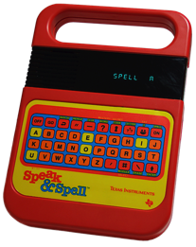
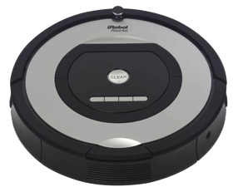
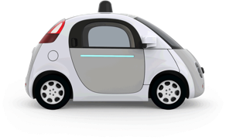
Speak & Spell
Furby
Roomba
Google Car
Model
Make connections
Topic discovery
What should the
material include?
Share
Construct a message
Establish structure
What is the right sequence?
Guide
Apply a specific skill
Match form and purpose
Does the material reflect the intended use?
Independent
Generate structured writing
Make choices
What do you want to create today?

Slide 33
Learn more at
bbookx.psu.edu

Slide 34
Robot Writers
And the future of OER
Kyle Bowen
Director, Education Technology
kbowen@psu.edu
@kyledbowen
Bart Pursel
Affiliate Faculty,
College of Information Sciences and Technology
Manager, Faculty Programs
bkp10@psu.edu

