Slide 1
The Here and Now of Higher Ed IT Governance, Risk, and Compliance Efforts
Jacqueline Bichsel, PhD
Senior Research Analyst
EDUCAUSE
AIRI, May 8, 2014

Slide 2
Notes:
IT GRC programs are in a state of development.
Institutions are unclear where they should start.
Uncertain as to whether they should develop programs in parallel or separately.
Resources and culture may dictate priority and progression.

Slide 3
EDUCAUSE Center for Analysis and Research (ECAR) IT GRC Survey
246 member institutions
Notes:
Questions about current programs in place for IT GRC, along with GRC processes used

Slide 4
The Current Landscape

Slide 5
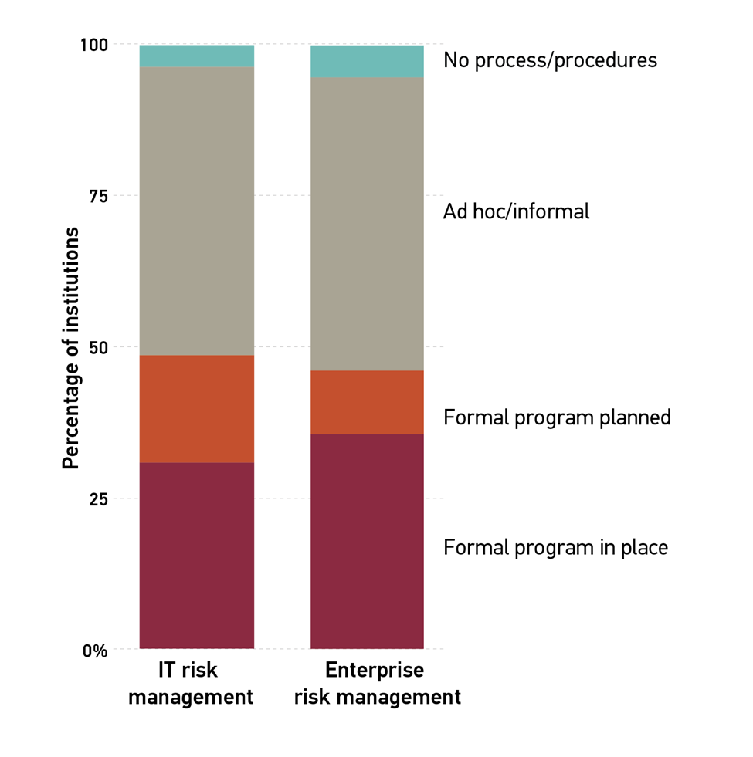
Risk Management
Notes:
Informal programs outnumber formal programs
A relatively smaller number have formal programs planned
Public and larger institutions are more likely to have formal programs

Slide 6
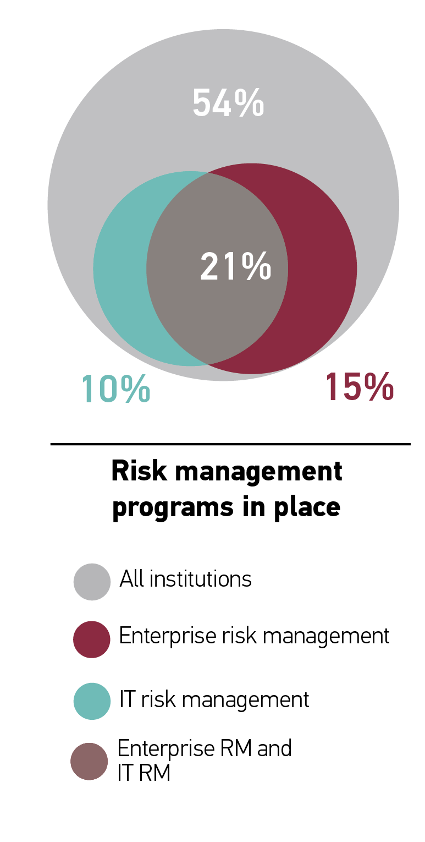
Notes:
1 in 5 institutions has both enterprise and IT RM
¾ of those with both enterprise and IT RM have them under the same umbrella
Those with a formal RM program (either enterprise or IT) are more mature in their RM efforts (discussed later)

Slide 7
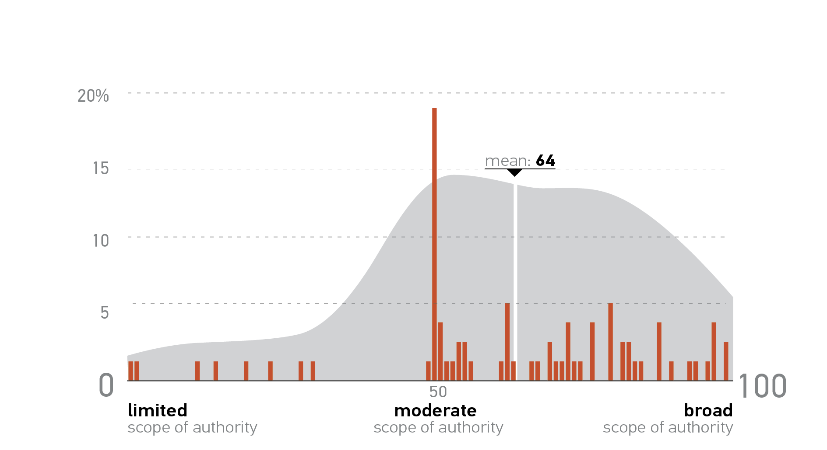
Most allow the risk management lead a moderate to broad scope of authority.
Notes:
Risk management leads are most often CISOs (38%) and CIOs (30%)

Slide 8
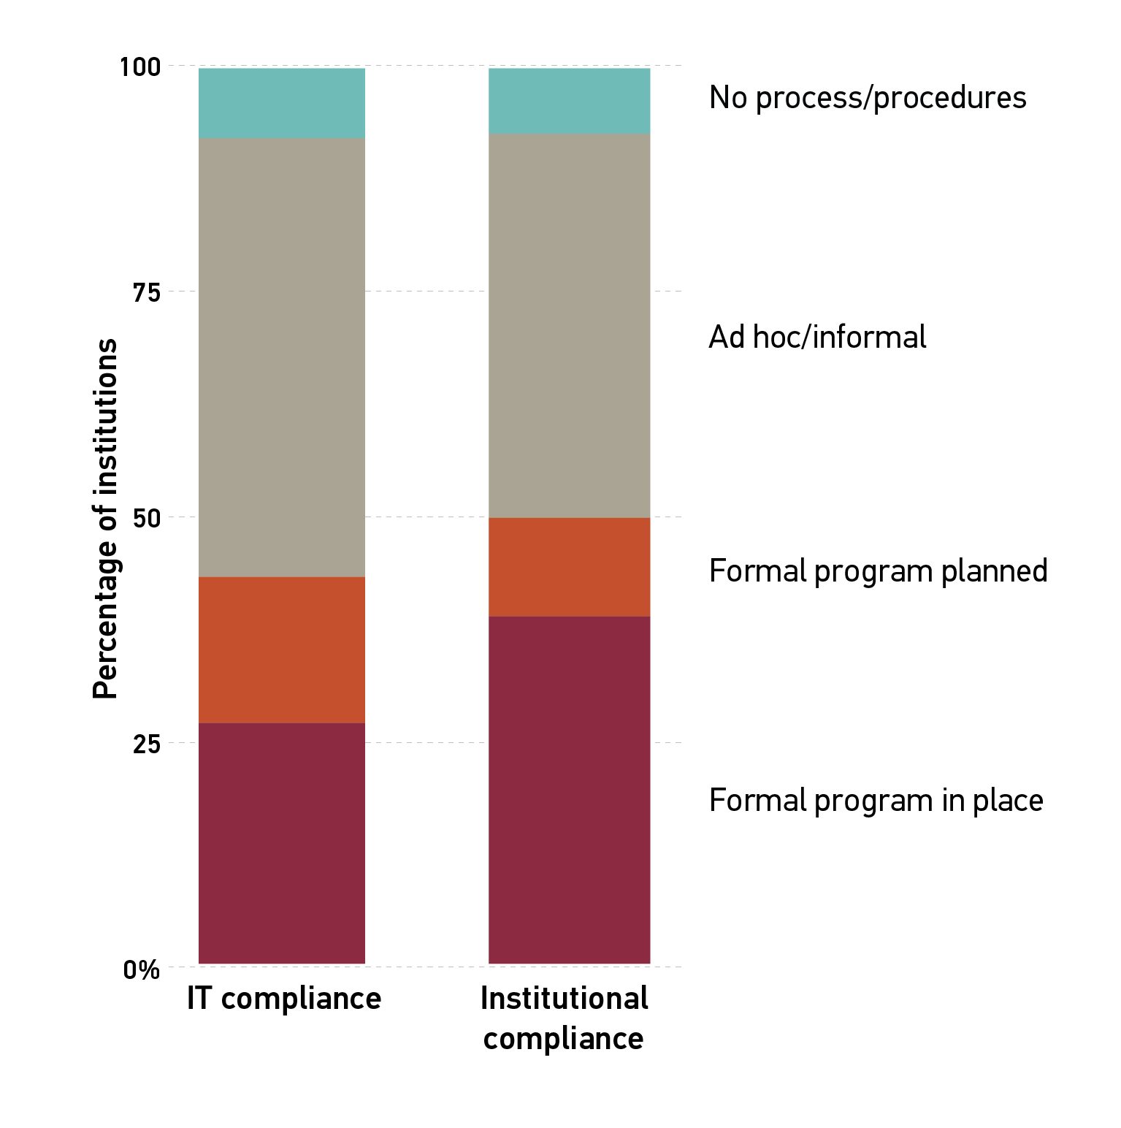
Compliance
Notes:
Informal programs outnumber formal programs
A relatively smaller number have formal programs planned

Slide 9
Notes:
¼ have both institutional and IT compliance
¾ of those with both institutional and IT compliance have them under the same umbrella

Slide 10
Compliance lead allowed a very broad scope of authority.
Notes:
1/3 led by CISO; 1/3 led by CIO
Significantly higher scope of authority
May be due to the fact that compliance is tied to regulatory requirements

Slide 11
Governance
Notes:
Most have institutional governance; over half have IT governance body
¾ of ITGBs are led by the CIO

Slide 12
Scope of the IT Governance Body
Notes:
Most frequent activities of ITGB concern advising
Service improvement and project priorities
Strategy
Service levels

Slide 13
Notes:
1/3 do not have any IT GRC programs in place
12% have all three in place
Many institutions are choosing to have either an IT RM or an IT compliance program
Only ½ of those with IT governance have IT RM or IT compliance

Slide 14
The IT Risk Environment

Slide 15
Balance between risk control and functionality/openness.
Notes:
Higher ed leans toward functionality and openness
No differences in CC, control, size, or RM lead
Makes sense for the unique mission of higher ed
Research and teaching necessitate certain freedoms and openness

Slide 16
Specific Risks
Notes:
Rated importance of several specific risks and effectiveness in addressing them
Information security is most important and has the largest gap between importance and effectiveness
Age of analytics and big data has pushed these risks to the forefront
High likelihood of impacting the institution’s reputation

Slide 17
81%
of institutions do not include IT risk in their institution’s strategic plan
Notes:
Lack of inclusion creates potential disconnect between institution strategy and IT execution
IT risk should not be limited to discussion within IT; potential impact for entire institution

Slide 18
Units Managing IT Risk
Notes:
Positively, IT has control over IT risk efforts
However, may be a sign that IT is viewed as something different
Need more institutional involvement:
adequate investment and leadership involvement
so that IT risk issues don’t go unrecognized

Slide 19
Frameworks Used in IT Risk Management
2 out of 3 institutions use at least one framework

Slide 20
The IT Compliance Environment

Slide 21
IT Compliance Issues
Notes:
1 in 5 feels there is adequate budget or staffing for compliance
All are associated with having either RM or compliance program (institutional or IT)

Slide 22
Notes:
Half of respondents think the regulatory environment is too complex
Payment Card Industry Data Security Standard is most difficult
Contract elements change regularly without HE input
FERPA easiest
Oldest existing privacy regulation
Less liability-rich

Slide 23
The IT Governance Environment

Slide 24
Those with an ITGB are more likely to:
Involve other departments in decision-making
Influence leadership
Formulate binding policy
Guide IT risk management
Have a clear IT vision, mission, or strategy

Slide 25
Frameworks Used in IT Governance
1 out of 3 institutions uses at least one framework
Notes:
Those who use a framework are more likely to:
Influence institutional leadership
Formulate binding policy
Guide IT risk management
Have a clear vision, mission, or strategy

Slide 26
Maturity in Risk Management

Slide 27
ECAR Maturity Indices
Provide starting point for institutions to assess strengths and weaknesses
Allow comparisons across the institution to benchmark progress across time or departments
Allow comparisons inter-institutionally to provide peer comparisons

Slide 28
Risk Management Maturity
Notes:
Maturity in risk management is especially important
Risk provides a framework for understanding many governance and compliance issues
Governance and compliance are better when risk management is mature

Slide 29
Communication/End-User Management
Communication about IT risk throughout the organization
Management of end-user activities

Slide 30
Acceptance
lack of resistance of faculty, staff, and administration to risk management efforts

Slide 31
Risk Assessment/Management
Identifying, tracking, prioritizing, and reporting risks
Implementing policies and controls
Involvement of leadership

Slide 32
Investment
adequate investment in risk management staff and services

Slide 33
More mature institutions…
Have a formal risk management program (enterprise or IT)
Allow the risk management lead a broad scope of authority
Use a framework (any framework) for RM
Are more effective in addressing specific IT risks

Slide 34
More mature institutions ALSO…
Invest more in IT compliance
Are better at reviewing and updating IT compliance practices
Have less difficulty addressing compliance rules and laws
Have better support from leadership and faculty in IT governance issues
Have better IT governance in every respect
Notes:
Influencing leadership
Prioritizing IT issues
Impacting institutional strategy

Slide 35
Thank you, AIRI!
Jacqueline Bichsel
For more information on EDUCAUSE:
http://www.educause.edu/
For more information on ECAR:
http://www.educause.edu/ecar

