Slide 1
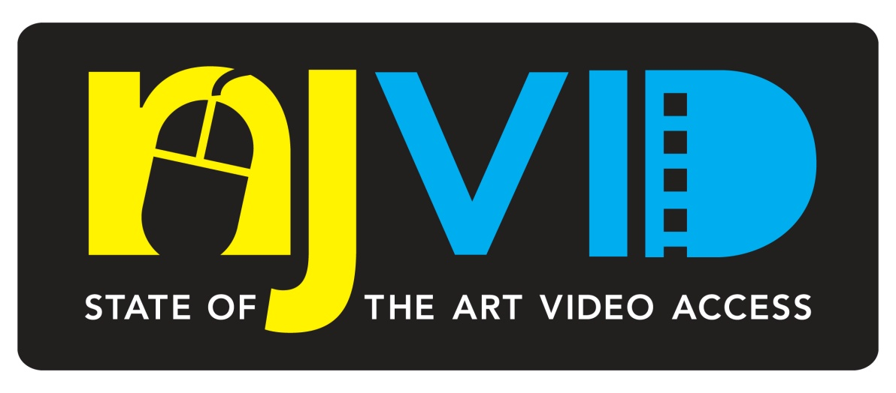
Statewide Digital Video Network
George Laskaris
NJEDge.Net
February 5, 2009
StateNets Meeting

Slide 2
Building Blocks of Statewide CI
What problems are we trying to solve?
What building blocks do we need?
Why collaborate?

Slide 3
Building Blocks of Statewide CI
The Problem Space
Our users are also our information creators
The information they create is often valuable and unique
Digital information is the most useful
Technically, Education is not limited by any silos:
Space, time, organizational boundaries

Slide 4
Building Blocks of Statewide CI
What building blocks do we need?
Common authentication and
Authorization
--Durable, standardized, consistent
--Restricts access for collection
management; coursework; research
--Enables collaboration:
faculty faculty
faculty student(s)
student student
university university
museum school

Slide 5
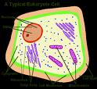
Building Blocks of Statewide CI
Collecting and Managing Faculty Research
Unique information
Preserved for long-term availability; audit trail
Made widely available for scholarly impact
Customized for scholarly and educational workflow
Volatile Information
Faculty may want to add, revise, remove
Usefulness often requires additional tools
SAS, SPSS, etc.
Visualization tools (Grapher, MatLab, etc.)
GIS

Slide 6
New Jersey Digital Video Portal
NJVid Mission
Collection driven – increase availability of digital video content for education and research
Support all learning organizations—higher ed, libraries, museums, archives, K12 schools
Protect rights of content owners and content users
Form the nucleus of a statewide cyberinfrastructure for content management and use

Slide 7
NJVid Challenges
Managing Large Video Files – Ingest, Presentation, and Preservation
Managing complex rights and organizational policy issues
Annotation of Videos for Lectures on Demand
Authentication and Authorization

Slide 8
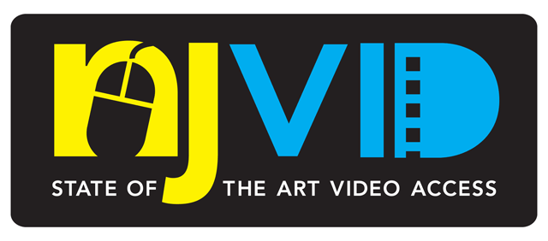
NJ Vid
New Jersey
Digital Highway
Video Collection
Licensed
Commercial
Video Collection
Learning Object
Repository
Authentication & Authorization
Shibboleth
Workflow Management System
Creation & Cataloging
Fedora Repository Storage & Management

Slide 9
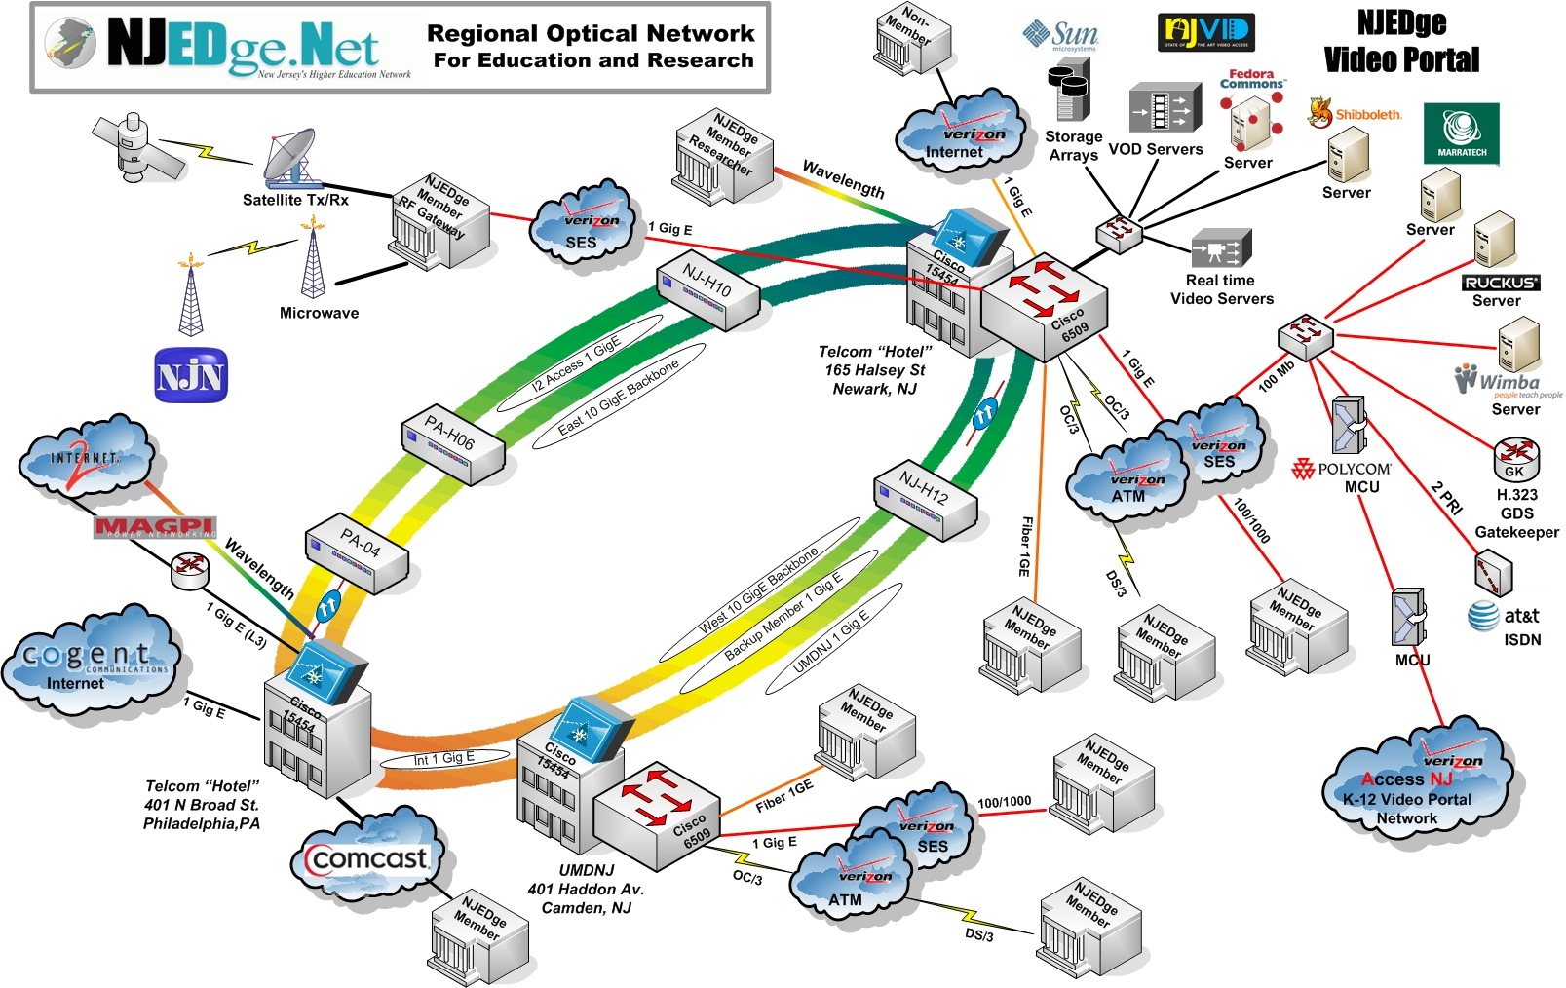

Slide 10
Storage Architecture - Needs
Object Store
Under Fedora management services
Relatively small presentation files
Archival Store
Infrequent access
Non-proprietary, uncompressed formats
Large Mass Store
Science data
On order of petabytes

Slide 11
Storage & Server Architecture
Partner/Custom Portals
Stream QuickTime
Download Flash
Fedora and Middleware
Host Server
Video Stream (QT H.264)
Fedora
Repository
(Digital Objects)
Backend Storage Server
Streaming Server (Darwin)
Archival Masters
External Storage
Checksum validation
Local Storage

Slide 12
Fedora and Fedora Commons
Fedora Commons
a non-profit organization funded by a four year, $4.9M grant from the Gordon and Betty Moore Foundation
to develop the organizational and technical frameworks necessary to effect revolutionary change in how scientists, scholars, museums, libraries, and educators collaborate to produce, share, and preserve their digital intellectual creations.
The Fedora platform is logically divided into four major functional areas that reflect its first principles:
repository services
preservation services
semantic services
enterprise services

Slide 13
Fedora Capabilities – A Snapshot
The Digital Object
An open content model expressed as XML
XACML for authorization, using the Sun XACML engine
Encapsulation for management and preservation
Repository Services
A service oriented architecture with APIs for access and management
Ontology services for expressing relationships
Messaging, and journaling services
Preservation Services
Audit trails
Versioning
Object integrity
Alerting

Slide 14
Fedora Layered Architecture
Applications
Middleware Svcs
App. Prog.
Interface
Fedora Repository
Data - XML
Server & Storage

Slide 15
NJVid Concept Architecture
User Input
(metadata)
NJVid Commons
Partner Portals
New Jersey Institutions
Workflow
Management
System
User, Collection & Preservation Svcs
Fedora Repository Service
Object
XML
Digital
Object
Repository
(Fedora)
Video
Matrox
Axio Encoder
Digital Video Master
Object Ingest
15

Slide 16
Hardware

Slide 17
Video Specifications
Video source – analog and digital camcorder
Archival master is uncompressed AVI (Audio Video Interleave)
AVI file sizes are approximately 20GB per hour
Streaming protocol is QuickTime H.264
29.9 frames/second, 640 x 480 resolution, data rate from 384 – 512 kb/sec
Delivery to user as QuickTime or Flash
Notes:
AVI stands for Audio Video Interleave. It is a special case of the RIFF (Resource Interchange File Format). AVI is defined by Microsoft. AVI is the most common format for audio/video data on the PC. AVI is an example of a de facto (by fact) standard.

Slide 18
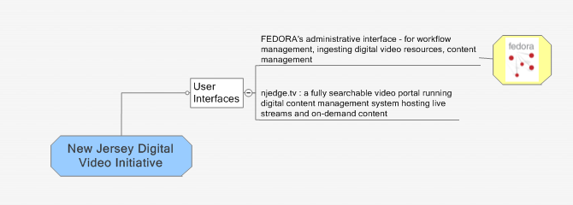
User Interfaces

Slide 19
Support for Resource and Privacy Rights
Rights govern the use of resources, including their preservation
Rights outlast the lifetime of the creator(s)
The link between context of creation and the resource is frequently broken.
An undocumented resource is unusable.

Slide 20
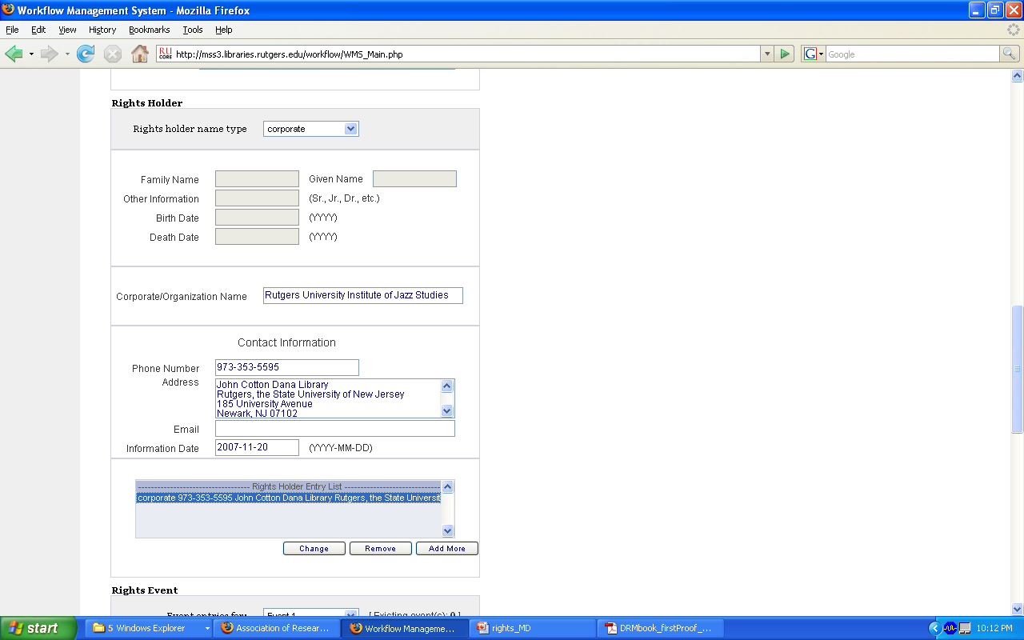
Workflow Management System
Descriptive and Administrative metadata
Supports access, management and ongoing preservation of information
Object upload and management
API to Fedora Repository
Open Source via RUcore website as of October 31, 2008
Htttp://rucore.libraries.rutgers.edu

Slide 21
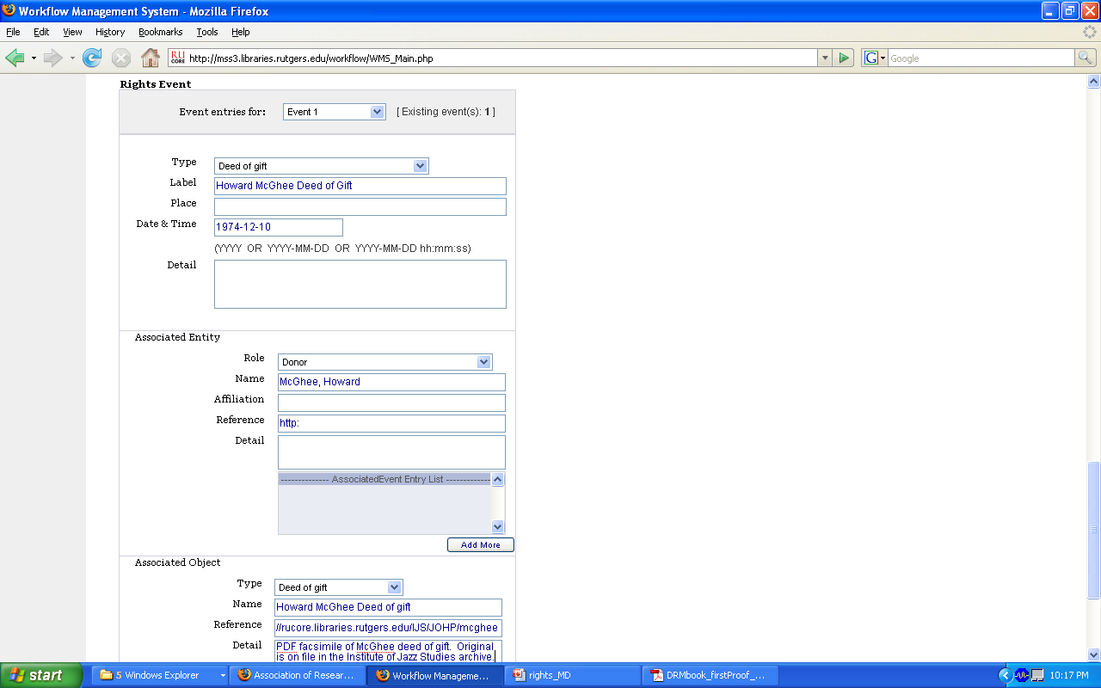
Workflow Management System
Event-based Metadata will enable organizations to document preservation and rights activities and add supporting documentation, such as licenses, publicity releases, etc.

Slide 22
Depositing Your Video in NJVid
Step One. License
To deposit your video in NJVid, you must grant a permanent, non-exclusive license to store, preserve and make the video accessible for use
Print this License
The Contributor certifies that the Work(s) are original and that it either owns all rights of copyright or has the right to use the copyrighted material by depositing a digital copy of the Work(s) with NJVid. The Contributor certifies that it has attained permission from all related and underlying rights holders to use any pieces of other copyrighted works that may be included in the contributed Work(s), or that the creator(s) of the Work(s) have done so. 4) The Contributor confirms that it possesses ownership of the physical copy or copies of the Work(s) being contributed, or that it has permission from the owner(s) of the physical copy or copies of the Work(s) to contribute them. If the contributor is not the creator of the video, it assures that it has secured appropriate licenses and permissions from the creator and/or former owners for reproduction of the Work(s). The contributor assumes all responsibility for questions of copyright and invasion of privacy that may arise in the copying and use of the Work(s), and to assume responsibility for obtaining all necessary permissions pertaining to use. The Contributor retains ownership of the Work(s). The Contributor in no way surrenders its own right to publish or otherwise use the Work(s), or to grant permission for others to do so.
I agree
I do not agree

Slide 23
Depositing Your Video in NJVid
Step Two. How can the video be displayed?
Streaming video only, no downloads
Streaming and downloadable video. No distribution or modification. NJVid will include an eye-readable statement of use restrictions but cannot prevent the further distribution or modification of the video
Streaming and downloadable video. Distribution and modification with attribution. NJVid will include an eye-readable statement but cannot enforce attribution/

Slide 24
Depositing Your Video in NJVid
Step Three. Who can Use the Video?
Anyone. This video is available for open access
This video is limited to members of my organization
This video is limited to instructors and registrants of
(select all that apply)
Course XXXXX
Course YYYY

Slide 25
The Video Digital Object in Fedora
Video Object
Descriptive
Repository ID
Technical
Metadata
Source
Rights
Behaviors
(Disseminators)
Digital Prov.
Data streams
SMAP1 – StrMap (TOC)
FLV1- download
MOV1 – QT stream
PDF1 – transcript (opt)
XACML policy (external)
ARCH1- Archival master
(external datastream)
XACML policy stmt
XACML policy stmt

Slide 26
An XACML Policy Example
<Subject>
<SubjectMatch MatchId="urn:oasis:names:tc:xacml:1.0:function:string-equal">
<AttributeValue
DataType="http://www.w3.org/2001/XMLSchema#string">student</AttributeValue>
<SubjectAttributeDesignator AttributeId="fedoraRole" MustBePresent="false"
DataType="http://www.w3.org/2001/XMLSchema#string"/>
</SubjectMatch>
</Subject>
<Resource>
<ResourceMatch MatchId="urn:oasis:names:tc:xacml:1.0:function:string-equal">
<AttributeValue DataType="http://www.w3.org/2001/XMLSchema#string">MOV-1
</AttributeValue>
.
.
</ResourceMatch>
</Resource>

Slide 27
Video Annotations
Support instruction and note taking
Faculty share annotations with students
Students create annotations for their own use and to share with peers.
Annotations are related to videos and can display in NJVid commons or be limited to creator’s “MyNJVid” portal or CMS

Slide 28
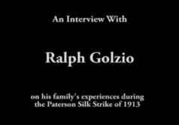
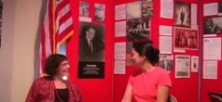
Logout | Help
Search
My Content
Annotate
Go
Title: The Hidden Child
Description: Of the 1,600,000 Jewish children who lived in Europe before World War II, only 100,000 survived the Holocaust.
-
-
-
Selected Video
Title: Ralph Golzio interview on Paterson Silk Strike of 1913
Description: Ralph Golzio was a teenager at the time of the Paterson Silk Strike of 1913.
Title: Sondra Gash interview
Description: Evelyn Hershey of the American Labor Museum interviews
>>
<<
Search For and Select a Video for Annotation

Slide 29
Logout | Help
Selection of video found through search
Search
My Content
Annotate
Go
Title: The Hidden Child
Description: Of the 1,600,000 Jewish children who lived in Europe before World War II, only 100,000 survived the Holocaust.
-
-
-
Title: Ralph Golzio interview on Paterson Silk Strike of 1913
Description: Ralph Golzio was a teenager at the time of the Paterson Silk Strike of 1913.
-
Title: Sondra Gash interview
Description: Evelyn Hershey of the American Labor Museum interviews
>>
<<
Drag and Drop Thumbnails Here To Create an Annotation

Slide 30
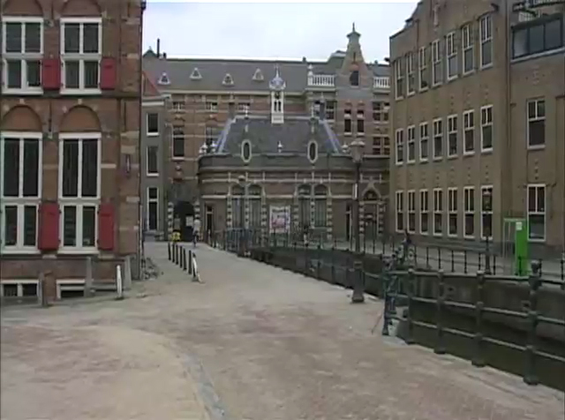
Logout | Help
Once an annotation is saved it will appear in the videos timeline.
Amsterdam, The Netherlands
Search
My Content
Annotate
Start Time:
5:01
End Time:
8:34
Title:
Amsterdam, The Netherlands
Note:
City street in Amsterdam.
-
Private
My Institution Only
NJVid Wide
Indexed/Searchable:
ü
Save
>>
<<
Start and stop markers can be placed.
Metadata placed here.
Annotate and Capture Start/End Times

Slide 31
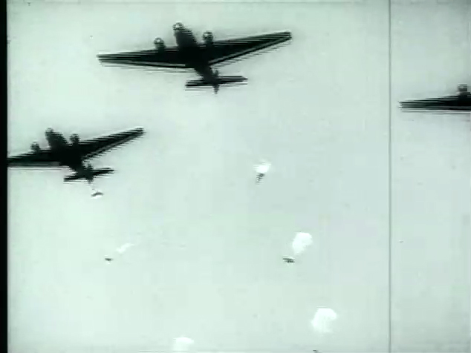
Multiple annotations saved appearing in the timeline.
Logout | Help
Amsterdam, The Netherlands
Bombing Raid WWII
Search
My Content
Annotate
Start Time:
12:30
End Time:
30:00
Title:
Bombing Raid WWII
Note:
Footage of a bombing raid during WWII.
-
Private
My Institution Only
NJVid Wide
Indexed/Searchable:
ü
Save
>>
<<
Annotate and Capture Start/End Times

Slide 32
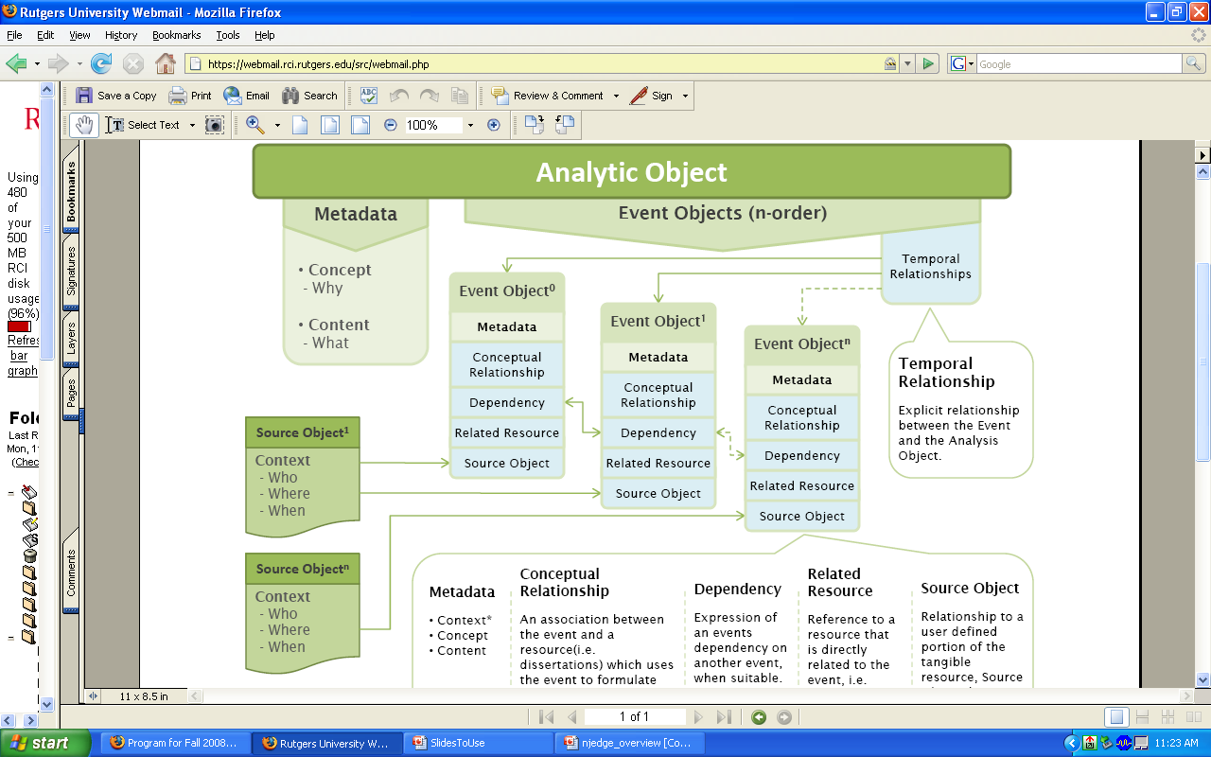

Slide 33
The Annotation Object
Repository ID
Institution: ABC
The Hidden Child
Selected Themes
Structure Map
Amsterdam – 5:01 to 8:34
Bombing Raid: 12:30 to 30:00
URI – pts to video stream
Access Restrictions
Metadata
QuickTime
Behaviors
(disseminator)
Flash
Data streams
Original Video
Object
SMAP1 – StrMap (Anno.)
XACML Policy
Annotation Screen Facsimile
Annotation Object

Slide 34
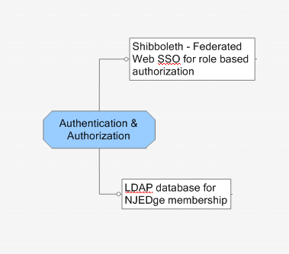
Authentication & Authorization

Slide 35
Authentication and Authorization
NJVid will support the full range of institutions
Participating institutions will need to provide LDAP directory information
Must establish agreement on shared attributes across institutions: person, department, role
Authentication via Shibboleth
A service for managing users at cooperating institutions
Shibboleth securely transfers attributes (institution, roles, etc) from the users’ site to the service provider (NJVid)
Authorization through XACML
eXtensible Access Control Markup Language
For encoding access control policies

Slide 36
Tiered Shibboleth Strategy
Organizations are Shibboleth IdP participants, supporting NJVid LDAP EduPerson profile
Centralized IdP at NJEdge with multi-organization LDAP:
Organization has data that can be mapped and batch imported (e.g., ILS patron files)
Organization creates LDAP records as needed
Authentication and authorization needed for:
Organizational management of videos (uploading, metadata, etc.)
Commercial videos licensed to individual organizations
Creating and sharing annotations via NJVid personal portal

Slide 37
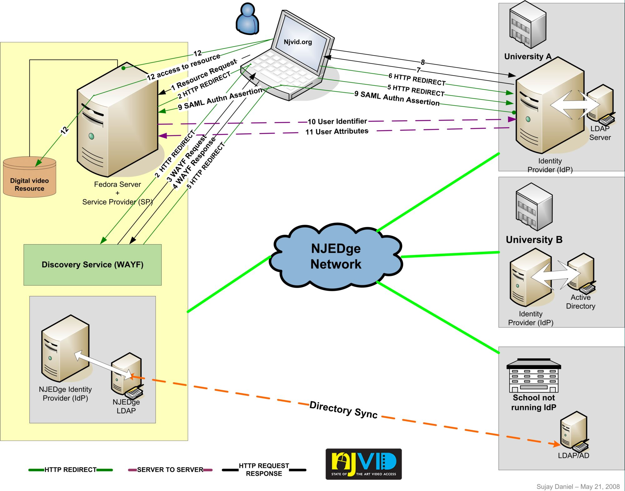

Slide 38
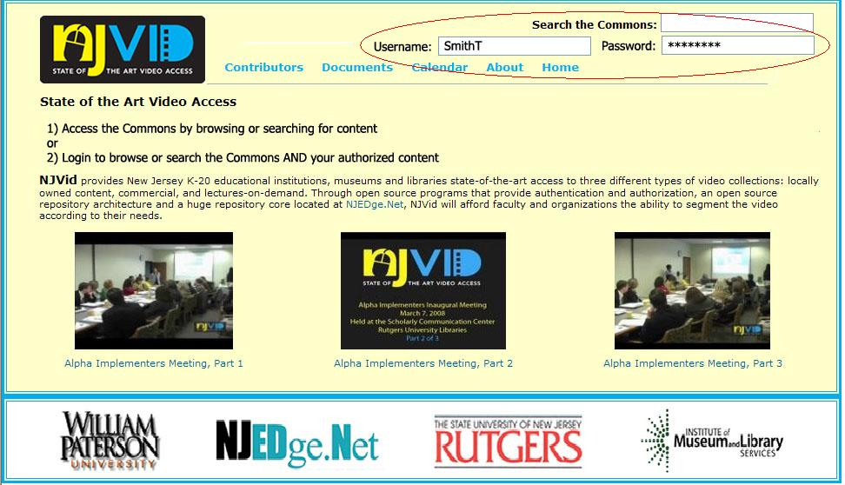

Slide 39
Questions

