Slide 1


GENI/OpenFlow @ Clemson
PI: KC Wang
Co-PI: Jim Pepin
CCIT: Dan Schmiedt,
Wayne Ficklin, Brian Parker
Grad Students:
Aaron Rosen, Ke Xu, Fan Yang
Undergraduate Students:
Ben Ujcich, Jeff Heider
Sponsor:
Jim Bottum

Slide 2
Why Clemson Supports Novel CI Projects
GENI/OpenFlow is one example
IT at Clemson university is a core function that supports research and education as well as administrative applications
Part of the ‘DNA’ of the campus
HPC/Cyberinstitute/regional networking/CITI
  All of these add value to Research and Education
Partners with Faculty

Slide 3
Why Support Geni/Openflow
Clemson University sees our OpenFlow network as a key enabler for innovation in four dimensions:
Computer Science and Engineering Research
Science and Engineering Research
Education Methods
Advanced IT Operation in support of the above
The following table gives a synopsis of our respective foci, each with a tentative list of potential objectives.

Slide 4
OpenFlow Enabler | CS&E Research |  | S&E Research |  | Education |  | IT
Programmable switching | Clean-slate architecture and protocols | GENI, OCI, OSG, …; Researching real IT challenges | GLIF service | Cyberinstitute | Networking, On-demand data to the classrooms, on-demand/disposable student labs, student collaboration tools | Living the future (advanced teaching environment + IT internship) | Access control | Campus IT Evolution; CITI; SC Cloud
Virtualized network | Network as a service |  | Optimized data access (per project) |  | One network per class |  | License management, Device & Identity management, data center service (government and industrial partnership)
Flow mobility | Resilient and mobile networking |  | On-demand cloud computing |  | Mobile classroom (personalized anywhere network per student) |  | Distributed data center (resiliency, reconfigurability, HPC on-demand)
Distributed LAN (beyond VLANs) | Flexible network organization |  | Distributed data computing |  | Remote & collaborative education |  | Data center services (HPC, storage) for regional partners

Slide 5
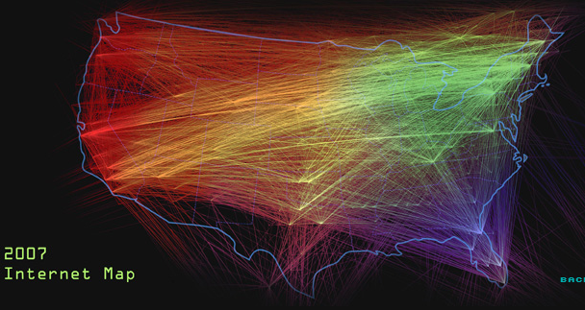
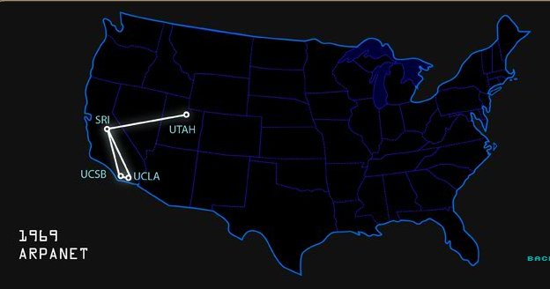
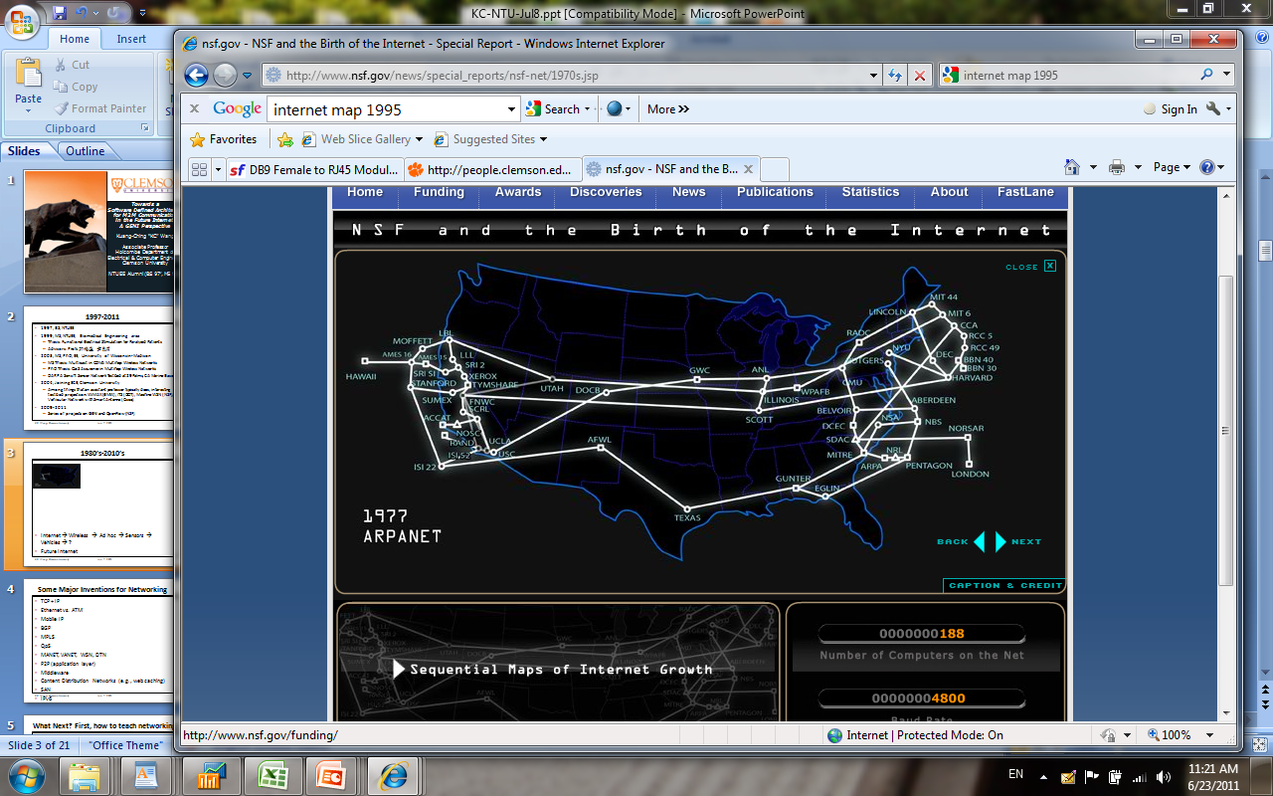
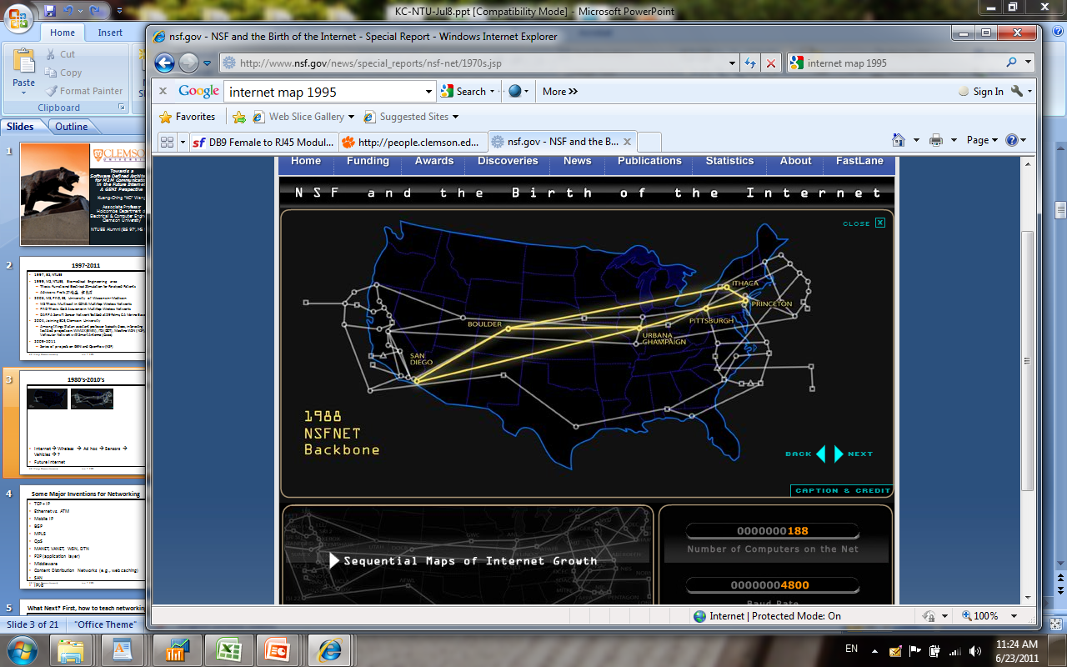
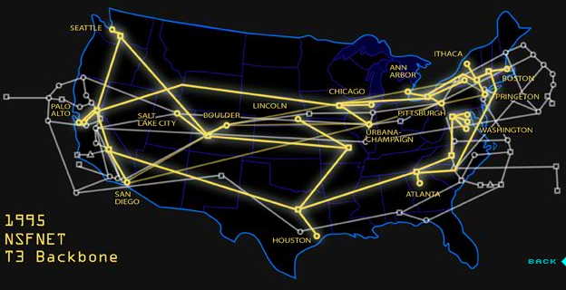





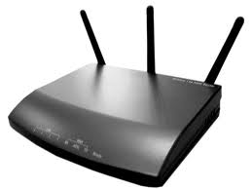




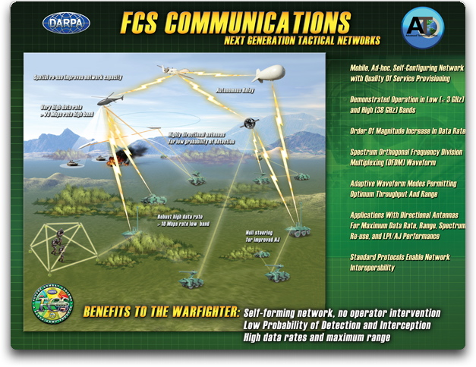
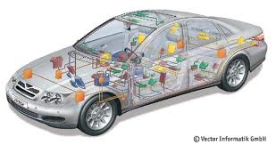

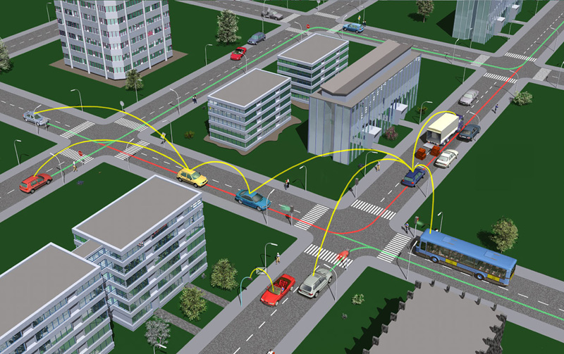
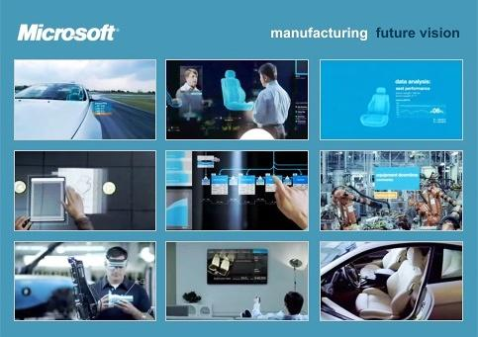
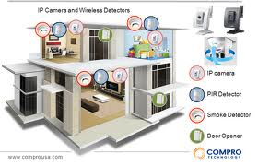
1970s-2010s (What happened to Internet)
‘69- ‘85 ARPANET (‘81 IPv4)
56 kb/s → T1:1.5Mb/s
‘85-‘95 NSFNET
56 kb/s → T3:45 Mb/s
‘93-now commercial (‘98 IPv6)
… → 100 Gb/s
plenty of protocols,
apps, contents created
Wireless technologies also has been evolving
  Faster, more ubiquitous, lower power, lower cost
  A number of new network settings surfaced as well
DSRC
World IPv6
Day
06-08-2011
WiFi
Bluetooth
Zigbee
MIMO
DSRC
WiMAX
LTE
Wireless
USB
WiGig
Military Communication
MANET
Vehicle Communication
V2V/V2I, Smart Grid
e-Manufacturing
sensor actuator network
e-Health
body and environment sensors

Slide 6
US-IGNITE Gigabit Applications Initiative
Office of Science and Technology Policy (OSTP)
National Science Foundation
Purpose:
  Demonstrate and develop future gigabit applications using broadband city infrastructures
  Focus area: transportation, energy, health, education, public safety
  Pilot gigabit cities
    Chattanooga TN, Washington DC, Lafayette LA, Cleveland OH, Utah, Philadelphia PA
  GENI serves as control framework – the glue
  Forming teams now, new projects launch in fall 2011

Slide 7
Our Focus
Mobility
  ↑ Internet traffic reaching mobile devices
  mobile data tripling three years in a row; > 50% video in mobile data traffic; 26x mobile data, 10x speed by 2015, Cisco 2011 projection, http://www.cisco.com/en/US/solutions/collateral/ns341/ns525/ns537/ns705/ns827/white_paper_c11-520862.html
Reconfigurability
  ↑ expectation of resiliency, resource (re-)configuration
  mobile connection stability ; data center resource agility; personalized service resource projection/reservation/optimization
Security
  ↑ consumer and enterprise applications over Internet
  personalized media streaming; personalized broadband access (incl. mobile access with cognitive radios); critical cyberinfrastructure

Slide 8



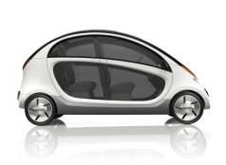
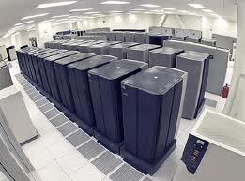
Example: Seamless Network Mobility
Net A
Provider A
OF controller
Application server
Client M’s
Personalization server
OpenFlow tunnel
Net B
Provider B
OF controller (or non-OF)
Net C
Net D
Provider A
or partner’s
OF controller
Provider A
or partner’s
OF controller
Client M
From reactive to proactive networking
  Mobile IP: Distributed, reactive (long latency), requires compatible agents everywhere, provider-dictated
  OpenFlow: Centralized, proactive, solutions for diverse network scenarios, opportunities for both provider and client customization

Slide 9
GENI/OpenFlow @ Clemson
Including a campus OpenFlow Wi-Fi
corridor for vehicle networking research

Slide 10
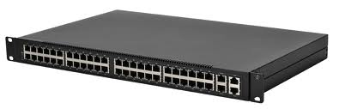

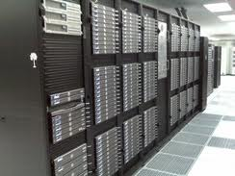
Clemson OpenFlow Deployment
ECE Security/P2P Labs
CS cloud computing lab
Campus --- Datacenter
Data Analysis Network (DAN)
CU Police
Surveillance Mesh
ECE Wireless, OpenFlow, NetFPGA Labs – mobile and mesh networks, cognitive/software defined radio
  OF Ethernet : 4 HP, 9 Pronto switches
  OF mesh: 5 APs deployed, 10+ to come
  GENI OF and non-OF core vlans: connected
OpenVswitch in VMs
at Palmetto Cluster
10

Slide 11
Clemson GENI/OpenFlow Projects
OpenFlow wireless
Campus operation & expansion
OpenFlow Mesh and Mobility Management
OpenFlow Campus Trial
IT Engagement; CI Team
Data Analysis Network
w/ CCIT + CI Team
On-demand VM Cloud
w/ Goasguen (CS)
EAGER experiments
NetFPGA lab
Security
w/ Brooks
Clemson
Accelerated Cloud w/ Smith
Clemson
Spiral 3 (pending)
Pervasive P2P
w/ Shen
Clemson
SDR
w/ Noneaker
Clemson
GENI Racks
w/ RENCI, Stanford
Network Coding
w/ Ramanathan, UW-Madison
GENI WiMAX
w/UW-Madison

Slide 12
Deep IT Integration
To facilitate sustained growth and leverage the power of all parties in University to stay creative, we need a new model.
  Students
    Graduate research assistants
    Undergraduate “Creative Inquiry” program
    Undergraduate IT internship program + curriculum
  Network engineers
    Support researchers deploy and operate GENI
    Operate GENI in production use
    Innovative institute use cases
  Faculty
    Research
    Teaching
IT
Research
Teaching

Slide 13
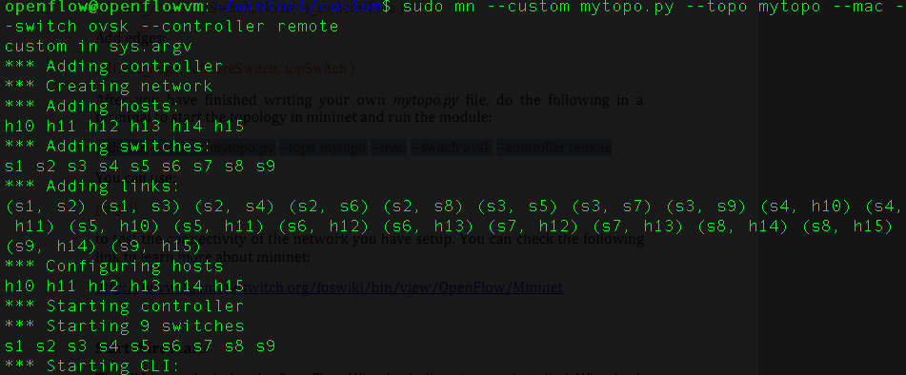
Integrated and Flexible OpenFlow Operation
Grad/UGrad students attend weekly IT tech meetings
  GENI/OpenFlow agenda
  Brainstorm with engineers
Grad students design tutorials and use cases to motivate engineers to use OF/GENI tools in campus network operation
  First use case: Data Analysis Network (DAN) based on OF
  Next possible use case: Netreg IPv6 transition
Subset of Clemson
campus network

Slide 14
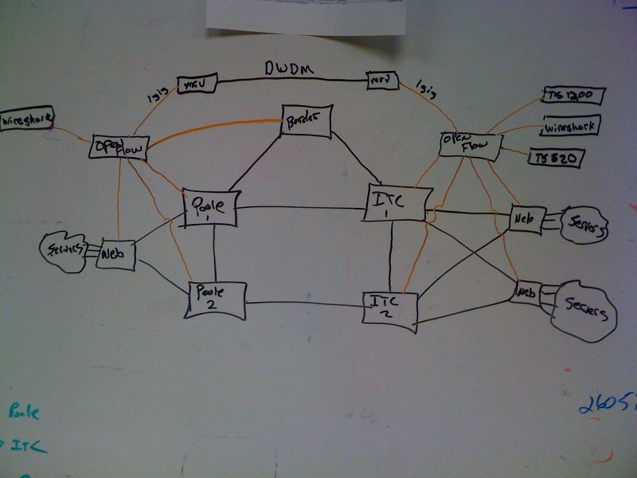
Proposed DAN implementation
Some noodling on the whiteboard…

Slide 15
Moving Forward
OpenFlow development
  OpenFlow software: controllers, switches
  Architecture: vertical and horizontal controller coordination
  Emerging OpenFlow use cases (mobility, IT, QoS, cloud, gigabit wireless)
Campus experimentation
  Clemson deployment: Ethernet, wireless, data center
  Forward-looking IT team
  Undergraduate and graduate student teams
  Coming up demos/presentations: EDUCAUSE 2011, Supercomputing 2011, GENI Engineering conferences
GENI engagement
  Clemson is one of the few heavily invested GENI campuses
  Many and more collaboration partners on OpenFlow:
    Academic: Stanford, U. Wisconsin, Indiana University, GT, …
    Companies

