Slide 1
Tracking SARA: An Update on the
State Authorization
Reciprocity Agreement
November 14, 2012
Notes:
Russ

Slide 2



Marshall Hill
Executive Director
Nebraska’s Coordinating
Commission for
Postsecondary Education
Russ Poulin
Deputy Director
Research & Analysis
WCET
Notes:
Russ – Will ask Marshall to introduce himself too.

Slide 3
WICHE Cooperative for Educational Technologies
WCET accelerates the adoption of effective practices and policies, advancing excellence in technology-enhanced teaching and learning in higher education.
http://wcet.wiche.edu
Notes:
Russ

Slide 4

The State Regulations
Twisty coaster photo: http://www.morguefile.com/archive/display/72796
Notes:
Russ

Slide 5

The State Regulations
Twisty coaster photo: http://www.morguefile.com/archive/display/72796
Notes:
Russ

Slide 6
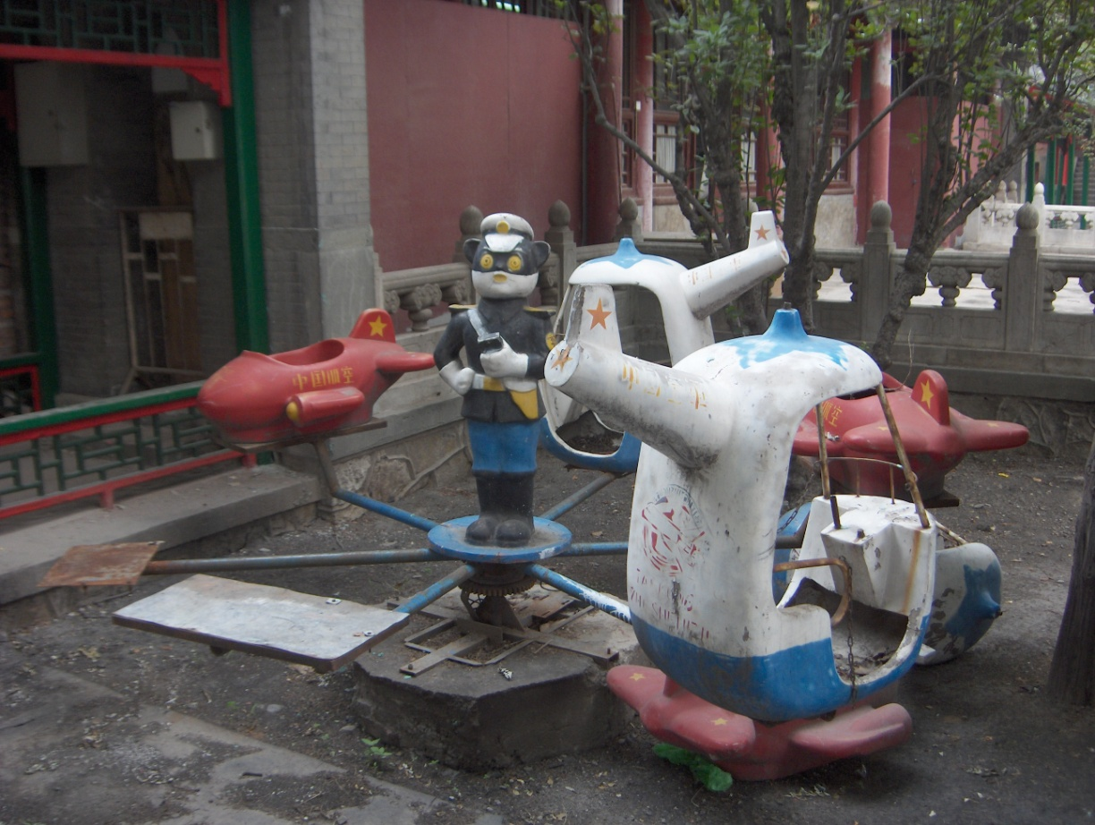
The State Regulations
Broken down photo:
http://www.morguefile.com/archive/display/758526
Notes:
Russ

Slide 7
State Authorization Reciprocity Agreement
The Merriam Webster Dictionary defines “reciprocity” as:
“a mutual exchange of privileges; specifically: a recognition by one of two countries or institutions of the validity of licenses or privileges granted by the other.”
Notes:
Marshall

Slide 8
State Authorization Reciprocity Agreement
The Merriam Webster Dictionary defines “reciprocity” as:
“a mutual exchange of privileges; specifically: a recognition by one of two countries or institutions of the validity of licenses or privileges granted by the other.”
CAVEAT: All SARA info given is as of now.
Details will change.
Notes:
Marshall

Slide 9
State Authorization Reciprocity Agreement
The Players
Presidents’ Forum/Council of State Governments
http://presidentsforum.excelsior.edu/projects/multi-state-reciprocity.html
Developing model “compact.”
Draft available.
Will be finished soon.
To see draft:
Latest: http://wcet.wiche.edu/advance/state-approval
April: http://wcetblog.wordpress.com/2012/04/27/sara-draft-feedback/
Notes:
Marshall

Slide 10
State Authorization Reciprocity Agreement
The Players
Regional compacts implementation version:
Southern Regional Education Board (SREB)
Western Interstate Commission for Higher Education (WICHE)
New England Board of Higher Education (NEBHE)
Midwest Higher Education Compact (MHEC)
To see draft: http://wcet.wiche.edu/advance/state-approval
Notes:
Russ

Slide 11
State Authorization Reciprocity Agreement
NEBHE
MHEC
WICHE
SREB
Notes:
Russ

Slide 12
State Authorization Reciprocity Agreement
NEBHE
MHEC
WICHE
SREB
Notes:
Russ

Slide 13
State Authorization Reciprocity Agreement
The Players
The Commission on Regulation of Postsecondary Distance Education:
APLU (land-grants) & SHEEO (state offices).
High profile members.
Reviewing SARA drafts and giving feedback.
http://www.sheeo.org/stateauth/stateauth-home.htm
Notes:
Marshall

Slide 14
Marshall Hill
marshall.hill@nebraska.gov
Russ Poulin
rpoulin@wiche.edu
QUESTIONS??
Notes:
Marshall & Russ

Slide 15
State Authorization Reciprocity Agreement
Basic Principles
Voluntary
  For state.
  For institutions.
Includes only degree-granting institutions
Notes:
Marshall

Slide 16
State Authorization Reciprocity Agreement
Basic Principles
Does not address “state licensure” issues:
  Nursing.
  Social work.
  Education.
Uses “home state” model
  Authorized in home state.
  Other participating states recognize.
Notes:
Marshall

Slide 17
State Authorization Reciprocity Agreement
Basic Principles
Reciprocity
turns
state
authorization
on
its
head
Notes:
Marshall

Slide 18
State Authorization Reciprocity Agreement
Criteria from Implementation SARA
Criteria for states to join:
Academics – based on accreditation.
Financial integrity – uses federal measure or surrogate.
Consumer protection – recruiting, tuition, refunds, admissions.
Complaints – process and documentation.
Notes:
Russ

Slide 19
State Authorization Reciprocity Agreement
Criteria from Implementation SARA
Criteria for states to join:
Academics – based on accreditation.
Financial integrity – uses federal measure or surrogate.
Consumer protection – recruiting, tuition, refunds, admissions.
Complaints – process and documentation.
Is this another level of bureaucracy??
Notes:
Russ

Slide 20
State Authorization Reciprocity Agreement
Physical Presence
Institutions CAN DO in partner states:
Distance-only courses / programs.
Courses/programs part of consortium.
Advertise.
Offer clinicals, practica, internships.
Offer other field experiences.
Short courses / part of a course.
Notes:
Russ

Slide 21
State Authorization Reciprocity Agreement
Physical Presence
Institutions CAN DO in partner states:
Serve military personnel, dependents, and employees on military installations.
Have faculty or employees in the state.
Required proctored exams.
Contract in the state.
Server in the state.
Notes:
Russ

Slide 22
State Authorization Reciprocity Agreement
Physical Presence
Institutions CAN NOT DO in partner states:
Establishing a physical location.
Requiring students to meet in a physical location for more than ¼ of course.
Establishing an administrative office in the state.
Notes:
Russ

Slide 23
State Authorization Reciprocity Agreement
Costs
States
  No fees, unless an unaffiliated state.
  Will need to readjust activities.
Institutions
  Yearly fee to participate.
  Initial estimate: $1,500 - $5,000 / year.
  Adjusted over time as more join.
Notes:
Marshall

Slide 24
State Authorization Reciprocity Agreement
Advantages
Students
  More assurance on complaint handling.
States
  Focusing on local institutions.
  Cutting costs.
Institutions
  Fewer and local authorization.
  Cutting costs.
Notes:
Marshall

Slide 25
Marshall Hill
Executive Director
marshall.hill@nebraska.gov
Russ Poulin
Deputy Director
rpoulin@wiche.edu
http://wcet.wiche.edu/connect/state-approval
http://wcetblog.wordpress.com
Notes:
Marshall & Russ

