Slide 1



Online learning with students, staff, and faculty with disabilities: Knowing the legal landscape of web accessibility

Slide 2

A little about myself . . .
Director
  WebAIM
  National Center on Disability and Access to Education
  (and project GOALS)
Housed at Utah State University
Accessibility advocate since 1996
I am NOT a lawyer. If you seek legal advice, please contact institutional counsel or an attorney
Cyndi Rowland, Ph.D.

Slide 3
Our Brief Focus Today . . .
Context for Web Accessibility
  What is it?
  Why is it important?
Legal issues
  Laws that pertain to you
  Legal climate
What you can do
  Documenting your efforts
  Resources
    For Institutional Benchmarking and Planning
      And an invitation to participate!
  GOALS partners include NCDAE, WICHE, WebAIM, SREB, MCCVLC, and SACSCOC. This work is made possible by a grant from the Fund for the Improvement of Postsecondary Education (FIPSE), US Department of Education. No official endorsement should be inferred.

Slide 4
Context for Web Accessibility

Slide 5
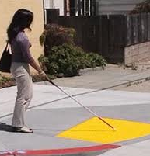
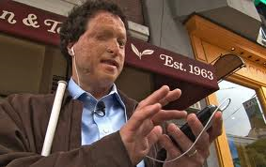
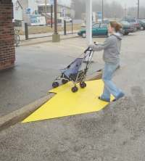
What is Accessibility?
Designing for the
Broadest array of
users
  Just as we designed accessibility for the built environment, we need it for the digital one.

Slide 6


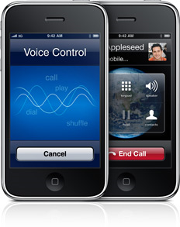
Why Accessibility?
  Digital accessibility allows participation and engagement of students, faculties and staffs who have disabilities.
  These individuals could not otherwise succeed on par with their peers with independence and dignity
Student learning
outcomes are
an issue

Slide 7
Who is Affected? Those with disabilities
Vision
Hearing
Fine motor
Cognitive
Seizures
Combinations of the above
While 19% of the US population has a disability (US Census), approximately 8.5% has a disability that affects computer and internet use. These are your students and employees

Slide 8
Perspectives of inaccessibility

Slide 9
Two YouTube Videos
YouTube:
IT Accessibility: What campus leaders have to say (University of Washington-15 min)
A Personal look at accessibility in higher education (NCDAE – 6 min)

Slide 10
What’s the big deal?
Prospective students who can’t register
Students who can’t get course content or complete assignments
Instructors who can’t engage in forums or chats with students
Staff who can’t process financial records
Independence Learning Discrimination

Slide 11
Legal Issues in Web Accessibility

Slide 12
Laws that pertain to education:
Rehabilitation Act (i.e., Sections 504, 508)
American’s with Disabilities Act (ADA)
Some State laws
International laws (i.e., country specific; UNCRPD)

Slide 13
Legal Issues
  Timeliness
  Effective Communication
  Reasonableness of accommodation
  Affirmative obligation

Slide 14
Rehabilitation Act
  “ no otherwise qualified individual with a disability in the United States… shall, solely by reason of his disability, be excluded from the participation in, be denied the benefits of, or be subjected to discrimination under any program or activity receiving federal financial assistance. . .” (29 U.S.C. Section 794)
Section 504
Pertains to all federally funded programs, including education

Slide 15
504 Model may not fit Web
Reactive, rather than proactive, model
Native access can be achieved in many cases, yet the model reinforces “accommodation”
Mindset of many is to go to DSO office and they’ll do it. They may not have the expertise or be able to influence the entire institution.

Slide 16
Section 508 of the Rehabilitation Act of 1997 provides the legislative language for accessible electronic information technology, including the Internet
Section 508
Took effect: June 21, 2001

Slide 17
Rehabilitation Act
Used to define floor of access (16 standards)
Many use this as their standard for convienence or worry
It is under a refresh
Emerging in federal RFP’s and contracts, watch your grant office
Section 508
Pertains to federal agencies

Slide 18
Civil Rights Legislation
Word “Internet” not in ADA
Employment discrimination
Title II: effective communication
Title III: place of public accommodation
ADA

Slide 19
AFFIRMATIVE
OBLIGATION
“A public entity violates its obligations under the ADA when it only responds on an ad-hoc basis to individual requests for accommodation. There is an affirmative duty to develop a comprehensive policy in advance of any request for auxiliary aids or services”

Slide 20
ADA helps us think about electronic access
Right to access entire building
  Rights to independence
  Back doors problematic
Could not go around ADA by “renting” inaccessible buildings
Remodel “springs” law into place
  Legacy pages
Written transition plan necessary
Regulations began to inform professions (e.g., architects, engineers, building inspectors)

Slide 21
Other Laws
Many states have their own accessibility law, but it does not always extend to higher education
International laws are in place if you serve students outside of the US

Slide 22
Questions or comments?
Next section: Recent legal complaints

Slide 23
Recent legal complaints

Slide 24
Recent Legal Activity on Accessibility
Department of Justice (Advanced Notice of Proposed Rulemaking 2011) to clarify the intent of the ADA with respect to digital accessibility. Expect to hear more in 2013.
  Read Section III Background to get a sense of their intent http://www.ada.gov/anprm2010/web%20anprm_2010.htm
White House Letter to all College and University Presidents (June, 2010)
  “It is unacceptable for universities to use emerging technology without insisting that this technology be accessible to all students”

Slide 25
Recent Legal Activity on Accessibility
Increasing climate of litigation.
Recent high profile complaints include:
  9 Law schools using specific web-based admissions program
  4 institutions using Google apps (e.g., Northwestern U, NYU)
  Other recent institutions: University of Montana, Florida State; Penn State; Case Western; Arizona State
  Educause and Internet2 e-text pilot (Courseload)
  Non-higher ed issues (e.g., Free Library of Philadelphia, Oracle, Ticketmaster, Disney, Jet Blue Airways, CNN, Target, MARTA)
  See summary in NCDAE November‘s newsletter

Slide 26
UNDUE BURDEN
. . .the subsequent substantial expense of providing access is not generally regarded as an undue burden when such cost could have been significantly reduced by considering the issue of accessibility at the time of the initial selection.

Slide 27
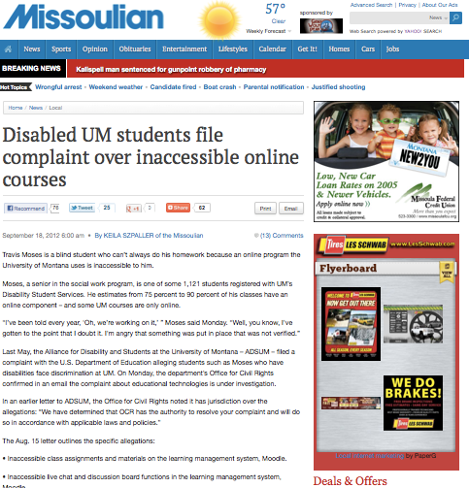
Patient students are loosing patience as time goes by
“I’ve been told every year, ‘Oh, we’re working on it,’ ” Moses said Monday. “Well, you know, I’ve gotten to the point that I doubt it. I’m angry that something was put in place that was not verified.”

Slide 28
Legal activity that will likely affect higher education
Captions
  National Association of the Deaf (NAD) filed against Netflix . They caption all streamed media by 2014. Netflix will also pay $755,000 in legal fees.
  Greater Los Angles Agency on Deafness (GLAD) filed against CNN for failing to provide captions on CNN.com. A judge ruled against CNN. This case continues on appeal
Use for access does not violate copyright (HathiTrust)
  The Authors Guild filed a complaint against multiple universities (i.e., University of California, University of Wisconsin, Indiana University, Cornell University and University of Michigan) for copyright infringement, a US District Court dismissed the suit and indicated that digitizing works at a university does not violate fair use. The Chafee amendment . to the Copyright Act was invoked in this decision. It indicates you are exempted from copyright law if you are duplicating materials for use with those who are blind or have disabilities.

Slide 29
What needs to be Accessible?

Slide 30
What needs to be accessible?
  Registration, paying fees, getting textbooks
  Classes, assignments, tests
  Employment, HR benefits, required training
  Campus web-based systems needed for employment
  Social aspects of campus (e.g., news, events)
Entire web architecture of your institution. Includes all things needed for independence and success for students, faculty, and staff

Slide 31

What needs to be accessible?
Image of a small goldfish thinking about how to eat a large piece of meat.
Entire web architecture of your institution. Includes all things needed for independence and success for students, faculty, and staff

Slide 32
Questions or comments?
Next section: What you can do

Slide 33
What can you do?

Slide 34
Document your efforts
Important to engage in
  Policy
  Implementation planning
  Monitoring successes and challenges
  Continuous improvements over time
  Be Deliberate
If you don’t know where to begin
  Use the structures of others
    GOALS Benchmarking and Planning Tool
    Policy promulgated by others

Slide 35
Consider a written transition plan
It will likely span 3-5 years

Slide 36
Resources to help

Slide 37
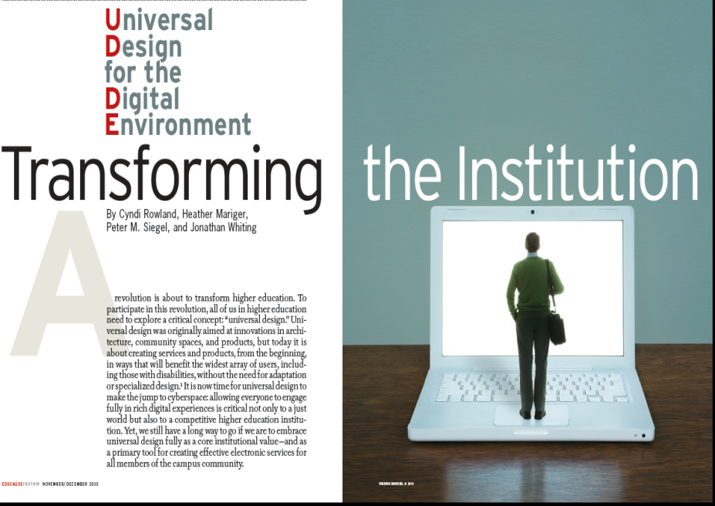
Educause Article Nov / Dec 2010
“Universal Design for the Digital Environment: Transforming the Institutuion”Making the jump to cyberspace: UDDE

Slide 38


Gaining Online Accessibility to Learning through Self-study

Slide 39
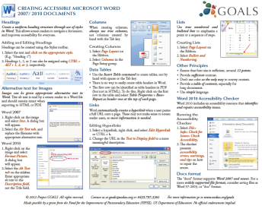
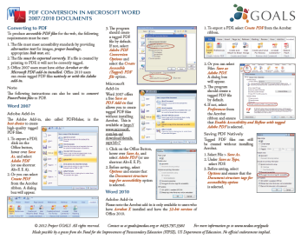
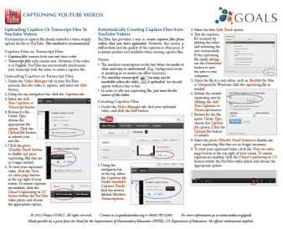
Cheatsheets www.ncdae.org/resources/cheatsheets/
Microsoft Word
PowerPoint
PDF Conversions
Adobe Acrobat
Captioning YouTube
Adobe InDesign
More to come….

Slide 40
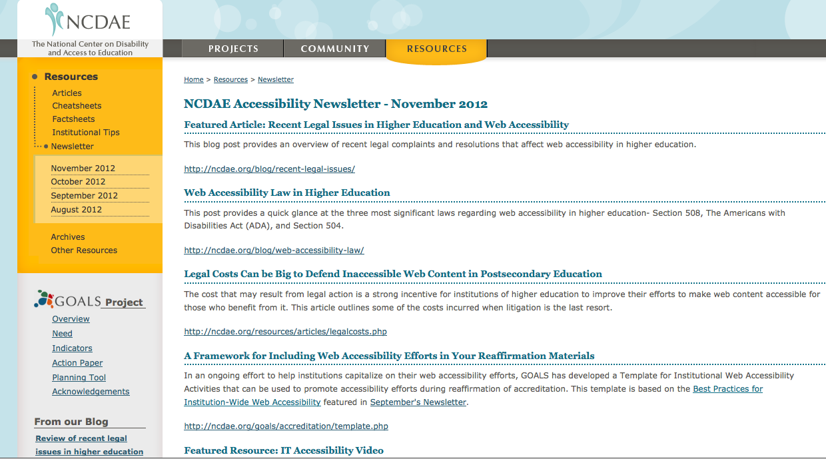
A Monthly Newsletter
To view or sign up visit:
www.ncdae.org/resources/newsletter/

Slide 41
And More…
An Action Paper for Institutional Administrators www.ncdae.org/goals/actionpaper.php
Institutional Tips www.ncdae.org/resources/tips/
Factsheets www.ncdae.org/resources/factsheets/
NCDAE Blog http://ncdae.org/blog/
Additional Articles www.ncdae.org/resources/articles/
Cost Study Data and Analysis – Coming January of 2013
An Institutional Benchmarking and Planning Tool ncdae.org/goals/planningtool.php

Slide 42



Invitation
Participate as a Field Test Site for the Tool Winter 2013
  First 50 get free access and support
  For more information visit: ncdae.org/goals/participating.php

Slide 43
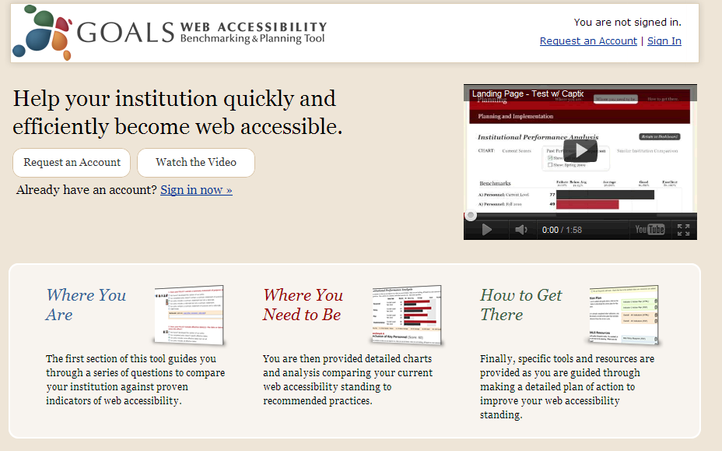
Screenshot of GOALS benchmarking and planning tool portal. Displays the core concepts of the GOALS tool which is to help institutions in self-study efforts identify (1) where they are (2) where they would like to be, and (3) how to get there

Slide 44
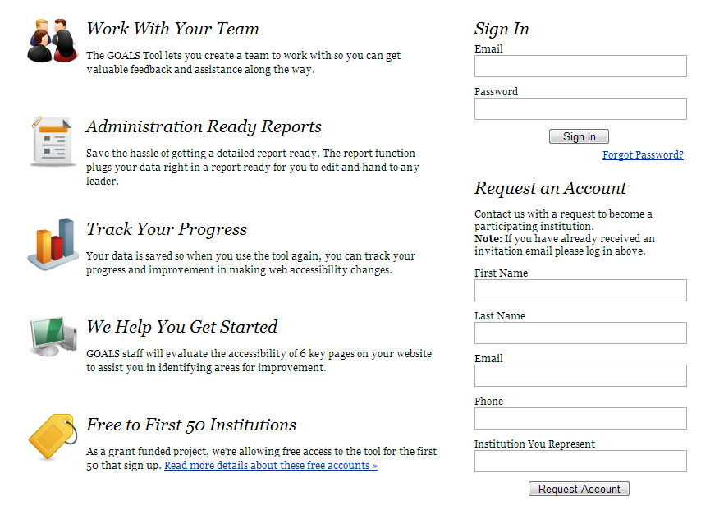
Screenshot of GOALS benchmarking and planning tool portal page. Displays the features in the tool including that you (1) work with your team (2) can access reports for your administration (3) track your progress over time graphically, (4) that GOALS staff will help get you started by evaluating 6 critical institutuional pages for you, and (5) that use of this tool is free to the first 50 institutions through FIPSE funding

Slide 45
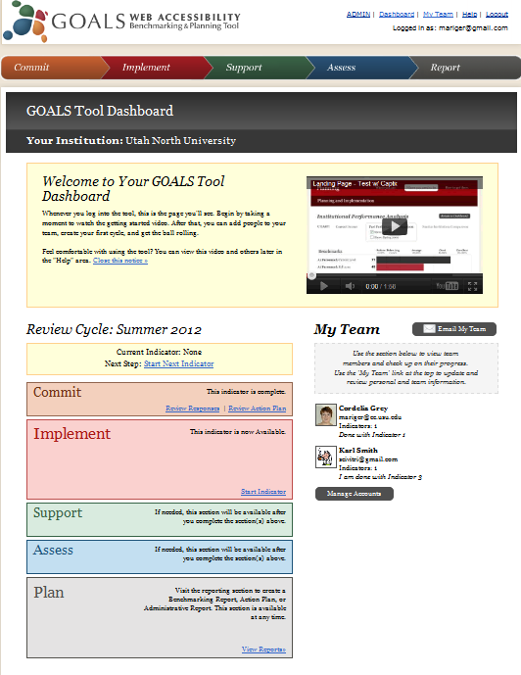
Screenshot of the GOALS benchmarking and planning tool “Dashboard”. From there the team leader can direct reviewers through a self study of the 4 key indicators of systemwide web accessibility (1) Vision and leadership commitment, (2) Planning and implementation, (3) Resources and supports, and (4) Continuous assessments and monitoring. Screenshot also displays Dashboard features such as your cycle of review, all team members and their status, and status on each indicator.

Slide 46
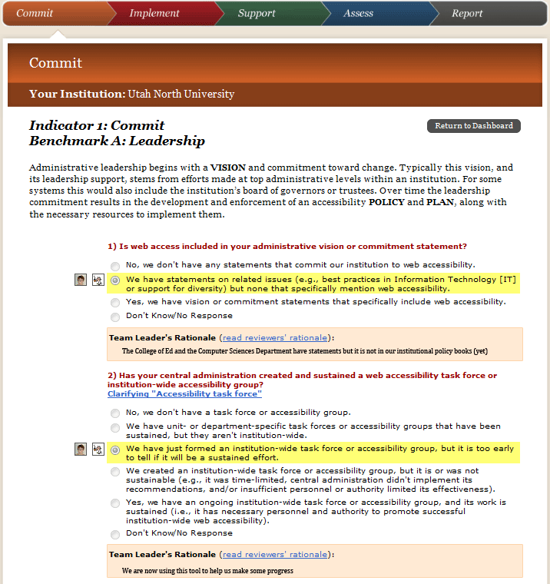
Screenshot of GOALS benchmarking and planning tool assessment of Indicator 1: Vision and Leadership. Displays review features so that the team can see the “institutional response” provided by the team leader along with their rationale.

Slide 47
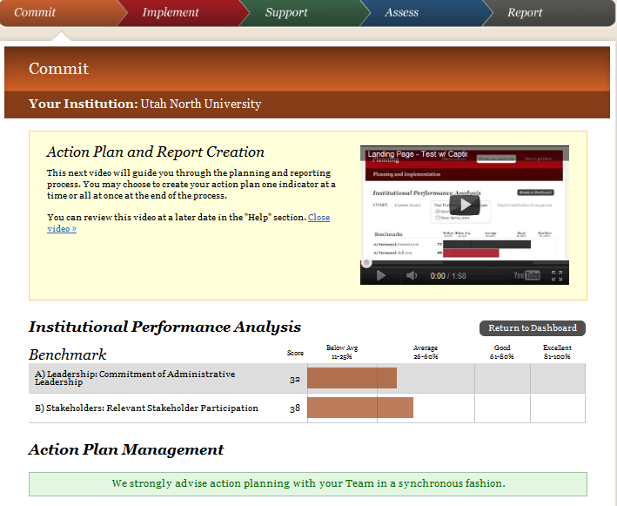
Screenshot of GOALS benchmarking and planning tool.
Displays Action Plan Creation with institutional performance analysis which is a graphical summary of performance along a continuum of poor – fair – good – excellent Also displays how performance can be compared over time or to the performance of peer institutions.
Also provides an instructional video

Slide 48
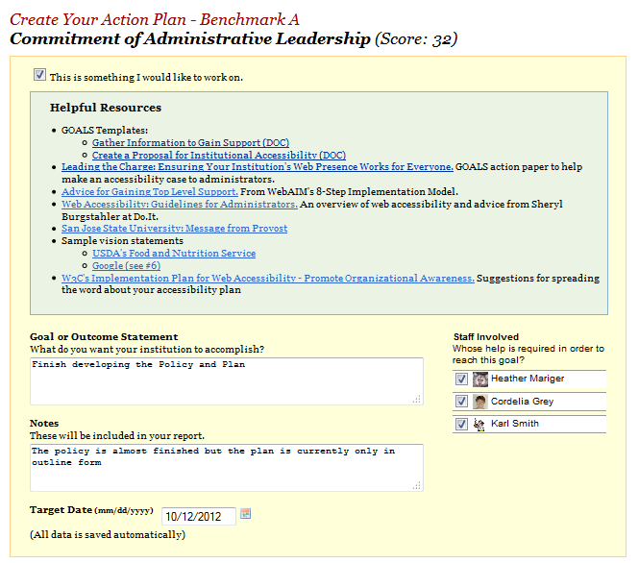
Screenshot of GOALS benchmarking and planning tool “Action Planning” process. Here team members decide in which areas to focus, can review helpful resources for their work and begin to identify goals and objectives, timelines, and persons responsible for the work

Slide 49
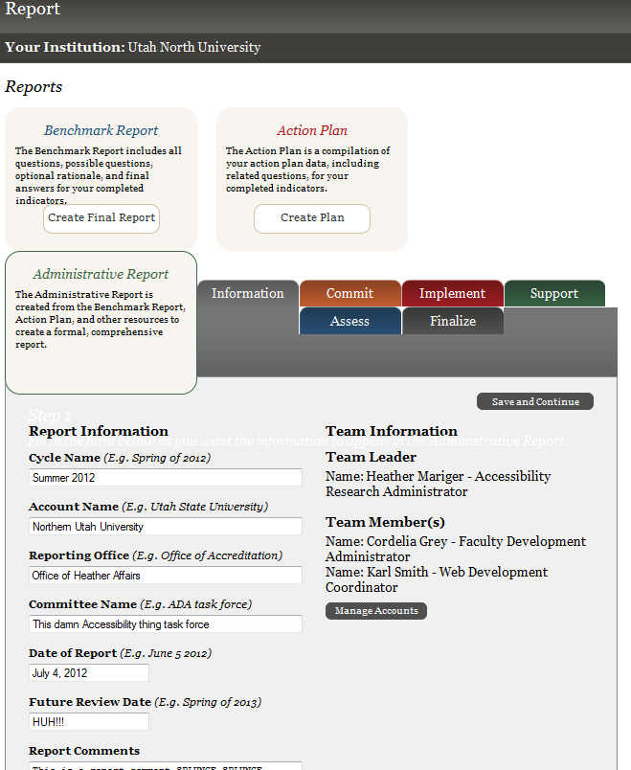
You can also generate reports – fill in the information you want the report to contain
Cycle name, account, reporting office, committee, date, review dates, comments etc…

Slide 50


GOALS Partner WebAIM offers Resources for Technical Staff webaim.org
Introduction to Web Accessibility webaim.org/intro/
Infographic: Web Accessiblity for Designers webaim.org/resources/designers/
Quick Reference: Testing Web Content for Accessibility webaim.org/resources/evalquickref/
Wave - a free web accessibility evaluation wave.webaim.org/
And much much more….

Slide 51


Contact me
Cyndi.Rowland@usu.edu

