Slide 1
A Foundation for the Future
Building blocks for comprehensive connectivity
Tracy Schroeder
Vice President, Information Services and Technology

Slide 2
Agenda
Strategic Planning Process
Identity and Access Management
Academic Data Warehouse, BI roadmap
Next generation student information systems
Digital Learning Initiative

Slide 3
Technology Planning Process
June – September | October – December | January – June | July - October | October
Preparation | Discussion | Drafting, Review and Revision | Community Feedback | Approval and Presentation
Assemble reference materials Introduce process to governance Identify and prepare for discussion groups | Present Kickoff speaker(s) Conduct community discussion groups, post for comment to BU Blogs Governance committees discuss sample plans, current trends and issues | Draft Goals Identify major related initiatives Present draft overall plan to governance committees, Council of Deans Revise | Present to key campus groups and collect feedback: Faculty Council Student Union Research Town Hall School and College meetings Revise and review with governance | Present to University Council
Notes:
First IT strategic plan at BU
New experience for community
Process of discussion, developing a shared vision of the future and what it will take to get there
Challenging in a time of rapid change, but necessary
Council on Ed Tech and LI simultaneous, report issued, being incorporated into plan
Fin/HR/Procurement, RA, and DAR projects recently completed, combination of pent up demand and weary/waryness around student/academic information systems replacement. Lengthening project request list, needing a guiding strategy
Several items in flux and lots of concurrent work, but goal to establish broad context and goals – not possible to single-thread

Slide 4
Identity and Access Management
Defined as directory services, authentication (including single sign-on), and federated identity
POLL:
What is the state of IAM on your campus?
All set – no changes needed
Planning a project
Executing a project
Notes:
Among the initiatives identified in what is now our draft technology plan is modernization of our IAM infrastructure.
Select one response

Slide 5
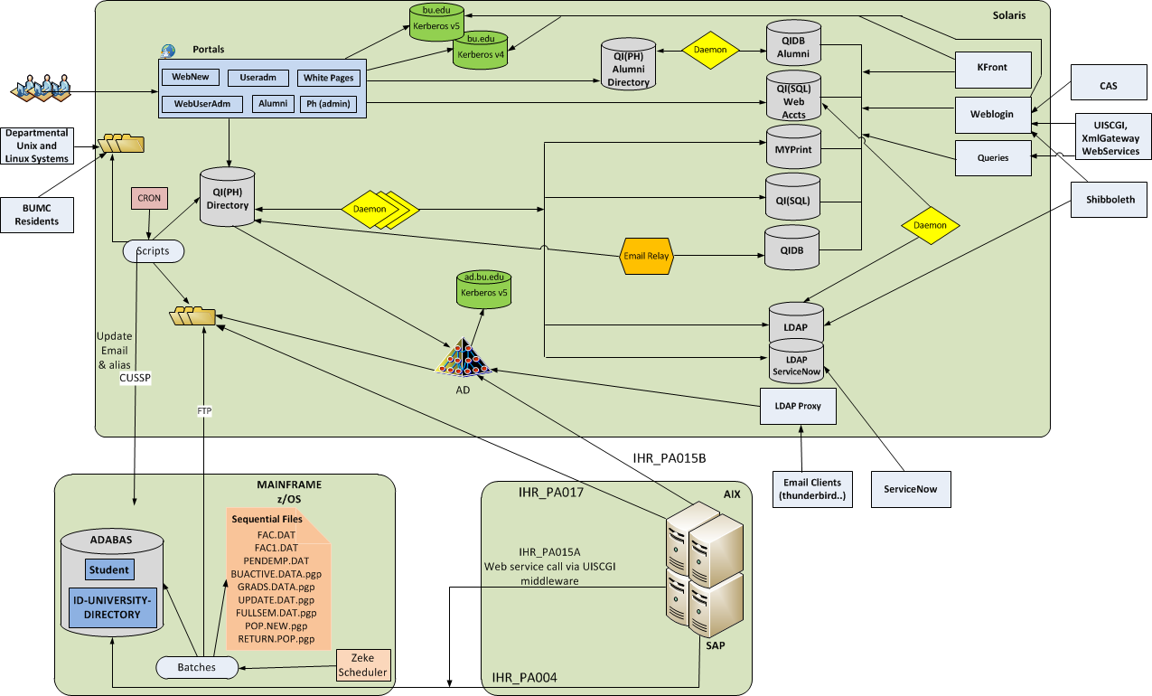
IAM – Current State Architecture
Notes:
BU was early to develop a custom set of directories and middleware for single sign-on. This infrastructure was adapted incrementally over many years, resulting in a complex, sometimes tangled web of solutions to specific problems rather than a holistic system that meets current needs and is readily adapted for foreseeable future use cases. We see the future as a time when a core competency of central IT needs to be rapid provisioning of new services and decommissioning of services that are no longer relevant, always providing the right access to the right people, easily. And this capability has to be provided efficiently.

Slide 6
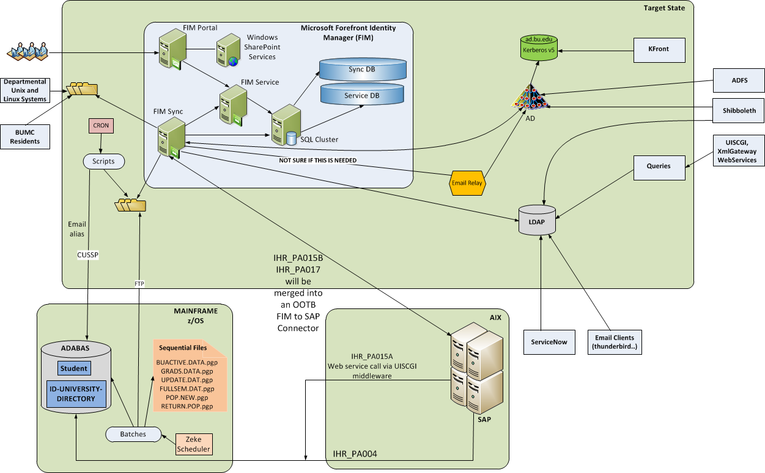
IAM – End State Architecture
Notes:
So we are working to both modernize and simplify our IAM infrastructure, to enable that agility, as well as reduce the cost of complexity associated with our current environment. This analysis and planning effort is non-trivial, however; it has taken us two years already to understand our current environment, design the future state and develop a roadmap for getting there.

Slide 7
Academic Data Warehouse
Defined as student and faculty data, from administrative and learning management systems. Includes data dictionary and data governance.
POLL:
What is the state of academic analytics on your campus?
Institutional Research gathers data and provides externally-reported numbers; other reporting is done by local units based upon extracts or local data sources
Central academic data repository and support service meets some use cases, external and internal
Central academic data repository and support service meets most use cases, external and internal, including real-time, predictive analytical capabilities
Other
Notes:
Select one, which may very well be “other”

Slide 8
Project Schedule – 7/17/2013
High Level Estimate
Timing Uncertain
Q1’12
Q2’12
Q3’12
Q4’12
Q1’13
Q2’13
Q3’13
Q4’13
Q1’14
Q2’14
Jan Feb Mar
Apr May Jun
Jul Aug Sep
Oct Nov Dec
Jan Feb Mar
Apr May Jun
Jul Aug Sep
Oct Nov Dec
Jan Feb Mar
Apr May Jun
ETL/Stage Mainframe
Admissions
Use Cases / Model Design
Historical Analysis
ETL / BI Execution
Admissions – Financial Aid
Use Cases /
Model Design
ETL / BI Execution
Pilot
Planning and Preparation
Execution
Financial Aid
Use Cases / Model Design
ETL / BI Execution
Registration & Enrollment
Use Cases / Model Design
ETL / BI Execution
Class, Course, Graduation
Use Cases / Model Design
ETL / BI Execution
Faculty
Use Cases / Model Design
Prospect & Inquiry
Advanced BI
Notes:
We have a custom developed student information system that dates back to the ‘80s, which does not have built in analytical capabilities. So analysis is done based upon a variety of routinely provided data extracts in most administrators’ weapon of choice – Excel. There are many local data repositories of segments of data, either based upon these extracts or, in some unfortunate cases, duplicatively entered. We are challenged to perform more than basic analysis institutionally and within schools and colleges on any routine basis due to the amount of effort it takes to gather and analyze the data, and we know this limitation cannot persist moving forward.
We are increasingly data driven, and we expect our data to become more voluminous and our analytical requirements to become more complex moving forward. So we have been working for about a year now on an academic data warehouse project that will establish a robust central repository for both canned and ad-hoc reporting, and provide more capable and secure reporting tools.
We have found the project very challenging, from Data element and analytical model definitions to Access and appropriate use policies, the readiness of our community in terms of skills and time, as well as the cost of service development and support. Our project sponsors have chosen the quality side of the triangle to prioritize over schedule and cost, so we have been moving more slowly than expected and our schedule has extended significantly. We are hoping to be ale to move more quickly in subsequent phases.

Slide 9
Student Systems Strategy
Defined as student administrative systems, from recruitment through graduation in student lifecycle.
POLL:
How are you thinking about student information systems on your campus?
Satisfied overall; not an area of concern or significant activity
Discussing new requirements or age/lack of capability of current systems
Working with current provider on significant enhancements
Looking for new solutions
Implementing new solutions
Notes:
Select all that apply

Slide 10
Student Systems Strategy
Mobility and usability first
Learner-centric
Relationship management goes social?
Process efficiency, Six Sigma/Lean
Alternative credentials
Flexible delivery models
New and hybrid student types
Data portability/ease of integration
Potentially massive scale
Agility to adapt to what we don’t know yet
Notes:
We are currently primarily discussing new requirements or age/lack of capability of current systems, also talking with vendors about their visions and roadmaps
Trying to limit our investment in current systems, and thinking about how to approach looking for a new system, given the state of the current marketplace
Working to envision a future system that can truly enable administrative transformation, both in the interest of cost reduction and new academic initiatives.
Some of the hot topics we have been discussing are identified here

Slide 11
Digital Learning
Defined as online and hybrid learning, for credit or non-credit, on conventional or massive scale.
POLL:
What is the status of planning and action regarding online learning on your campus?
Minimal interest/discussion
Interest and discussion but no institutionally-driven activities
Related Council, Committee or Task force formed
Institutionally driven experiments in progress
Digital Learning or related organization formed
Notes:
Select all that apply

Slide 12
Digital Learning Initiative
Director
Program Manager
Fellows
Faculty
Teaching
Visiting
Strategic thinking
Seed Grant Projects
MOOC Development
Learning Research
Platform Development
Marketing & Communications
Libraries
Peer Institutions
Consortia
CEIT
Schools and Colleges
IS&T
External resources
Thought leaders
Notes:
Humanware behind digital learning – conceptual organization, translating this into practical terms of positions, who reports to who, and budgets with flexibility and innovation as the guiding principles
Co-creator point, beyond service provider, less structure
"external resources" includes, not only people we might hire from outside BU, but also edX and the network we plan to develop with thinkers and innovators in the digital learning space

